Slide 1
Chapter 14: Transactions

Slide 2
Outline
Transaction Concept
Transaction State
Concurrent Executions
Serializability
Recoverability
Implementation of Isolation
Transaction Definition in SQL
Testing for Serializability.

Slide 3

http://research.microsoft.com/~gray/
James Gray(詹姆斯 • 格雷)
1998 解决保障数据的完整性、安全性、并行性，以及从故障恢复方面发挥了十分关键的作用
TRANSACTION PROCESSING:
CONCEPTS AND TECHNIQUES

Slide 4
Transaction Concept
A transaction is a unit of program execution that accesses and possibly updates various data items.
E.g., transaction to transfer $50 from account A to account B:
1. read(A)
2. A := A – 50
3. write(A)
4. read(B)
5. B := B + 50
6. write(B)
Two main issues to deal with:
Failures of various kinds, such as hardware failures and system crashes
Concurrent execution of multiple transactions

Slide 5
Required Properties of a Transaction
Transaction to transfer $50 from account A to account B:
1. read(A)
2. A := A – 50
3. write(A)
4. read(B)
5. B := B + 50
6. write(B)
Atomicity requirement
If the transaction fails after step 3 and before step 6, money will be “lost” leading to an inconsistent database state
Failure could be due to software or hardware
The system should ensure that updates of a partially executed transaction are not reflected in the database
Durability requirement — once the user has been notified that the transaction has completed (i.e., the transfer of the $50 has taken place), the updates to the database by the transaction must persist even if there are software or hardware failures.

Slide 6
Required Properties of a Transaction (Cont.)
Transaction to transfer $50 from account A to account B:
1. read(A)
2. A := A – 50
3. write(A)
4. read(B)
5. B := B + 50
6. write(B)
Consistency requirement in above example:
The sum of A and B is unchanged by the execution of the transaction
In general, consistency requirements include
Explicitly specified integrity constraints such as primary keys and foreign keys
Implicit integrity constraints
e.g., sum of balances of all accounts, minus sum of loan amounts must equal value of cash-in-hand
A transaction, when starting to execute, must see a consistent database.
During transaction execution the database may be temporarily inconsistent.
When the transaction completes successfully the database must be consistent
Erroneous transaction logic can lead to inconsistency

Slide 7
Required Properties of a Transaction (Cont.)
Isolation requirement — if between steps 3 and 6 (of the fund transfer transaction) , another transaction T2 is allowed to access the partially updated database, it will see an inconsistent database (the sum A + B will be less than it should be).
T1 T2
1. read(A)
2. A := A – 50
3. write(A) read(A), read(B), print(A+B)
4. read(B)
5. B := B + 50
6. write(B
Isolation can be ensured trivially by running transactions serially
That is, one after the other.
However, executing multiple transactions concurrently has significant benefits, as we will see later.

Slide 8
ACID Properties
A transaction is a unit of program execution that accesses and possibly updates various data items. To preserve the integrity of data the database system must ensure:
Atomicity. Either all operations of the transaction are properly reflected in the database or none are.
Consistency. Execution of a transaction in isolation preserves the consistency of the database.
Isolation. Although multiple transactions may execute concurrently, each transaction must be unaware of other concurrently executing transactions. Intermediate transaction results must be hidden from other concurrently executed transactions.
That is, for every pair of transactions T_{i} and T_{j}, it appears to T_{i} that either T_{j}, finished execution before T_{i} started, or T_{j} started execution after T_{i} finished.
Durability. After a transaction completes successfully, the changes it has made to the database persist, even if there are system failures.

Slide 9
Transaction State
Active – the initial state; the transaction stays in this state while it is executing
Partially committed – after the final statement has been executed.
Failed -- after the discovery that normal execution can no longer proceed.
Aborted – after the transaction has been rolled back and the database restored to its state prior to the start of the transaction. Two options after it has been aborted:
Restart the transaction
can be done only if no internal logical error
Kill the transaction
Committed – after successful completion.

Slide 10
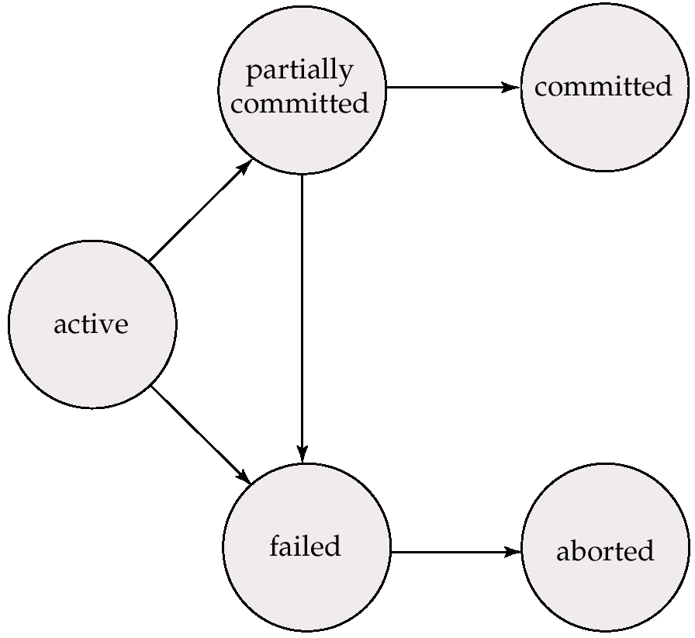
Transaction State (Cont.)
成功完成，永
久写入数据库
最后一条语
句被执行后
事务回滚，数
据库恢复到事
务开始前状态
初始状态
事务无法继
续正常执行

Slide 11
Concurrent Executions
Multiple transactions are allowed to run concurrently in the system. Advantages are:
Increased processor and disk utilization, leading to better transaction throughput
E.g. one transaction can be using the CPU while another is reading from or writing to the disk
Reduced average response time for transactions: short transactions need not wait behind long ones.
Concurrency control schemes – mechanisms to achieve isolation
That is, to control the interaction among the concurrent transactions in order to prevent them from destroying the consistency of the database
Will study in Chapter 15, after studying notion of correctness of concurrent executions.

Slide 12
Schedules
Schedule – a sequences of instructions that specify the chronological order in which instructions of concurrent transactions are executed
A schedule for a set of transactions must consist of all instructions of those transactions
Must preserve the order in which the instructions appear in each individual transaction.
A transaction that successfully completes its execution will have a commit instructions as the last statement
By default transaction assumed to execute commit instruction as its last step
A transaction that fails to successfully complete its execution will have an abort instruction as the last statement

Slide 13
Schedule 1
Let T₁ transfer $50 from A to B, and T₂ transfer 10% of the balance from A to B.
An example of a serial schedule in which T₁ is followed by T₂ :

Slide 14
Schedule 2
A serial schedule in which T₂ is followed by T₁ :

Slide 15
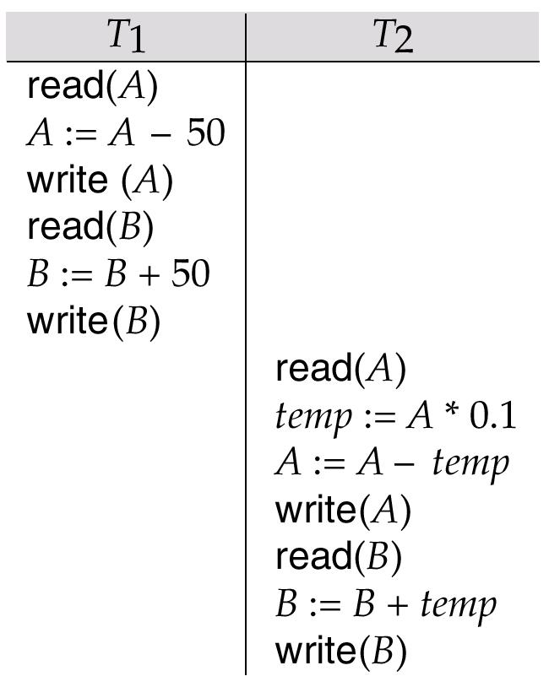
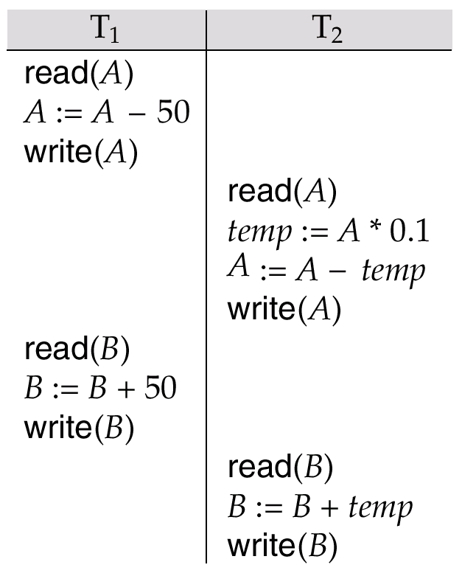
Schedule 3
Let T₁ and T₂ be the transactions defined previously. The following schedule is not a serial schedule, but it is equivalent to Schedule 1.
1000
950
A=950
A=950
2000
2050
B=2050
950
A=855
temp=95
855
A=855
B=2050
2050
2145
B=2145
B=2145

Slide 16
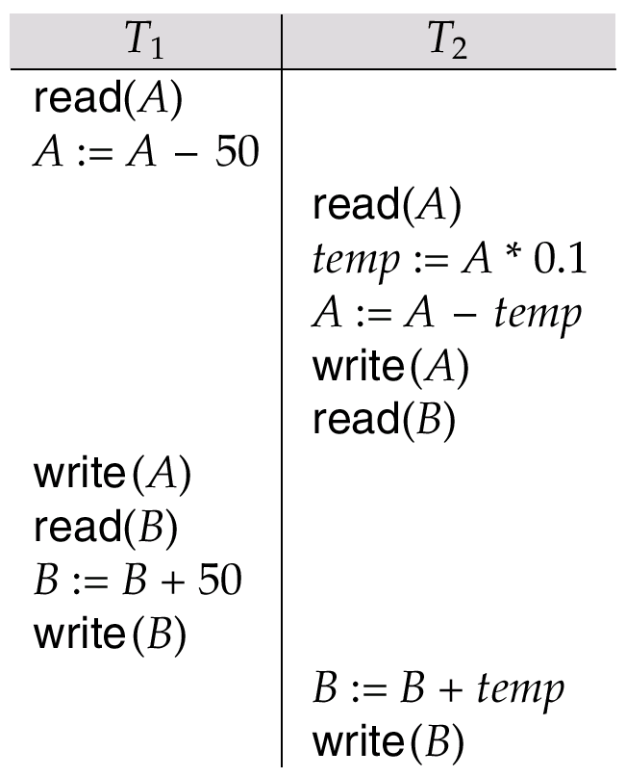
Schedule 4
The following concurrent schedule does not preserve the sum of “A + B”
1000
950
1000
100
900
A=900
2000
A=950
2000
2050
B=2050
2100
B=2100

Slide 17
Serializability
Basic Assumption – Each transaction preserves database consistency.
Thus, serial execution of a set of transactions preserves database consistency.
A (possibly concurrent) schedule is serializable if it is equivalent to a serial schedule.
Different forms of schedule equivalence give rise to the notions of:
1. conflict serializability
2. view serializability

Slide 18
Simplified view of transactions
We ignore operations other than read and write instructions
We assume that transactions may perform arbitrary computations on data in local buffers in between reads and writes.
Our simplified schedules consist of only read and write instructions.

Slide 19
Conflicting Instructions
Let l_{i} and l_{j} be two Instructions of transactions T_{i} and T_{j} respectively. Instructions l_{i} and l_{j} conflict if and only if there exists some item Q accessed by both l_{i} and l_{j}, and at least one of these instructions wrote Q.
1. l_{i} = read(Q), l_{j} = read(Q). l_{i} and l_{j} don’t conflict. 2. l_{i} = read(Q), l_{j} = write(Q). They conflict. 3. l_{i} = write(Q), l_{j} = read(Q). They conflict 4. l_{i} = write(Q), l_{j} = write(Q). They conflict
Intuitively, a conflict between l_{i} and l_{j} forces a (logical) temporal order between them.
If l_{i} and l_{j} are consecutive in a schedule and they do not conflict, their results would remain the same even if they had been interchanged in the schedule.

Slide 20
Conflict Serializability
If a schedule S can be transformed into a schedule S´ by a series of swaps of non-conflicting instructions, we say that S and S´ are conflict equivalent.
We say that a schedule S is conflict serializable if it is conflict equivalent to a serial schedule

Slide 21
Conflict Serializability (Cont.)
Schedule 3 can be transformed into Schedule 6 -- a serial schedule where T₂ follows T₁, by a series of swaps of non-conflicting instructions. Therefore, Schedule 3 is conflict serializable.
Schedule 3
Schedule 6

Slide 22
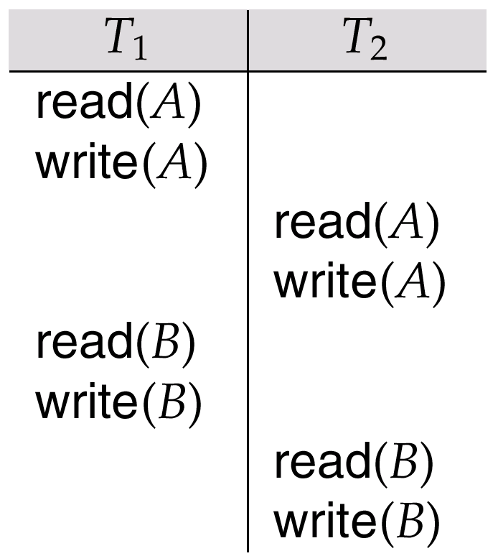
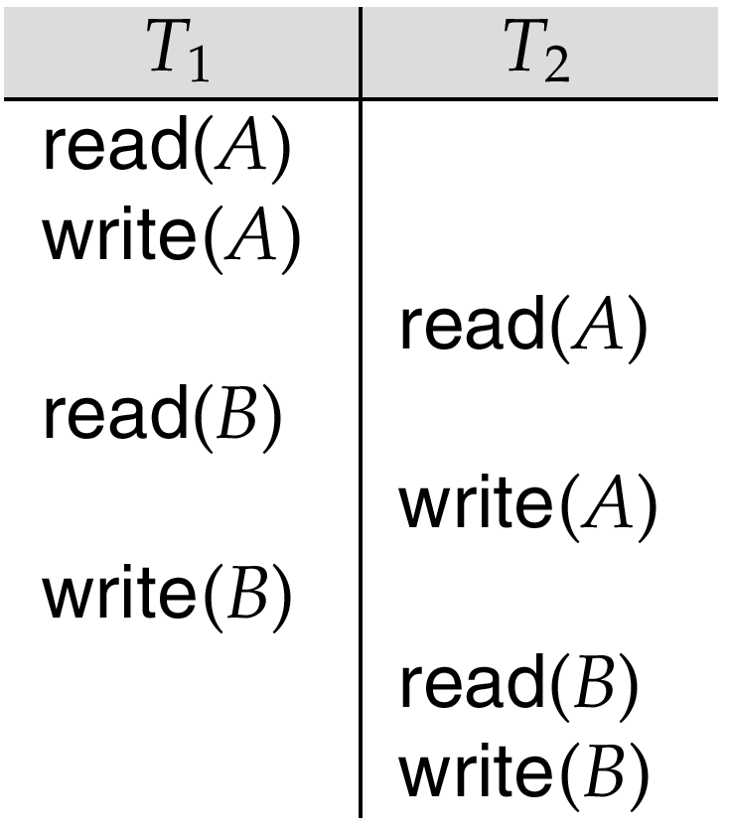
Schedule 5 -- Schedule 3 After Swapping A Pair of Instructions

Slide 23
Schedule 5 -- Schedule 3 After Swapping A Pair of Instructions
write(B)
write(A)

Slide 24
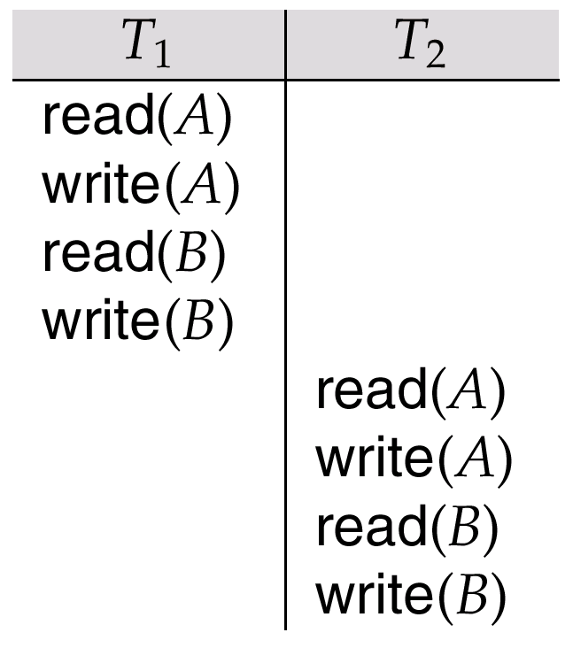
Schedule 6 -- A Serial Schedule That is Equivalent to Schedule 3
write(B)
write(A)

Slide 25
Conflict Serializability (Cont.)
Example of a schedule that is not conflict serializable:
We are unable to swap instructions in the above schedule to obtain either the serial schedule < T₃, T₄ >, or the serial schedule < T₄, T₃ >.

Slide 26
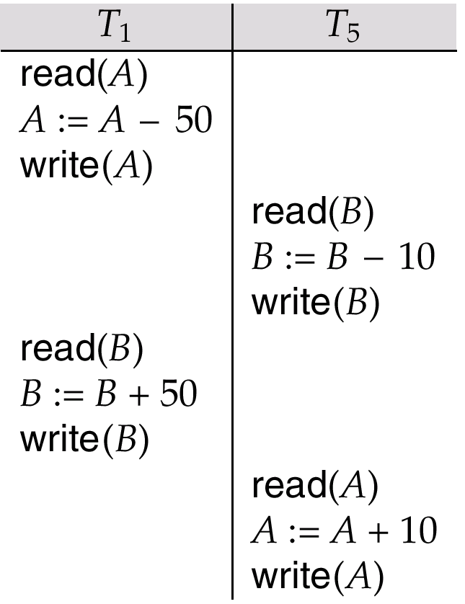
Other Notions of Serializability
Schedule 8 (from text) given below produces same outcome as the serial schedule < T₁, T₅ >, yet is not conflict equivalent or view equivalent to it.
Determining such equivalence requires analysis of operations other than read and write.
1000
950
A=950
2000
1990
B=1990
1990
2040
B=2040
950
960
A=960

Slide 27
Precedence Graph
Consider some schedule of a set of transactions T₁, T₂, ..., T_{n}
Precedence graph — a direct graph where the vertices are the transactions (names).
We draw an arc from T_{i} to T_{j} if the two transaction conflict, and T_{i} accessed the data item on which the conflict arose earlier.
We may label the arc by the item that was accessed.
Example

Slide 28
Example Schedule (Schedule A) + Precedence Graph
T₁ T₂ T₃ T₄ T₅ read(X) read(Y) read(Z) read(V) read(W) read(W) read(Y) write(Y) write(Z) read(U) read(Y) write(Y) read(Z) write(Z)
read(U) write(U)
T₁
T₂
T₄
T₃
T₅

Slide 29
Testing for Conflict Serializability
A schedule is conflict serializable if and only if its precedence graph is acyclic.
Cycle-detection algorithms exist which take order n² time, where n is the number of vertices in the graph.
(Better algorithms take order n + e where e is the number of edges.)
If precedence graph is acyclic, the serializability order can be obtained by a topological sorting of the graph.
That is, a linear order consistent with the partial order of the graph.
For example, a serializability order for the schedule (a) would be one of either (b) or (c)

Slide 30
Recoverable Schedules
Recoverable schedule — if a transaction T_{j} reads a data item previously written by a transaction T_{i} , then the commit operation of T_{i} must appear before the commit operation of T_{j}.
The following schedule is not recoverable if T₉ commits immediately after the read(A) operation.
If T₈ should abort, T₉ would have read (and possibly shown to the user) an inconsistent database state. Hence, database must ensure that schedules are recoverable.

Slide 31
可恢复调度
可串行化调度考虑ACID特性中的隔离性，旨在数据库正常运行的时候可以正确处理事务的并发。
然而当数据库发生故障需要回滚时，数据库需要高效可靠地恢复事务数据。
T1 | T2
W(x)
commit
 | R(x)
 | abort
T1 | T2
W(x)
 | R(x)
 | commit
abort
T1 | T2 | T3
W(x)
 | W(x)
 |  | R(x)
abort
可恢复
recoverable
不可恢复
Not recoverable
级联回滚 Cascade rollback

Slide 32
可恢复调度
T₂ 已经提交了事务，但T₂ 基于T₁ 写入的数据进行了进一步修改，当T₁ 被回滚时，T₂ 也应行回滚。
T₂ 在时刻t₁₀ 进行了提交，成为了结束的事务。 （用户已经看到了修改的结果，不应被回滚）
比如T₂ 事务提交表示购物已经完成，用户已经拿到了商品，此时难以回滚该事务。
T₂ 难以被回滚会造成事务T₁也难以被回滚。
不可恢复调度：读写了未提交事务修改的数据。
可恢复调度要求：当T₁未提交时，T₂（读写了T₁ 数据的事务）不应该提交。

Slide 33
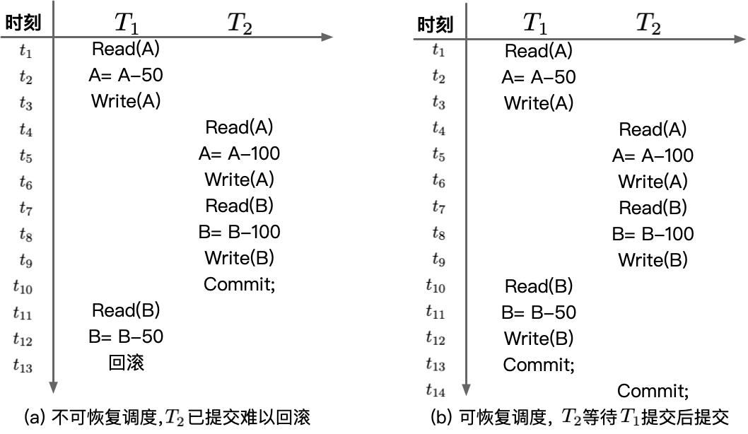
可恢复调度
可恢复调度：对于调度S，若T_{j} 读取了T_{i} 所写的数据，则需要保证T_{j} 在T_{i} 之后进行提交（即COMMIT操作），调度S是可恢复调度。

Slide 34
无级联调度
可恢复调度中在T₁进行回滚操作的时候，T₂ 需要一起回滚以进行数据库的恢复。
级联回滚：一个事务T₁ 回滚引起的另一个事务T₂ 回滚的现象为级联回滚 。级联回滚是保证事务原子性的重要手段 。
较多的级联回滚有时会极大地影响数据库的性能。

Slide 35
Cascading Rollbacks
Cascading rollback – a single transaction failure leads to a series of transaction rollbacks. Consider the following schedule where none of the transactions has yet committed (so the schedule is recoverable) If T₁₀ fails, T₁₁ and T₁₂ must also be rolled back.
Can lead to the undoing of a significant amount of work

Slide 36
Cascadeless Schedules
Cascadeless schedules — for each pair of transactions T_{i} and T_{j} such that T_{j} reads a data item previously written by T_{i}, the commit operation of T_{i} appears before the read operation of T_{j}.
Every cascadeless schedule is also recoverable
It is desirable to restrict the schedules to those that are cascadeless
Example of a schedule that is NOT cascadeless

Slide 37
无级联回滚调度
无级联调度：当调度S 中任意T_{j} 读取某个T_{i} 修改的数据X时，T_{i} 都已经进行了提交，则调度S 是无级联的。
无级联调度都是可恢复调度。

Slide 38
Concurrency Control
A database must provide a mechanism that will ensure that all possible schedules are both:
Conflict serializable.
Recoverable and preferably cascadeless
A policy in which only one transaction can execute at a time generates serial schedules, but provides a poor degree of concurrency
Concurrency-control schemes tradeoff between the amount of concurrency they allow and the amount of overhead that they incur
Testing a schedule for serializability after it has executed is a little too late!
Tests for serializability help us understand why a concurrency control protocol is correct
Goal – to develop concurrency control protocols that will assure serializability.

Slide 39
隔离性的实现
为保证数据库的一致性, 调度必须是冲突或视图可串行化的, 可恢复的, 并且最好是无级联回滚的.
一次只允许一个事务执行的策略产生的都是串行调度, 但并发度太差.
某些方案只允许产生冲突可串行化的调度, 而另一些则允许非冲突可串行化但视图可串行化的调度.
如果应用环境对并发一致性要求不高,或者应用程序希望自身来保证数据一致性，则可以放松数据库的一致性的要求,设置不同的隔离性级别。

Slide 40
事务隔离性级别：丢失修改
T1
Read X (10)
Compute X -= 2
(8)
Write X
私有内存
X=8
X=10
X=9
X = 9
Time
T2
Read X (10)
Compute X -= 1
(9)
Write X
私有内存
两个事务T1和T2读入同一数据并修改，T1提交的结果破坏了T2提交的结果，导致T1的修改丢失

Slide 41
事务隔离性级别：读脏数据
Compute
X+=15
(25)
Rollback
T1
Read X (10)
Write X
X=10
X=25
X=10
Time
Read X (25)
T2读到了从未提交到
数据库中的数据
T2
事务T1修改某一数据，并将其写回磁盘，事务T2读取同一数据后，T1由于某种原因被撤消，这时T1已修改过的数据恢复原值，T2读到的数据与数据库中数据不一致，则T2读到的数据就是脏数据

Slide 42
事务隔离性级别：不能重复读
T1
Read X (10)
Compute X+=15
(25)
Commit
Write X
X=10
X=25
Time
Read X (10)
Read X (25)
T2
事务T2读取某一数据后，事务T1对其做了修改，当T2再次读取该数据时，得到与前次不同的值

Slide 43
事务隔离性级别：发生幻象
Jones,6
T1
Insert
Smith,4
Jones,6
Smith,4
Time
Brewer,7
Brewer,7
T2
Select count (*) where rank > 3
Select count (*) where rank > 3
2 rows returned
3 rows returned
事务T2按一定条件读取了某些数据后，事务T1插入了一些满足这些条件的数据，当T2再次按相同条件读取数据时，发现多了一些记录

Slide 44
事务隔离性级别
SQL中隔离性级别的定义
serializable：一个调度的执行必须等价于一个串行调度的结果
repeatable read：只允许读取已提交的记录，并要求一个事务对同一记录的两次读取之间，其它事务不能对该记录进行更新
read committed：只允许读取已提交的记录，但不要求可重复读
read uncommitted：允许读取未提交的记录

Slide 45
事务隔离性级别
隔离性级别
不一致现象
Read uncommitted
读脏数据
不能重复读
幻象
Read committed
不能重复读
幻象
Repeatable read
幻象
Serializable
--

Slide 46
Weak Levels of Consistency
Some applications are willing to live with weak levels of consistency, allowing schedules that are not serializable
E.g., a read-only transaction that wants to get an approximate total balance of all accounts
E.g., database statistics computed for query optimization can be approximate (why?)
Such transactions need not be serializable with respect to other transactions
Tradeoff accuracy for performance

Slide 47
Levels of Consistency in SQL-92
Serializable — default
Repeatable read — only committed records to be read, repeated reads of same record must return same value. However, a transaction may not be serializable – it may find some records inserted by a transaction but not find others.
Read committed — only committed records can be read, but successive reads of record may return different (but committed) values.
Read uncommitted — even uncommitted records may be read.
Lower degrees of consistency useful for gathering approximate information about the database
Warning: some database systems do not ensure serializable schedules by default
E.g., Oracle and PostgreSQL by default support a level of consistency called snapshot isolation (not part of the SQL standard)

Slide 48
Transaction Definition in SQL
Data manipulation language must include a construct for specifying the set of actions that comprise a transaction.
In SQL, a transaction begins implicitly.
A transaction in SQL ends by:
Commit work commits current transaction and begins a new one.
Rollback work causes current transaction to abort.
In almost all database systems, by default, every SQL statement also commits implicitly if it executes successfully
Implicit commit can be turned off by a database directive
E.g. in JDBC, connection.setAutoCommit(false);

Slide 49
Other Notions of Serializability

Slide 50
View Serializability
Let S and S´ be two schedules with the same set of transactions.
S and S´ are view equivalent if the following three conditions are met, for each data item Q,
If in schedule S, transaction T_{i} reads the initial value of Q, then in schedule S’ also transaction T_{i} must read the initial value of Q.
If in schedule S transaction T_{i} executes read(Q), and that value was produced by transaction T_{j} (if any), then in schedule S’ also transaction T_{i} must read the value of Q that was produced by the same write(Q) operation of transaction T_{j} .
The transaction (if any) that performs the final write(Q) operation in schedule S must also perform the final write(Q) operation in schedule S’.
As can be seen, view equivalence is also based purely on reads and writes alone.

Slide 51
View Serializability (Cont.)
A schedule S is view serializable if it is view equivalent to a serial schedule.
Every conflict serializable schedule is also view serializable.
Below is a schedule which is view-serializable but not conflict serializable.
What serial schedule is above equivalent to?
Every view serializable schedule that is not conflict serializable has blind writes.

Slide 52
Test for View Serializability
The precedence graph test for conflict serializability cannot be used directly to test for view serializability.
Extension to test for view serializability has cost exponential in the size of the precedence graph.
The problem of checking if a schedule is view serializable falls in the class of NP-complete problems.
Thus, existence of an efficient algorithm is extremely unlikely.
However ,practical algorithms that just check some sufficient conditions for view serializability can still be used.

Slide 53
More Complex Notions of Serializability
The schedule below produces the same outcome as the serial schedule < T₁, T₅ >, yet is not conflict equivalent or view equivalent to it.
If we start with A = 1000 and B = 2000, the final result is 960 and 2040
Determining such equivalence requires analysis of operations other than read and write.

Slide 54
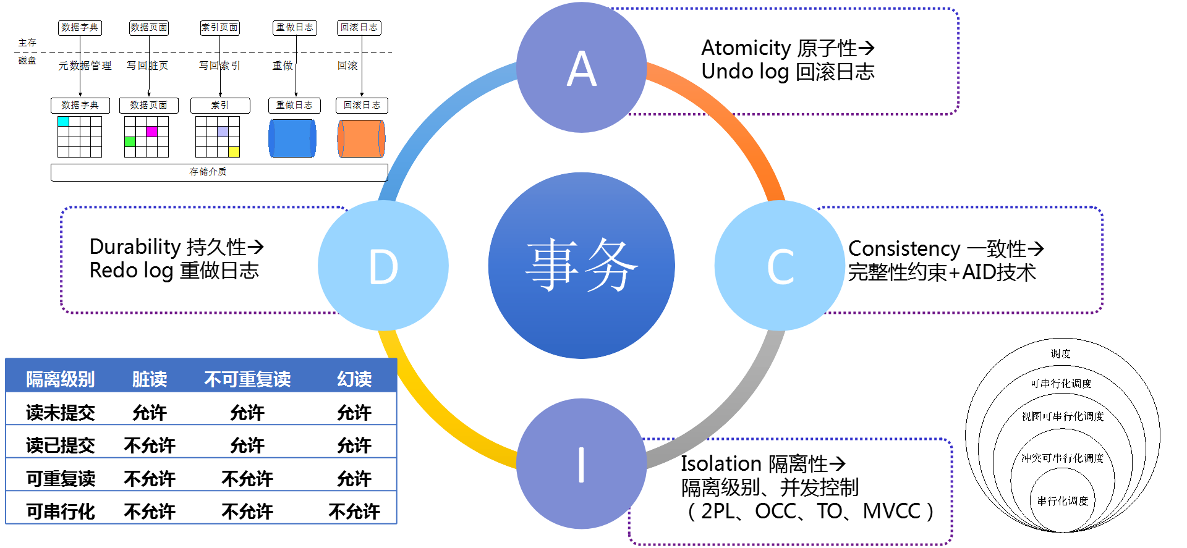
事务特性总结

Slide 55
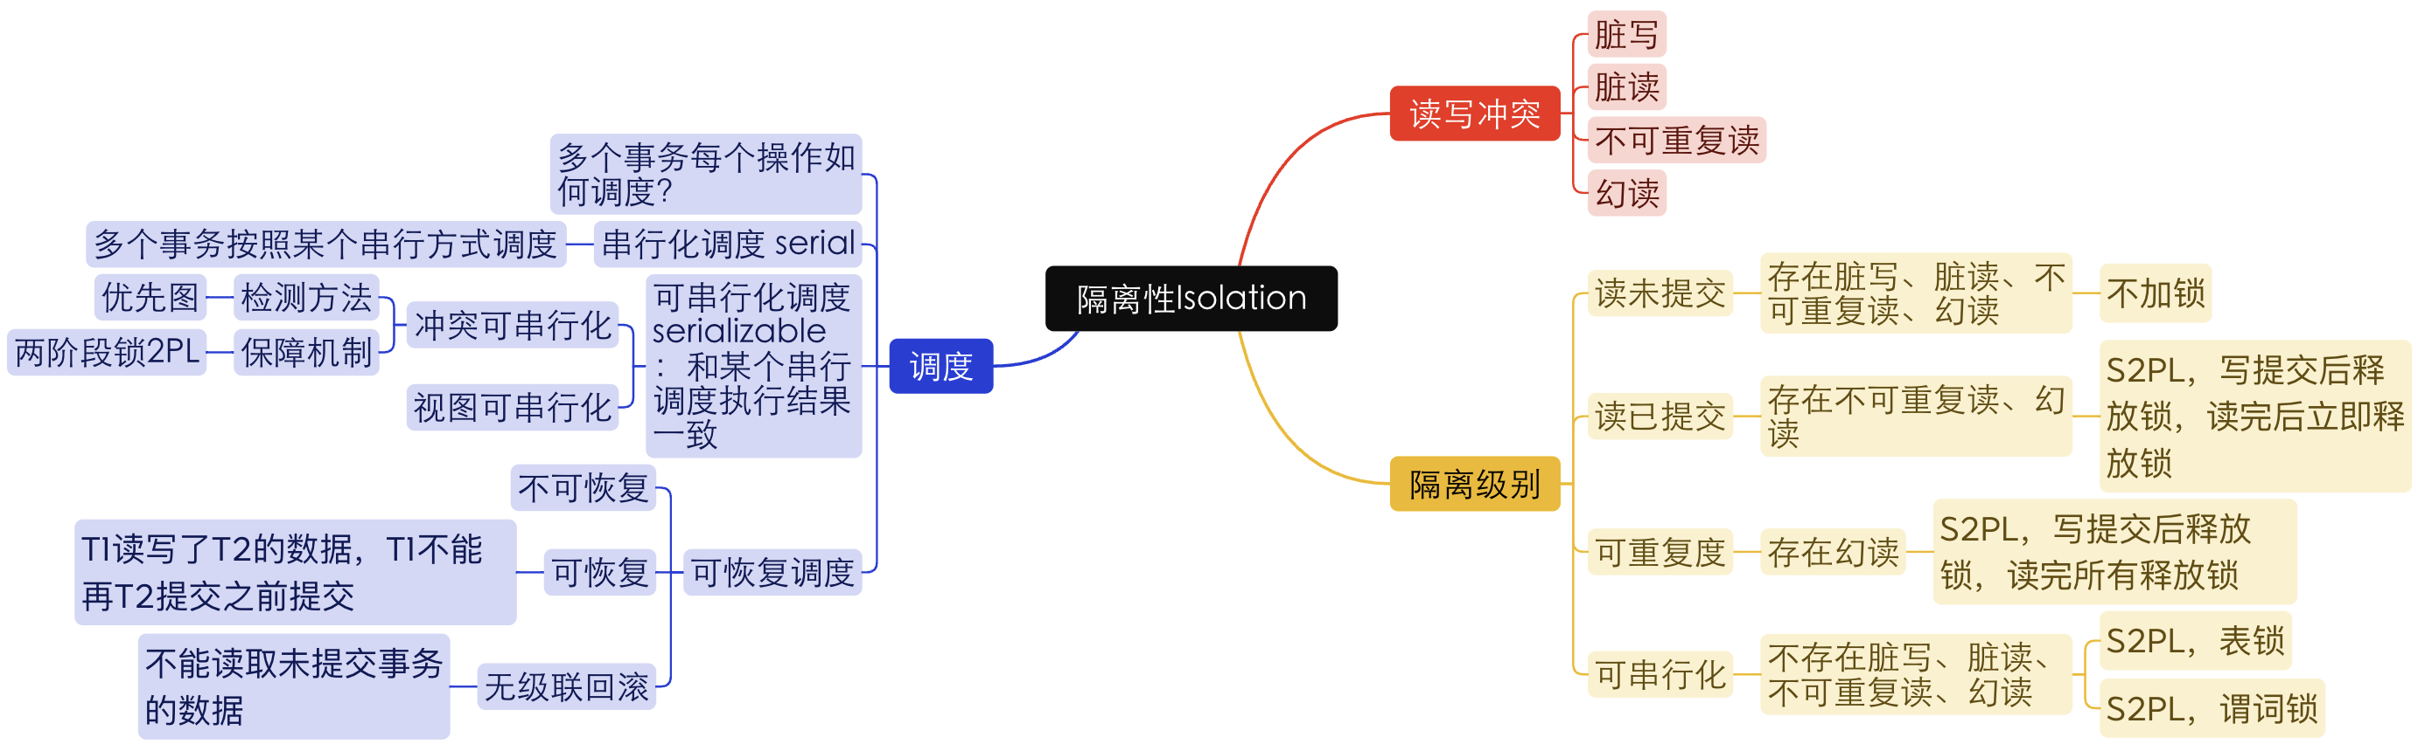
隔离性
并发控制是实现事务隔离性的手段。
串行调度（serial schedule）：慢、资源浪费
可串行化调度（serializability）：快、并发调度，但需要避免冲突
终态可串行化调度（final state serializability）
冲突可串行化调度（conflict serializability）
视图可串行化调度（view serializability）
事务的四大隔离级别实现机制→第15章并发控制的具体算法

Slide 56
End of Chapter 14

