Slide 1
Outland Adventures
Delta Team - March 8th, 2024

Slide 2
Team Delta
Ryan Norrbom: Data Analyst - Synthesizes reports to guide strategic decisions.
Gerardo Cordero: Marketing Coordinator - Uses reports insights and reviewed documentation.
Eric Williams-Phillips: Collaboration Officer - Manages group collaboration tools and processes, reviewed and certified code.
Bayleigh Kelton: Unavailable
Notes:
Thank you, Delta Team! It has been a great end of semester!

Slide 3
Case Study Overview
Outland Adventures:
An entrepreneurial venture by Blythe Timmerson and Jim Ford, focusing on guided outdoor adventures for hiking and camping enthusiasts.
Business Expansion:
Transitioned from a sideline to a full-time commitment due to the identification of a strong market need.
Expanded team with specialized roles to enhance trip planning, marketing, supply management, and online presence.
Operational Insights:
Implementation of an e-commerce site by Mei Wong to facilitate information dissemination and online sales.
Introduction of a structured approach to managing trips, equipment, and customer engagements.
Key Reports Analysis:
Equipment Aging Report emphasized regular checks for quality maintenance.
Strategic Considerations:
The necessity of continuous operational optimization to align with market demands and customer expectations.
Emphasis on data-driven decision-making to identify trends, opportunities, and areas for improvement.
Future Outlook:
Potential exploration of new destinations based on customer preferences and market trends.
Continued focus on enhancing customer experience and operational efficiency for sustained growth.
Trip Utilization Report showed popular destinations and marketing targets.
Equipment Sales Report revealed strong sales in certain gear, indicating revenue opportunities.
Repeat Customer Report highlighted the significance of retention and satisfaction for growth.

Slide 4
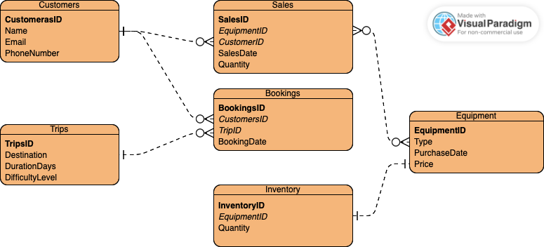
Entity Relationships
We first mapped out the desired reports.
Next, we created an initial ERD, then added columns and relationship mappings
The ERD showcases relationships between each table. For example, a many to one for Bookings to Customers, since customers may have many bookings.
Notes:
Our team followed the standard ERD design process and finalized the database design.

Slide 5

Reports

Slide 6
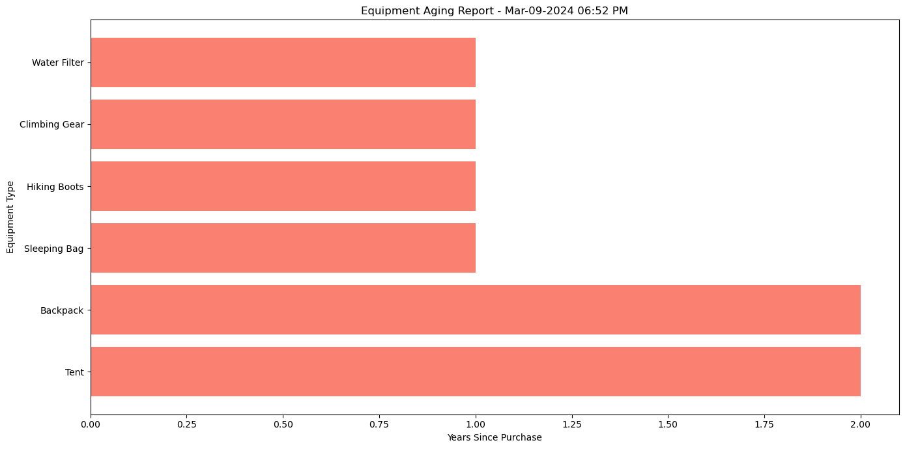
Equipment Aging
This report lists each piece of equipment, its type, and the years since purchase, helping identify items needing replacement or maintenance.
Assumption: The quality and functionality of equipment degrade over time, affecting customer satisfaction and safety.
Example: Equipment ID: 1 (Tent) shows 2 years since purchase, indicating it may soon need evaluation for usability.
Notes:
Equipment ID: 1, Type: Tent, Months Since Purchase: 25 Equipment ID: 2, Type: Backpack, Months Since Purchase: 24 Equipment ID: 3, Type: Sleeping Bag, Months Since Purchase: 23 Equipment ID: 4, Type: Hiking Boots, Months Since Purchase: 23 Equipment ID: 5, Type: Climbing Gear, Months Since Purchase: 21 Equipment ID: 6, Type: Water Filter, Months Since Purchase: 20

Slide 7
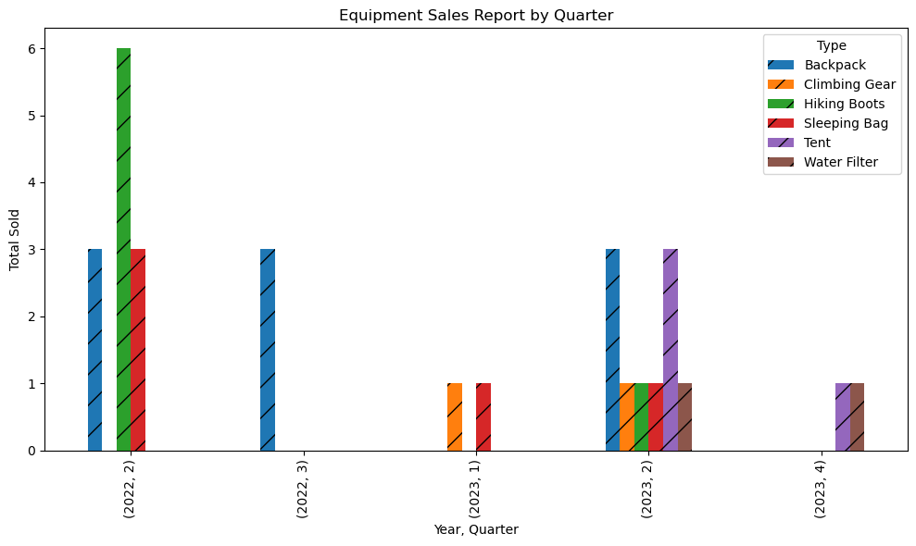
Equipment Sales
This report outlines how many units of each type of equipment were sold, offering a perspective on customer preferences and potential revenue streams.
Assumption: Sales figures indicate customer demand and the success of the equipment sales aspect of the business.
Example: Tents and backpacks have higher sales (3 each), highlighting a strong market interest in these items.
Notes:
Displaying Equipment Sales Report by Quarter - Mar-09-2024 06:43 PM: Equipment Type: Tent, Year: 2023, Quarter: 4, Total Sold: 1 Equipment Type: Water Filter, Year: 2023, Quarter: 4, Total Sold: 1 Equipment Type: Tent, Year: 2023, Quarter: 2, Total Sold: 3 Equipment Type: Backpack, Year: 2023, Quarter: 2, Total Sold: 3 Equipment Type: Sleeping Bag, Year: 2023, Quarter: 2, Total Sold: 1 Equipment Type: Hiking Boots, Year: 2023, Quarter: 2, Total Sold: 1 Equipment Type: Climbing Gear, Year: 2023, Quarter: 2, Total Sold: 1 Equipment Type: Water Filter, Year: 2023, Quarter: 2, Total Sold: 1 Equipment Type: Sleeping Bag, Year: 2023, Quarter: 1, Total Sold: 1 Equipment Type: Climbing Gear, Year: 2023, Quarter: 1, Total Sold: 1 Equipment Type: Backpack, Year: 2022, Quarter: 3, Total Sold: 3 Equipment Type: Hiking Boots, Year: 2022, Quarter: 2, Total Sold: 6 Equipment Type: Backpack, Year: 2022, Quarter: 2, Total Sold: 3 Equipment Type: Sleeping Bag, Year: 2022, Quarter: 2, Total Sold: 3

Slide 8
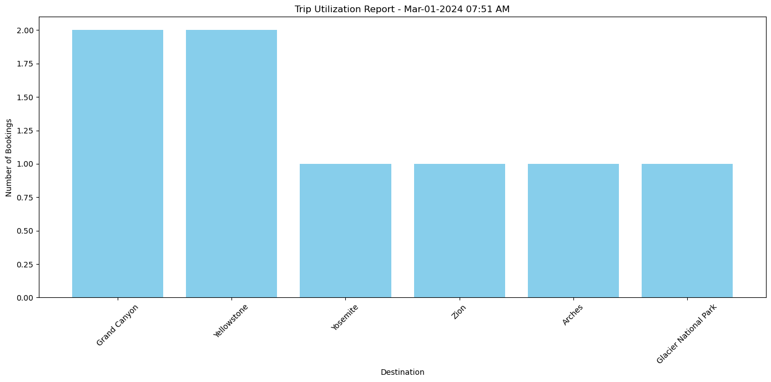
Trip Utilization
This report provides insight into the popularity of different destinations based on the number of bookings.
Assumption: The number of bookings reflects the popularity and potential profitability of trips to various destinations.
Example: Trip ID: 1 to the Grand Canyon shows only 2 bookings, suggesting a need to analyze its marketing or operational execution.
Notes:
Trip ID: 1, Destination: Grand Canyon, Number of Bookings: 2
Trip ID: 2, Destination: Yellowstone, Number of Bookings: 2
Trip ID: 3, Destination: Yosemite, Number of Bookings: 1
Trip ID: 4, Destination: Zion, Number of Bookings: 1
Trip ID: 5, Destination: Arches, Number of Bookings: 1
Trip ID: 6, Destination: Glacier National Park, Number of Bookings: 1

Slide 9
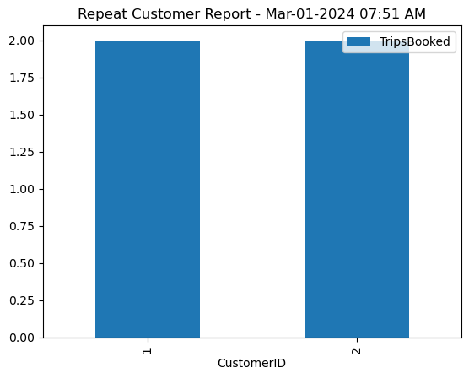
Repeat Customers
This report tracks the number of trips booked by individual customers, identifying loyal customers and indicating the company's success in retaining clients.
Assumption: A higher number of trips booked by a customer signifies satisfaction and loyalty, which are key for long-term business sustainability.
Example: Customer ID: 1 shows 2 trips booked, suggesting a satisfied repeat customer.
Notes:
Customer ID: 1, Trips Booked: 2
Customer ID: 2, Trips Booked: 2

Slide 10

Thank You

