Slide 1
RSA Wiener Attack
Exploiting Small Private Exponents
Continued Fractions, Key Recovery and Experimental Evaluation
Group members: Wu Ziyuan, Cai Bingyi
2026-10-19
Notes:
Hello everyone. Our project studies Wiener’s small-private-exponent attack against RSA. Even with a 2048-bit modulus, can an attacker recover the private key using only the public values e and n when d is too small?
Sources: PRESENTATION_SCRIPT_EN.md

Slide 2
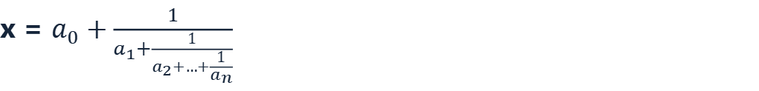

Small Private Exponents and Wiener’s Attack
RSA key relation
Continued fractions and convergents
ed − kφ(n) = 1
x = $a_{0}+\frac{1}{a_{1}+\frac{1}{a_{2}+…+\frac{1}{a_{n}}}}$
Classical sufficient bound for d
x = [a₀; a₁, a₂, …, aₙ]
d < $\frac{1}{3}n^{\frac{1}{4}}$
Under the theorem’s assumptions
Expand e/n and truncate each prefix to obtain candidates kᵢ/dᵢ.
k/d ≈ e/n
Each denominator dᵢ is a candidate private exponent to verify
A small d makes them become very close
Continued fractions reduce an exhaustive search over d to a small set of convergent candidates.
To evaluate this vulnerability, we generate both normal RSA keys and valid RSA keys whose private exponent is intentionally small.
02 / 07
Notes:
When d satisfies the classical Wiener condition shown here, k/d is very close to e/n. Expanding e/n as a continued fraction and truncating its prefixes gives convergents whose denominators are candidate private exponents. This avoids enumerating every possible d.
Sources: PRESENTATION_SCRIPT_EN.md

Slide 3

Normal RSA and Weak RSA Construction
Normal RSA
Wiener-weak RSA
Generate distinct primes p and q of similar size
=
Generate distinct primes p and q of similar size
n = p·q φ(n) = (p−1)(q−1)
=
n = p·q φ(n) = (p−1)(q−1)
Choose the common public exponent e = 65537
Estimate the Wiener threshold T ≈ $\frac{1}{3}n^{\frac{1}{4}}$
Check that gcd(e, φ(n)) = 1
Set target d ≈ ratio·T
Compute d = e⁻¹ mod φ(n)
Find a nearby odd d coprime with φ(n)
Return a valid normal RSA key
Compute e = d⁻¹ mod φ(n), then verify RSA relations
Normal RSA: fixes e, then derives d.
Weak RSA: chooses a small d, then derives e.
Both satisfy RSA relations; the intended difference is the size of d.
03 / 07
Notes:
Both procedures generate similarly sized p and q, then calculate n and φ(n). Normal RSA fixes e=65537 and computes its modular inverse d. The weak generator chooses d near a requested fraction of the Wiener threshold, then computes e. Since d is coprime with φ(n), the resulting weak key remains a valid RSA key.
Sources: PRESENTATION_SCRIPT_EN.md; CODE_EXPLANATION.md

Slide 4
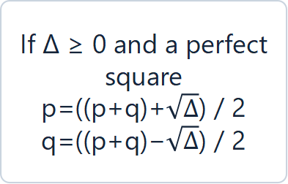
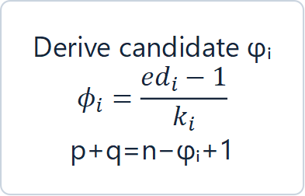
Wiener Attack Candidate Recovery
Public input
e and n
True d, p, q and φ are unknown
Expand e/n as a continued fraction
and generate convergents kᵢ/dᵢ
Check each candidate
kᵢ ≠ 0 and kᵢ | (edᵢ − 1)
(check if φᵢ is integer)
Derive candidate φᵢ
$$φ_{i}=\frac{ed_{i}−1}{k_{i}}$$
p+q=n−φᵢ+1
Verify edᵢ mod φᵢ = 1
Return dᵢ, p, q
Otherwise continue
Recover p and q from the roots
Check p,q>1, pq=n
and φᵢ=(p−1)(q−1)
If Δ ≥ 0 and a perfect square
p=((p+q)+$\sqrt{Δ}$) / 2
q=((p+q)−$\sqrt{Δ}$) / 2
Build the quadratic
(x−p)(x−q)=0
x²−(p+q)x+n=0
Δ=(p+q)²−4n=(p-q)²
If any check fails, the algorithm continues with the next convergent. The attack accepts only public e and n.
04 / 07
Notes:
The attack receives only public e and n. It computes the continued fraction of e/n and treats each convergent’s numerator and denominator as k and candidate d. If e·d−1 is divisible by k, the algorithm derives a candidate φ(n), then p+q. Together with pq=n, this gives a quadratic equation. Its discriminant must be a perfect square to recover integer p and q. The algorithm returns only after exact checks confirm pq=n, φ=(p−1)(q−1), and e·d mod φ=1.
Sources: PRESENTATION_SCRIPT_EN.md; CODE_EXPLANATION.md

Slide 5
Live Demo: 2048-bit Weak and Normal RSA
01
Generate two 2048-bit RSA keys live: one weak and one normal
02
Pass only the public values e and n to the attack
03
Recover d, φ(n), p and q from the weak key, then verify decryption
04
Run the identical attack against the normal RSA key
05 / 07

Slide 6
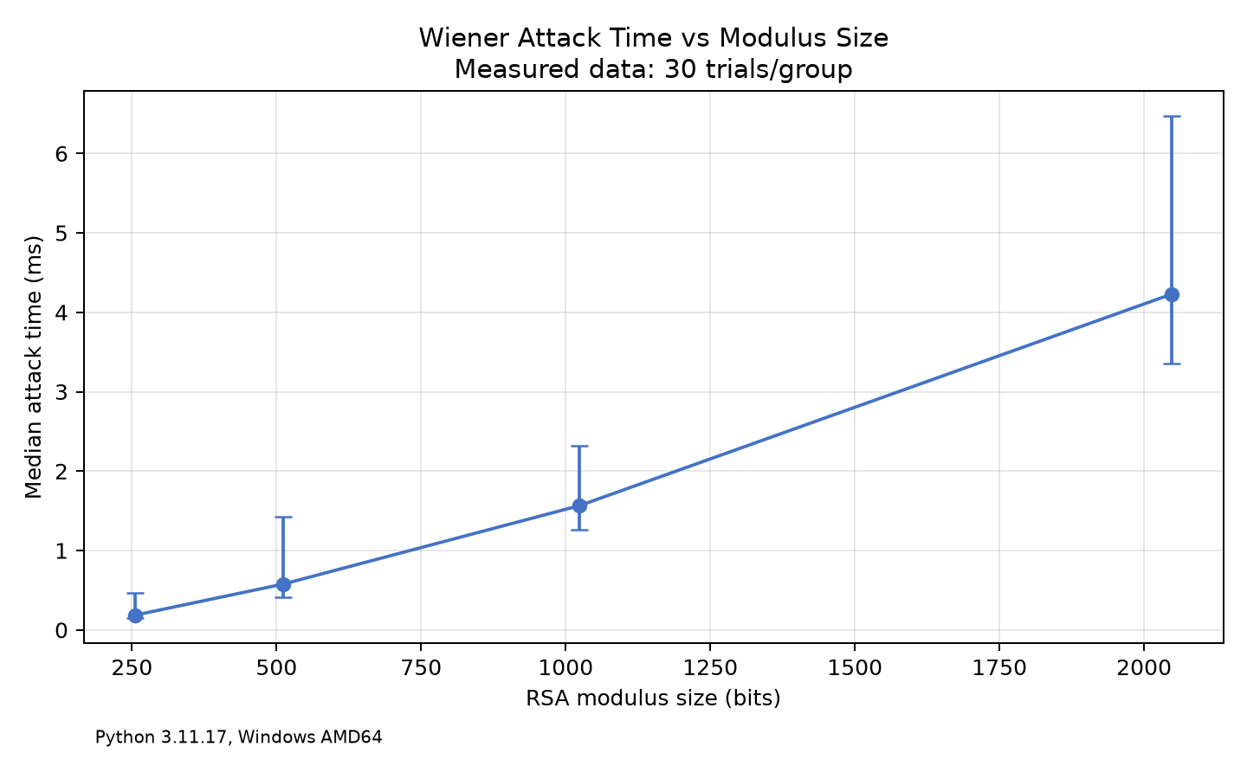
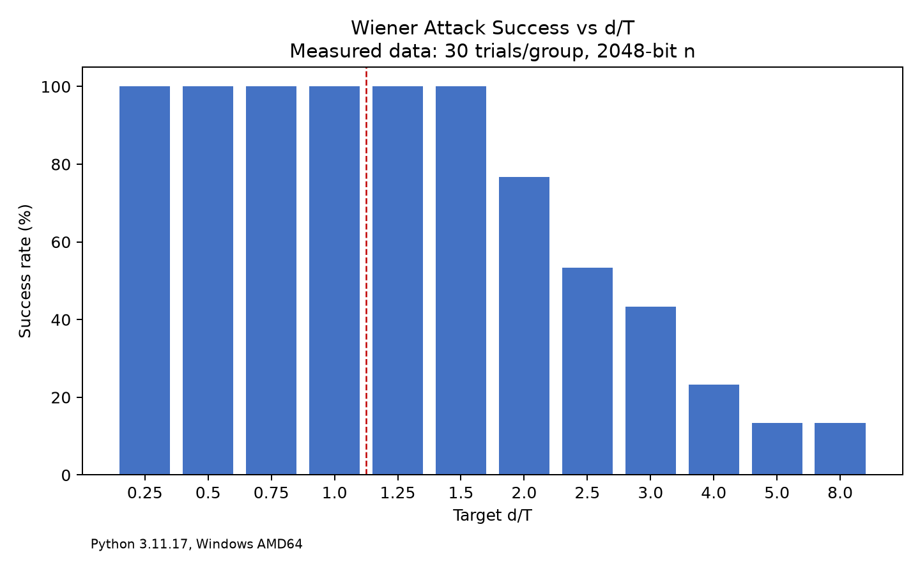
Experimental Results and Analysis
E3 · 2048-bit key comparison
Key type | Median d/T | Recovered
Weak RSA | 0.75 | 30/30
Normal RSA | 2.578 × 10⁴⁶² | 0/30
E1: 2048-bit n, 30 trials/group. E2: d/T=0.75; error bars show min to max. Attack timing excludes key generation.
06 / 07

Slide 7
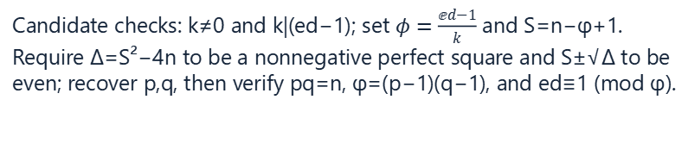

Self-Implemented Core Functions
RSA parameter construction
Continued fractions and attack verification
generate_normal_rsa()
continued_fraction()
Fix e=65537; sample distinct p,q and check n’s bit length; require gcd(e,φ)=1, then derive d=e⁻¹ mod φ.
Computes continued-fraction coefficients by Euclidean division.
generate_weak_rsa()
convergents()
Chooses a small d from target $\frac{d}{T}$, then derives e=d⁻¹ mod φ..
Evaluate each continued-fraction prefix to produce candidate k/d pairs for Wiener’s search.
_nearest_odd_coprime()
Searches near the target for a valid odd d coprime with φ. (accept only 1<d<φ and gcd(d,φ)=1)
wiener_attack()
Uses only e and n to search candidates (accept only public (e,n)), recover and verify d, p, q.
Wiener-bound checks
Candidate checks: k≠0 and k|(ed−1); set $φ=\frac{ⅇd−1}{k}$ and S=n−φ+1. Require Δ=S²−4n to be a nonnegative perfect square and S±√Δ to be even; recover p,q, then verify pq=n, φ=(p−1)(q−1), and ed≡1 (mod φ).
approximate_wiener_threshold()
Uses two integer square roots to approximate $\frac{n^{\frac{1}{4}}}{3}$
.
is_below_wiener_bound()
Tests the classical bound exactly with 81d⁴ < n.
07 / 07

