Slide 1
Snowman Editor
A level design tool for the game
A Good Snowman Is Hard To Build
Author: Gerard Martin Teixidor
Director: Gustavo Ariel Patow and Mateu Villaret Auselle
Study: Grau en Enginyeria Informàtica
University: Universitat de Girona (EPS)

Slide 2
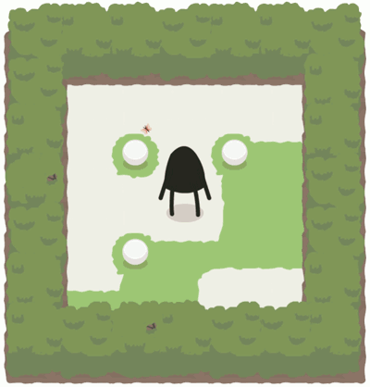
A Good Snowman Is Hard To Build

Slide 3
Level design
In the video game world, it does not exists a game mechanics automated testing.
Find possible solutions that where not planned. Currently it is done by hand.

Slide 4
Objectives
Development of a tool to find these unwanted solutions of the game A Good Snowman Is Hard To Build
Solve using an “heuristic” approach (PDDL)
Solve using an optimal approach (SMT)
A graphical level editor

Slide 5
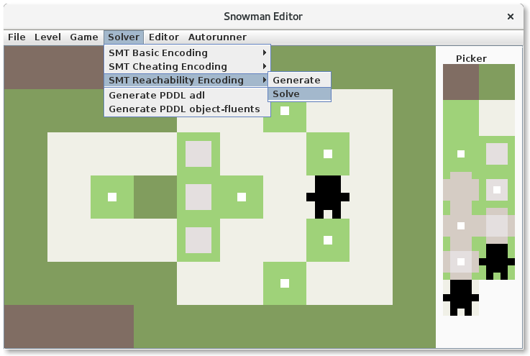
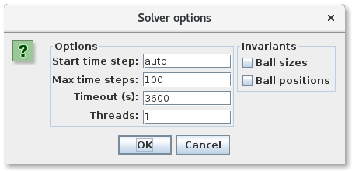
Snowman Editor

Slide 6
Snowman Editor modules
Split in:
Planner module
Snowman problem module
Game modification module
GUI module

Slide 7
Automated planning
A
B
C
A
C
B
Initial state
Goal state
Notes:
State
Actions link states
Actions have PRE and EFF
Final states

Slide 8
Planning Domain Definition Language (PDDL)
PDDL is an standard Artificial Intelligence
planning language. It has multiple subsets.
It defines:
Initial state
Set of actions
Goal preconditions

Slide 9
adl subset
(:action move_character
:parameters
(?from ?to - location ?dir - direction)
:precondition
(next ?from ?to?dir)
…
:effect
…)
(:action move_ball
:parameters
(?b - ball ?ppos ?from ?to - location
?dir - direction)
:precondition
(next ?from ?to ?dir)
(next ?ppos ?from ?dir)
…
:effect
…)

Slide 10
adl subset
(:action move_character
:parameters
(?from ?to - location ?dir - direction)
25 (?from) ∗ 25 (?to) ∗ 4 (?dir) = 2500 unfolded actions
(:action move_ball
:parameters
(?b - ball ?ppos ?from ?to - location ?dir - direction)
3 (?ball) ∗ 25 (?ppos) ∗ 25 (?f rom) ∗ 25 (?to) ∗ 4 (?dir) = 187500 unfolded actions

Slide 11
object-fluents subset
(:functions
(character-at) - location
(ball-at ?b - ball) – location
(next-up ?l - location) - location
(next-down ?l - location) - location
(next-right ?l - location) - location
(next-left ?l - location) - location
)
(:action move_up_character
:parameters
:precondition
…
:effect
…)
(:action move_up_ball
:parameters
(?b - ball)
:precondition
…
:effect
…)

Slide 12
object-fluents subset
(:action move_up_character
:parameters
(:action move_down_character
:parameters
(:action move_right_character
:parameters
(:action move_left_character
:parameters
4 unfolded actions
(:action move_up_ball
:parameters
(?b - ball)
(:action move_down_ball
:parameters
(?b - ball)
(:action move_right_ball
:parameters
(?b - ball)
(:action move_left_ball
:parameters
(?b - ball)
4 actions ∗ 3 (?ball) = 12 unfolded actions

Slide 13
Preliminary PDDL results
Only the Rantanplan supports object-fluents subset. It has only been able to solve toy instances.
Notes:
Logica i programació

Slide 14
Propositional satisfiability problem (SAT)
Is the problem of determining if there exists an interpretation that satisfies a given Boolean formula.
Example:
(¬A ∨ ¬B ∨ ¬C) ∧
(A ∨ ¬C) ∧
(¬B ∨ E ∨ ¬E) ∧
(C)
Possible interpretation {A, ¬B, C, D, E}

Slide 15
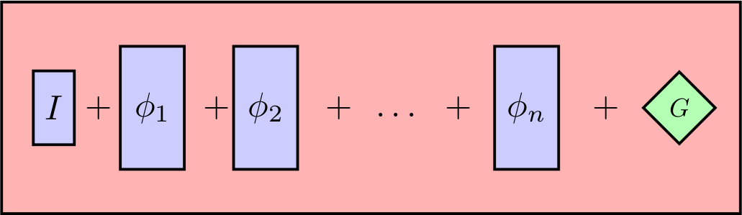
Planning as satisfiability
Reduce the automated planning problem to SAT
Planning as SMT (LIA) instead of Planning as SAT
Notes:
Fi encodes multiple actions which only one is choosen
If exists a sequence of n actions which brings from S0 to final state
SMT

Slide 16
Basic encoding
Character action
PRE = CHARACTER_LOCATION_VALID
EFF = MOVE_CHARACTER and
EQUAL_BALLS_VARIABLES and
EQUAL_SNOW_VARIABLES and
EQUAL_OCCUPANCY_VARIABLES

Slide 17
Basic encoding
Ball action
PRE = CHARACTER_NEXT_TO_BALL and
NO_WALL_IN_FRONT and
NO_OTHER_BALLS_OVER and
not (OTHER_BALL_IN_FRONT and OTHER_BALL_UNDER) and
OTHER_BALLS_IN_FRONT_LARGER
EFF = MOVE_BALL and
(not OTHER_BALL_UNDER → MOVE_CHARACTER)
(OTHER_BALL_UNDER → EQUAL_CHARACTER_VARIABLES)
EQUAL_OTHER_BALLS_VARIABLES and
UPDATE_SNOW_VARIABLES and
UPDATE_BALL_SIZE and
UPDATE_OCCUPANCY_VARIABLES and
INVARIANT_BALL_SIZES

Slide 18
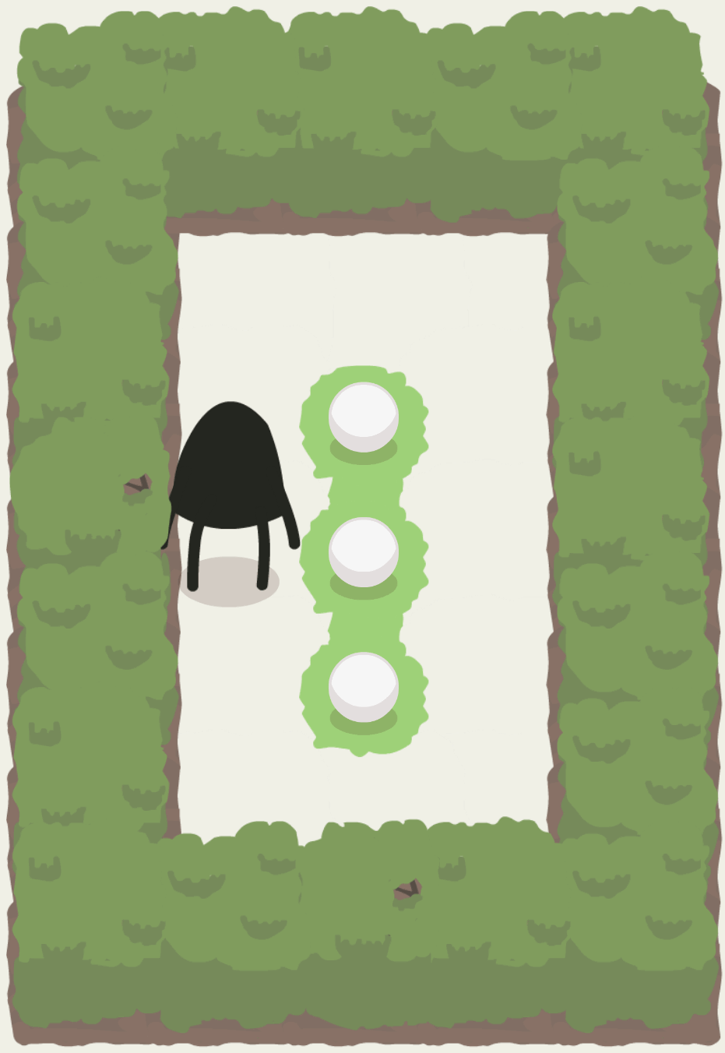
Basic encoding: Tanya
Output | Action
solver | up
 | right
 | up
 | right
 | down
 | left
 | left
 | down
 | down
 | right
 | down
 | right
 | up
 | left
 | left
 | up
 | right

Slide 19
 |  | Human |  | Basic Encoding
Level | Map size | Actions | Ball Actions | Solved | Timesteps | Time | Valid | Actions | Ball Actions
Lucy | 24 | 19 | 8 | TRUE | 19 | 10937 | TRUE | 19 | 8
Andy | 25 | 19 | 6 | TRUE | 19 | 44140 | TRUE | 19 | 6
Tanya | 15 | 18 | 6 | TRUE | 17 | 28474 | TRUE | 17 | 5
Kevin | 24 | 42 | 11 | TRUE | 38 | 1827178 | TRUE | 38 | 11
Sarha | 19 | 26 | 8 | TRUE | 26 | 125156 | TRUE | 26 | 8
Louise | 14 | 52 | 15 | TRUE | 33 | 1356625 | TRUE | 33 | 13
Alice | 35 | 53 | 24 | FALSE | 36 | 3600001
Freya | 19 | 49 | 15 | FALSE | 33 | 3600001
Chris | 16 | 31 | 7 | TRUE | 31 | 243521 | TRUE | 31 | 7
Alex | 23 | 56 | 13 | FALSE | 26 | 3600001
Julian | 35 | 44 | 13 | FALSE | 35 | 3600009
Ryan | 24 | 52 | 15 | FALSE | 31 | 3600001
Sally | 25 | 92 | 15 | FALSE | 35 | 3600000
Lauren | 16 | 66 | 15 | FALSE | 33 | 3600001
Jill & Jack | 22 | 56 | 26 | FALSE | 25 | 3600001
Willow | 34 | 95 | 14 | FALSE | 33 | 3600001
Ben & Alan | 32 | 177 | 40 | FALSE | 26 | 3600001
Adam | 21 | 97 | 12 | FALSE | 30 | 3600001
R., J. & M. | 38 | 152 | 47 | FALSE | 20 | 3600001
Jessica & Amelia | 25 | 84 | 26 | FALSE | 21 | 3600001
C. & M. | 34 | 83 | 34 | FALSE | 28 | 3600001
David | 40 | 24 | 7 | TRUE | 23 | 93841 | TRUE | 23 | 8
Lydia | 21 | 27 | 7 | TRUE | 27 | 129804 | TRUE | 27 | 7
Mary | 14 | 46 | 10 | FALSE | 35 | 3600001
Helen | 24 | 57 | 13 | FALSE | 30 | 3600001
Paul | 25 | 67 | 28 | FALSE | 37 | 3600001
Kate | 25 | 36 | 11 | FALSE | 30 | 3600000
Rebecca | 18 | 27 | 6 | TRUE | 24 | 119374 | TRUE | 24 | 6
William | 25 | 50 | 15 | FALSE | 36 | 3600001
Zoe & Richard | 28 | 92 | 29 | FALSE | 25 | 3600001
Notes:
Kevin has a lot of movement actions

Slide 20
Cheating encoding
Character action
-
Ball action
PRE = NO_WALL_IN_FRONT and
NO_OTHER_BALLS_OVER and
not (OTHER_BALL_IN_FRONT and OTHER_BALL_UNDER) and
OTHER_BALLS_IN_FRONT_LARGER and
CHARACTER_LOCATION_TELEPORT_VALID
EFF = MOVE_BALL and
EQUAL_OTHER_BALLS_VARIABLES and
EQUAL_SNOW_VARIABLES and
UPDATE_BALL_SIZE and
UPDATE_OCCUPANCY_VARIABLES and
INVARIANT_BALL_SIZES

Slide 21
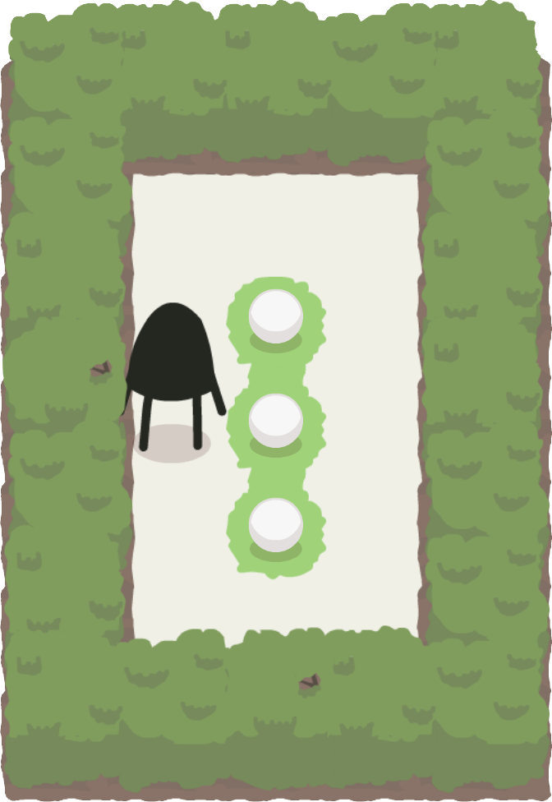
Cheating encoding: Tanya
Ball | Location | Size
0 | 2,2 | Small
1 | 2,3 | Small
2 | 2,4 | Small
Output | Action
solver | left(2)
 | down(2)
 | left(0)
 | up(0)
 | left(1)

Slide 22
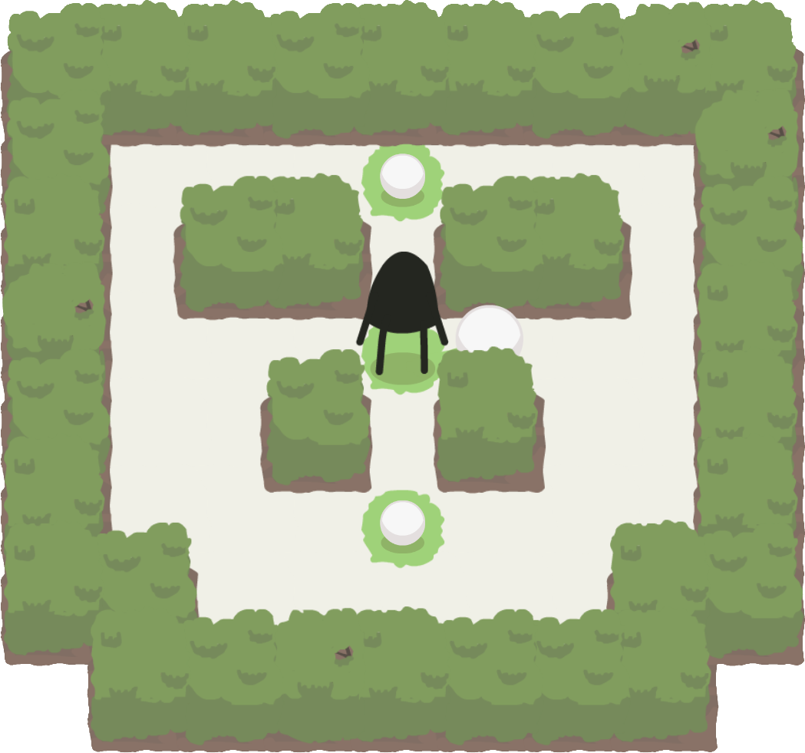
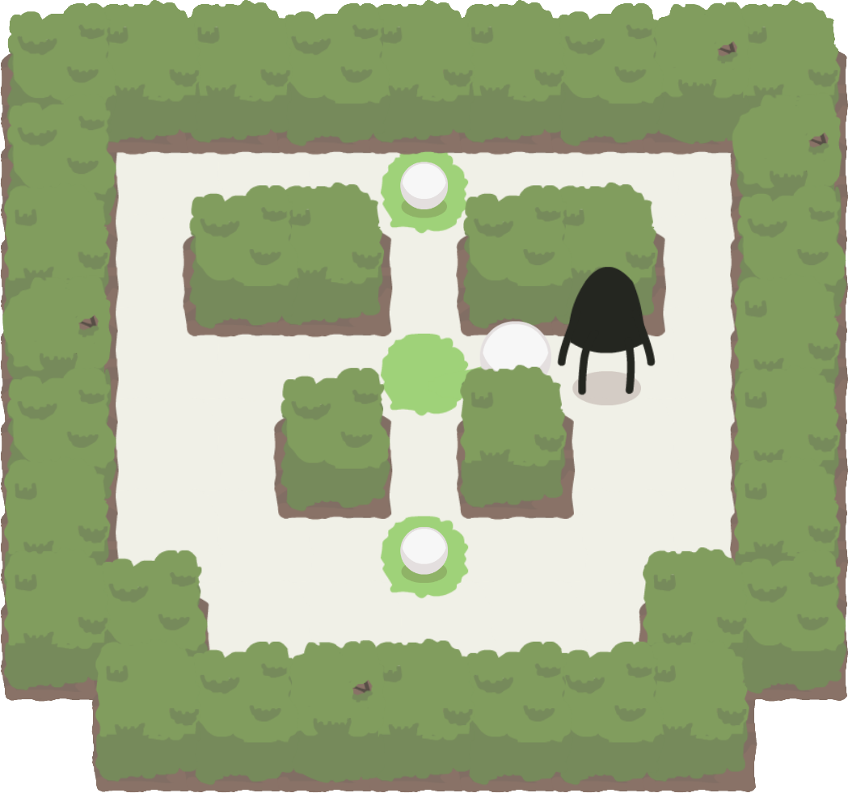
Path reconstruction
Path Start: Coordinate(4,4)
Path End: Coordinate(6,4)
Path: left
Path: left
Path: down
Path: down
Path: right
Path: down
Path: right
Path: right
Path: up
Path: right
Path: up
Path: up
Action: left

Slide 23

Cheating encoding: Tanya
Output | Action
solver | up
 | up
 | right
 | right
 | down
solver | left
pathfinder | up
 | left
solver | down
pathfinder | right
 | right
 | down
 | down
solver | left
pathfinder | down
 | left
solver | up
pathfinder | right
 | right
 | up
solver | left

Slide 24
 | Basic Encoding |  |  |  |  |  | Cheating Encoding
Level | Solved | Steps | Time | Valid | Actions | B. Actions | Solved | Steps | Time | Valid | Actions | B. Actions
Lucy | TRUE | 19 | 10937 | TRUE | 19 | 8 | TRUE | 8 | 469 | TRUE | 19 | 8
Andy | TRUE | 19 | 44140 | TRUE | 19 | 6 | TRUE | 6 | 356 | TRUE | 23 | 6
Tanya | TRUE | 17 | 28474 | TRUE | 17 | 5 | TRUE | 5 | 168 | TRUE | 21 | 5
Kevin | TRUE | 38 | 1827178 | TRUE | 38 | 11 | TRUE | 11 | 4865 | TRUE | 38 | 11
Sarha | TRUE | 26 | 125156 | TRUE | 26 | 8 | TRUE | 8 | 493 | FALSE | 36 | 8
Louise | TRUE | 33 | 1356625 | TRUE | 33 | 13 | TRUE | 7 | 439 | FALSE | 27 | 7
Alice | FALSE | 36 | 3600001 |  |  |  | TRUE | 11 | 14893 | FALSE | 38 | 11
Freya | FALSE | 33 | 3600001 |  |  |  | TRUE | 5 | 194 | FALSE | 22 | 5
Chris | TRUE | 31 | 243521 | TRUE | 31 | 7 | TRUE | 7 | 346 | TRUE | 31 | 7
Alex | FALSE | 26 | 3600001 |  |  |  | TRUE | 13 | 69187 | TRUE | 70 | 13
Julian | FALSE | 35 | 3600009 |  |  |  | TRUE | 11 | 5122 | FALSE | 44 | 11
Ryan | FALSE | 31 | 3600001 |  |  |  | TRUE | 9 | 1979 | FALSE | 36 | 9
Sally | FALSE | 35 | 3600000 |  |  |  | TRUE | 13 | 16963 | TRUE | 71 | 13
Lauren | FALSE | 33 | 3600001 |  |  |  | TRUE | 9 | 2488 | FALSE | 34 | 9
Jill & Jack | FALSE | 25 | 3600001 |  |  |  | TRUE | 14 | 135360 | FALSE | 49 | 14
Willow | FALSE | 33 | 3600001 |  |  |  | TRUE | 14 | 96567 | FALSE | 101 | 14
Ben & Alan | FALSE | 26 | 3600001 |  |  |  | FALSE | 12 | 3600001
Adam | FALSE | 30 | 3600001 |  |  |  | TRUE | 12 | 10069 | TRUE | 79 | 12
R., J. & M. | FALSE | 20 | 3600001 |  |  |  | FALSE | 8 | 3600001
J. & A. | FALSE | 21 | 3600001 |  |  |  | FALSE | 12 | 3600001
C. & M. | FALSE | 28 | 3600001 |  |  |  | FALSE | 11 | 3600001
David | TRUE | 23 | 93841 | TRUE | 23 | 8 | TRUE | 7 | 796 | TRUE | 24 | 7
Lydia | TRUE | 27 | 129804 | TRUE | 27 | 7 | TRUE | 7 | 430 | TRUE | 27 | 7
Mary | FALSE | 35 | 3600001 |  |  |  | TRUE | 10 | 1455 | TRUE | 45 | 10
Helen | FALSE | 30 | 3600001 |  |  |  | TRUE | 11 | 8748 | TRUE | 52 | 11
Paul | FALSE | 37 | 3600001 |  |  |  | TRUE | 9 | 1203 | FALSE | 40 | 9
Kate | FALSE | 30 | 3600000 |  |  |  | TRUE | 10 | 7868 | TRUE | 53 | 10
Rebecca | TRUE | 24 | 119374 | TRUE | 24 | 6 | TRUE | 2 | 34 | FALSE | 11 | 2
William | FALSE | 36 | 3600001 |  |  |  | TRUE | 13 | 9434 | FALSE | 67 | 13
Z. & R. | FALSE | 25 | 3600001 |  |  |  | FALSE | 10 | 3600001
Notes:
Louise cheated from 13 to 7 Ball actions

Slide 25
Reachability encoding
Character action
-
Ball action
PRE = NO_WALL_IN_FRONT and
NO_OTHER_BALLS_OVER and
not (OTHER_BALL_IN_FRONT and OTHER_BALL_UNDER) and
OTHER_BALLS_IN_FRONT_LARGER and
CHARACTER_LOCATION_TELEPORT_VALID and
REACHABILITY
EFF = MOVE_BALL and
EQUAL_OTHER_BALLS_VARIABLES and
EQUAL_SNOW_VARIABLES and
UPDATE_BALL_SIZE and
UPDATE_OCCUPANCY_VARIABLES and
INVARIANT_BALL_SIZES

Slide 26
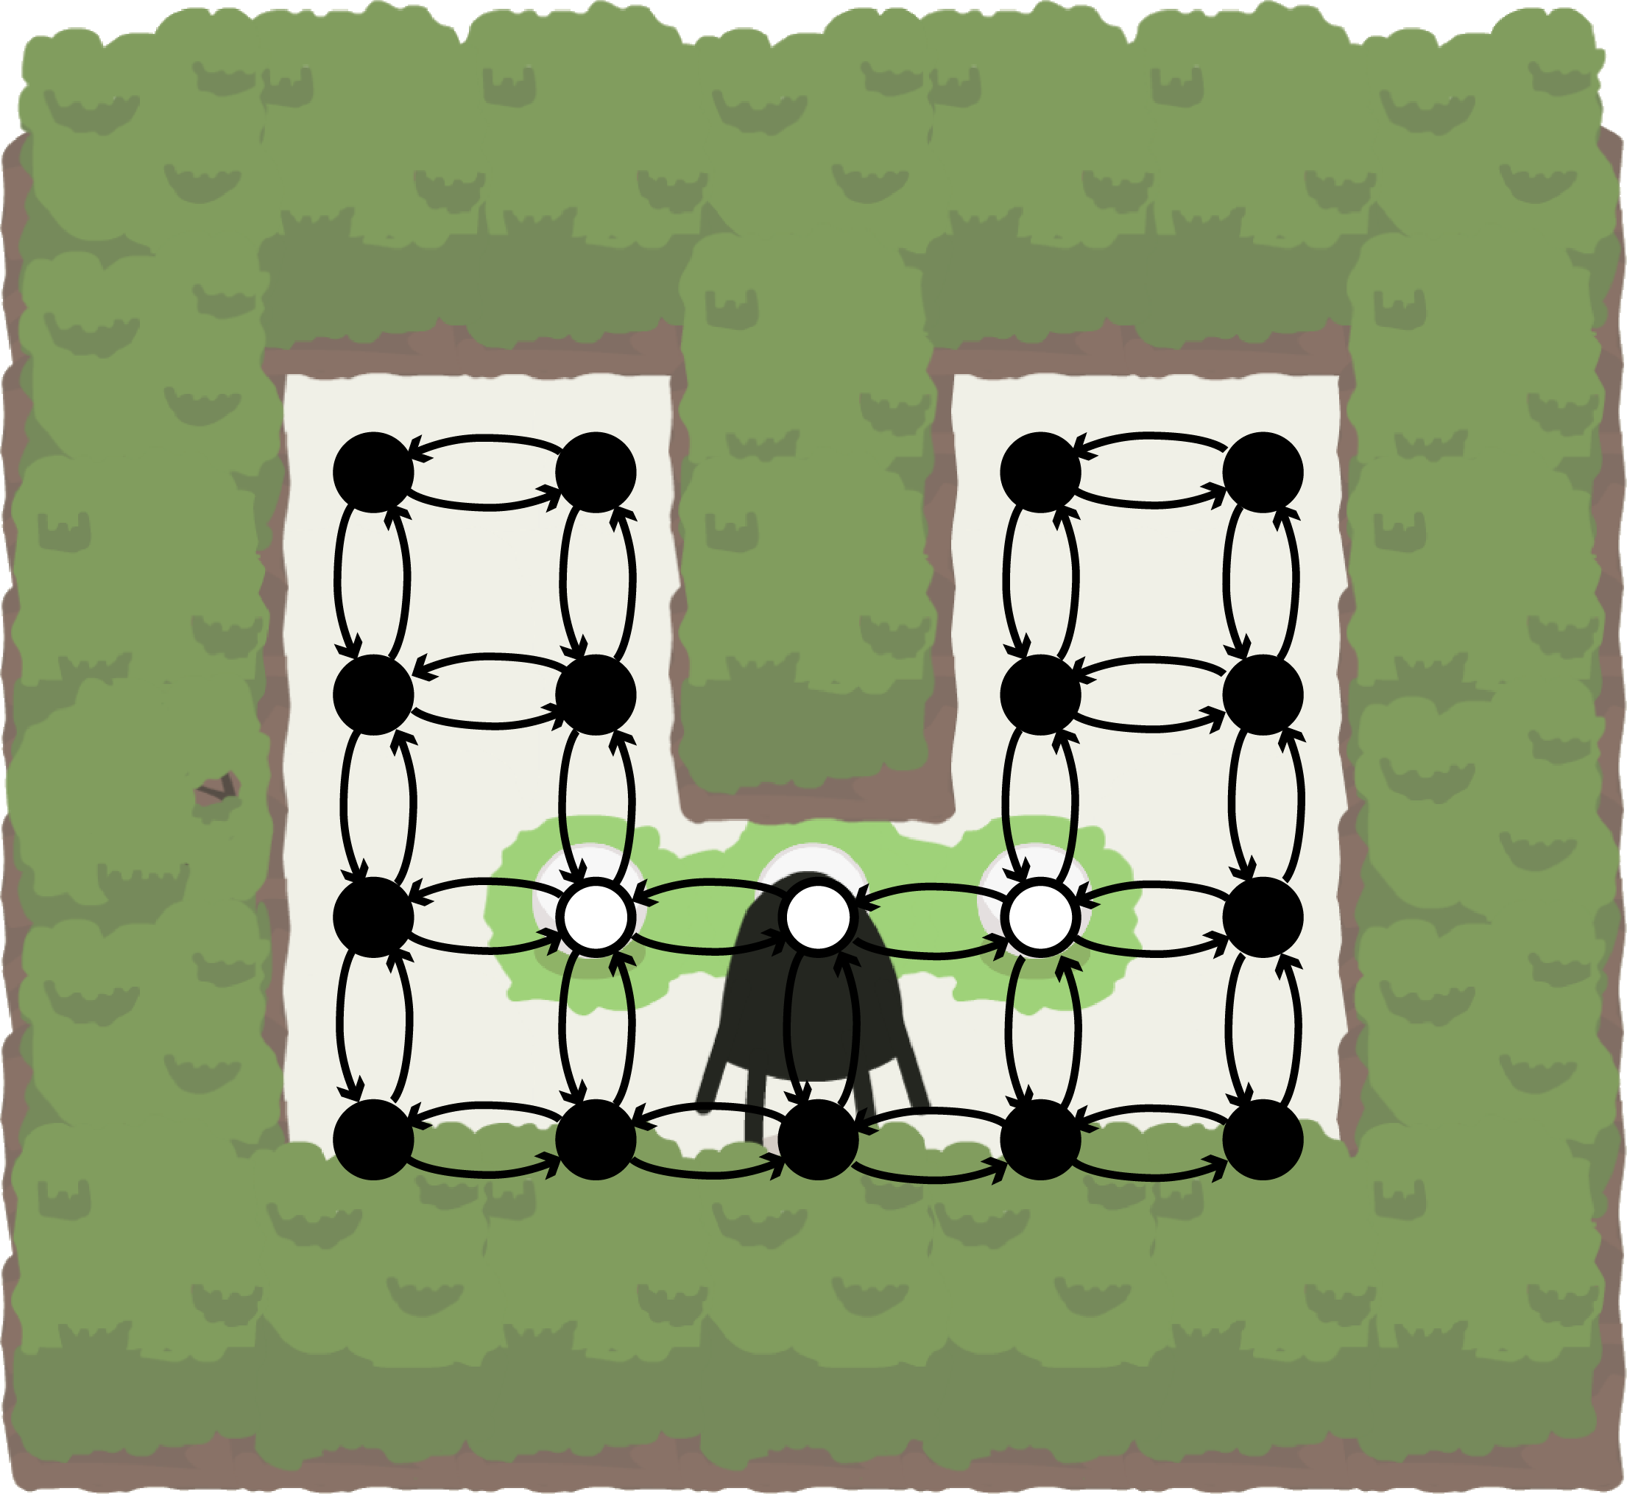
Reachability precondition

Slide 27

Reachability encoding: Tanya
Output | Action
pathfinder | up
solver | right
pathfinder | up
 | right
solver | down
pathfinder | left
 | left
 | down
 | down
solver | right
pathfinder | down
 | right
solver | up
pathfinder | left
 | left
 | up
solver | right

Slide 28
 | Cheating Encoding |  |  |  |  |  | Reachability Encoding
Level | Solved | Steps | Time | Valid | Actions | B. Actions | Solved | Steps | Time | Valid | Actions | B. Actions
Lucy | TRUE | 8 | 469 | TRUE | 19 | 8 | TRUE | 8 | 855 | TRUE | 23 | 8
Andy | TRUE | 6 | 356 | TRUE | 23 | 6 | TRUE | 6 | 525 | TRUE | 27 | 6
Tanya | TRUE | 5 | 168 | TRUE | 21 | 5 | TRUE | 5 | 247 | TRUE | 17 | 5
Kevin | TRUE | 11 | 4865 | TRUE | 38 | 11 | TRUE | 11 | 6674 | TRUE | 40 | 11
Sarha | TRUE | 8 | 493 | FALSE | 36 | 8 | TRUE | 8 | 621 | TRUE | 34 | 8
Louise | TRUE | 7 | 439 | FALSE | 27 | 7 | TRUE | 13 | 29818 | TRUE | 35 | 13
Alice | TRUE | 11 | 14893 | FALSE | 38 | 11 | TRUE | 19 | 1172751 | TRUE | 66 | 19
Freya | TRUE | 5 | 194 | FALSE | 22 | 5 | TRUE | 13 | 11829 | TRUE | 46 | 13
Chris | TRUE | 7 | 346 | TRUE | 31 | 7 | TRUE | 7 | 507 | TRUE | 31 | 7
Alex | TRUE | 13 | 69187 | TRUE | 70 | 13 | TRUE | 13 | 77492 | TRUE | 67 | 13
Julian | TRUE | 11 | 5122 | FALSE | 44 | 11 | TRUE | 13 | 44354 | TRUE | 73 | 13
Ryan | TRUE | 9 | 1979 | FALSE | 36 | 9 | TRUE | 15 | 109487 | TRUE | 60 | 15
Sally | TRUE | 13 | 16963 | TRUE | 71 | 13 | TRUE | 13 | 24129 | TRUE | 71 | 13
Lauren | TRUE | 9 | 2488 | FALSE | 34 | 9 | TRUE | 11 | 7104 | TRUE | 42 | 11
Jill & Jack | TRUE | 14 | 135360 | FALSE | 49 | 14 | TRUE | 16 | 472872 | TRUE | 60 | 16
Willow | TRUE | 14 | 96567 | FALSE | 101 | 14 | TRUE | 14 | 87312 | TRUE | 95 | 14
Ben & Alan | FALSE | 12 | 3600001 |  |  |  | FALSE | 14 | 3600001
Adam | TRUE | 12 | 10069 | TRUE | 79 | 12 | TRUE | 12 | 9280 | TRUE | 89 | 12
R., J. & M. | FALSE | 8 | 3600001 |  |  |  | FALSE | 8 | 3600000
J. & A. | FALSE | 12 | 3600001 |  |  |  | FALSE | 12 | 3600001
C. & M. | FALSE | 11 | 3600001 |  |  |  | FALSE | 12 | 3600001
David | TRUE | 7 | 796 | TRUE | 24 | 7 | TRUE | 7 | 2324 | TRUE | 32 | 7
Lydia | TRUE | 7 | 430 | TRUE | 27 | 7 | TRUE | 7 | 503 | TRUE | 27 | 7
Mary | TRUE | 10 | 1455 | TRUE | 45 | 10 | TRUE | 10 | 1571 | TRUE | 41 | 10
Helen | TRUE | 11 | 8748 | TRUE | 52 | 11 | TRUE | 11 | 11899 | TRUE | 58 | 11
Paul | TRUE | 9 | 1203 | FALSE | 40 | 9 | TRUE | 26 | 216808 | TRUE | 72 | 26
Kate | TRUE | 10 | 7868 | TRUE | 53 | 10 | TRUE | 10 | 6400 | TRUE | 37 | 10
Rebecca | TRUE | 2 | 34 | FALSE | 11 | 2 | TRUE | 6 | 255 | TRUE | 24 | 6
William | TRUE | 13 | 9434 | FALSE | 67 | 13 | TRUE | 15 | 14590 | TRUE | 57 | 15
Z. & R. | FALSE | 10 | 3600001 |  |  |  | FALSE | 11 | 3600002

Slide 29
Demo

Slide 30
Thanks
Questions?

