Slide 1
Pysotope: EA Analysis
Isotopic correction module

Slide 2
Drift Correction
Considers the N2 peak of Sorghum against time since beginning of run
Questions:
Do we only consider peaks with Identifier 2 == “STANDARD”?
Do we ignore peak size?
Confirm columns “Ampl. 28” and “Ampl. 29” the peak amplitude?
Following figures illustrate a potential peak-size driven isotopic influence

Slide 3
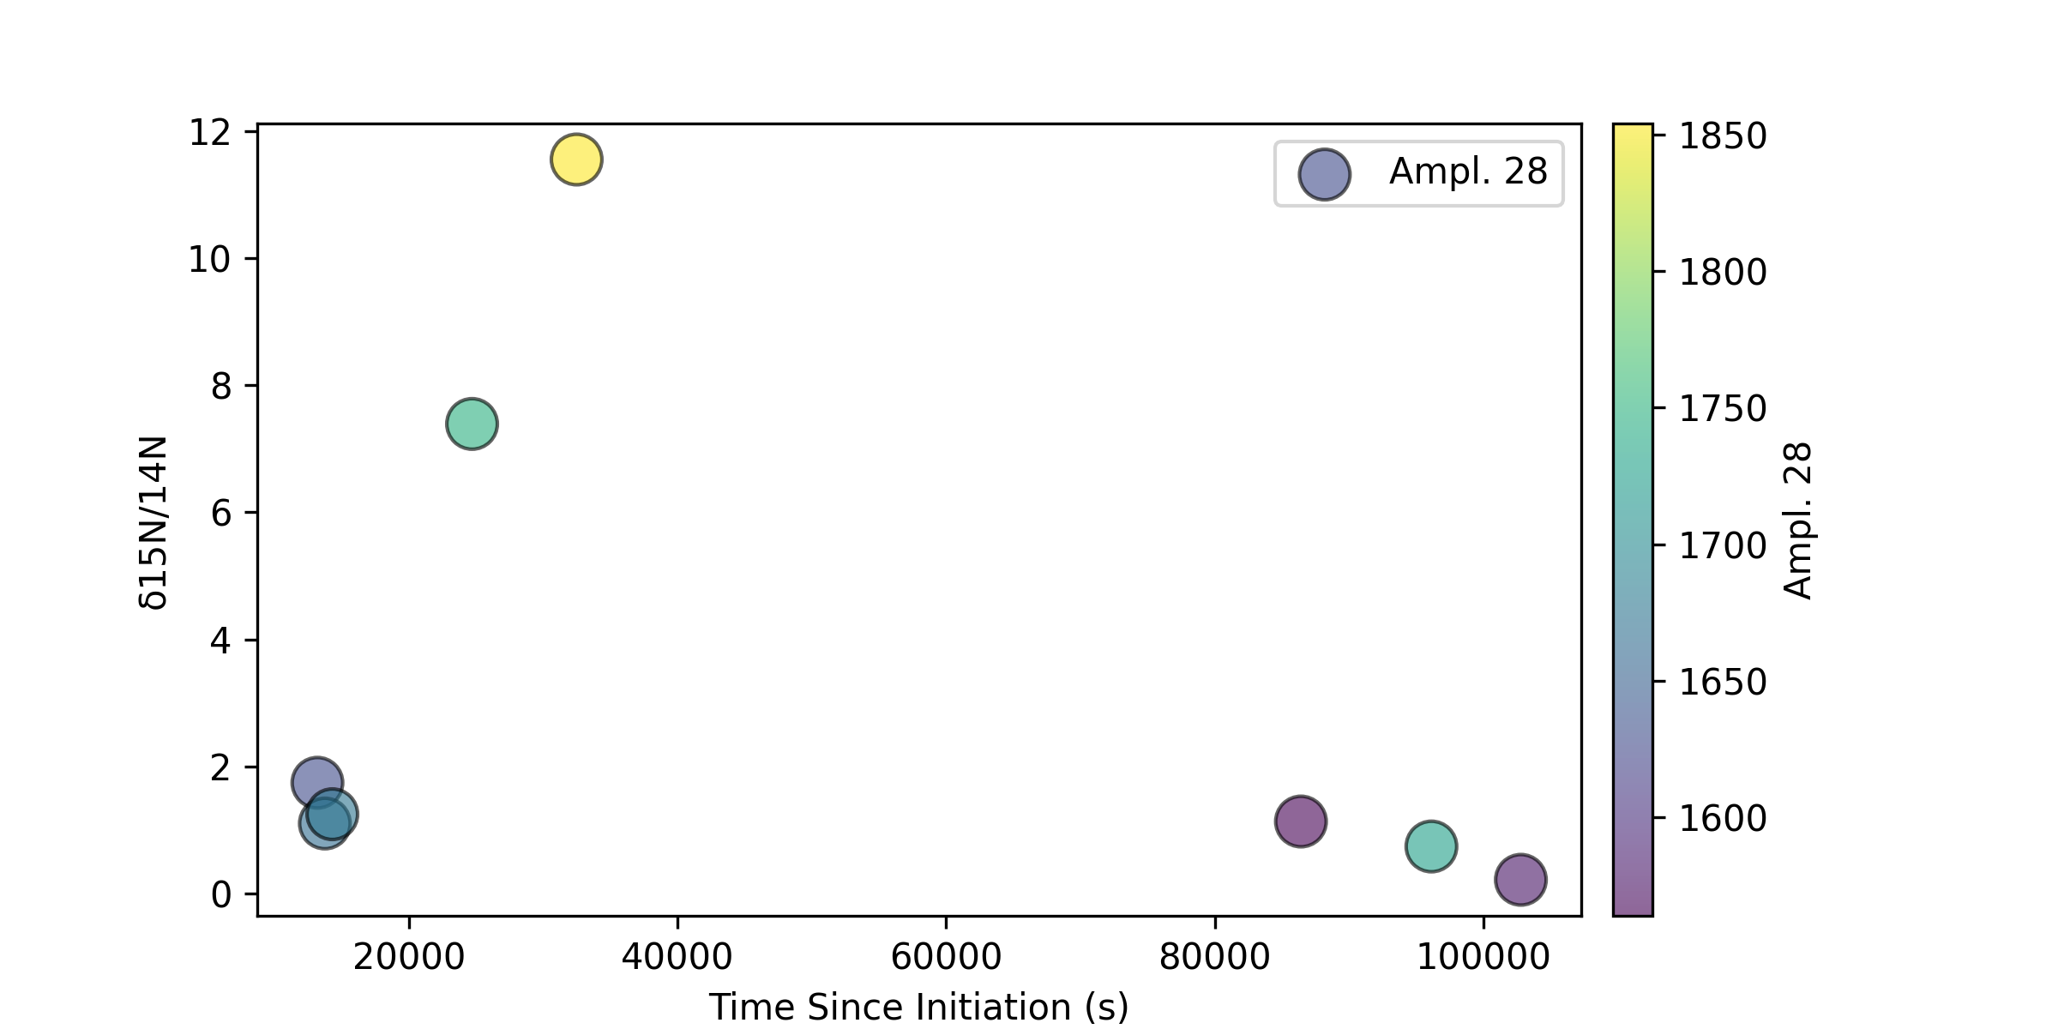
Drift Correction – peak size

Slide 4
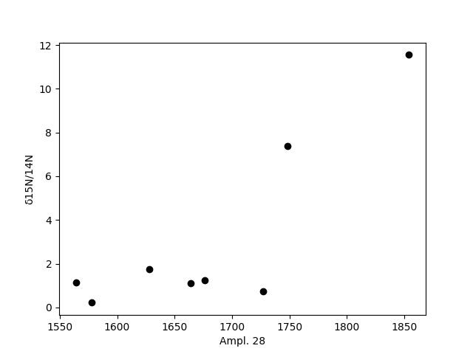
Drift Correction – peak size

Slide 5

Drift Correction – peak size

Slide 6
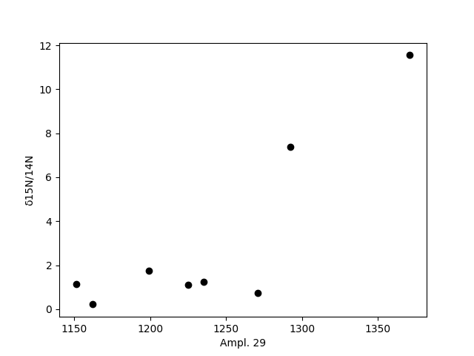
Drift Correction – peak size

Slide 7
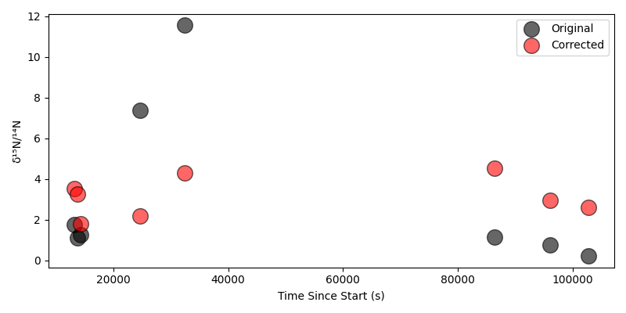
Drift Correction only using Ampl. 28 and Ampl. 29

Slide 8
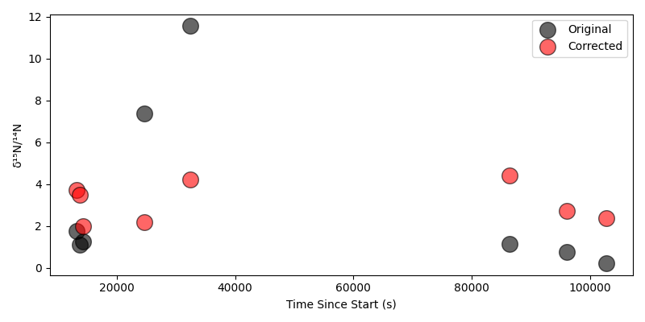
Drift Correction using Ampl. 28, Ampl. 29, and seconds since start

Slide 9
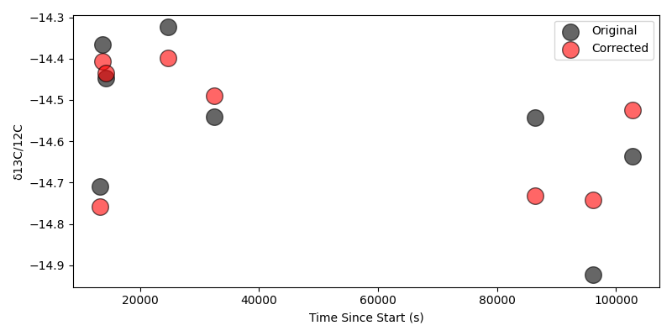
Similar with carbon - amplitudes

Slide 10
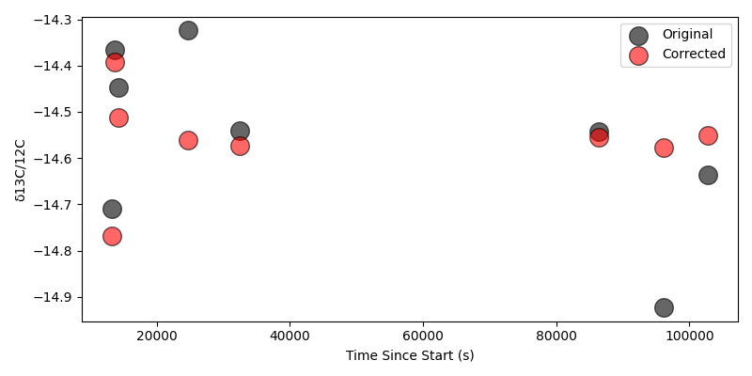
Similar with carbon – amplitudes and time

Slide 11
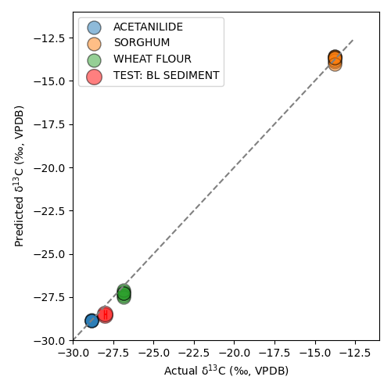
Multi-variate Correction
Variables: Time, Amplitudes (x3)
BL SEDIMENT (n = 2)
Mean predicted δ13C: -28.503 ‰
Bias (mean-target): -0.196 ‰
RMSE: 0.201 ‰

Slide 12
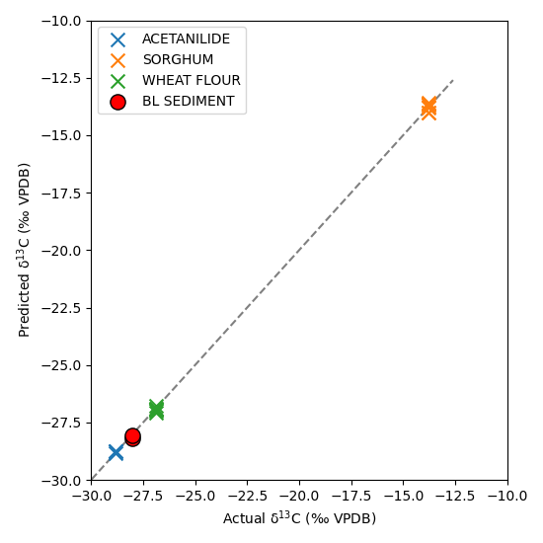
Original Correction
Variables: Time, Amplitudes (x3)
BL SEDIMENT (n = 2)
Mean predicted δ13C: -28.503 ‰
Bias (mean-target): -0.125 ‰
RMSE: 0.139 ‰

