Slide 1
IOSharp: .NET Micro Framework on Linux
AUTHOR: Gerard Solé i Castellví
DIRECTOR: Juan López Rúbio
DEGREE: Bachelor in Telematics Engineering

Slide 2
Index
1. Introduction 3
1.1. .NET Micro Framework 5
2. IOSharp 6
2.1. GPIO 8
2.2. Interrupts 9
2.3. SPI 10
2.4. UART 11
2.5. Example 12
3. AlterNative 13
3.1. Contributions 14
3.1. Translation process 15
3.2. IOSharp C++ 17
3.3. Example 18
4. Performance Test 19
4.1. Example 20
5. Conclusions 21
6. Questions & Answers 23

Slide 3
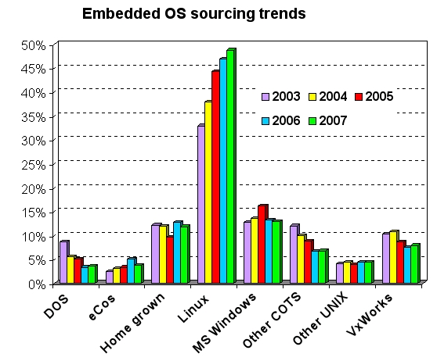
1. Introduction
Power increase from 8 to 32 bits on microprocessors
Cost reduction on hardware production
Increasing usage of Linux in embedded devices
Fig. 1: Linux growth between 2003 and 2007

Slide 4
1. Introduction II
Objectives
Deploy NETMF programs on any Linux device
Run HomeSense gateway on Raspberry Pi
Performance increase using a translation tool called AlterNative

Slide 5
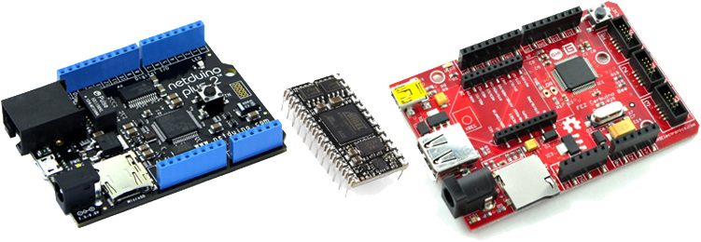
1.1. .NET Micro Framework
Virtual Machine running on the bare metal
Designed for resource-constrained devices
Multiple I/O Ports and Protocols
Fig. 2: Netudino Plus, Mini and FEZ Cerbuino. Arduino form factor

Slide 6

2. IOSharp
NETMF implementation on a High-Level basis
C# with Mono on Linux
C library for interfacing with communication protocols
Cross-Platform → Board independent
Requires an underlying Linux
Download at
https://github.com/GerardSoleCa/IOSharp-netmf-Linux

Slide 7
2. IOSharp II
Fig. 3: Original NETMF stack compared with IOSharp stack

Slide 8
2.1. GPIO
Used to read or write simple High or Low States on a Pin
I/O Ports are controlled and enabled or disabled through the file system
SYSFS → /sys/class/gpio/
Direction
State

Slide 9
2.2. Interrupts
Polling from a GPIO using the Poll function
P/Invokes are required for cross-language calls
Fig. 4: flow diagram for an Interrupt Port

Slide 10
2.3. SPI
Implemented using the provided Linux Kernel function
Included on IOSharp-C library
P/Invoked from C#
Fig. 5: Master-Slave SPI example

Slide 11
2.4. UART
NETMF and .NET Framework where compared
Same namespace → System.IO.Ports
Required methods for HomeSense in both implementations
Avoided a new reimplementation.
IOSharp relays on Mono Serial Port (UART)

Slide 12
2.5. Example
HomeSense proves that the GPIO, SPI, UART and Interrupts are working on the IOSharp implementation
First milestone is accomplished
Video showing HomeSense on Raspberry Pi
IOSharp requires one more transmission than NETMF

Slide 13
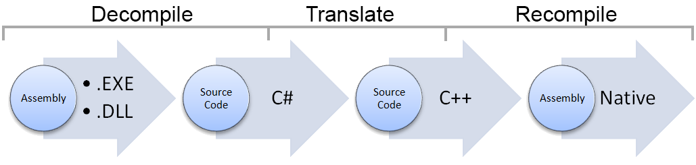
3. AlterNative
Source code translator written in C#
Translate a .NET Assembly to native C++
Use cases:
Performance
Cross-Platform development
Fig. 6: AlterNative translation process

Slide 14
3.1. Contributions
Make AlterNative compatible with Linux and MacOSX
Develop parts of the proprietary library for Linux
DateTime
TimeSpan
File
Encoding

Slide 15
3.2. Translation process
void Main(string[] args){
Console.WriteLine("Write a String"); string line = Console.ReadLine(); Console.WriteLine("Read line: " + line); byte[] b = new byte[2]; b[0] = 0; b[1] = 255; Console.WriteLine(Encoding.UTF8.GetString(b));
}
void Main(String args[]){
Console::WriteLine(new String("Write a String")); String* line = Console::ReadLine(); Console::WriteLine(new String("Read line: ") + line); Array<char>* b = new Array<char>(2); b->SetData(0, 0); b->SetData(1, 255); Console::WriteLine(Encoding::UTF8->GetString(b));
}

Slide 16
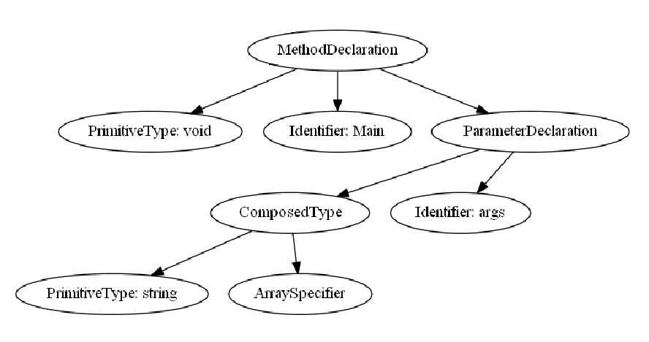
3.2. Translation process II
Composed Identifier
Fig. 7: AST conversions from C# to C++
void Main(string[] args){}
void Main(string args[]){}

Slide 17
3.3. IOSharp C++
IOSharp is translated using AlterNative
AlterNative System Library replaces Mono runtime
Fig. 8: NETMF, IOSharp and IOSharp C++ Stacks

Slide 18
3.4. Example
AlterNative with the ILSpy interface
Translating the GPIOManager from IOSharp library

Slide 19
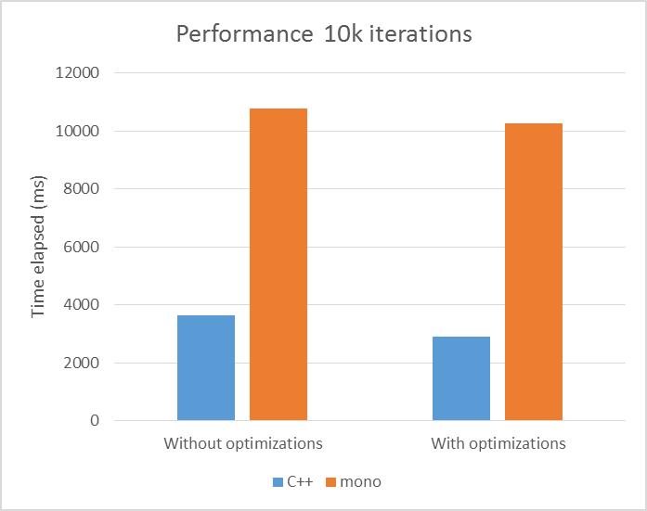
4. Performance Test
Evaluate the increased performance using AlterNative
Fig. 9: Graph showing the speedup of the C++ version in front of the Mono one. 62% of gain.

Slide 20
4.1. Example
Performance test using the10K GPIO iterations
Fig. 10: Time comparison between Mono and C++ in 10K iterations of an Output Port

Slide 21
5. Conclusions
IOSharp implementation supports
GPIO with Interrupts
SPI
UART
AlterNative part shows
Performance improvement

Slide 22
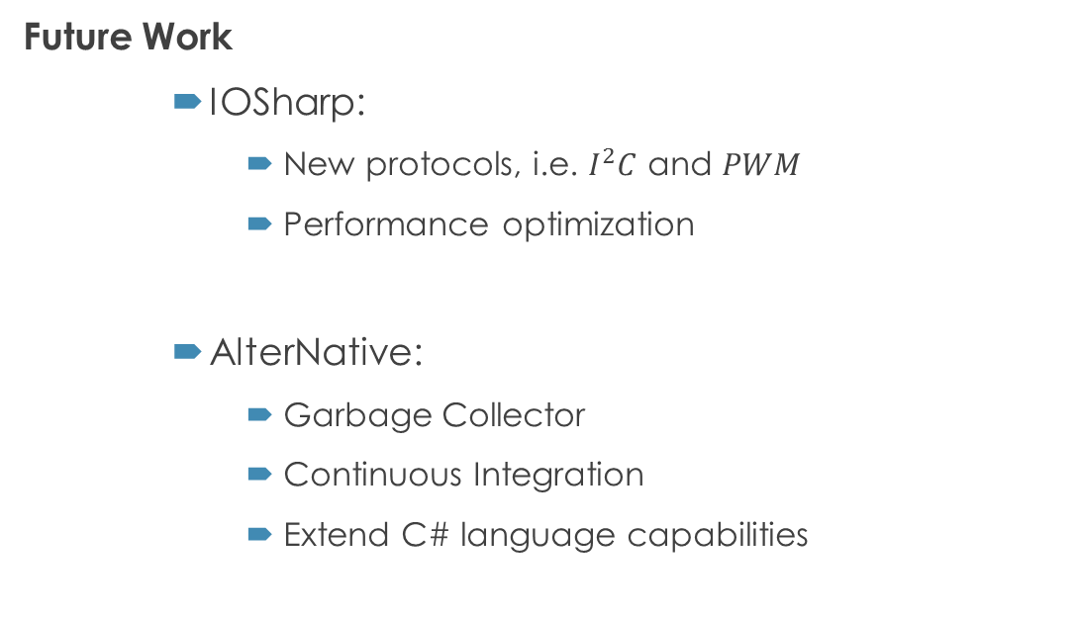
5. Conclusions II
Future Work
IOSharp:
New protocols, i.e. $I^{2}C$ and $PWM$
Performance optimization
AlterNative:
Garbage Collector
Continuous Integration
Extend C# language capabilities

Slide 23
6. Questions & Answers
Questions are guaranteed in life – Answers aren’t

