Slide 1
IOSharp: .NET Micro Framework on Linux
AUTHOR: Gerard Solé i Castellví
DIRECTOR: Juan López Rúbio
DEGREE: Bachelor in Telematics Engineering

Slide 2
Index
1. Introduction
1.1. .NET Micro Framework
2. IOSharp
2.1. GPIO
2.2. Interrupts
2.3. SPI
2.4. UART
3. AlterNative
3.1. Translation process
3.2. Example
4. Performance Test
4.1. Example
5. Conclusions
6. Questions & Answers

Slide 3
1. Introduction
Power increase from 8 to 32 bits on microprocessors
Cost reduction on hardware production
Increasing usage of Linux in embedded systems
Cross-Platform source code generation
Performance increase on translation

Slide 4
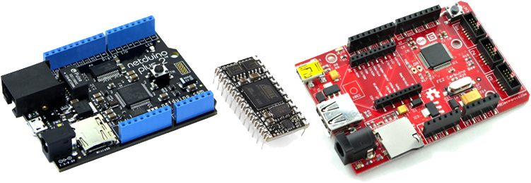
1.1. .NET Micro Framework
Virtual Machine running on the bare metal
Designed for resource-constrained devices
Multiple I/O Ports and Protocols

Slide 5

2. IOSharp
NETMF implementation on a High-Level basis
C# with Mono on Linux
C library for interfacing with communication protocols
Cross-Platform → Board independent
Required an underlying Linux
Download at
https://github.com/GerardSoleCa/IOSharp-netmf-Linux

Slide 6
2. IOSharp II

Slide 7
2.1. GPIO
I/O Ports are controlled through the file system
SYSFS → /sys/class/gpio/

Slide 8
2.2. Interrupts
Polling from a GPIO using the Poll function
P/Invokes required for cross-language calls

Slide 9
2.3. SPI

Slide 10
2.4. UART

Slide 11
3. AlterNative

Slide 12
3.1. Translation process

Slide 13
3.2. Example

Slide 14
4. Performance Test

Slide 15
4.1. Example

Slide 16
5. Conclusions

Slide 17
6. Questions & Answers

