Slide 1
IOSharp: .NET Micro Framework on Linux
AUTHOR: Gerard Solé i Castellví
DIRECTOR: Juan López Rúbio
DEGREE: Bachelor in Telematics Engineering

Slide 2
Index
1. Introduction 3
1.1. .NET Micro Framework 4
2. IOSharp 5
2.1. GPIO 7
2.2. Interrupts 8
2.3. SPI 9
2.4. UART 10
2.5. Example 11
3. AlterNative 12
3.1. Translation process 13
3.2. IOSharp C++ 15
3.3. Example 16
4. Performance Test 17
4.1. Example 18
5. Conclusions 19
6. Questions & Answers 22

Slide 3
1. Introduction
Power increase from 8 to 32 bits on microprocessors
Cost reduction on hardware production
Increasing usage of Linux in embedded devices
Cross-Platform source code generation
Performance increase on translation

Slide 4
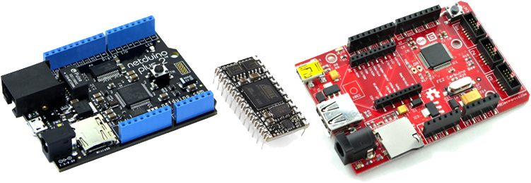
1.1. .NET Micro Framework
Virtual Machine running on the bare metal
Designed for resource-constrained devices
Multiple I/O Ports and Protocols

Slide 5

2. IOSharp
NETMF implementation on a High-Level basis
C# with Mono on Linux
C library for interfacing with communication protocols
Cross-Platform → Board independent
Required an underlying Linux
Download at
https://github.com/GerardSoleCa/IOSharp-netmf-Linux

Slide 6
2. IOSharp II

Slide 7
2.1. GPIO
I/O Ports are controlled and enabled or disabled through the file system
SYSFS → /sys/class/gpio/
Direction
State

Slide 8
2.2. Interrupts
Polling from a GPIO using the Poll function
P/Invokes are required for cross-language calls

Slide 9
2.3. SPI
Implemented using the provided Linux Kernel function
Included on IOSharp-C library
P/Invoked from C#

Slide 10
2.4. UART
NETMF and .NET Framework where compared
Same namespace → System.IO.Ports
Required methods for HomeSense in both implementations
Avoided a new reimplementation.
IOSharp relays on Mono Serial Port (UART)

Slide 11
2.5. Example
Video showing HomeSense on Raspberry Pi

Slide 12
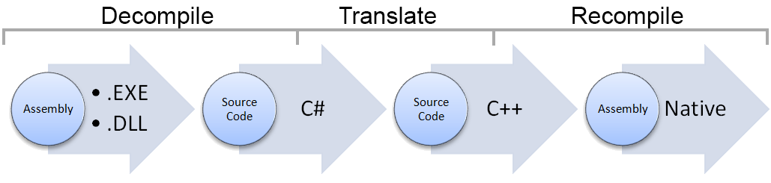
3. AlterNative
Source code translator written in C#
Translate a .NET Assembly to native C++
Use cases:
Performance
Cross-Platform assembly generator

Slide 13
3.1. Translation process
void Main(string[] args){}
void Main(String args[]){}

Slide 14
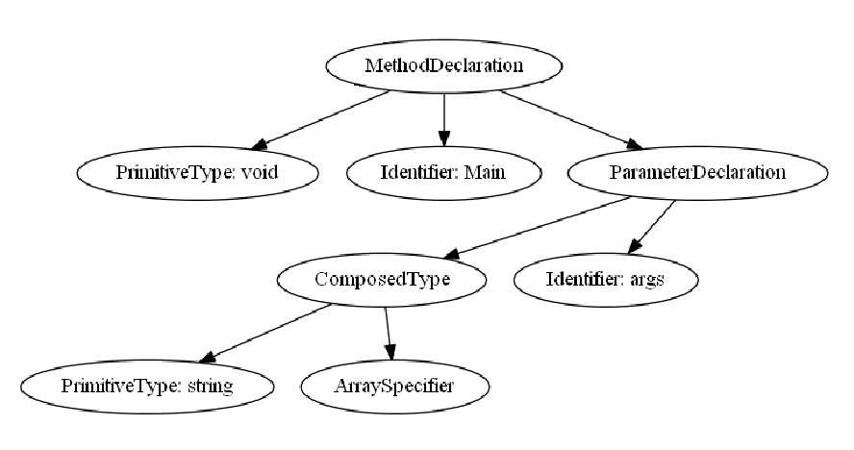
3.1. Translation process II
Composed Identifier
void Main(string[] args){}
void Main(string args[]){}

Slide 15
3.2. IOSharp C++
IOSharp is translated using AlterNative
AlterNative System Library replaces Mono runtime

Slide 16
3.3. Example
AlterNative with the ILSpy interface
Translating the GPIOManager from IOSharp library

Slide 17
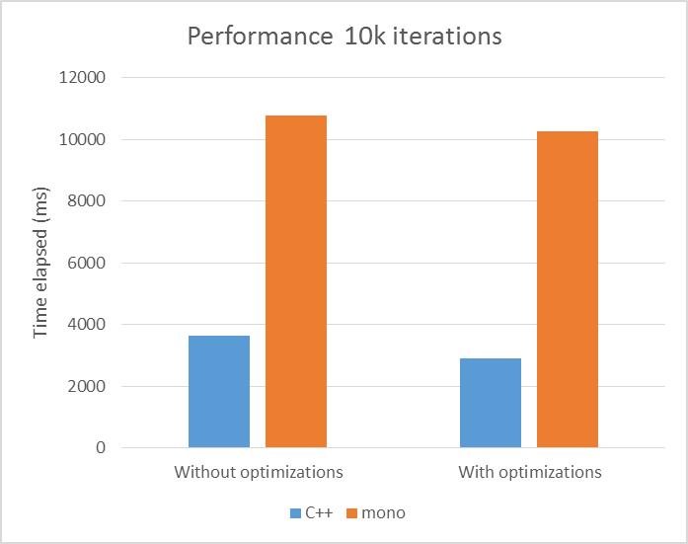
4. Performance Test
Evaluate the increased performance using AlterNative

Slide 18
4.1. Example
Performance test using the10K GPIO iterations

Slide 19
5. Conclusions
IOSharp implementation supports
GPIO with Interrupts
SPI
UART
AlterNative part shows
Improvement on IOSharp performance
Cross-Platform with

Slide 20
5. Conclusions II
Future Work
IOSharp:
Add new protocols
Performance optimization
AlterNative:
Garbage Collector
Continuous Integration
Extend capabilities

Slide 21
5. Conclusions III
Environmental Impact
IOSharp:
Add new protocols
Performance optimization
AlterNative:
Garbage Collector
Continuous Integration
Extend capabilities

Slide 22
6. Questions & Answers
Questions are guaranteed in life – Answers aren’t

