Slide 1
IOSharp: .NET Micro Framework on Linux
AUTHOR: Gerard Solé i Castellví
DIRECTOR: Juan López Rúbio
DEGREE: Bachelor in Telematics Engineering
Notes:
Molt bo el format

Slide 2
Index
1. Introduction 3
1.1. .NET Micro Framework 4
2. IOSharp 5
2.1. GPIO 7
2.2. Interrupts 8
2.3. SPI 9
2.4. UART 10
2.5. Example 11
3. AlterNative 12
3.1. Translation process 13
3.2. IOSharp C++ 15
3.3. Example 16
4. Performance Test 17
4.1. Example 18
5. Conclusions 19
6. Questions & Answers 22

Slide 3
1. Introduction
Power increase from 8 to 32 bits on microprocessors
Cost reduction on hardware production
Increasing usage of Linux in embedded devices
Cross-Platform source code generation
Performance increase on translation
Notes:
Ho separaria en 2 :
1- Els 3 primers punts amb una grafica de nombre d’embedded per any o similar -> per justificar que cada vegada els embedded tenen mes potencia. => Exemple: Cas real: Gateway HomeSense => Gateway HomeSense amb Raspberry PI ( i poso les dues fotos)
2 – Objectius del projecte
- Aqui anirien els 2 punts següents.
- Que vols fer al projecte? Potser la mateixa llista de la memoria. Per basicament son 2 coses:
- poder fer servir el codi .NETMF de baix nivell (ports d’IO) en un embedded Linux
- optimitzar el codi resultant amb un mecanisme de traduccio de codi per millorar el rendiment

Slide 4
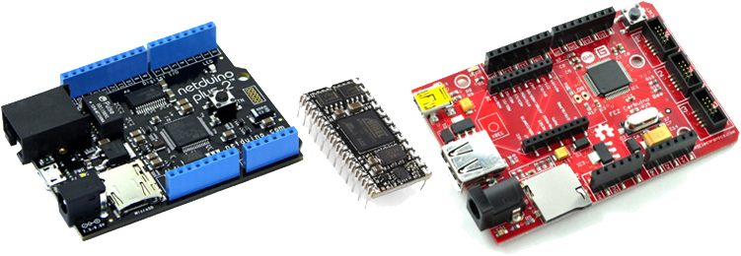
1.1. .NET Micro Framework
Virtual Machine running on the bare metal
Designed for resource-constrained devices
Multiple I/O Ports and Protocols
Notes:
Ok.
- Potser afegiria que fan servir el mateix form factor que Arduino (o ho diria de paraula)

Slide 5

2. IOSharp
NETMF implementation on a High-Level basis
C# with Mono on Linux
C library for interfacing with communication protocols
Cross-Platform → Board independent
Required an underlying Linux
Download at
https://github.com/GerardSoleCa/IOSharp-netmf-Linux
Notes:
Aquesta aquí no la veig clara
Si vols justificar el perque d’IO# potser es millor el diagrama de blocs on es vegi que coses te NETMF i quines fa NET/Mono i veure les peces que tu afegeixes

Slide 6
2. IOSharp II
Notes:
Aquí el que et deia, en aquesta es bona pero posaria al costat quina pinta fa al NETMF

Slide 7
2.1. GPIO
I/O Ports are controlled and enabled or disabled through the file system
SYSFS → /sys/class/gpio/
Direction
State
Notes:
Que es un port de GPIO?

Slide 8
2.2. Interrupts
Polling from a GPIO using the Poll function
P/Invokes are required for cross-language calls
Notes:
Ok!

Slide 9
2.3. SPI
Implemented using the provided Linux Kernel function
Included on IOSharp-C library
P/Invoked from C#
Notes:
Ok

Slide 10
2.4. UART
NETMF and .NET Framework where compared
Same namespace → System.IO.Ports
Required methods for HomeSense in both implementations
Avoided a new reimplementation.
IOSharp relays on Mono Serial Port (UART)
Notes:
OK
(aquí es on començo a “demanar” la 2º transparencia del principi on es veien els objectius… ara vas tancant els diferents ports que formen part del primer “objectiu gran” de fer que funcioni .NETMF a .NET/Mono en Linux)

Slide 11
2.5. Example
Video showing HomeSense on Raspberry Pi
Notes:
Ok
- Com de dolents son els resultats?

Slide 12
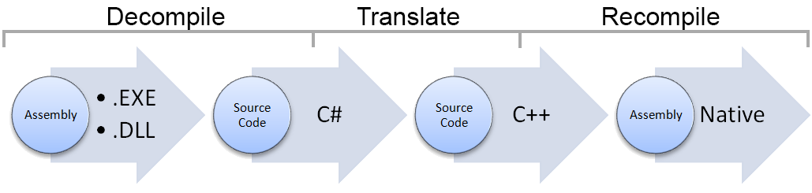
3. AlterNative
Source code translator written in C#
Translate a .NET Assembly to native C++
Use cases:
Performance
Cross-Platform assembly generator
Notes:
Jo a uses cases canviaria cross-platform “assemby generation” per cross-platform development

Slide 13
3.1. Translation process
void Main(string[] args){}
void Main(String args[]){}
Notes:
Potser valdria la pena posar un tros d’exemple mes gran (5 o 6 linies).
I despres marques la linia 1ª per explicar el seu AST mes a fons

Slide 14
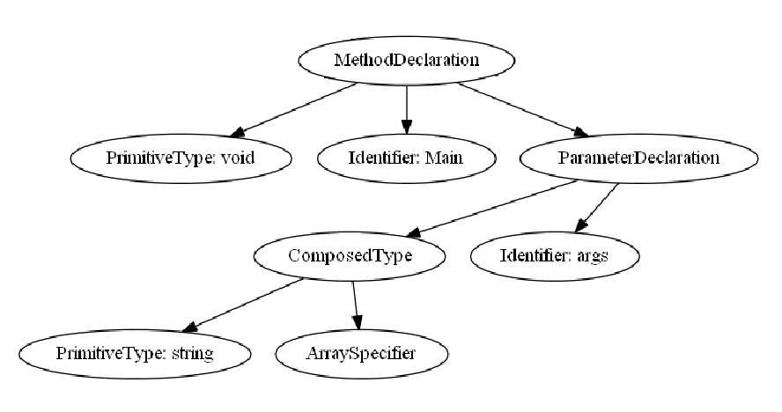
3.1. Translation process II
Composed Identifier
void Main(string[] args){}
void Main(string args[]){}
Notes:
Ok

Slide 15
3.2. IOSharp C++
IOSharp is translated using AlterNative
AlterNative System Library replaces Mono runtime
Notes:
Ok!
- La figura que no m’agrada al principi hauria de ser un mix entre la que ja tens alla i les dues de l’esquerra aquí.

Slide 16
3.3. Example
AlterNative with the ILSpy interface
Translating the GPIOManager from IOSharp library
Notes:
Ho faras en temps real?
En algun punt estaria be, remarcar que has fet TU d’AlterNative (igual que a la memoria)

Slide 17
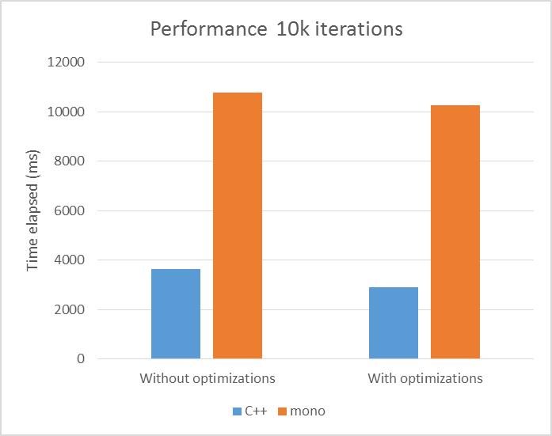
4. Performance Test
Evaluate the increased performance using AlterNative
Notes:
- Quin % de speedup conseguim?

Slide 18
4.1. Example
Performance test using the10K GPIO iterations
Notes:
- Ho faras en temps real o val la pena posar alguna foto?

Slide 19
5. Conclusions
IOSharp implementation supports
GPIO with Interrupts
SPI
UART
AlterNative part shows
Improvement on IOSharp performance
Cross-Platform with
Notes:
Si fas la llista d’objectius al principi (com la de la memoria) la podries posar aquí “ampliada” es a dir posar una linia mes a cada punt dient que s’ha fet en el punt concret.

Slide 20
5. Conclusions II
Future Work
IOSharp:
Add new protocols
Performance optimization
AlterNative:
Garbage Collector
Continuous Integration
Extend capabilities
Notes:
Canviara “new protocols” per “new serial port protocols, ie. I2c
Canviara “extend capabilities” per “extend C# language capabilities”

Slide 21
5. Conclusions III
Environmental Impact
IOSharp:
Add new protocols
Performance optimization
AlterNative:
Garbage Collector
Continuous Integration
Extend capabilities
Notes:
No se si te sentit dedicar una sencera al environmental impact

Slide 22
6. Questions & Answers
Questions are guaranteed in life – Answers aren’t

