Slide 1
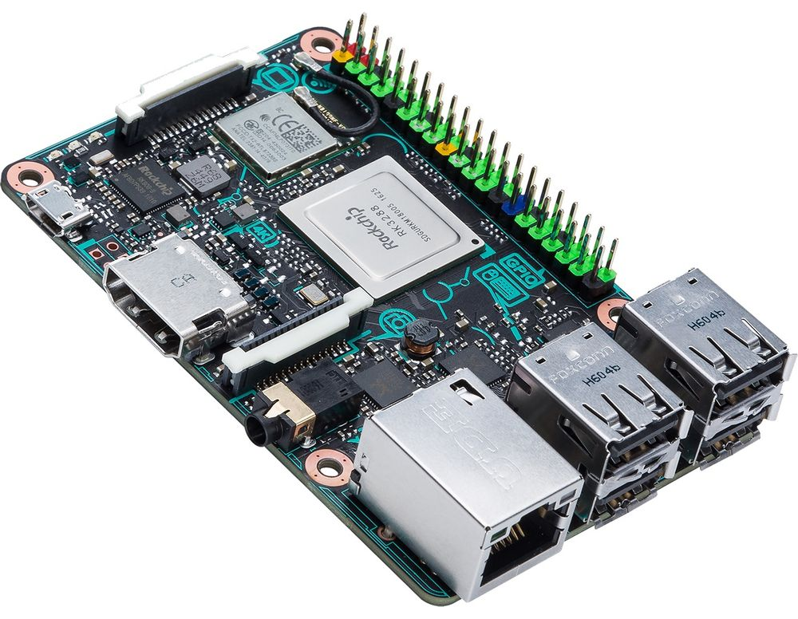
Single Board Computers
Heterogeneous platform
Multicore CPU and GPU
Eg : Asus Tinkerboard = 4 core CPU at 1.8 GHz, 6 core GPU at 0.6 GHz, 4GB RAM
Commonly found in entry level notebooks

Slide 2
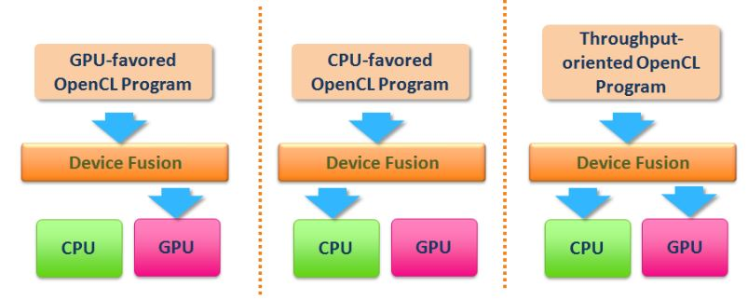
Single Board Computers
Support common Linux distros
  Common libraries (OpenCV) readily availabe
  Develop directly on device, common compilers and debuggers (g++ w/ gdb)
Support heterogeneous programming frameworks
  OpenCL full profile (compiler support)
Can utilize CPU and GPU to accelerate Computer Vision tasks

Slide 3
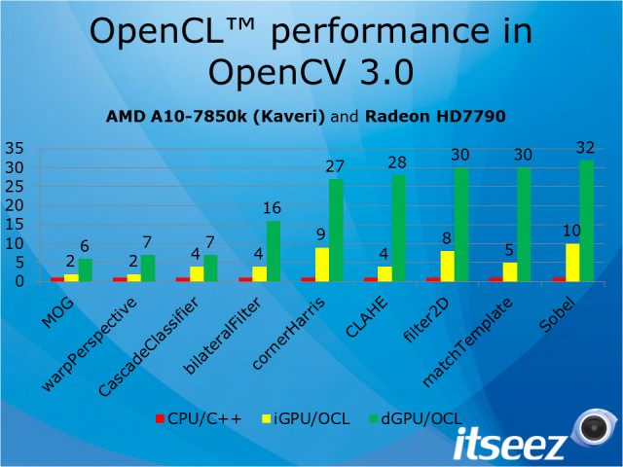
Single Board Computers
Case study – OpenCV library
  Enable heterogeneous processing with OpenCL API in OpenCV
  Drawbacks
    OpenCL is not performance portable
    Functions were developed for desktop hardware (written for scalar architecture not vector architecture)
      Functions with OpenCL support may run slower on mobile GPU than mobile CPU
    Synchronous – make function call into OpenCL API and wait for results
      Many suboptimal memory transfers between CPU and GPU
      CPU is idle

Slide 4
Single Board Computers
Case study – OpenCV library
  Successful optimizations (ARM hardware)
    NEON – SIMD (Single Instruction Multiple Data)
    VFPV3 – Floating Point acceleration
  Can realize ~30% decrease in processing time
    Depending on function

