Slide 1
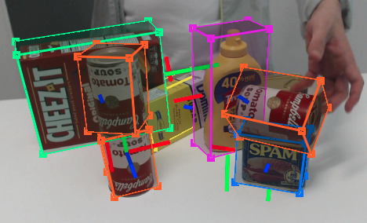
6 DOF pose estimation
Dataset of 3D CAD models
RGB/RGB-D/PCD input
  Trade-off of speed vs accuracy
Estimate 6 DOF
  Translation & Rotation

Slide 2
6 DOF pose estimation
Differs to generic object tracking – CAD model is known
Two fundamental approaches
  Tracking by detection : Slower, more accurate
  Detection + Temporal tracking : Faster, less accurate

Slide 3
6 DOF pose estimation
Neural Networks (Convolution + Fully connected)
  Most common
Classical Machine learning Classifier (ie Random forest)
  Not commonly used, still effective
In need of benchmark
  2018 ECCV : BOP Benchmark
    Datasets
    Measures
    Grouping of methods

