Slide 1
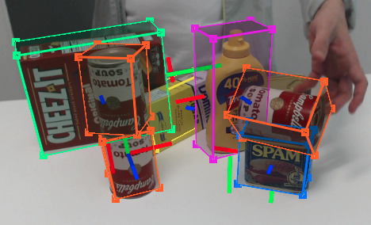
6 DOF pose estimation
Implementation of poseCNN

Slide 2
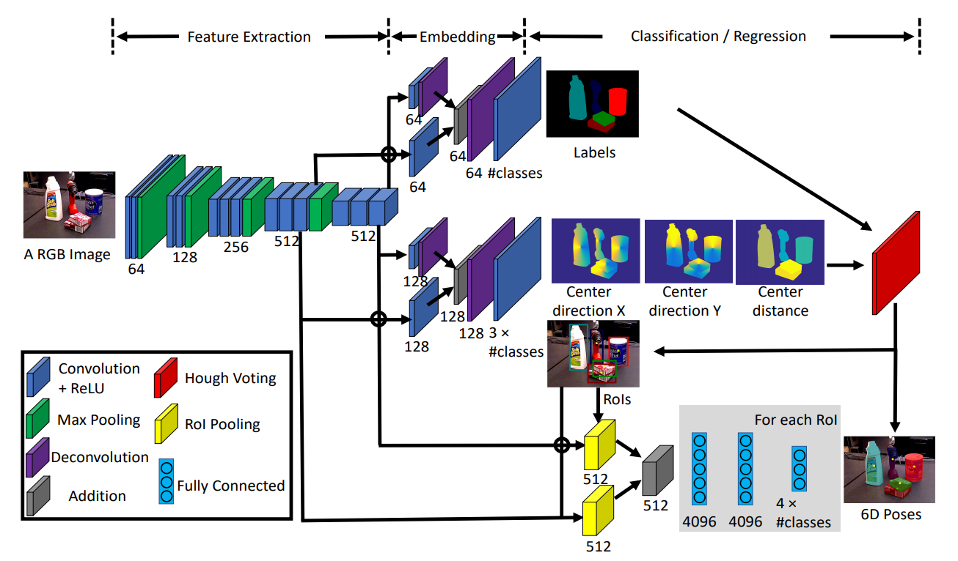
6 DOF pose estimation

Slide 3
6 DOF pose estimation
Feature maps used at various levels
Similar functions as object detection

Slide 4
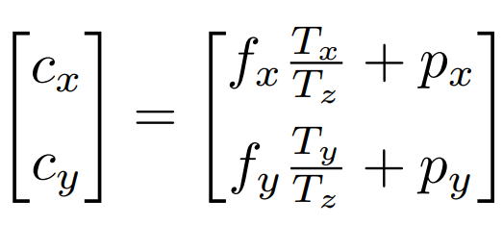
6 DOF pose estimation
Semantic labeling
Center estimation
Rotation estimation
  ROI
  Fully connected layers

Slide 5
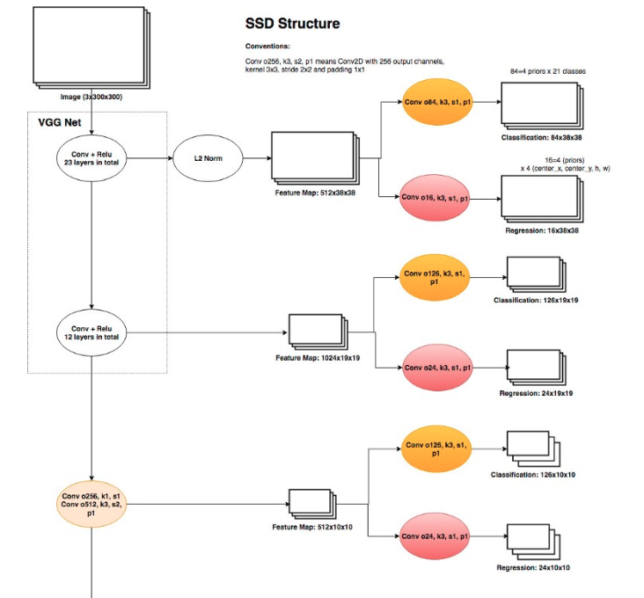
Next week
C++/OpenCV implementation of YoloV3
  Singular task
  Feature maps depths

