Slide 1
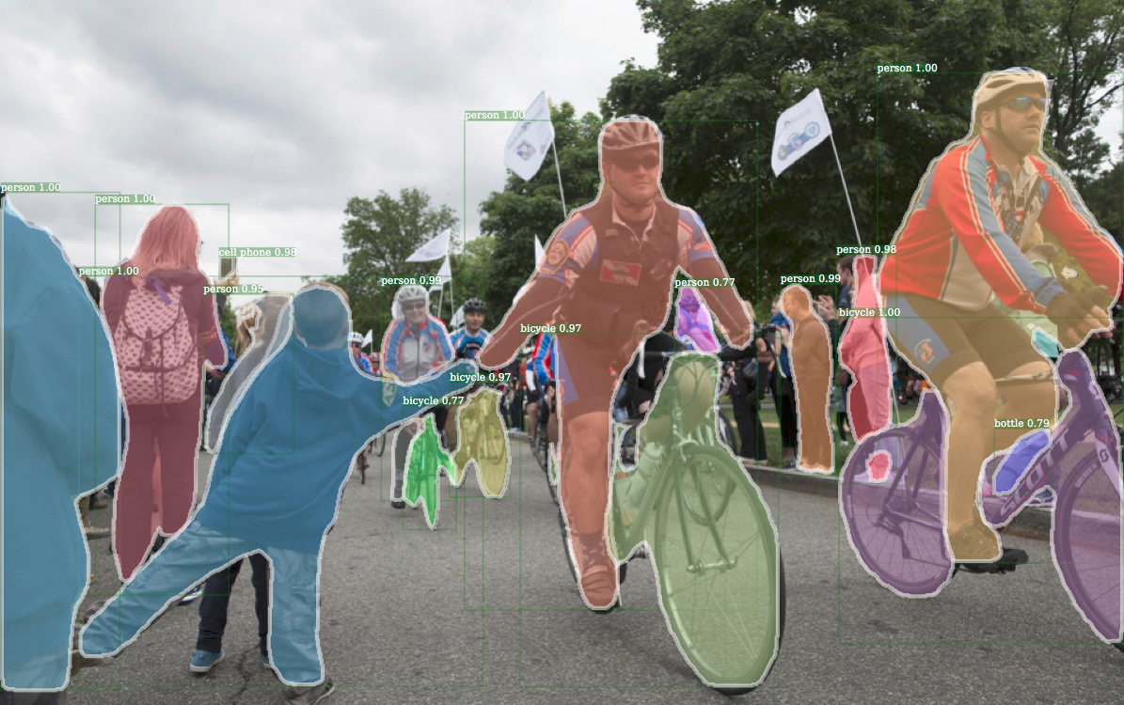
Instance segmentation
Not only object detection, classification, location but also pixel-wise segmentation
Pixels of object used for point-cloud processing (fusion), CAD alignment
Richer output than object detection (bounding box of object instance)
  More computationally expensive - Mask R-CNN adds object mask step in parallel, small added overhead
  Can detect human pose
Mask R-CNN (Facebook AI research)

Slide 2
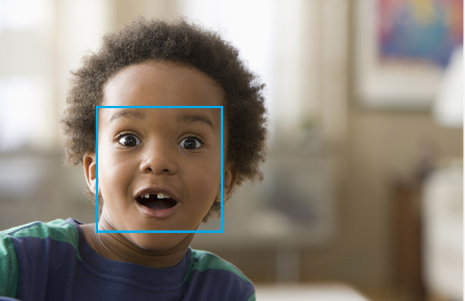
Emotion recognition
Visual based
  Similar challenges and construction to image classification & detection problems
  Feature extraction, classification
Audio based
  Audio signal processing, FFT
  Audio signal representation as oscillogram/spectogram – image processing

Slide 3
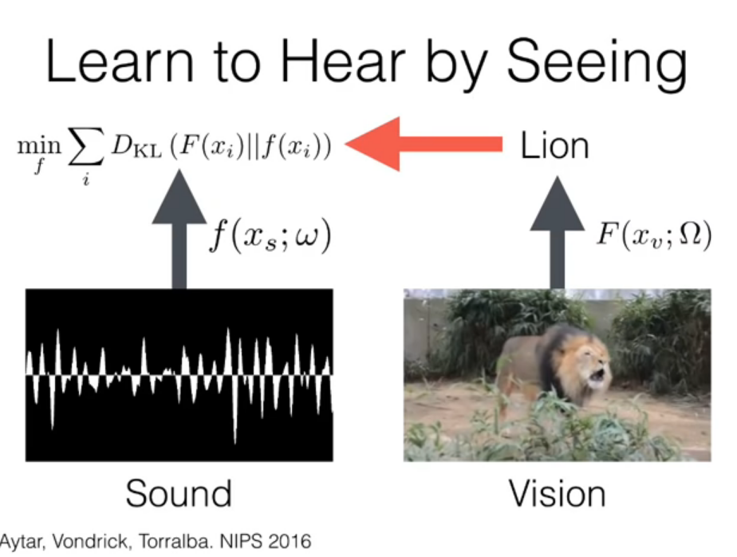
Emotion recognition
Video
  Difficult to generate labeled dataset for sound – solution is video data
Teaching audio learner to hear via image teacher

