Slide 1
Containerization & version control

Slide 2





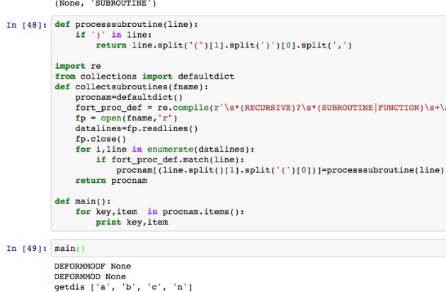

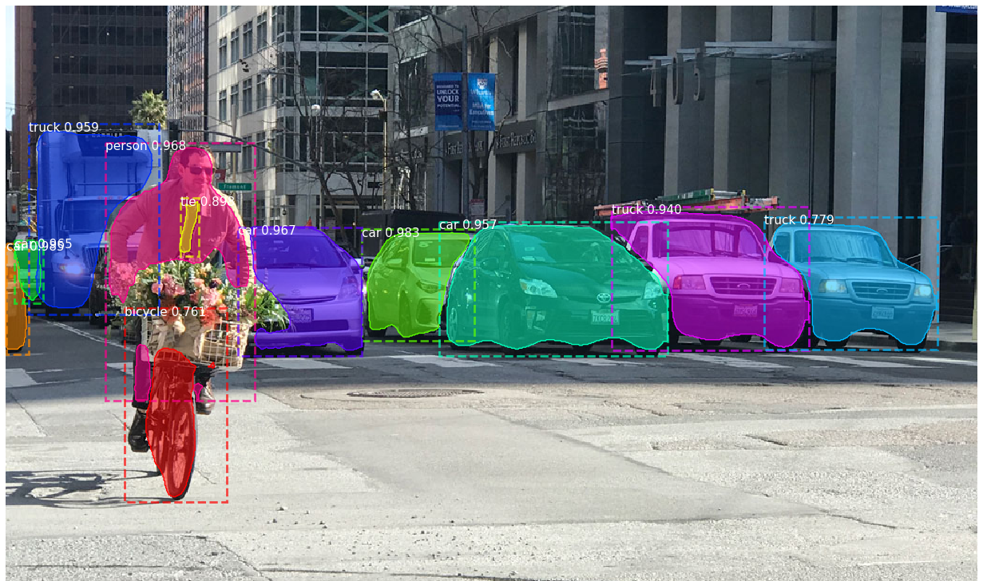
Problem: version control and deployment
9.3
3.5
1.8
1.0.9
+
Notes:
<number>

Slide 3
Problem
Testing of algorithms is a complicated process
Requires extensive installation/building from source - time consuming/problematic
Also problematic due to multiple version of same package on testing computer causing issues
Once environment has been built and algorithm tested -> to utilize on another computer process must be repeated
Error prone
Documenting an installation process only useful when instructions/dependencies remain current
Interdependencies change vastly
Notes:
<number>

Slide 4
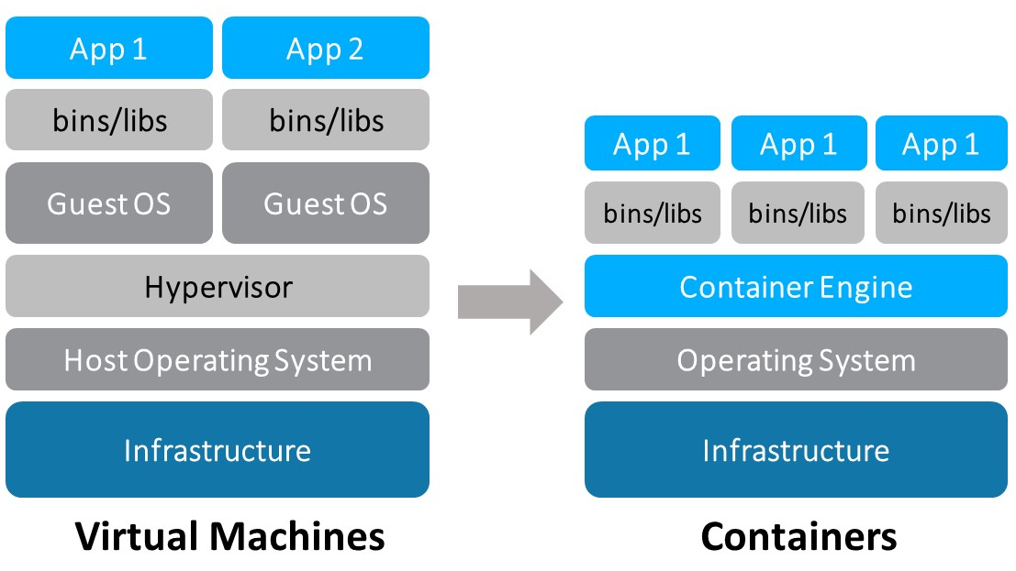
Docker
Containerized
Self-contained (libraries, packages etc) – no further installation required
Enables robust deployment
Lightweight compared to VM
OS independent
Only requires Docker engine on host
(& NVIDIA driver for GPU acceleration)
Enables deployment flexibility
Notes:
<number>

Slide 5
Docker
Allows rapid testing of algorithms
‘Pull’ prebuilt images with required packages & deploy algorithm in scenario of interest
Keeps testing computer clean, minimizes clutter
Containerized
Once ‘image’ is built, can be deployed as a ‘container’ indefinitely – no maintenance
Can deploy many instances of the same image on one or many hosts
Can build independent system components with individual defined behaviour
Perception system: Independent subsystems & individual outputs interpreted by high-level management system
Detection system
Tracking system and localization system
Pose estimation system
Notes:
<number>

Slide 6
Docker
Host interaction
Access sensors
‘--device=/dev/video0’ – passes default video capturing device to docker container
File system
Volumes: Defines directory shared between host and container, or between containers
-v /home/user/directoryOnHost:/directoryInContainer
Container can either deployed/function in many ways
CLI
Having fixed functionality: using ‘CMD’ in Dockerfile, i.e. captures sensor data, processes data and returns output on deployment
Notes:
<number>

Slide 7
Docker
Example implementation
Pull lightweight Ubuntu 16.04 OS base image
Add packages for video codecs, I/O & compiling tools with standard packet manager (apt-get)
Build OpenCV (3.4) with Cmake
Clone a repository and compile object detection application (using g++ )
Run container with a volume mounted
When container is launched, container searches host for specific directory with images to classify. Output is saved to host
Or
Run container with a volume mounted & video input
When container is launched, video input is classified and alert is made when certain detection is made and saved to host
Defined in Dockerfile
used to build image
Notes:
<number>

