Slide 1
MMF1927H · WORKSHOP IN MATHEMATICAL FINANCE
Currency Skew as a
Cross-Asset Equity
Signal
A regional equity-rotation pipeline built on FX option skew, market momentum, and tradable execution timing.
FINAL GROUP PROJECT · 31 JULY 2026
ASSETS
SPY · United States
EZU · Eurozone
EWJ · Japan
Alex Khadra · Matthew Antoniuk · Gerard Wu
SPY · EZU · EWJ
github.com/GerardWu100/geographic-equity-rotation
Notes:
Open with the one-line thesis: FX options skew is a market price for directional currency demand; we test whether it helps rotate among U.S., Eurozone, and Japanese equities. Final presentation version using the latest StrategyPipeline results.

Slide 2
THE QUESTION
What We Set Out to Test
Does the price of currency optionality tell us where regional equities go next?
1
Build
2
Validate
3
Result
Bloomberg panel → regional features → per-ETF Ridge models → simple top-two allocation.
Remove duplicated closed-market rows, use tradable next-close timing, and purge overlapping labels.
The signal is real but modest; the strategy compounds, yet SPY-only still wins.
TAKEAWAY A clean negative-to-neutral result is the point: evidence first, benchmark claims second.
MMF1927H · Final Group Project · 31 July 2026
2 / 17
Notes:
Frame the deck as a disciplined test, not a marketing pitch. The allocation section focuses on one simple rule rather than a large hyperparameter search.

Slide 3
SOURCE · DAY 1
Data & Provenance
Two Bloomberg extracts become one valid-session panel.
EQUITY ETFS
VOLATILITY
FX SKEW
WINDOW
SPY · EZU · EWJ
VIX · V2X
EURUSD · USDJPY · EURJPY
2012-02-27 → 2026-07-28
PX_LAST, PX_MID, PX_VOLUME
NKYVF excluded until verified
25Δ, 1M risk reversals
3,625 valid market sessions
137
3,625
2,954
9 / 9 / 6
copied rows removed
valid observations
prediction decisions
features: SPY / EZU / EWJ
TAKEAWAY The result is about three liquid regional ETFs; it is not a proof across a broad universe.
MMF1927H · Final Group Project · 31 July 2026
3 / 17
Notes:
Provenance discipline: raw extracts remain untouched; the valid-session panel reflects removal of copied closed-market rows. Raw extracts are read, not overwritten; transformations live in code.

Slide 4
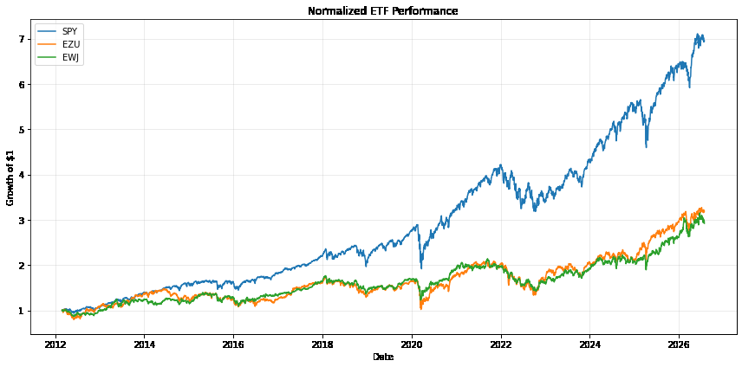
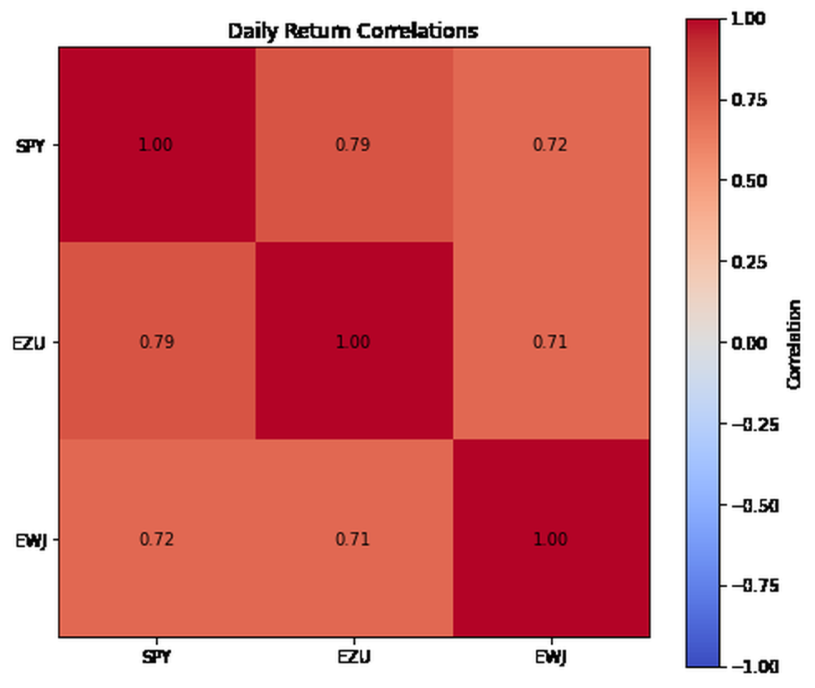
EXPLORATORY ANALYSIS
Three Regions, One Correlated Complex
SPY dominates the sample, but correlations still leave diversification room.
CUMULATIVE PERFORMANCE
DAILY RETURN CORRELATION
SPY
0.71–0.79
strongest standalone benchmark
daily correlations
TAKEAWAY Beating diversified benchmarks is easier here than beating the best single asset.
MMF1927H · Final Group Project · 31 July 2026
4 / 17
Notes:
Use this as context only. SPY dominance makes the benchmark bar very high. Daily correlations leave diversification room but collapse upward in stress periods.

Slide 5
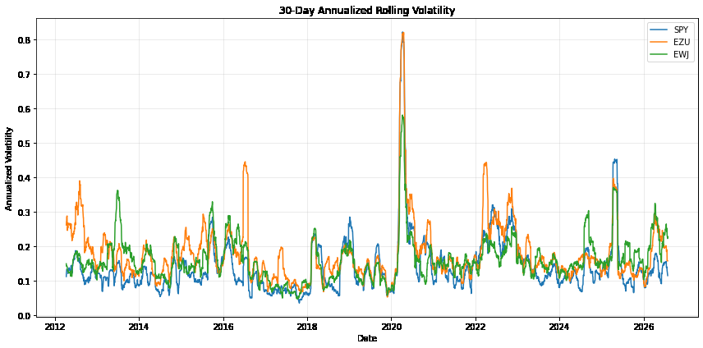
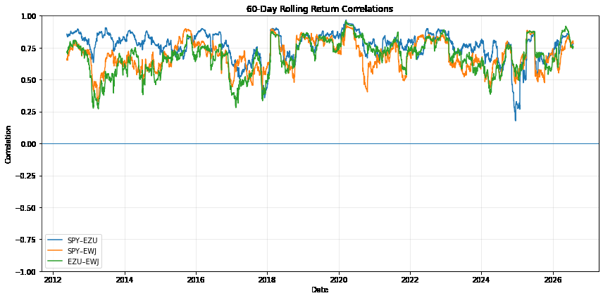
EXPLORATORY ANALYSIS
Regimes Move — Risk Estimates Must Move Too
Volatility and cross-region correlation are strongly non-stationary.
• Volatility spikes around crisis periods.
• Pairwise correlations range from diversifying to nearly one.
• The portfolio layer therefore re-estimates risk instead of assuming one static covariance.
TAKEAWAY Non-stationarity is why validation must be walk-forward and risk must be re-estimated.
MMF1927H · Final Group Project · 31 July 2026
5 / 17
Notes:
This slide justifies rolling risk estimates and walk-forward validation. Point out that diversification is needed most when it often works least.

Slide 6
FEATURE · DAY 3
The Core Idea: Skew as Currency Demand
A risk reversal is a price for asymmetric currency protection, not just a volatility level.
25Δ risk reversal = IV(25Δ call) − IV(25Δ put)
Sign correction
Each ETF sees “positive” the same way: demand for its own local currency.
Positive = market pays more for upside in the base currency.
SPY
EURUSD −
USDJPY +
EZU
EURUSD +
EURJPY +
EWJ
USDJPY −
EURJPY −
TAKEAWAY The signal is a relative-demand read across currencies, not a single FX spot bet.
MMF1927H · Final Group Project · 31 July 2026
6 / 17
Notes:
Spend time here: this is the creative core of the project. Acknowledge that we did not test spot FX returns as a control; that is a limitation.

Slide 7
FEATURE · DAY 3
Feature Inventory — Keep the Economic Logic
We diagnosed broader feature families, then modelled a smaller defensible set.
MOMENTUM
20d and 60d return
9
9
TREND
price vs. 50d moving average
SPY features
EZU features
VOLUME
relative volume and change
6
Japan volatility inputs were removed rather than repaired.
CURRENCY DEMAND
two sign-corrected FX risk reversals
EWJ features
VOLATILITY
VIX/V2X only; Japan vol excluded
Forward target: 20 valid-session return, built by shifting price backward.
TAKEAWAY A compact feature set makes the final model easier to defend than a wider, noisier design.
MMF1927H · Final Group Project · 31 July 2026
7 / 17
Notes:
The NKYVF data-quality issue is folded into the feature-design discussion. Be clear: dropping NKYVF reduces feature count for EWJ and keeps the model honest.

Slide 8
EXECUTION DESIGN
A Tradable Target and a Real Purge
The target is filled at the next valid close, not the just-observed close.
t close
next close
+20 sessions
purge
features known
weights filled
return measured
21 sessions removed
21
prevents overlapping train/test labels
5
expanding-window validation
4
SPY/EZU plus FX pairs and prices
session purge
walk-forward folds
assets with clean risk inputs
TAKEAWAY The purge is the detail to defend: a 20-session target leaks unless the boundary is cleared.
MMF1927H · Final Group Project · 31 July 2026
8 / 17
Notes:
Explain the timeline slowly. The target is designed so the trade happens at the next valid close. The 21-session purge covers the target horizon plus the next-close execution lag.

Slide 9
MODEL · DAY 4
One Regularized Linear Model per Region
Ridge regression deliberately shrinks noisy coefficients rather than fitting a flexible black box.
Standardize
Ridge
Predict
Rank
fit scaler inside fold
40 alphas; time-series CV
20-session return
cross-region signal
Why Ridge?
~3k rows, collinear features, low signal-to-noise, and coefficients we can explain.
Leakage controls
Scaler, alpha search, and coefficients refit inside every fold. Nothing is fit once on the full sample.
TAKEAWAY The model is intentionally humble: regularization is a guardrail, not a performance trick.
MMF1927H · Final Group Project · 31 July 2026
9 / 17
Notes:
Ridge means linear regression with a penalty that shrinks coefficients toward zero. Avoid claiming sophisticated machine learning. The strength is the validation design.

Slide 10
OUT-OF-SAMPLE EVIDENCE
Walk-Forward Rank Information Coefficient
Spearman rank correlation between predicted and realized 20-session returns.
14/15
Good breadth, but not stable enough to oversell.
positive fold-region pairs
COVID
May be partly a crisis-beta proxy.
strongest fold
EWJ is weakest; this matters because it remains a large portfolio tilt later.
TAKEAWAY The signal is positive on average, but regime dispersion is as important as the mean.
MMF1927H · Final Group Project · 31 July 2026
10 / 17
Notes:
Rank information coefficient means Spearman correlation between the model ranking and the realized return ranking. Do not overstate this: fold dispersion is large, and the COVID fold contributes heavily.

Slide 11
PORTFOLIO CONSTRUCTION
From Three Predictions to One Portfolio
Predicted returns are noisy, so the corrected rule uses ranks and risk scaling.
1
Forecast ranks
2
Top two
3
Risk scale
4
Cash sleeve
Use ordering, not noisy magnitude.
Hold highest-ranked ETFs 50/50.
Target 12% annual volatility.
Uninvested capital earns 0%.
ETF | Train R² | Test R²
SPY | 0.076 | 0.021
EZU | 0.059 | −0.021
EWJ | 0.051 | −0.014
Test R² is near zero or negative → do not trust forecast levels.
20
5 bps
20%
17.7%
session rebalance
cost per ETF side
risk shrinkage
average cash
MMF1927H · Final Group Project · 31 July 2026
11 / 17
Notes:
This allocation rule is less exciting than a large search, but much cleaner. The rule converts forecasts into ranks because expected-return magnitudes are unstable.

Slide 12
RESULTS
Backtest Performance, Net of Costs
2014-09-26 to 2026-06-08; same execution and cost assumptions across strategies.
0.689
7.75%
strategy Sharpe
strategy CAGR
0.985
13.94%
SPY Sharpe
SPY CAGR
Positive compounding, but not a benchmark win.
TAKEAWAY The benchmark comparison is strict: SPY-only remains the clean winner.
MMF1927H · Final Group Project · 31 July 2026
12 / 17
Notes:
These numbers come from the latest StrategyPipeline notebook. The strategy does not fail as a research result; it fails as a standalone benchmark-beating trade.

Slide 13
RESULTS
Risk Targeting Lowered Volatility, Not Enough Return
Compare the same top-two selection before and after the 12% volatility target.
−2.95
points of annualized volatility
−0.29
points of drawdown improvement
Sharpe declined from 0.819 to 0.689 after scaling.
TAKEAWAY Risk targeting controlled exposure, but did not improve the final return-risk trade-off.
MMF1927H · Final Group Project · 31 July 2026
13 / 17
Notes:
This prevents the audience from confusing risk management with alpha generation. Scaling can lower volatility while still lowering Sharpe if the cash drag is too high or timing is weak.

Slide 14
ROBUSTNESS
Does the Result Depend on One Rebalance Phase?
The fixed risk-managed strategy was re-run from all 20 possible starting offsets.
Risk-managed top-two across 20 offsets
What this answers
7.07%
8.08%
8.66%
• Not just one lucky rebalance date.
• Still not an untouched future sample.
• Useful robustness, not a final proof.
minimum CAGR
median CAGR
maximum CAGR
Sharpe range: 0.596 to 0.805. Drawdown range: −28.2% to −17.7%.
TAKEAWAY Phase robustness is helpful; a future out-of-sample period is still the real test.
MMF1927H · Final Group Project · 31 July 2026
14 / 17
Notes:
This result comes from the corrected notebook and makes the schedule choice less arbitrary. Be careful: it does not prove the feature-development process was independent.

Slide 15
REALITY CHECK
The Opportunity Is Real — We Captured Little of It
A perfect-foresight oracle gives the upper bound for regional rotation under the same dates and costs.
2.268
37.72%
oracle Sharpe
oracle CAGR
39.9%
better than random, but not reliable selection
top-one match
The oracle is not tradable. It is an opportunity bound, not a benchmark.
TAKEAWAY There were large regional-selection opportunities; this signal captured only a small part.
MMF1927H · Final Group Project · 31 July 2026
15 / 17
Notes:
The oracle is perfect foresight and uses future information. Its role is to show that rotation had value in principle, not that our signal reached it.

