Slide 1
PHYTHON -3
INTRODUCTION

Slide 2
Loyola Stalin
17 years of experience
Solution Architect
Exposure in Product +Service industry
loyolastalin@gmail.com
Linked-in : loyolastalin

Slide 3
Agenda
Brief about Computer
Necessity of the compiler/ assembler/ Interpreter
Intro to Python
Hello World in Python
Practice Questions

Slide 4

Agenda
1
Brief about COMPUTER
Agenda
2
Programming Language
3
Compiler and Interpreter
4
Phython-3
5
Python Compilation
6
DEMO - Hello World
7
Practice Questions

Slide 5
COMPUTER

Slide 6

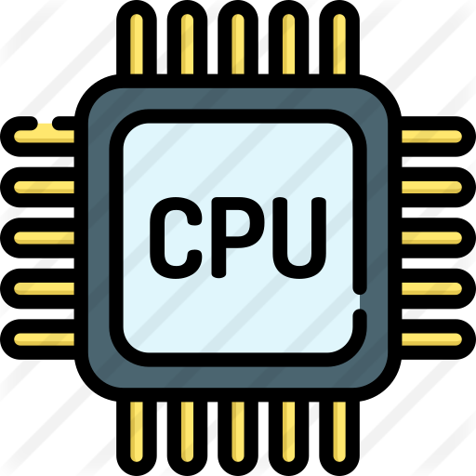


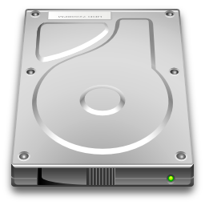


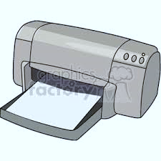

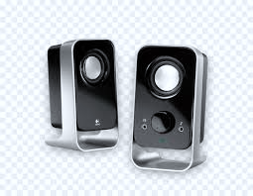
COMPUTER
Waits for Next Instructions
Hard Disc
Input Device
Secondary Memory
Output Device
Primary Memory

Slide 7
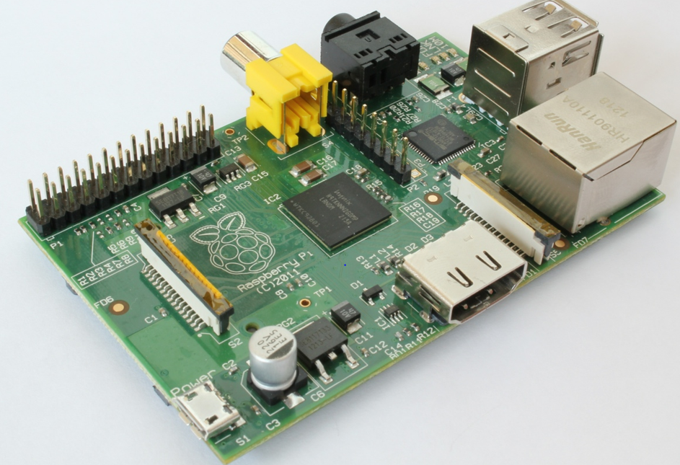

Generic Computer
Waits for Next Instructions
Input Device
Hard Disc
Secondary Memory
Output Device
Primary Memory

Slide 8
Programming Language

Slide 9

Programming Language
“The method of human communication, either spoken or written”
- Dictionary meaning
Language
CPU understandable language
Consists a sequence of stored instructions

Slide 10
Programming Language
LOW Level
Assembly Level
High Level
01010101 0100001
01010101 0100001
01010101 0100001
01010101 0100001
LOAD AH,01
MOV BH
CPY DH
Fun Sum(int a, int b]
{
return a + b;
}

Slide 11
Compiler and Interpreter

Slide 12
Programming Language
Compiler
Interpreter
Interpreter Intermediate
Converts – High level to Low/machine level in a at once
Converts – High level to Low level line by line
Converts to byte code and Virtual Machine loads to main memory

Slide 13
Phthon-3

Slide 14
Why Python
Need to add more
Dynamic Language
Python is Interpreted
Python is Interactive
Python is Object-Oriented

Slide 15
Features
Easy-to-learn: Python has few keywords, simple structure, and a clearly defined syntax. This allows a student to pick up the language quickly.
• Easy-to-read: Python code is more clearly defined and visible to the eyes.
• Easy-to-maintain: Python's source code is fairly easy-to-maintain.
• A broad standard library: Python's bulk of the library is very portable and cross platform compatible on UNIX, Windows, and Macintosh.
• Interactive Mode: Python has support for an interactive mode, which allows interactive testing and debugging of snippets of code.
• Portable: Python can run on a wide variety of hardware platforms and has the same interface on all platforms. • Extendable: You can add low-level modules to the Python interpreter. These modules enable programmers to add to or customize their tools to be more efficient.
• Databases: Python provides interfaces to all major commercial databases.
• GUI Programming: Python supports GUI applications that can be created and ported to many system calls, libraries and windows systems, such as Windows MFC, Macintosh, and the X Window system of Unix.
• Scalable: Python provides a better structure and support for large programs than shell scripting.
Apart

Slide 16
Python-Compilation

Slide 17
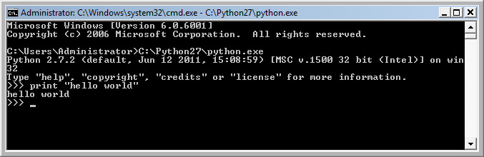
Interactive vs Script coding
Interactive
Script
Type directly one line at a time
Sequence of statements (lines) into a file
Program.py
x = 5
if x < 10:
print 'Smaller’
if x > 20:
print 'Bigger'
print 'Finish'

Slide 18
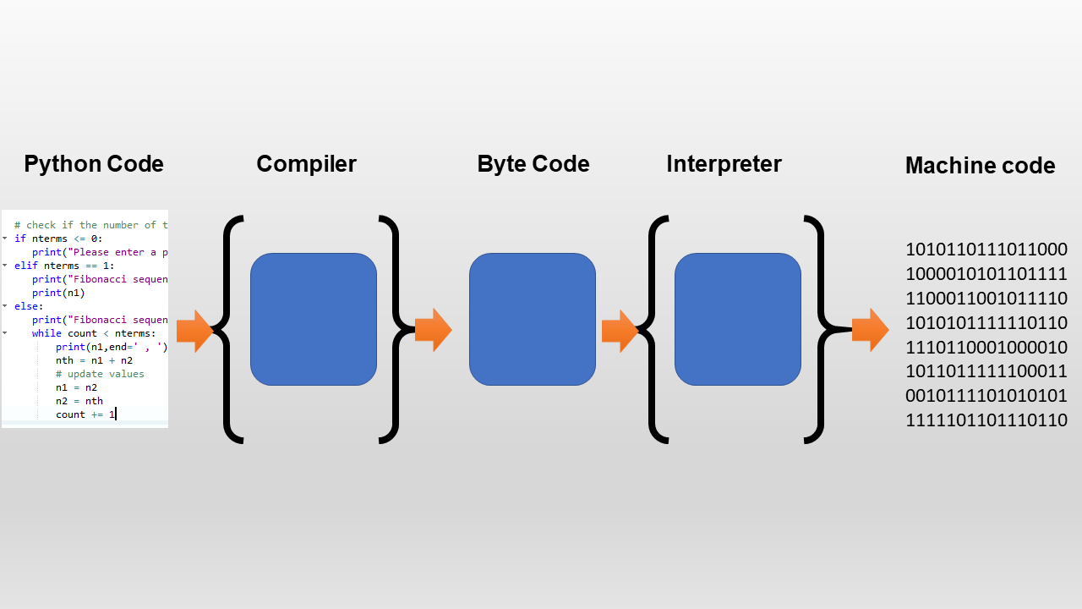
Script compilation
Python Virtual Compiler
Cpython
Program.pyc

Slide 19
DEMO

Slide 20
Interactive – Hello World
C:\>python
Python 3.1 (r25:51918, Sep 19 2006, 08:49:13)
[GCC 4.0.1 (Apple Computer, Inc. build 5341)] on darwin
Type "help", "copyright", "credits" or "license" for more information.
>>> x = “hello world”
>>> print x
>>> exit()

Slide 21
Script – Hello World
Program.py
x = “Hello world”
print x
C:\>python program.py
Hello world

Slide 22
Practice Questions

Slide 23
Question - A
CPU understands only
High level Language
Low level Language
Assembly level
None of the Above
C:\>python program.py
Hello world

Slide 24
Question - B
Does RAM a volatile storage?
True
False
C:\>python program.py
Hello world

Slide 25
Question - C
Which unit does it use to measure CPU speed?
Hz
MB
KB
M/S
C:\>python program.py
Hello world

Slide 26
Question - D
Can the Secondary storage interact with CPU?
Yes
NO
https://www.geeksforgeeks.org/introduction-of-secondary-memory/
C:\>python program.py
Hello world

Slide 27
Question - E
CPU can read High level language?
Yes
NO
C:\>python program.py
Hello world

Slide 28
Thank you

