Slide 1
PHYTHON -3
FOUNDATION

Slide 2

Agenda
1
Language General Concept
Agenda
2
Demo - Expression
3
Sentence / Line
4
Data Type and Conversion
5
Conditional Statement
6
DEMO – ODD/ EVEN
7
Assignment

Slide 3
General Concept

Slide 4

Constants vs Variables
Constants
Variables
Fixed values such as numbers, letters, and strings are called “constants”
A variable is a named place in the memory where a programmer can store data
>>> print 123
123
>>> print 98.6
98.6
>>> a = 'Hello world’
>>> a
Hello world
x = 12.2
y = 14

Slide 5
Constants vs Variables
Constants
Variables
Fixed values such as numbers, letters, and strings are called “constants”
A variable is a named place in the memory where a programmer can store data
Variable Rules
Must start with a letter or underscore _
Must consist of letters and numbers and underscores
Case Sensitive
>>> print 123
123
>>> print 98.6
98.6
>>> a = 'Hello world’
>>> a
Hello world

Slide 6
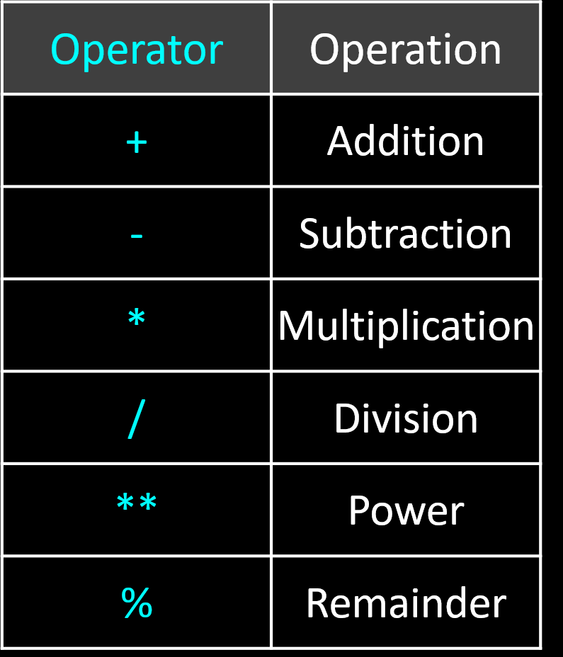
Expressions
A sequence of operands and operators, like a + b - 5 , is called an expression
Operands
Arithmentic Operators
Constants
Variables

Slide 7
Arithmetic Expressions Precedence Rules
PPMDAS
Highest precedence rule to lowest precedence rule
Parenthesis are always respected
Exponentiation (raise to a power)
Multiplication, Division, and Remainder
Addition and Subtraction
Left to right

Slide 8
Numeric/Arithmetic Expressions - Examples
>>> x = 2
>>> x = x + 2
>>> print x
4
>>> y = 440 * 12
>>> y
5280
>>> z = y / 1000
>>> z
5
>>> j = 23
>>> k = j % 5
>>> k
3
>>> 4 ** 3
64
Operator | Operation
+ | Addition
- | Subtraction
* | Multiplication
/ | Division
** | Power
% | Remainder
4 R 3
5
23
20
3

Slide 9
Sentence / Lines

Slide 10
Reserved Words
Syntax/ Keyword specific to the language
You can not use reserved words as variable names / identifiers
and del for is raise
assert elif from lambda return
break else global not try
class except if or while
continue exec import pass yield
def ﬁnally in print
Notes:
Like a dog .... food ... food ...

Slide 11
Assignment Statement
Assigning a value to a variable using the assignment statement (=)
An assignment statement consists of an expression on the right hand side and a variable to store the result
x = 3.9 * x * ( 1 - x )

Slide 12
Sentences / Lines
Sentences | Guess
x = 2
x = x + 2
Print x
Input y
Variable
Operator
Constant
Reserved Word

Slide 13
Data Types

Slide 14
Numbers
Integer
Decimal
Whole Numbers
Real Numbers
>>> 123
123
>>> type(98)
<type 'int'>
>>> 123.4
123.4
>>> type(98.4)
<type ‘float'>

Slide 15
Mixing Numbers Types – Implicit Conversion
When you perform an operation where one operand is an integer and the other operand is a floating point the result is a floating point
The integer is converted to a floating point before the operation
>>> print 99 / 100
0
>>> print 99 / 100.0
0.99
>>> print 99.0 / 100
0.99
>>> print 1 + 2 * 3 / 4.0 - 5
-2.5
>>>

Slide 16
Explicit Conversion
Explicit way of changing the data type
float() , int(), str()
>>> print float(99) / 100
0.99
>>> print 99 / int(100.0)
0
>>> print “hello” + str (1)
hello1

Slide 17
DEMO – Data Types
& Conversion

Slide 18
Conditional Statement

Slide 19
Condition
Decision taken based on the Boolean/Logical expression and choose the path and perform operation
x = 5
X < 10 ?
Yes
Program1.py:
x = 5
if x < 10:
print 'Smaller’
if x > 20:
print 'Bigger'
Output:
Smaller
print 'Smaller'
X > 20 ?
Yes
Compile
print 'Bigger'
print 'Finis'

Slide 20
Logical Expressions
Boolean expressions ask a question and produce a Yes or No result which we use to control program flow
Boolean expressions using comparison operators evaluate to - True / False - Yes / No
Comparison operators look at variables but do not change the variables
Python | Meaning
< | Less than
<= | Less than or Equal
== | Equal to
>= | Greater than or Equal
> | Greater than
!= | Not equal
Remember: “=” is used for assignment.

Slide 21
DEMO – ODD / EVEN

Slide 22
Condition
Decision taken based on the Boolean/Logical expression and choose the path and perform operation
x = 5
X % 2 == 0
?
Yes
Program1.py:
x = (int) Input()
if x %2 ==0:
print ‘EVEN’
else
print ‘ODD'
Output:
ODD
print ‘EVEN'
print ‘ODD'
Compile
print 'Finished'

Slide 23
Practice Questions

Slide 24
Question - A
Get the Number from user using Input() reserved/keyword and using if condition and using logical operator to find a given number is prime or not
Simple Calculator
Get a Operand(A, S, M, D) A- Addition, S- Subtraction, M- Multiplication, D- Division as a input
Get two integer input from the user
Based on the Operand perform the Arithmetic Operation
Print the Result
HRA calculation for a given employee’s salary and print the pay slip, get the basic salary as a input from the use and print the pay slip in the bellow format
Name | Stalin
Basic Pay | 1234
HRA | 5% upto 3500, 10% 3500 – 10000, else 12%
LTA | 12%
BF | 5%
Cross Salary | BP + HRA +LTA
Deduction | BF + 200
Net Salary | Cross Salary - Deduction
C:\>python program.py
Hello world

Slide 25
Thank you

