Slide 1
PHYTHON - 7
Memory Management

Slide 2
Agenda
Introduction
Memory – Stack and Heap
Garbage collection

Slide 3
Introduction

Slide 4

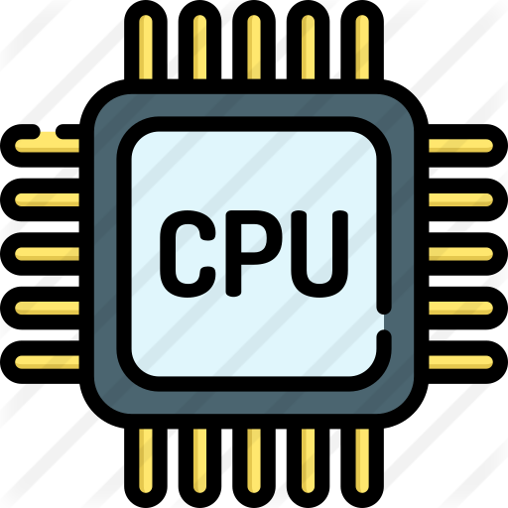


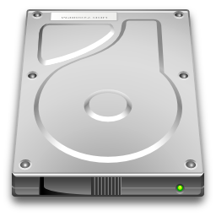


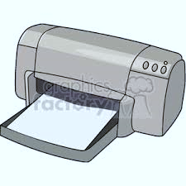

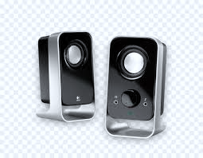
Introduction
Waits for Next Instructions
Hard Disc
Input Device
Secondary Memory
Output Device
Primary Memory

Slide 5
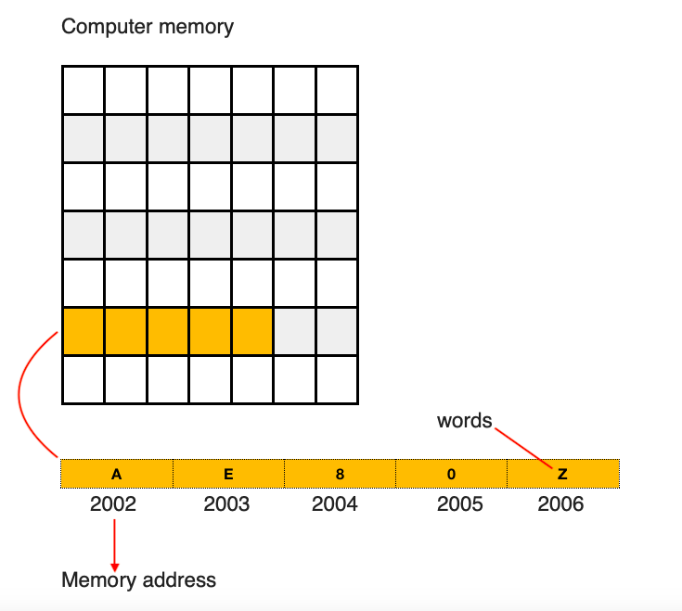
Introduction
Waits for Next Instructions
Hard Disc
Input Device
Secondary Memory
Output Device
Primary Memory

Slide 6
Stack and Heap

Slide 7
Stack and Heap
RAM
Stack Memory
Heap Memory
def main():
x = ‘stalin’
main()
x
S
t
a
l
i
n
main
0x 10012
0x 10012

Slide 8
Stack and Heap
RAM
def first(num):
x1 = second(num)
return x1
def second(var):
var = var + 10
return var
def main():
x = 10
result = first(x)
main()
Stack Memory
Heap Memory
Second
var
20
first
x1
10
main
x
Result

Slide 9
Different object types
Simple Objects
Container Objects
User Defined
numbers
strings
List
Dict
Tuple
set
User defined class

Slide 10


How object stored – Simple Object
names
references objects
def main():
x = 300
y = 300
main()
names
x
y
PyObject
References
type | integer
refcount | 2
value | 300

Slide 11




nums
How object stored - Collection
nums = [-10, -9, -9]
PyObject
Value | -10
refcount | 1
type | integer
PyListObject
PyObject
type | list
refcount | 1
value
size | 3
capacity | 10
Value | -9
refcount | 2
type | integer

Slide 12
Address and Ref- Count
>>> x = 10
>>> y = 10
>>> id(x)
>>> id(y)
>>> id(x) is id(y)
>>> import sys
>>> x = 10
>>> y = 10
>>> sys.getrefcount(10)
>>> sys.getsizeof(dict())

Slide 13
Garbage Collection

Slide 14


Garbage Collection
“Reclaiming memory when the object taking up that space is no longer in use”
Definition
Reference Counting
Tracing

Slide 15
Reference Counting
>>> import sys
>>> x = 10
>>> y = 10
>>> sys.getrefcount(10)
>>> y = None
>>> sys.getrefcount(10)
Add and Remove Reference
Reclaim memory when Ref count Reaches 0
>>> import gc
>>> gc.get_objects()

Slide 16
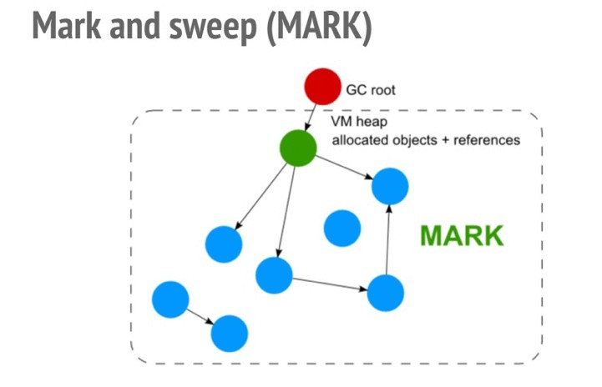
Tracing garbage Collection

Slide 17
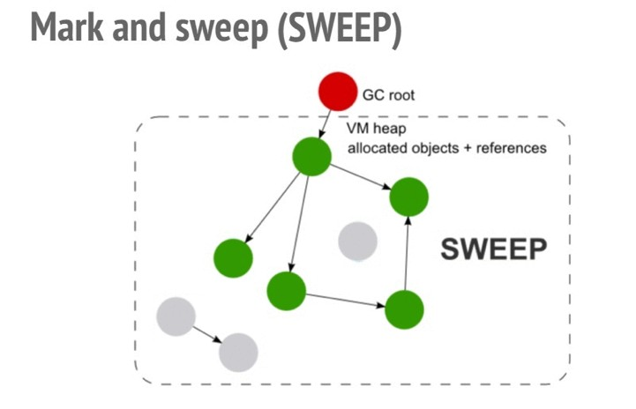
Tracing garbage Collection
source: http://webappguru.blogspot.com/2015/11/mark-and-sweep-garbage-collection.html

Slide 18
Thank you

