Slide 1
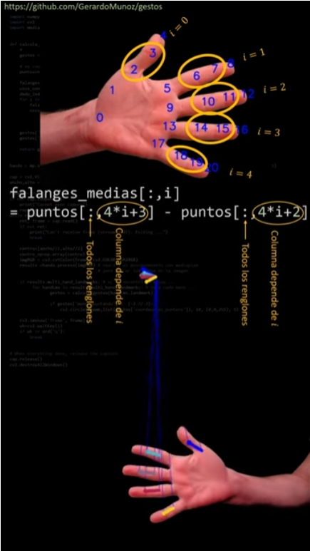
Operaciones Vectoriales
https://www.youtube.com/watch?v=sGDJwilP-oo
Enviar preguntas a
gmunoz@udistrital.edu.co

Slide 2
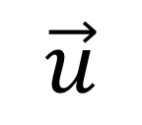
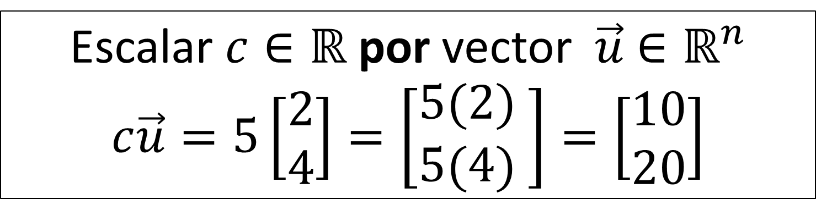
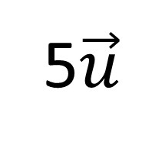
Escalar por vector
5$\vec{u}$
Escalar $c∈ℝ$ por vector $\vec{u}$ $∈ℝ^{n}$
$$c\vec{u}=5\left[\begin{matrix}2 \\ 4\end{matrix}\right]=\left[\begin{matrix}5(2) \\ 5(4) \end{matrix}\right]=\left[\begin{matrix}10 \\ 20\end{matrix}\right]$$
$$\vec{u}$$

Slide 3
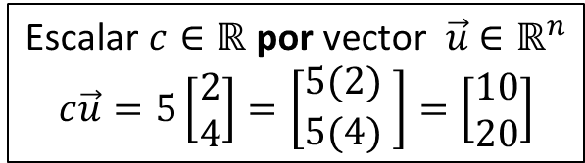
Operaciones entre vectores
Escalar $c∈ℝ$ por vector $\vec{u}$ $∈ℝ^{n}$
$$c\vec{u}=5\left[\begin{matrix}2 \\ 4\end{matrix}\right]=\left[\begin{matrix}5(2) \\ 5(4) \end{matrix}\right]=\left[\begin{matrix}10 \\ 20\end{matrix}\right]$$

Slide 4
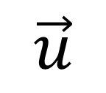
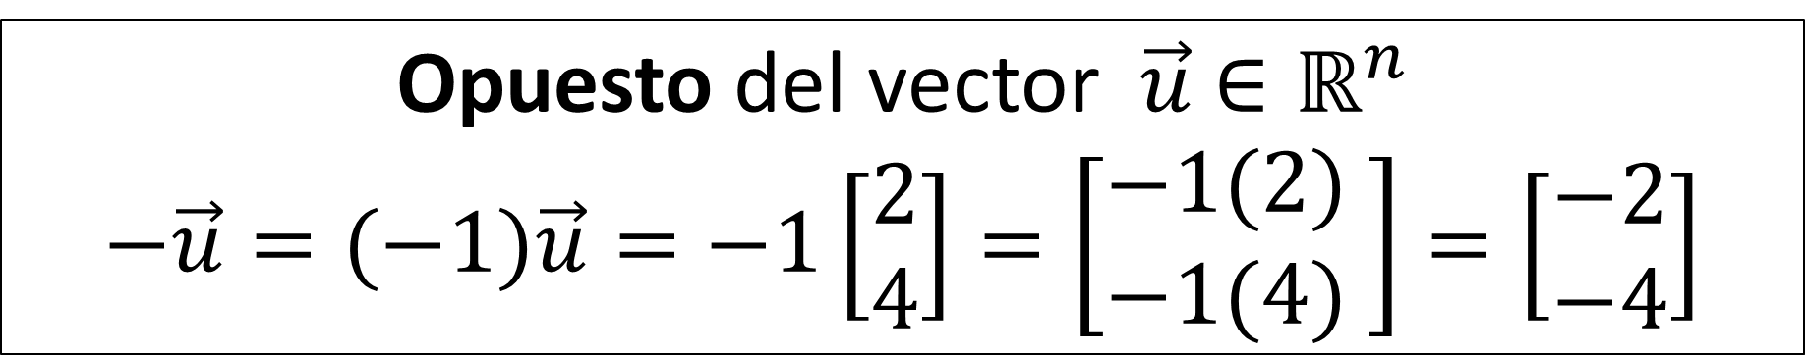
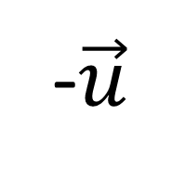
Vector Opuesto
$$\vec{u}$$
-$\vec{u}$
Opuesto del vector $\vec{u}$ $∈ℝ^{n}$
$$−\vec{u}=(−1)\vec{u}=−1\left[\begin{matrix}2 \\ 4\end{matrix}\right]=\left[\begin{matrix}−1(2) \\ −1(4) \end{matrix}\right]=\left[\begin{matrix}−2 \\ −4\end{matrix}\right]$$

Slide 5
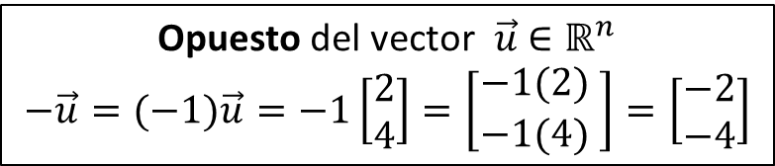
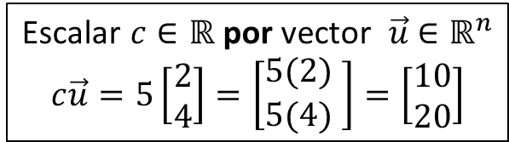
Operaciones entre vectores
Escalar $c∈ℝ$ por vector $\vec{u}$ $∈ℝ^{n}$
$$c\vec{u}=5\left[\begin{matrix}2 \\ 4\end{matrix}\right]=\left[\begin{matrix}5(2) \\ 5(4) \end{matrix}\right]=\left[\begin{matrix}10 \\ 20\end{matrix}\right]$$
Opuesto del vector $\vec{u}$ $∈ℝ^{n}$
$$−\vec{u}=(−1)\vec{u}=−1\left[\begin{matrix}2 \\ 4\end{matrix}\right]=\left[\begin{matrix}−1(2) \\ −1(4) \end{matrix}\right]=\left[\begin{matrix}−2 \\ −4\end{matrix}\right]$$

Slide 6

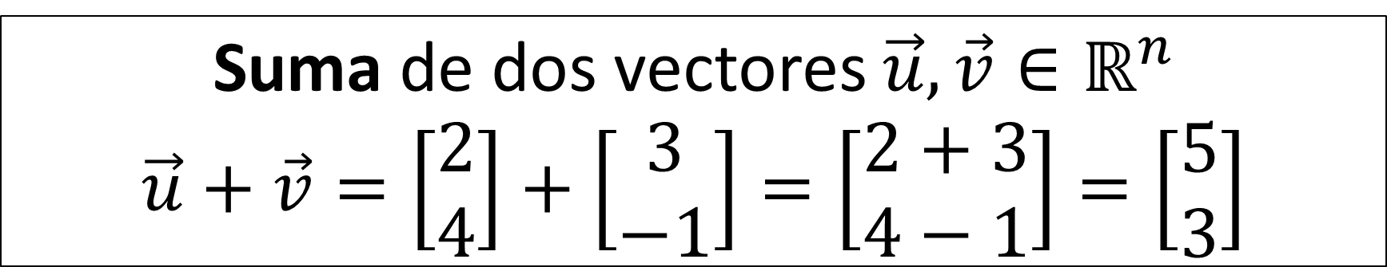
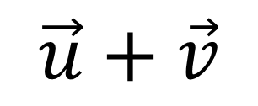

Suma de vectores
Suma de dos vectores $\vec{u},\vec{v}∈ℝ^{n}$
$$\vec{u}+\vec{v}=\left[\begin{matrix}2 \\ 4\end{matrix}\right]+\left[\begin{matrix}3 \\ −1\end{matrix}\right]=\left[\begin{matrix}2+3 \\ 4−1\end{matrix}\right]=\left[\begin{matrix}5 \\ 3\end{matrix}\right]$$
$$\vec{u}+\vec{v}$$
$$\vec{u}$$
$$\vec{v}$$

Slide 7
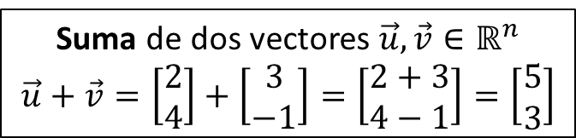
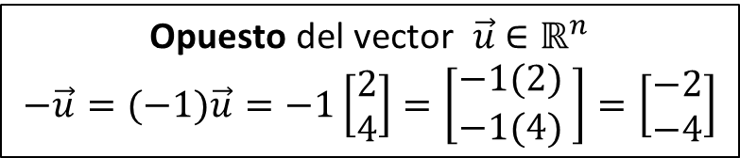
Operaciones entre vectores
Escalar $c∈ℝ$ por vector $\vec{u}$ $∈ℝ^{n}$
$$c\vec{u}=5\left[\begin{matrix}2 \\ 4\end{matrix}\right]=\left[\begin{matrix}5(2) \\ 5(4) \end{matrix}\right]=\left[\begin{matrix}10 \\ 20\end{matrix}\right]$$
Opuesto del vector $\vec{u}$ $∈ℝ^{n}$
$$−\vec{u}=(−1)\vec{u}=−1\left[\begin{matrix}2 \\ 4\end{matrix}\right]=\left[\begin{matrix}−1(2) \\ −1(4) \end{matrix}\right]=\left[\begin{matrix}−2 \\ −4\end{matrix}\right]$$
Suma de dos vectores $\vec{u},\vec{v}∈ℝ^{n}$
$$\vec{u}+\vec{v}=\left[\begin{matrix}2 \\ 4\end{matrix}\right]+\left[\begin{matrix}3 \\ −1\end{matrix}\right]=\left[\begin{matrix}2+3 \\ 4−1\end{matrix}\right]=\left[\begin{matrix}5 \\ 3\end{matrix}\right]$$

Slide 8
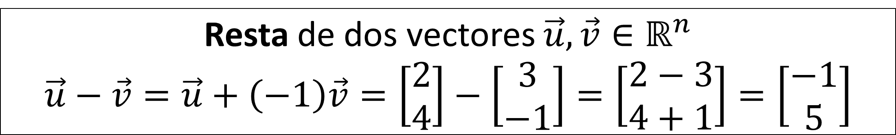
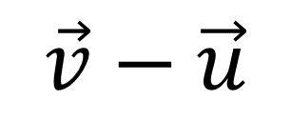
Resta entre vectores
Resta de dos vectores $\vec{u},\vec{v}∈ℝ^{n}$
$$\vec{u}−\vec{v}=\vec{u}+\left(−1\right)\vec{v}=\left[\begin{matrix}2 \\ 4\end{matrix}\right]−\left[\begin{matrix}3 \\ −1\end{matrix}\right]=\left[\begin{matrix}2−3 \\ 4+1\end{matrix}\right]=\left[\begin{matrix}−1 \\ 5\end{matrix}\right]$$
$$\vec{u}$$
$$\vec{v}$$
$$\vec{v}−\vec{u}$$

Slide 9
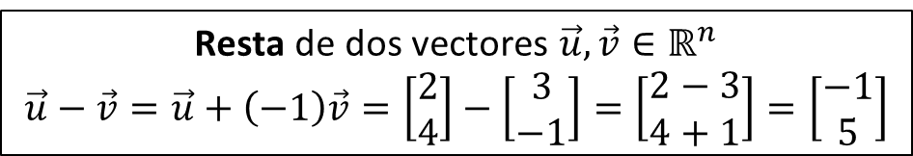
Operaciones entre vectores
Escalar $c∈ℝ$ por vector $\vec{u}$ $∈ℝ^{n}$
$$c\vec{u}=5\left[\begin{matrix}2 \\ 4\end{matrix}\right]=\left[\begin{matrix}5(2) \\ 5(4) \end{matrix}\right]=\left[\begin{matrix}10 \\ 20\end{matrix}\right]$$
Opuesto del vector $\vec{u}$ $∈ℝ^{n}$
$$−\vec{u}=(−1)\vec{u}=−1\left[\begin{matrix}2 \\ 4\end{matrix}\right]=\left[\begin{matrix}−1(2) \\ −1(4) \end{matrix}\right]=\left[\begin{matrix}−2 \\ −4\end{matrix}\right]$$
Suma de dos vectores $\vec{u},\vec{v}∈ℝ^{n}$
$$\vec{u}+\vec{v}=\left[\begin{matrix}2 \\ 4\end{matrix}\right]+\left[\begin{matrix}3 \\ −1\end{matrix}\right]=\left[\begin{matrix}2+3 \\ 4−1\end{matrix}\right]=\left[\begin{matrix}5 \\ 3\end{matrix}\right]$$
Resta de dos vectores $\vec{u},\vec{v}∈ℝ^{n}$
$$\vec{u}−\vec{v}=\vec{u}+\left(−1\right)\vec{v}=\left[\begin{matrix}2 \\ 4\end{matrix}\right]−\left[\begin{matrix}3 \\ −1\end{matrix}\right]=\left[\begin{matrix}2−3 \\ 4+1\end{matrix}\right]=\left[\begin{matrix}−1 \\ 5\end{matrix}\right]$$

Slide 10
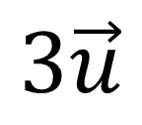
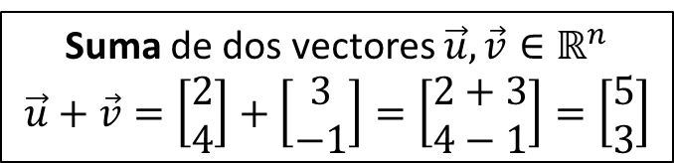
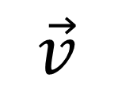
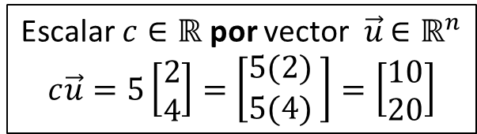
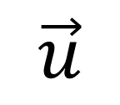

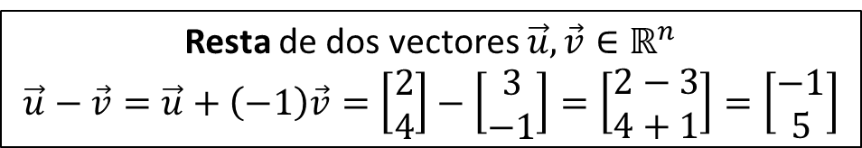
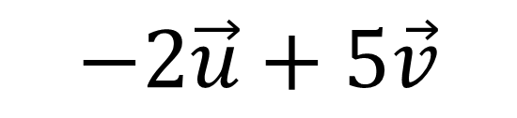
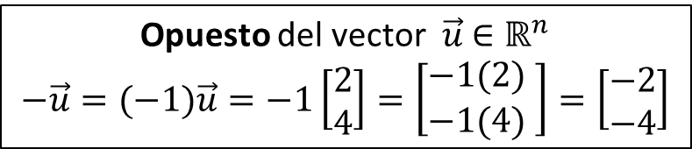
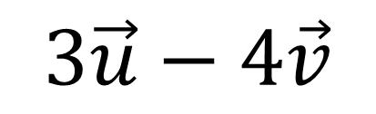
Operaciones de la Combinación Lineal
Escalar $c∈ℝ$ por vector $\vec{u}$ $∈ℝ^{n}$
$$c\vec{u}=5\left[\begin{matrix}2 \\ 4\end{matrix}\right]=\left[\begin{matrix}5(2) \\ 5(4) \end{matrix}\right]=\left[\begin{matrix}10 \\ 20\end{matrix}\right]$$
Opuesto del vector $\vec{u}$ $∈ℝ^{n}$
$$−\vec{u}=(−1)\vec{u}=−1\left[\begin{matrix}2 \\ 4\end{matrix}\right]=\left[\begin{matrix}−1(2) \\ −1(4) \end{matrix}\right]=\left[\begin{matrix}−2 \\ −4\end{matrix}\right]$$
Suma de dos vectores $\vec{u},\vec{v}∈ℝ^{n}$
$$\vec{u}+\vec{v}=\left[\begin{matrix}2 \\ 4\end{matrix}\right]+\left[\begin{matrix}3 \\ −1\end{matrix}\right]=\left[\begin{matrix}2+3 \\ 4−1\end{matrix}\right]=\left[\begin{matrix}5 \\ 3\end{matrix}\right]$$
Resta de dos vectores $\vec{u},\vec{v}∈ℝ^{n}$
$$\vec{u}−\vec{v}=\vec{u}+\left(−1\right)\vec{v}=\left[\begin{matrix}2 \\ 4\end{matrix}\right]−\left[\begin{matrix}3 \\ −1\end{matrix}\right]=\left[\begin{matrix}2−3 \\ 4+1\end{matrix}\right]=\left[\begin{matrix}−1 \\ 5\end{matrix}\right]$$
Ejemplo: dibujar
Ejercicio: dibujar
$$3\vec{u}−4\vec{v}$$
$$3\vec{u}$$
$$−2\vec{u}+5\vec{v}$$
$$\vec{v}$$
$$\vec{u}$$
$$3\vec{u}−4\vec{v}$$

Slide 11
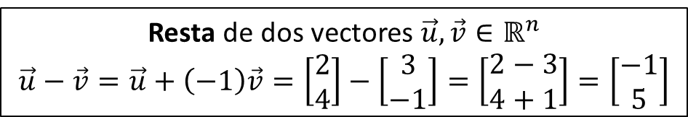
Operaciones entre vectores
Escalar $c∈ℝ$ por vector $\vec{u}$ $∈ℝ^{n}$
$$c\vec{u}=5\left[\begin{matrix}2 \\ 4\end{matrix}\right]=\left[\begin{matrix}5(2) \\ 5(4) \end{matrix}\right]=\left[\begin{matrix}10 \\ 20\end{matrix}\right]$$
Opuesto del vector $\vec{u}$ $∈ℝ^{n}$
$$−\vec{u}=(−1)\vec{u}=−1\left[\begin{matrix}2 \\ 4\end{matrix}\right]=\left[\begin{matrix}−1(2) \\ −1(4) \end{matrix}\right]=\left[\begin{matrix}−2 \\ −4\end{matrix}\right]$$
Suma de dos vectores $\vec{u},\vec{v}∈ℝ^{n}$
$$\vec{u}+\vec{v}=\left[\begin{matrix}2 \\ 4\end{matrix}\right]+\left[\begin{matrix}3 \\ −1\end{matrix}\right]=\left[\begin{matrix}2+3 \\ 4−1\end{matrix}\right]=\left[\begin{matrix}5 \\ 3\end{matrix}\right]$$
Resta de dos vectores $\vec{u},\vec{v}∈ℝ^{n}$
$$\vec{u}−\vec{v}=\vec{u}+\left(−1\right)\vec{v}=\left[\begin{matrix}2 \\ 4\end{matrix}\right]−\left[\begin{matrix}3 \\ −1\end{matrix}\right]=\left[\begin{matrix}2−3 \\ 4+1\end{matrix}\right]=\left[\begin{matrix}−1 \\ 5\end{matrix}\right]$$

Slide 12
Producto punto

Slide 13



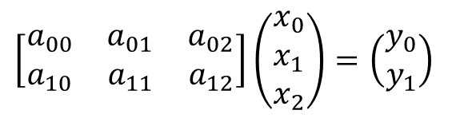


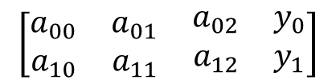









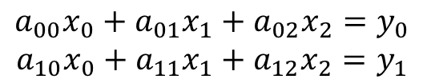


Matriz por vector
$$\left[\begin{matrix}a_{00} & a_{01} & a_{02} \\ a_{10} & a_{11} & a_{12}\end{matrix}\right]\left(\begin{matrix}x_{0} \\ x_{1} \\ x_{2}\end{matrix}\right)=\left(\begin{matrix}y_{0} \\ y_{1}\end{matrix}\right)$$
Sistema de ecuaciones
Transformación Matricial
Encontrar$\vec{y}$
$$\begin{matrix}a_{00}x_{0}+a_{01}x_{1}+a_{02}x_{2}=y_{0} \\ a_{10}x_{0}+a_{11}x_{1}+a_{12}x_{2}=y_{1}\end{matrix}$$
$$T_{A}\left(\begin{matrix}x_{0} \\ x_{1} \\ x_{2}\end{matrix}\right)=\left(\begin{matrix}y_{0} \\ y_{1}\end{matrix}\right)$$
Encontrar$\vec{x}$
Composición
Álgebra
Lineal
Perceptrón lineal
Algoritmos
Encontrar la matriz $A$
$$x_{0}$$
Matriz extendida
$$a_{00}$$
$$a_{01}$$
$$y_{0}$$
$$\left[\begin{matrix}a_{00} & a_{01} & \begin{matrix}a_{02} & y_{0}\end{matrix} \\ a_{10} & a_{11} & \begin{matrix}a_{12} & y_{1}\end{matrix}\end{matrix}\right]$$
Visualización
geométrica
$$x_{1}$$
$$a_{02}$$
$$a_{10}$$
$$a_{11}$$
$$y_{1}$$
$$a_{12}$$
$$x_{2}$$
Combinación lineal
$$x_{0}\left(\begin{matrix}a_{00} \\ a_{10}\end{matrix}\right)+x_{1}\left(\begin{matrix}a_{01} \\ a_{11}\end{matrix}\right)+x_{2}\left(\begin{matrix}a_{02} \\ a_{12}\end{matrix}\right)=\left(\begin{matrix}y_{0} \\ y_{1}\end{matrix}\right)$$

Slide 14

Matriz por vector
$$\left[\begin{matrix}a_{00} & a_{01} & a_{02} \\ a_{10} & a_{11} & a_{12}\end{matrix}\right]\left(\begin{matrix}x_{0} \\ x_{1} \\ x_{2}\end{matrix}\right)=\left(\begin{matrix}y_{0} \\ y_{1}\end{matrix}\right)$$
Sistema de ecuaciones
Transformación Matricial
Encontrar$\vec{y}$
$$\begin{matrix}a_{00}x_{0}+a_{01}x_{1}+a_{02}x_{2}=y_{0} \\ a_{10}x_{0}+a_{11}x_{1}+a_{12}x_{2}=y_{1}\end{matrix}$$
$$T_{A}\left(\begin{matrix}x_{0} \\ x_{1} \\ x_{2}\end{matrix}\right)=\left(\begin{matrix}y_{0} \\ y_{1}\end{matrix}\right)$$
Encontrar$\vec{x}$
Composición
Perceptrón lineal
Algoritmos
Encontrar la matriz $A$
$$x_{0}$$
Matriz extendida
$$a_{00}$$
$$a_{01}$$
$$y_{0}$$
$$\left[\begin{matrix}a_{00} & a_{01} & \begin{matrix}a_{02} & y_{0}\end{matrix} \\ a_{10} & a_{11} & \begin{matrix}a_{12} & y_{1}\end{matrix}\end{matrix}\right]$$
Visualización
geométrica
$$x_{1}$$
$$a_{02}$$
$$a_{10}$$
$$a_{11}$$
$$y_{1}$$
$$a_{12}$$
$$x_{2}$$
Combinación lineal
$$x_{0}\left(\begin{matrix}a_{00} \\ a_{10}\end{matrix}\right)+x_{1}\left(\begin{matrix}a_{01} \\ a_{11}\end{matrix}\right)+x_{2}\left(\begin{matrix}a_{02} \\ a_{12}\end{matrix}\right)=\left(\begin{matrix}y_{0} \\ y_{1}\end{matrix}\right)$$

Slide 15

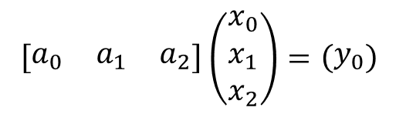






Matriz por vector
$$\left[\begin{matrix}a_{0} & a_{1} & a_{2}\end{matrix}\right]\left(\begin{matrix}x_{0} \\ x_{1} \\ x_{2}\end{matrix}\right)=\left(\begin{matrix}y_{0}\end{matrix}\right)$$
Sistema de ecuaciones
Transformación Matricial
Encontrar$\vec{y}$
$$\begin{matrix}a_{0}x_{0}+a_{1}x_{1}+a_{2}x_{2}=y_{0}\end{matrix}$$
$$T_{A}\left(\begin{matrix}x_{0} \\ x_{1} \\ x_{2}\end{matrix}\right)=\left(\begin{matrix}y_{0}\end{matrix}\right)$$
Encontrar$\vec{x}$
Composición
Producto
Punto
Perceptrón lineal
Algoritmos
Encontrar la matriz $A$
$$x_{0}$$
Matriz extendida
$$a_{0}$$
$$a_{1}$$
$$y_{0}$$
$$\left[\begin{matrix}a_{0} & a_{1} & \begin{matrix}a_{2} & y_{0}\end{matrix}\end{matrix}\right]$$
Visualización
geométrica
$$x_{1}$$
$$a_{2}$$
$$x_{2}$$
Combinación lineal
$$x_{0}\left(\begin{matrix}a_{0}\end{matrix}\right)+x_{1}\left(\begin{matrix}a_{1}\end{matrix}\right)+x_{2}\left(\begin{matrix}a_{2}\end{matrix}\right)=\left(\begin{matrix}y_{0}\end{matrix}\right)$$

Slide 16
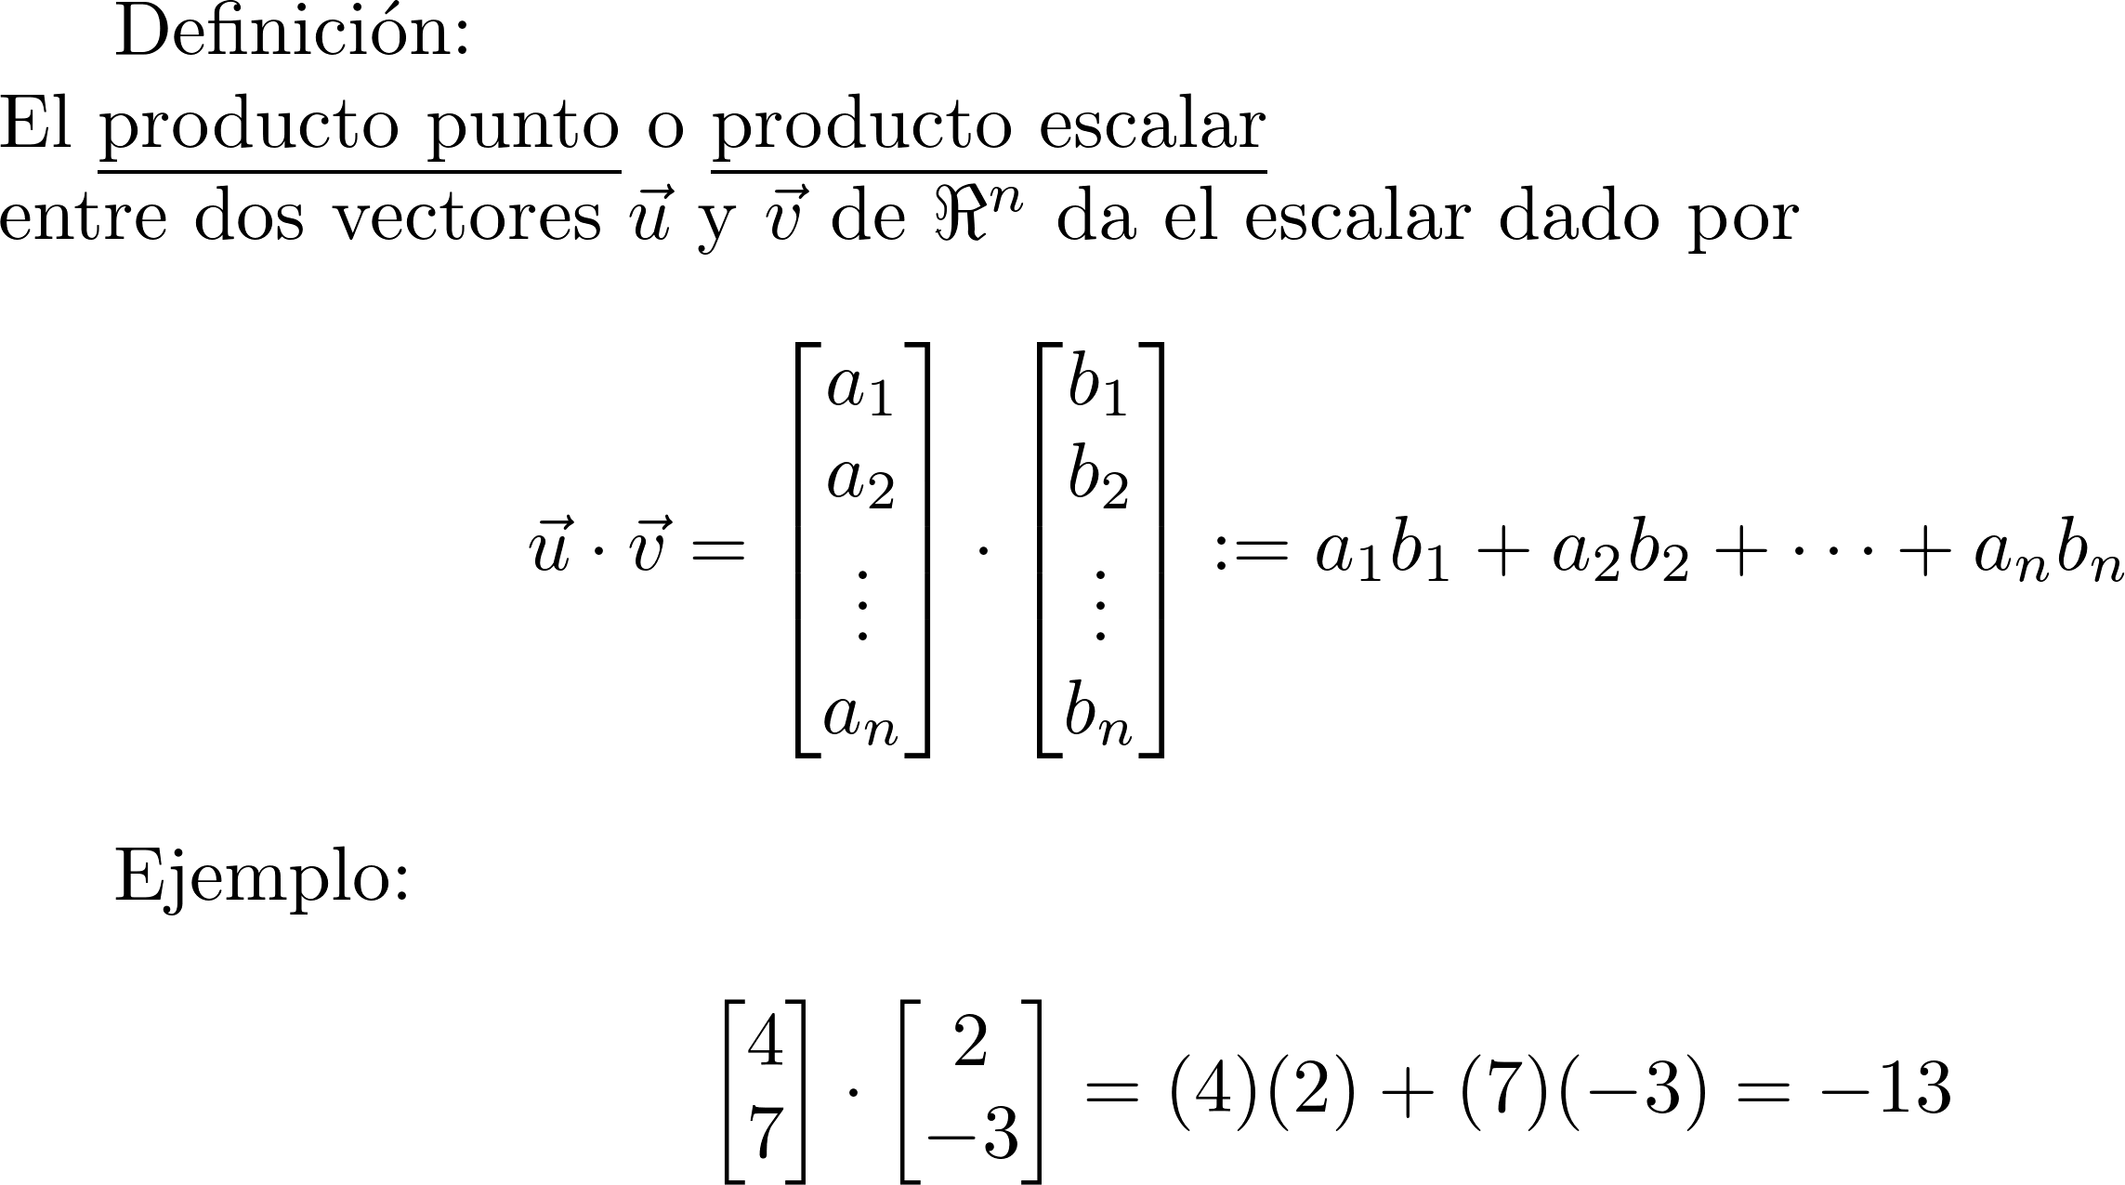
Definición de producto punto

Slide 17
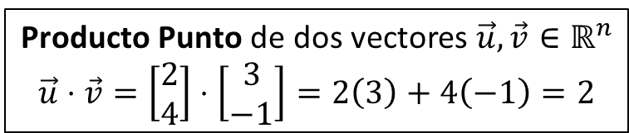
Operaciones entre vectores
Escalar $c∈ℝ$ por vector $\vec{u}$ $∈ℝ^{n}$
$$c\vec{u}=5\left[\begin{matrix}2 \\ 4\end{matrix}\right]=\left[\begin{matrix}5(2) \\ 5(4) \end{matrix}\right]=\left[\begin{matrix}10 \\ 20\end{matrix}\right]$$
Opuesto del vector $\vec{u}$ $∈ℝ^{n}$
$$−\vec{u}=(−1)\vec{u}=−1\left[\begin{matrix}2 \\ 4\end{matrix}\right]=\left[\begin{matrix}−1(2) \\ −1(4) \end{matrix}\right]=\left[\begin{matrix}−2 \\ −4\end{matrix}\right]$$
Suma de dos vectores $\vec{u},\vec{v}∈ℝ^{n}$
$$\vec{u}+\vec{v}=\left[\begin{matrix}2 \\ 4\end{matrix}\right]+\left[\begin{matrix}3 \\ −1\end{matrix}\right]=\left[\begin{matrix}2+3 \\ 4−1\end{matrix}\right]=\left[\begin{matrix}5 \\ 3\end{matrix}\right]$$
Resta de dos vectores $\vec{u},\vec{v}∈ℝ^{n}$
$$\vec{u}−\vec{v}=\vec{u}+\left(−1\right)\vec{v}=\left[\begin{matrix}2 \\ 4\end{matrix}\right]−\left[\begin{matrix}3 \\ −1\end{matrix}\right]=\left[\begin{matrix}2−3 \\ 4+1\end{matrix}\right]=\left[\begin{matrix}−1 \\ 5\end{matrix}\right]$$
Producto Punto de dos vectores $\vec{u},\vec{v}∈ℝ^{n}$
$$\vec{u}⋅\vec{v}=\left[\begin{matrix}2 \\ 4\end{matrix}\right]⋅\left[\begin{matrix}3 \\ −1\end{matrix}\right]=2\left(3\right)+4\left(−1\right)=2$$

Slide 18
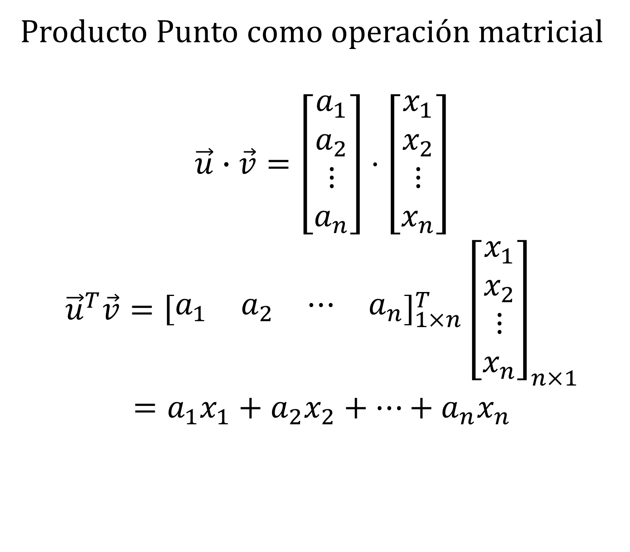
Producto Punto como operación matricial
$$\vec{u}∙\vec{v}=\left[\begin{matrix}\begin{matrix}a_{1} \\ a_{2}\end{matrix} \\ \begin{matrix}⋮ \\ a_{n}\end{matrix}\end{matrix}\right]⋅\left[\begin{matrix}\begin{matrix}x_{1} \\ x_{2}\end{matrix} \\ \begin{matrix}⋮ \\ x_{n}\end{matrix}\end{matrix}\right]$$
$${\vec{u}}^{T}\vec{v}={\left[\begin{matrix}a_{1} & a_{2} & ⋯ & a_{n}\end{matrix}\right]}_{1×n}^{T}{\left[\begin{matrix}\begin{matrix}x_{1} \\ x_{2}\end{matrix} \\ \begin{matrix}⋮ \\ x_{n}\end{matrix}\end{matrix}\right]}_{n×1}$$
$$=a_{1}x_{1}+a_{2}x_{2}+⋯+a_{n}x_{n}$$

Slide 19
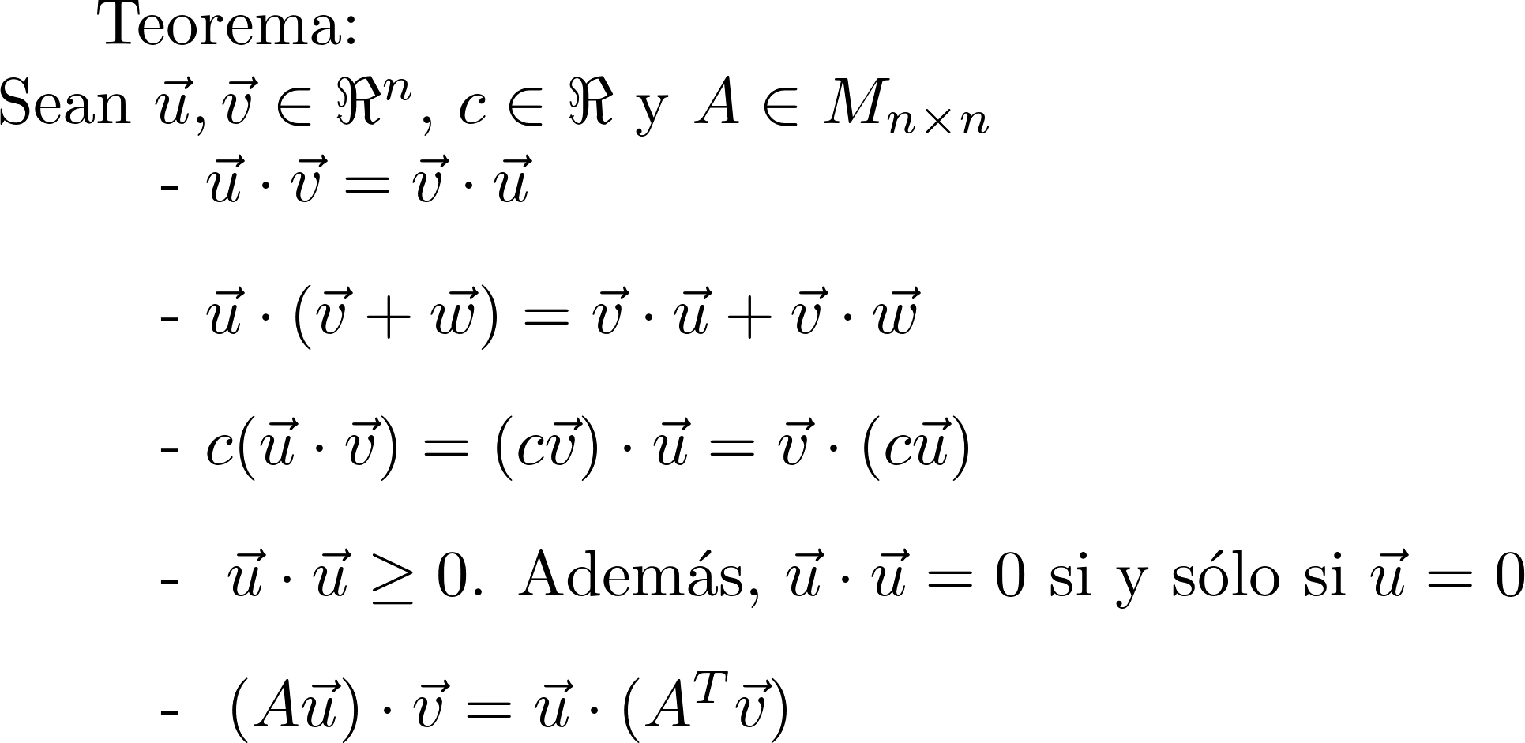
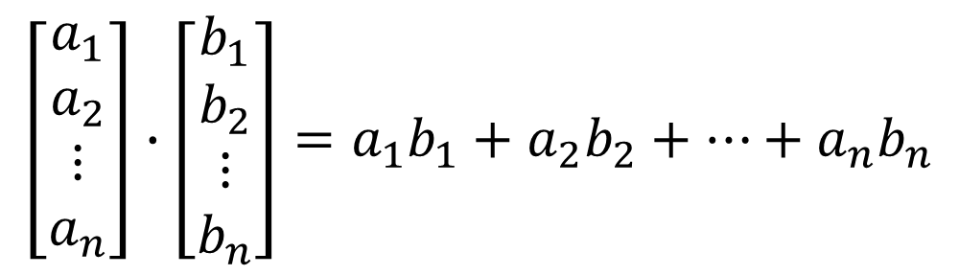
Propiedades del producto punto
$$\left[\begin{matrix}\begin{matrix}a_{1} \\ a_{2}\end{matrix} \\ \begin{matrix}⋮ \\ a_{n}\end{matrix}\end{matrix}\right]∙\left[\begin{matrix}\begin{matrix}b_{1} \\ b_{2}\end{matrix} \\ \begin{matrix}⋮ \\ b_{n}\end{matrix}\end{matrix}\right]=a_{1}b_{1}+a_{2}b_{2}+⋯+a_{n}b_{n}$$

Slide 20

Propiedades del producto punto
$$A\left(B+C\right)=AB+AC$$

Slide 21
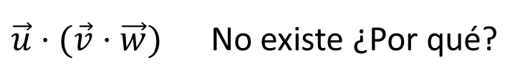
Propiedades del producto punto
$\vec{u}⋅$ $(\vec{v}⋅$ $\vec{w})$ No existe ¿Por qué?

Slide 22
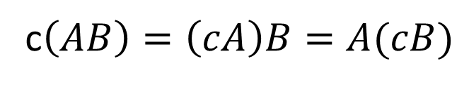
Propiedades del producto punto
c$\left(AB\right)=\left(cA\right)B=A(cB)$

Slide 23
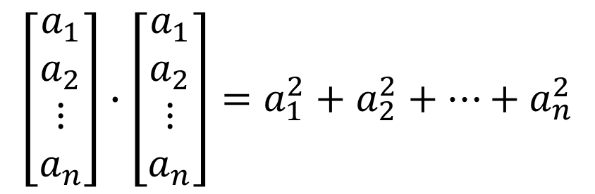
Propiedades del producto punto
$$\left[\begin{matrix}\begin{matrix}a_{1} \\ a_{2}\end{matrix} \\ \begin{matrix}⋮ \\ a_{n}\end{matrix}\end{matrix}\right]∙\left[\begin{matrix}\begin{matrix}a_{1} \\ a_{2}\end{matrix} \\ \begin{matrix}⋮ \\ a_{n}\end{matrix}\end{matrix}\right]=a_{1}^{2}+a_{2}^{2}+⋯+a_{n}^{2}$$

Slide 24

Propiedades del producto punto
$(A\vec{u})⋅$ $\vec{v}={\left(A\vec{u}\right)}^{T}\vec{v}$
$={(\vec{u}}^{T}A^{T})\vec{v}=$ ${\vec{u}}^{T}\left(A^{T}\vec{v}\right)$
$$=\vec{u}⋅\left(A^{T}\vec{v}\right)$$

Slide 25
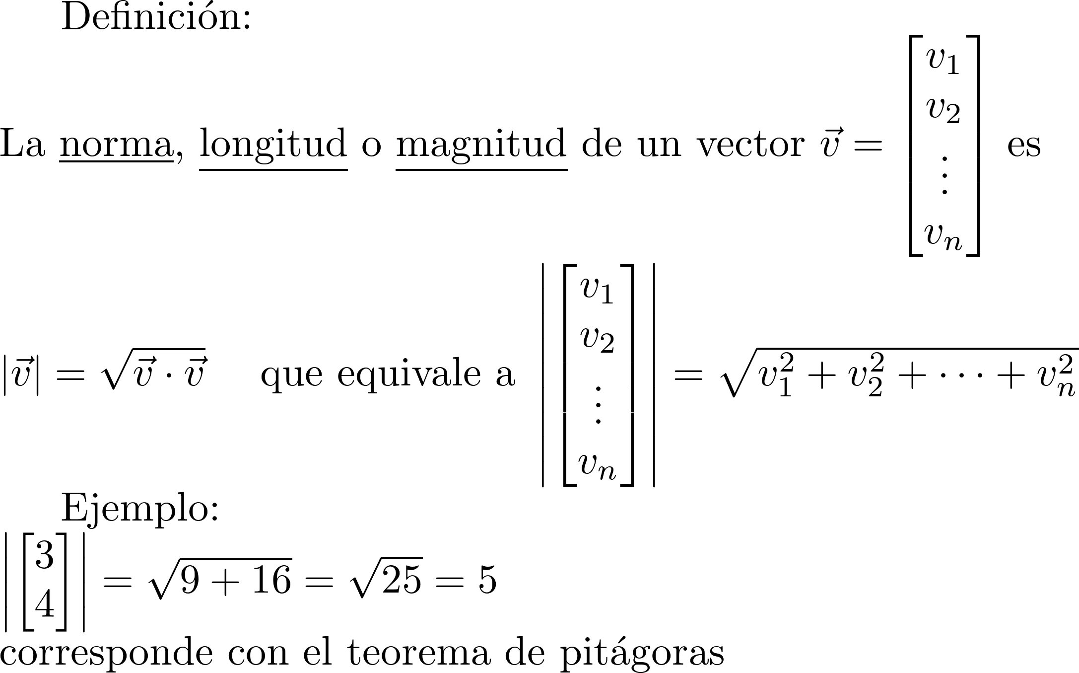
Definición de magnitud
5
4
3

Slide 26

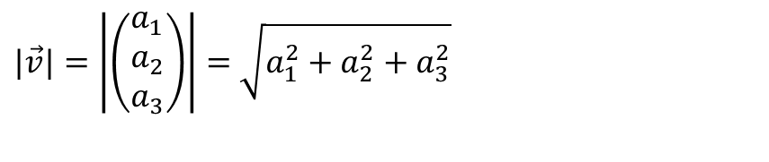


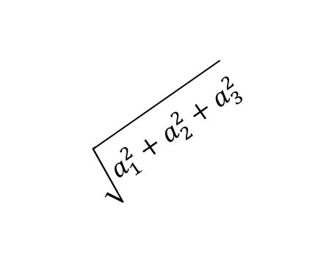
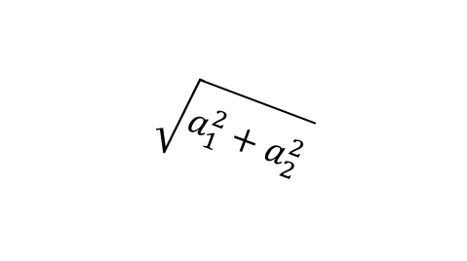
$$\vec{v}$$
$|\vec{v}|=\left|\left(\begin{matrix}a_{1} \\ a_{2} \\ a_{3}\end{matrix}\right)\right|=$ $\sqrt{a_{1}^{2}+a_{2}^{2}+a_{3}^{2}}$
$$\sqrt{a_{1}^{2}+a_{2}^{2}+a_{3}^{2}}$$
$$a_{3}$$
$$\vec{o}$$
$$a_{1}$$
$$\sqrt{a_{1}^{2}+a_{2}^{2}}$$
$$a_{2}$$

Slide 27
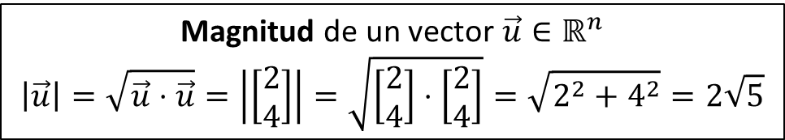
Operaciones entre vectores
Escalar $c∈ℝ$ por vector $\vec{u}$ $∈ℝ^{n}$
$$c\vec{u}=5\left[\begin{matrix}2 \\ 4\end{matrix}\right]=\left[\begin{matrix}5(2) \\ 5(4) \end{matrix}\right]=\left[\begin{matrix}10 \\ 20\end{matrix}\right]$$
Opuesto del vector $\vec{u}$ $∈ℝ^{n}$
$$−\vec{u}=(−1)\vec{u}=−1\left[\begin{matrix}2 \\ 4\end{matrix}\right]=\left[\begin{matrix}−1(2) \\ −1(4) \end{matrix}\right]=\left[\begin{matrix}−2 \\ −4\end{matrix}\right]$$
Suma de dos vectores $\vec{u},\vec{v}∈ℝ^{n}$
$$\vec{u}+\vec{v}=\left[\begin{matrix}2 \\ 4\end{matrix}\right]+\left[\begin{matrix}3 \\ −1\end{matrix}\right]=\left[\begin{matrix}2+3 \\ 4−1\end{matrix}\right]=\left[\begin{matrix}5 \\ 3\end{matrix}\right]$$
Resta de dos vectores $\vec{u},\vec{v}∈ℝ^{n}$
$$\vec{u}−\vec{v}=\vec{u}+\left(−1\right)\vec{v}=\left[\begin{matrix}2 \\ 4\end{matrix}\right]−\left[\begin{matrix}3 \\ −1\end{matrix}\right]=\left[\begin{matrix}2−3 \\ 4+1\end{matrix}\right]=\left[\begin{matrix}−1 \\ 5\end{matrix}\right]$$
Producto Punto de dos vectores $\vec{u},\vec{v}∈ℝ^{n}$
$$\vec{u}⋅\vec{v}=\left[\begin{matrix}2 \\ 4\end{matrix}\right]⋅\left[\begin{matrix}3 \\ −1\end{matrix}\right]=2\left(3\right)+4\left(−1\right)=2$$
Magnitud de un vector $\vec{u}∈ℝ^{n}$
$$\left|\vec{u}\right|=\sqrt{\vec{u}⋅\vec{u}}=\left|\left[\begin{matrix}2 \\ 4\end{matrix}\right]\right|=\sqrt{\left[\begin{matrix}2 \\ 4\end{matrix}\right]⋅\left[\begin{matrix}2 \\ 4\end{matrix}\right]}=\sqrt{2^{2}+4^{2}}=2\sqrt{5}$$

Slide 28
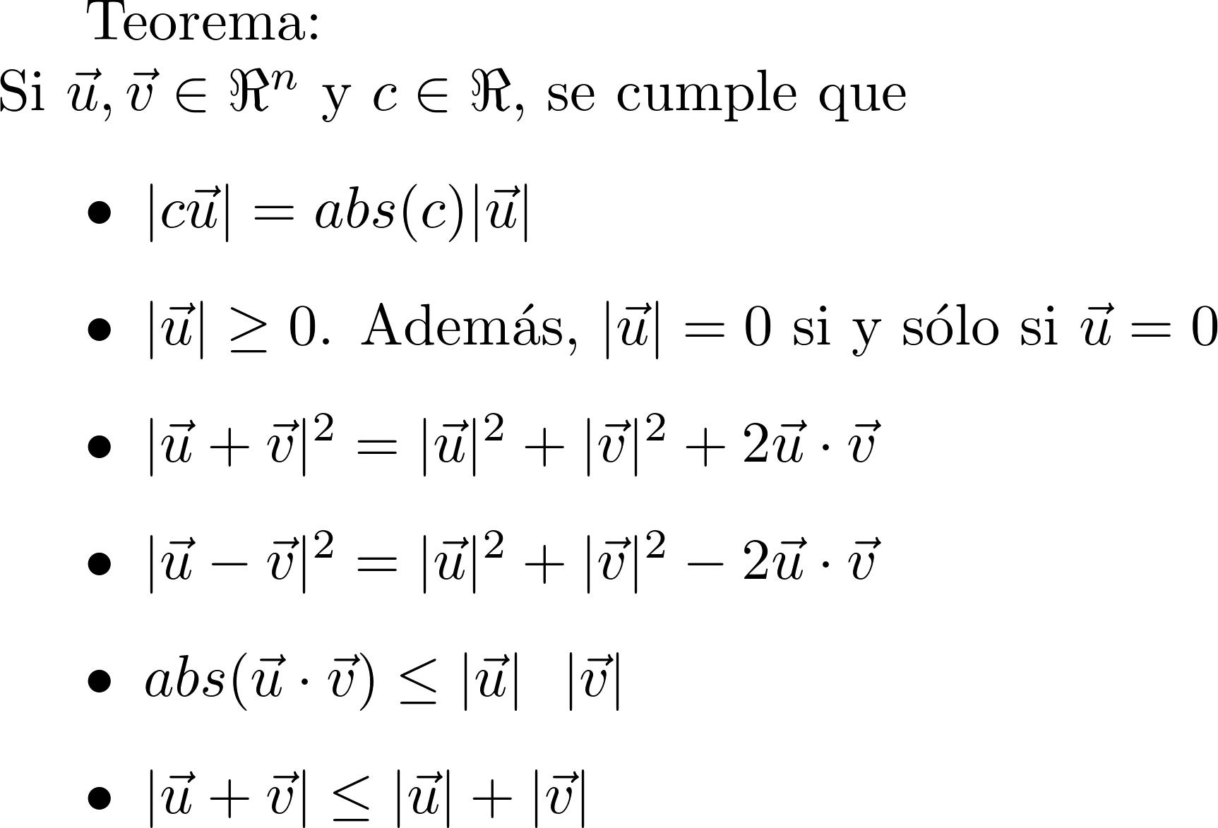




Propiedades de la magnitud
|$c\vec{u}| =\left|\left[\begin{matrix}\begin{matrix}{ca}_{1} \\ {ca}_{2}\end{matrix} \\ \begin{matrix}⋮ \\ {ca}_{n}\end{matrix}\end{matrix}\right]\right|$
$$=\sqrt{{c^{2}a}_{1}^{2}+{c^{2}a}_{2}^{2}+⋯+{c^{2}a}_{n}^{2}}$$
$=\sqrt{{c^{2}(a}_{1}^{2}+a_{2}^{2}+⋯+a_{n}^{2})}$
$=\text{a}\text{bs}(c)\sqrt{{ (a}_{1}^{2}+a_{2}^{2}+⋯+a_{n}^{2})}$
8
10
4
5
-3
5
3
6
-4
$$\left|\left(\begin{matrix}3 \\ 4\end{matrix}\right)\right|=5$$
$$\left|−1\left(\begin{matrix}3 \\ 4\end{matrix}\right)\right|=abs\left(−1\right)5=5$$
$$\left|2\left(\begin{matrix}3 \\ 4\end{matrix}\right)\right|=abs\left(2\right)5=10$$

Slide 29

Propiedades de la magnitud
$$\sqrt{\left[\begin{matrix}\begin{matrix}a_{1} \\ a_{2}\end{matrix} \\ \begin{matrix}⋮ \\ a_{n}\end{matrix}\end{matrix}\right]∙\left[\begin{matrix}\begin{matrix}a_{1} \\ a_{2}\end{matrix} \\ \begin{matrix}⋮ \\ a_{n}\end{matrix}\end{matrix}\right]}=\sqrt{a_{1}^{2}+a_{2}^{2}+⋯+a_{n}^{2}}$$

Slide 30




Propiedades de la magnitud
$${\left|\vec{u}−\vec{v}\right|}^{2}={\left(\sqrt{\left(\vec{u}−\vec{v}\right)⋅\left(\vec{u}−\vec{v}\right)}\right)}^{2}$$
$=\left(\vec{u}−\vec{v}\right)⋅\left(\vec{u}−\vec{v}\right)$
= $\left(\vec{u}−\vec{v}\right)⋅\vec{u}−\left(\vec{u}−\vec{v}\right)⋅\vec{v}$
$=\vec{u}⋅\vec{u}−\vec{v}⋅\vec{u}−\vec{u}⋅\vec{v}+\vec{v}⋅\vec{v}$
$={\left|\vec{u}\right|}^{2}+{\left|\vec{v}\right|}^{2}−2\vec{u}⋅\vec{v}$
$$=\vec{v}⋅\vec{v}$$
$${\left|\vec{w}\right|}^{2}=\vec{w}⋅\vec{w}$$

Slide 31






Propiedades de la magnitud
$$\vec{u}+\vec{v}$$
$$|\vec{v}|$$
$$\vec{v}$$
$|\vec{u}+\vec{v}$|
$$\vec{u}$$
$$|\vec{u}|$$
Desigualdad triangular

Slide 32
Propiedades de la magnitud

Slide 33

Operaciones entre vectores
Escalar $c∈ℝ$ por vector $\vec{u}$ $∈ℝ^{n}$
$$c\vec{u}=5\left[\begin{matrix}2 \\ 4\end{matrix}\right]=\left[\begin{matrix}5(2) \\ 5(4) \end{matrix}\right]=\left[\begin{matrix}10 \\ 20\end{matrix}\right]$$
Opuesto del vector $\vec{u}$ $∈ℝ^{n}$
$$−\vec{u}=(−1)\vec{u}=−1\left[\begin{matrix}2 \\ 4\end{matrix}\right]=\left[\begin{matrix}−1(2) \\ −1(4) \end{matrix}\right]=\left[\begin{matrix}−2 \\ −4\end{matrix}\right]$$
Suma de dos vectores $\vec{u},\vec{v}∈ℝ^{n}$
$$\vec{u}+\vec{v}=\left[\begin{matrix}2 \\ 4\end{matrix}\right]+\left[\begin{matrix}3 \\ −1\end{matrix}\right]=\left[\begin{matrix}2+3 \\ 4−1\end{matrix}\right]=\left[\begin{matrix}5 \\ 3\end{matrix}\right]$$
Resta de dos vectores $\vec{u},\vec{v}∈ℝ^{n}$
$$\vec{u}−\vec{v}=\vec{u}+\left(−1\right)\vec{v}=\left[\begin{matrix}2 \\ 4\end{matrix}\right]−\left[\begin{matrix}3 \\ −1\end{matrix}\right]=\left[\begin{matrix}2−3 \\ 4+1\end{matrix}\right]=\left[\begin{matrix}−1 \\ 5\end{matrix}\right]$$
Producto Punto de dos vectores $\vec{u},\vec{v}∈ℝ^{n}$
$$\vec{u}⋅\vec{v}=\left[\begin{matrix}2 \\ 4\end{matrix}\right]⋅\left[\begin{matrix}3 \\ −1\end{matrix}\right]=2\left(3\right)+4\left(−1\right)=2$$
Distancia entre dos vectores $\vec{u},\vec{v}∈ℝ^{n}$
$$Dist(\vec{u},\vec{v})=|\vec{u}−\vec{v}|=Dist(\left[\begin{matrix}2 \\ 4\end{matrix}\right],\left[\begin{matrix}3 \\ −1\end{matrix}\right])=\left|\left[\begin{matrix}2 \\ 4\end{matrix}\right]−\left[\begin{matrix}3 \\ −1\end{matrix}\right]\right|=\sqrt{{(−1)}^{2}+5^{2}}=\sqrt{26}$$
Magnitud de un vector $\vec{u}∈ℝ^{n}$
$$\left|\vec{u}\right|=\sqrt{\vec{u}⋅\vec{u}}=\left|\left[\begin{matrix}2 \\ 4\end{matrix}\right]\right|=\sqrt{\left[\begin{matrix}2 \\ 4\end{matrix}\right]⋅\left[\begin{matrix}2 \\ 4\end{matrix}\right]}=\sqrt{2^{2}+4^{2}}=2\sqrt{5}$$

Slide 34


Slide 35



Distancia entre vectores
$$\vec{v}$$
$$\vec{u}$$

Slide 36


Distancia entre vectores
$$\vec{v}$$
$$\vec{u}$$
$$|\vec{u}−\vec{v}|$$
$$\vec{u}−\vec{v}$$

Slide 37

Distancia entre vectores
$$\vec{v}$$
$$|\vec{u}−\vec{v}|$$
$$\vec{u}$$
$$|\vec{u}−\vec{v}|$$
$$\vec{u}−\vec{v}$$

Slide 38
Distancia entre vectores
$$\vec{v}$$
$$|\vec{u}−\vec{v}|$$
$$\vec{u}$$
$$|\vec{u}−\vec{v}|$$
$$\vec{u}−\vec{v}$$

Slide 39

Propiedades de la distancia

Slide 40





Vector unitario
1
$$\vec{u}=\left({2 \atop 0}\right)$$
-1
1
2
3
|$\left({2 \atop 0}\right)$|$=\sqrt{4+0}=2$
$$\hat{u}=\frac{1}{2}\left({2 \atop 0}\right)=\left({1 \atop 0}\right)$$
-1

Slide 41


Operaciones entre vectores
Escalar $c∈ℝ$ por vector $\vec{u}$ $∈ℝ^{n}$
$$c\vec{u}=5\left[\begin{matrix}2 \\ 4\end{matrix}\right]=\left[\begin{matrix}5(2) \\ 5(4) \end{matrix}\right]=\left[\begin{matrix}10 \\ 20\end{matrix}\right]$$
Opuesto del vector $\vec{u}$ $∈ℝ^{n}$
$$−\vec{u}=(−1)\vec{u}=−1\left[\begin{matrix}2 \\ 4\end{matrix}\right]=\left[\begin{matrix}−1(2) \\ −1(4) \end{matrix}\right]=\left[\begin{matrix}−2 \\ −4\end{matrix}\right]$$
Suma de dos vectores $\vec{u},\vec{v}∈ℝ^{n}$
$$\vec{u}+\vec{v}=\left[\begin{matrix}2 \\ 4\end{matrix}\right]+\left[\begin{matrix}3 \\ −1\end{matrix}\right]=\left[\begin{matrix}2+3 \\ 4−1\end{matrix}\right]=\left[\begin{matrix}5 \\ 3\end{matrix}\right]$$
Resta de dos vectores $\vec{u},\vec{v}∈ℝ^{n}$
$$\vec{u}−\vec{v}=\vec{u}+\left(−1\right)\vec{v}=\left[\begin{matrix}2 \\ 4\end{matrix}\right]−\left[\begin{matrix}3 \\ −1\end{matrix}\right]=\left[\begin{matrix}2−3 \\ 4+1\end{matrix}\right]=\left[\begin{matrix}−1 \\ 5\end{matrix}\right]$$
Producto Punto de dos vectores $\vec{u},\vec{v}∈ℝ^{n}$
$$\vec{u}⋅\vec{v}=\left[\begin{matrix}2 \\ 4\end{matrix}\right]⋅\left[\begin{matrix}3 \\ −1\end{matrix}\right]=2\left(3\right)+4\left(−1\right)=2$$
Distancia entre dos vectores $\vec{u},\vec{v}∈ℝ^{n}$
$$Dist(\vec{u},\vec{v})=|\vec{u}−\vec{v}|=Dist(\left[\begin{matrix}2 \\ 4\end{matrix}\right],\left[\begin{matrix}3 \\ −1\end{matrix}\right])=\left|\left[\begin{matrix}2 \\ 4\end{matrix}\right]−\left[\begin{matrix}3 \\ −1\end{matrix}\right]\right|=\sqrt{{(−1)}^{2}+5^{2}}=\sqrt{26}$$
Magnitud de un vector $\vec{u}∈ℝ^{n}$
$$\left|\vec{u}\right|=\sqrt{\vec{u}⋅\vec{u}}=\left|\left[\begin{matrix}2 \\ 4\end{matrix}\right]\right|=\sqrt{\left[\begin{matrix}2 \\ 4\end{matrix}\right]⋅\left[\begin{matrix}2 \\ 4\end{matrix}\right]}=\sqrt{2^{2}+4^{2}}=2\sqrt{5}$$
Vector unitario de un vector $\vec{u}∈ℝ^{n}$
$$\hat{u}=\frac{1}{\left|\vec{u}\right|}\vec{u}=\frac{1}{2\sqrt{5}}\left[\begin{matrix}2 \\ 4\end{matrix}\right]=\left[\begin{matrix}2/2\sqrt{5} \\ 4/2\sqrt{5}\end{matrix}\right]$$

Slide 42








Teorema del coseno
a
a
a
C
B
C
B
C
B
b
c
b
A
c
b
A
c
A
$$−\frac{2AB}{C}x_{a}=\frac{C^{2}−B^{2}−A^{2}}{C}$$
$$−2ABcos\left(a\right)=C^{2}−B^{2}−A^{2}$$
$$A^{2}−B^{2}−2ABcos\left(a\right)=C^{2}$$
$$C^{2}=A^{2}−B^{2}−2ABcos\left(a\right)$$

Slide 43






(Otro) significado del producto punto
$$\vec{u}⋅\vec{v}=\left|\vec{u}\right|\left|\vec{v}\right|\cos\left(α\right)$$

Slide 44








Interpretación gráfica del producto punto
$$\vec{u}⋅\vec{v}=\left|\vec{u}\right|\left|\vec{v}\right|\cos\left(α\right)$$
Cuando son paralelos
$α=0\cos\left(α\right)=1$
$\vec{u}⋅\vec{v}=\left|\vec{u}\right|\left|\vec{v}\right|$
Es este caso $\vec{u}=c\vec{v}$ para algún $c∈ℝ$
Cuando son unitarios
$$\left|\hat{u}\right|=1 \left|\hat{v}\right|=1$$
$$\hat{u}⋅\hat{v}=\cos\left(α\right)$$
$$0°$$
1
$$\hat{v}$$
Cuando son perpendiculares
$α=90°\cos\left(α\right)=$0
$$\vec{u}⋅\vec{v}=0$$
$$\hat{u}$$
-1
1
$$90°$$
-1

Slide 45


Similitud Coseno entre dos vectores
$$\cos\left(\vec{u},\vec{v}\right):=\frac{\vec{u}⋅\vec{v}}{\left|\vec{u}\right|\left|\vec{v}\right|}$$
-1
0
1
0
-1
0
1
-180°
-90°
0°
90°
180°
270°
360°

Slide 46


Propiedades de la
Similitud Coseno
$$\cos\left(\vec{u},\vec{v}\right):=\frac{\vec{u}⋅\vec{v}}{\left|\vec{u}\right|\left|\vec{v}\right|}$$
Teorema: Si $\vec{u},\vec{v}∈ℝ^{n}$, $a,b∈ℝ$
$\cos\left(\vec{u},\vec{v}\right)=\cos\left(\vec{v},\vec{u}\right)$ (Conmutativa)
$−1≤\cos\left(\vec{u},\vec{v}\right)≤1$ (Acotada)
$\cos\left(−\vec{u},\vec{v}\right)=−cos\left(\vec{u},\vec{v}\right)$ (Imparidad)
$\cos\left(\vec{u},\vec{v}\right)=\cos\left(a\vec{u},b\vec{v}\right)$ con $a>0, b>0$(Invariante a escala positiva)
$\cos\left(\vec{u},\vec{v}\right)=\cos\left(R(\vec{u}),R(\vec{v})\right)$ donde $R$ es una rotación (Invariante a rotaciones)
$\operatorname{dcos}\left(\vec{u},\vec{v}\right)≔1−\cos\left(\vec{u},\vec{v}\right)$ casi es una distancia pero no siempre cumple la desigualdad triangular.

Slide 47






Similitud Coseno
$$\cos\left(\vec{u},\vec{v}\right):=\frac{\vec{u}⋅\vec{v}}{\left|\vec{u}\right|\left|\vec{v}\right|}$$

Slide 48


Operaciones entre vectores
Escalar $c∈ℝ$ por vector $\vec{u}$ $∈ℝ^{n}$
$$c\vec{u}=5\left[\begin{matrix}2 \\ 4\end{matrix}\right]=\left[\begin{matrix}5(2) \\ 5(4) \end{matrix}\right]=\left[\begin{matrix}10 \\ 20\end{matrix}\right]$$
Opuesto del vector $\vec{u}$ $∈ℝ^{n}$
$$−\vec{u}=(−1)\vec{u}=−1\left[\begin{matrix}2 \\ 4\end{matrix}\right]=\left[\begin{matrix}−1(2) \\ −1(4) \end{matrix}\right]=\left[\begin{matrix}−2 \\ −4\end{matrix}\right]$$
Suma de dos vectores $\vec{u},\vec{v}∈ℝ^{n}$
$$\vec{u}+\vec{v}=\left[\begin{matrix}2 \\ 4\end{matrix}\right]+\left[\begin{matrix}3 \\ −1\end{matrix}\right]=\left[\begin{matrix}2+3 \\ 4−1\end{matrix}\right]=\left[\begin{matrix}5 \\ 3\end{matrix}\right]$$
Resta de dos vectores $\vec{u},\vec{v}∈ℝ^{n}$
$$\vec{u}−\vec{v}=\vec{u}+\left(−1\right)\vec{v}=\left[\begin{matrix}2 \\ 4\end{matrix}\right]−\left[\begin{matrix}3 \\ −1\end{matrix}\right]=\left[\begin{matrix}2−3 \\ 4+1\end{matrix}\right]=\left[\begin{matrix}−1 \\ 5\end{matrix}\right]$$
Producto Punto de dos vectores $\vec{u},\vec{v}∈ℝ^{n}$
$$\vec{u}⋅\vec{v}=\left[\begin{matrix}2 \\ 4\end{matrix}\right]⋅\left[\begin{matrix}3 \\ −1\end{matrix}\right]=2\left(3\right)+4\left(−1\right)=2$$
Distancia entre dos vectores $\vec{u},\vec{v}∈ℝ^{n}$
$$Dist(\vec{u},\vec{v})=|\vec{u}−\vec{v}|=Dist(\left[\begin{matrix}2 \\ 4\end{matrix}\right],\left[\begin{matrix}3 \\ −1\end{matrix}\right])=\left|\left[\begin{matrix}2 \\ 4\end{matrix}\right]−\left[\begin{matrix}3 \\ −1\end{matrix}\right]\right|=\sqrt{{(−1)}^{2}+5^{2}}=\sqrt{26}$$
Magnitud de un vector $\vec{u}∈ℝ^{n}$
$$\left|\vec{u}\right|=\sqrt{\vec{u}⋅\vec{u}}=\left|\left[\begin{matrix}2 \\ 4\end{matrix}\right]\right|=\sqrt{\left[\begin{matrix}2 \\ 4\end{matrix}\right]⋅\left[\begin{matrix}2 \\ 4\end{matrix}\right]}=\sqrt{2^{2}+4^{2}}=2\sqrt{5}$$
Similitud Coseno entre dos vectores $\vec{u},\vec{v}∈ℝ^{n}$
$$Cos(\vec{u},\vec{v})=\frac{\vec{u}⋅\vec{v}}{|\vec{u}||\vec{v}|}=Cos(\left[\begin{matrix}2 \\ 4\end{matrix}\right],\left[\begin{matrix}3 \\ −1\end{matrix}\right])=\frac{\left[\begin{matrix}2 \\ 4\end{matrix}\right]⋅\left[\begin{matrix}3 \\ −1\end{matrix}\right]}{\left|\left[\begin{matrix}2 \\ 4\end{matrix}\right]\right| \left|\left[\begin{matrix}3 \\ −1\end{matrix}\right]\right|}=\frac{2}{(2\sqrt{5}) (\sqrt{10}) }$$
Vector unitario de un vector $\vec{u}∈ℝ^{n}$
$$\hat{u}=\frac{1}{\left|\vec{u}\right|}\vec{u}=\frac{1}{2\sqrt{5}}\left[\begin{matrix}2 \\ 4\end{matrix}\right]=\left[\begin{matrix}2/2\sqrt{5} \\ 4/2\sqrt{5}\end{matrix}\right]$$

Slide 49

Perpendicular y paralelo

Slide 50


Operaciones entre vectores
Escalar $c∈ℝ$ por vector $\vec{u}$ $∈ℝ^{n}$
$$c\vec{u}=5\left[\begin{matrix}2 \\ 4\end{matrix}\right]=\left[\begin{matrix}5(2) \\ 5(4) \end{matrix}\right]=\left[\begin{matrix}10 \\ 20\end{matrix}\right]$$
Opuesto del vector $\vec{u}$ $∈ℝ^{n}$
$$−\vec{u}=(−1)\vec{u}=−1\left[\begin{matrix}2 \\ 4\end{matrix}\right]=\left[\begin{matrix}−1(2) \\ −1(4) \end{matrix}\right]=\left[\begin{matrix}−2 \\ −4\end{matrix}\right]$$
Suma de dos vectores $\vec{u},\vec{v}∈ℝ^{n}$
$$\vec{u}+\vec{v}=\left[\begin{matrix}2 \\ 4\end{matrix}\right]+\left[\begin{matrix}3 \\ −1\end{matrix}\right]=\left[\begin{matrix}2+3 \\ 4−1\end{matrix}\right]=\left[\begin{matrix}5 \\ 3\end{matrix}\right]$$
Resta de dos vectores $\vec{u},\vec{v}∈ℝ^{n}$
$$\vec{u}−\vec{v}=\vec{u}+\left(−1\right)\vec{v}=\left[\begin{matrix}2 \\ 4\end{matrix}\right]−\left[\begin{matrix}3 \\ −1\end{matrix}\right]=\left[\begin{matrix}2−3 \\ 4+1\end{matrix}\right]=\left[\begin{matrix}−1 \\ 5\end{matrix}\right]$$
Producto Punto de dos vectores $\vec{u},\vec{v}∈ℝ^{n}$
$$\vec{u}⋅\vec{v}=\left[\begin{matrix}2 \\ 4\end{matrix}\right]⋅\left[\begin{matrix}3 \\ −1\end{matrix}\right]=2\left(3\right)+4\left(−1\right)=2$$
Distancia entre dos vectores $\vec{u},\vec{v}∈ℝ^{n}$
$$Dist(\vec{u},\vec{v})=|\vec{u}−\vec{v}|=Dist(\left[\begin{matrix}2 \\ 4\end{matrix}\right],\left[\begin{matrix}3 \\ −1\end{matrix}\right])=\left|\left[\begin{matrix}2 \\ 4\end{matrix}\right]−\left[\begin{matrix}3 \\ −1\end{matrix}\right]\right|=\sqrt{{(−1)}^{2}+5^{2}}=\sqrt{26}$$
Magnitud de un vector $\vec{u}∈ℝ^{n}$
$$\left|\vec{u}\right|=\sqrt{\vec{u}⋅\vec{u}}=\left|\left[\begin{matrix}2 \\ 4\end{matrix}\right]\right|=\sqrt{\left[\begin{matrix}2 \\ 4\end{matrix}\right]⋅\left[\begin{matrix}2 \\ 4\end{matrix}\right]}=\sqrt{2^{2}+4^{2}}=2\sqrt{5}$$
Similitud Coseno entre dos vectores $\vec{u},\vec{v}∈ℝ^{n}$
$$Cos(\vec{u},\vec{v})=\frac{\vec{u}⋅\vec{v}}{|\vec{u}||\vec{v}|}=Cos(\left[\begin{matrix}2 \\ 4\end{matrix}\right],\left[\begin{matrix}3 \\ −1\end{matrix}\right])=\frac{\left[\begin{matrix}2 \\ 4\end{matrix}\right]⋅\left[\begin{matrix}3 \\ −1\end{matrix}\right]}{\left|\left[\begin{matrix}2 \\ 4\end{matrix}\right]\right| \left|\left[\begin{matrix}3 \\ −1\end{matrix}\right]\right|}=\frac{2}{(2\sqrt{5}) (\sqrt{10}) }$$
Vector unitario de un vector $\vec{u}∈ℝ^{n}$
$$\hat{u}=\frac{1}{\left|\vec{u}\right|}\vec{u}=\frac{1}{2\sqrt{5}}\left[\begin{matrix}2 \\ 4\end{matrix}\right]=\left[\begin{matrix}2/2\sqrt{5} \\ 4/2\sqrt{5}\end{matrix}\right]$$
Dos vectores $\vec{u},\vec{v}∈ℝ^{n}$ son ortogonales si $cos(\vec{u},\vec{v})=$0,
i.e. los vectores son perpendiculares
$Ort(\vec{u},\vec{v})=\left\{\begin{aligned}Verdadero si \vec{u}⋅\vec{v}=0 \\ Falso si \vec{u}⋅\vec{v}≠0\end{aligned}\right.$ $Ort\left(\left[\begin{matrix}2 \\ 4\end{matrix}\right],\left[\begin{matrix}3 \\ −1\end{matrix}\right]\right)=Falso$

Slide 51


Proyección

Slide 52





Operaciones entre vectores
Escalar $c∈ℝ$ por vector $\vec{u}$ $∈ℝ^{n}$
$$c\vec{u}=5\left[\begin{matrix}2 \\ 4\end{matrix}\right]=\left[\begin{matrix}5(2) \\ 5(4) \end{matrix}\right]=\left[\begin{matrix}10 \\ 20\end{matrix}\right]$$
Opuesto del vector $\vec{u}$ $∈ℝ^{n}$
$$−\vec{u}=(−1)\vec{u}=−1\left[\begin{matrix}2 \\ 4\end{matrix}\right]=\left[\begin{matrix}−1(2) \\ −1(4) \end{matrix}\right]=\left[\begin{matrix}−2 \\ −4\end{matrix}\right]$$
Suma de dos vectores $\vec{u},\vec{v}∈ℝ^{n}$
$$\vec{u}+\vec{v}=\left[\begin{matrix}2 \\ 4\end{matrix}\right]+\left[\begin{matrix}3 \\ −1\end{matrix}\right]=\left[\begin{matrix}2+3 \\ 4−1\end{matrix}\right]=\left[\begin{matrix}5 \\ 3\end{matrix}\right]$$
Resta de dos vectores $\vec{u},\vec{v}∈ℝ^{n}$
$$\vec{u}−\vec{v}=\vec{u}+\left(−1\right)\vec{v}=\left[\begin{matrix}2 \\ 4\end{matrix}\right]−\left[\begin{matrix}3 \\ −1\end{matrix}\right]=\left[\begin{matrix}2−3 \\ 4+1\end{matrix}\right]=\left[\begin{matrix}−1 \\ 5\end{matrix}\right]$$
Producto Punto de dos vectores $\vec{u},\vec{v}∈ℝ^{n}$
$$\vec{u}⋅\vec{v}=\left[\begin{matrix}2 \\ 4\end{matrix}\right]⋅\left[\begin{matrix}3 \\ −1\end{matrix}\right]=2\left(3\right)+4\left(−1\right)=2$$
Distancia entre dos vectores $\vec{u},\vec{v}∈ℝ^{n}$
$$Dist(\vec{u},\vec{v})=|\vec{u}−\vec{v}|=Dist(\left[\begin{matrix}2 \\ 4\end{matrix}\right],\left[\begin{matrix}3 \\ −1\end{matrix}\right])=\left|\left[\begin{matrix}2 \\ 4\end{matrix}\right]−\left[\begin{matrix}3 \\ −1\end{matrix}\right]\right|=\sqrt{{(−1)}^{2}+5^{2}}=\sqrt{26}$$
Magnitud de un vector $\vec{u}∈ℝ^{n}$
$$\left|\vec{u}\right|=\sqrt{\vec{u}⋅\vec{u}}=\left|\left[\begin{matrix}2 \\ 4\end{matrix}\right]\right|=\sqrt{\left[\begin{matrix}2 \\ 4\end{matrix}\right]⋅\left[\begin{matrix}2 \\ 4\end{matrix}\right]}=\sqrt{2^{2}+4^{2}}=2\sqrt{5}$$
Similitud Coseno entre dos vectores $\vec{u},\vec{v}∈ℝ^{n}$
$$Cos(\vec{u},\vec{v})=\frac{\vec{u}⋅\vec{v}}{|\vec{u}||\vec{v}|}=Cos(\left[\begin{matrix}2 \\ 4\end{matrix}\right],\left[\begin{matrix}3 \\ −1\end{matrix}\right])=\frac{\left[\begin{matrix}2 \\ 4\end{matrix}\right]⋅\left[\begin{matrix}3 \\ −1\end{matrix}\right]}{\left|\left[\begin{matrix}2 \\ 4\end{matrix}\right]\right| \left|\left[\begin{matrix}3 \\ −1\end{matrix}\right]\right|}=\frac{2}{(2\sqrt{5}) (\sqrt{10}) }$$
Vector unitario de un vector $\vec{u}∈ℝ^{n}$
$$\hat{u}=\frac{1}{\left|\vec{u}\right|}\vec{u}=\frac{1}{2\sqrt{5}}\left[\begin{matrix}2 \\ 4\end{matrix}\right]=\left[\begin{matrix}2/2\sqrt{5} \\ 4/2\sqrt{5}\end{matrix}\right]$$
La proyección de $\vec{u},\text{sobre}\vec{v}∈ℝ^{n}$ está dada por:
$Proy\left(\vec{u},\vec{v}\right)=\frac{\vec{u}⋅\vec{v}}{\vec{v}⋅\vec{v}}\vec{v}$
$Proy\left(\left[\begin{matrix}2 \\ 4\end{matrix}\right],\left[\begin{matrix}3 \\ −1\end{matrix}\right]\right)=\frac{\left[\begin{matrix}2 \\ 4\end{matrix}\right]⋅\left[\begin{matrix}3 \\ −1\end{matrix}\right]}{\left[\begin{matrix}3 \\ −1\end{matrix}\right]⋅\left[\begin{matrix}3 \\ −1\end{matrix}\right]}\left[\begin{matrix}3 \\ −1\end{matrix}\right]=\left[\begin{matrix}3/5 \\ −1/5\end{matrix}\right]$
Dos vectores $\vec{u},\vec{v}∈ℝ^{n}$ son ortogonales si $cos(\vec{u},\vec{v})=$0,
i.e. los vectores son perpendiculares
$Ort(\vec{u},\vec{v})=\left\{\begin{aligned}Verdadero si \vec{u}⋅\vec{v}=0 \\ Falso si \vec{u}⋅\vec{v}≠0\end{aligned}\right.$ $Ort\left(\left[\begin{matrix}2 \\ 4\end{matrix}\right],\left[\begin{matrix}3 \\ −1\end{matrix}\right]\right)=Falso$

Slide 53
Ejercicios
Ejercicios:\\
Sección 2.2 de Nakos

Slide 54
Producto Interno

Slide 55



$$R$$
$$R^{2}$$
$$R^{n}$$

Slide 56







Espacios Vectoriales
$$u+v, cu$$
A1, A2, A3, A4, A5
M1, M2, M3, M4, M5
$$R$$
$$R^{2}$$
$$R^{n}$$
$$R^{Z}$$
$$R^{R}$$
$$\left\{1,2\right\}→ℝ$$
$$\left\{1,2, …, n\right\}→ℝ$$
$$ℤ→ℝ$$
$$ℝ →ℝ$$

Slide 57






Espacios Vectoriales
$$u+v, cu$$
$$P_{2}$$
$$P_{n}$$
$$F(R)$$
$$P_{1}$$
$$P$$
$$R$$
$$R^{2}$$
$$R^{n}$$
$$R^{Z}$$
$$R^{R}$$

Slide 58





Espacios Vectoriales
$$u+v, cu$$
Espacios Vectoriales de dimensión finita
$$P_{2}$$
$$P_{n}$$
$$P$$
$$F(R)$$
$$P_{1}$$
$$R$$
$$R^{2}$$
$$R^{n}$$
$$R^{Z}$$
$$R^{R}$$

Slide 59


Espacios Métricos
Espacios Vectoriales
$$u+v, cu$$
Espacios Vectoriales de dimensión finita
$$P_{2}$$
$$F(R)$$
$$P_{n}$$
$$P$$
$$P_{1}$$
$$R$$
$$R^{2}$$
$$R^{n}$$
$$R^{Z}$$
$$R^{R}$$

Slide 60


Espacios Métricos
$$d(u,v)$$
Espacios Vectoriales
$$u+v, cu$$

Slide 61


Espacios Métricos
$$d(u,v)$$
Espacios Normados
$$|u|$$
Espacios Vectoriales
$$u+v, cu$$

Slide 62

Espacios Métricos
$$d(u,v)$$
Espacios Normados
$$|u|$$
Espacios con producto interno
$$\left\langle u,v\right\rangle$$
Espacios Vectoriales
$$u+v, cu$$

Slide 63

Espacios Métricos
$$d(u,v)$$
Espacios Normados
$$|u|$$
$R^{n}$ con
producto punto
Espacios con producto interno
$$\left\langle u,v\right\rangle$$
Espacios Vectoriales
$$u+v, cu$$

Slide 64




Espacios Métricos
Recordemos que la distancia entre dos vectores $\vec{u}$ y $\vec{v}$ de $ℝ^{n}$ cumple las siguientes propiedades:
Si en un conjunto $S$ es posible medir la distancia $d(a,b)$ entre los elementos $a,b∈S$;
y además la distancia cumple las anteriores propiedades se dice que el conjunto $S$ es un espacio métrico.
Por ejemplo:
El conjunto $C[0,1]$ de las funciones continuas entre 0 y 1 con la métrica
$$d_{1}\left(f,g\right)=\int_{0}^{1}{abs\left(f\left(x\right)−g\left(x\right)\right)dx}$$
f
$$d_{1}\left(f,g\right)$$
g
http://www-groups.mcs.st-andrews.ac.uk/~john/analysis/Lectures/L15.html
$C[0,1]$

