Slide 1
Instrucciones PIO

Slide 2
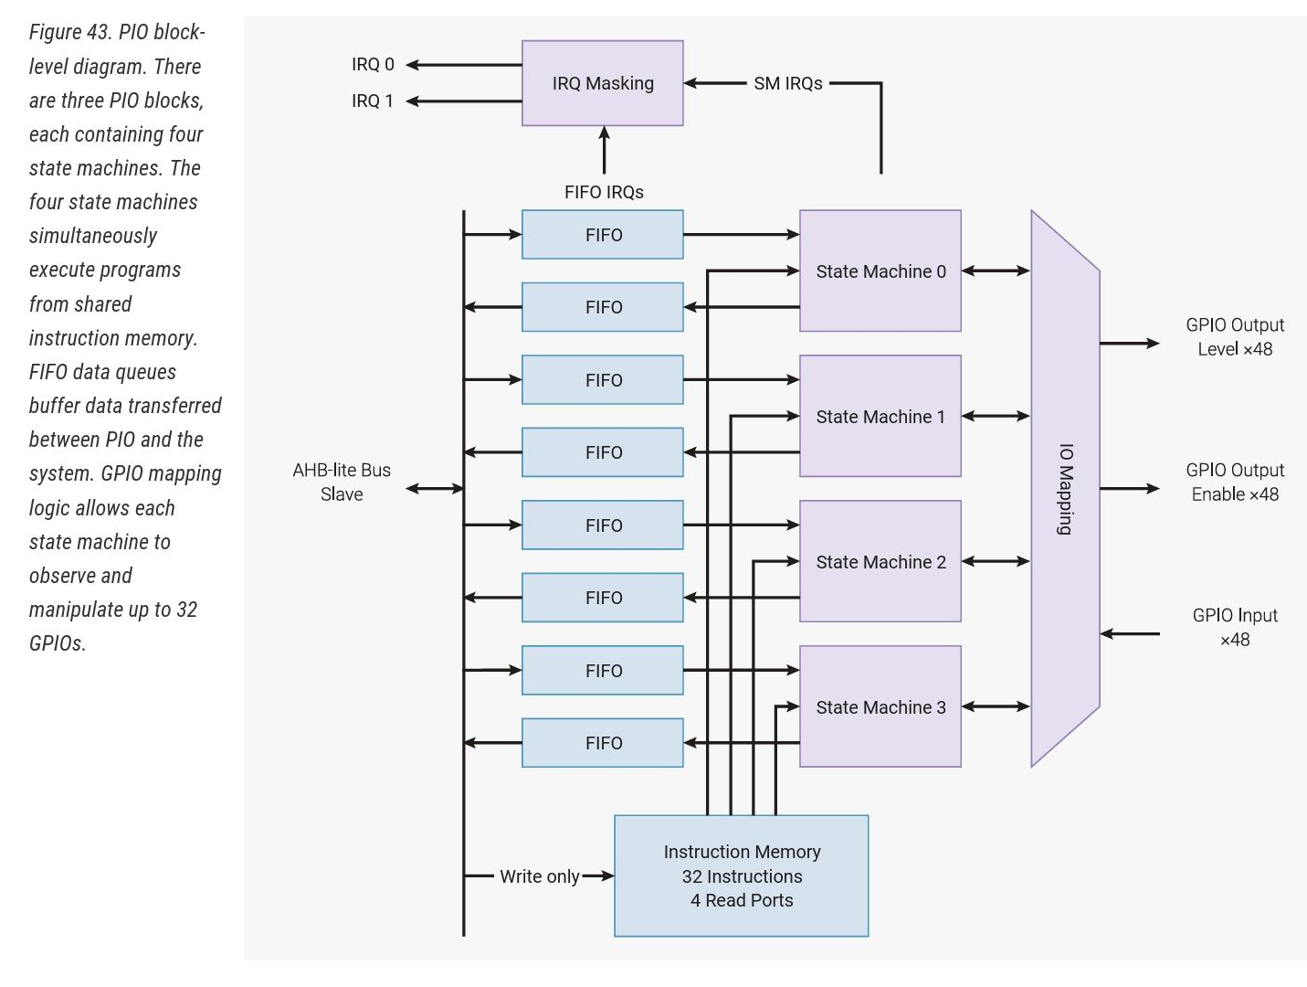

Slide 3
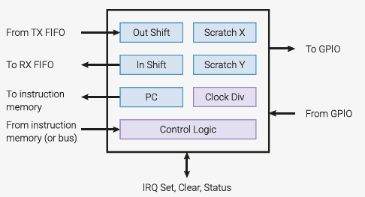
RP2040
The clock divider is computed as system clock frequency / freq, so there can be slight rounding errors.
The minimum possible clock divider is one 65536th of the system clock: so at the default system clock frequency of 125MHz, the minimum value of freq is 1908. To run state machines at slower frequencies, you’ll need to reduce the system clock speed with machine.freq().
RP2040 125MHz
RP2350 150MHz

Slide 4
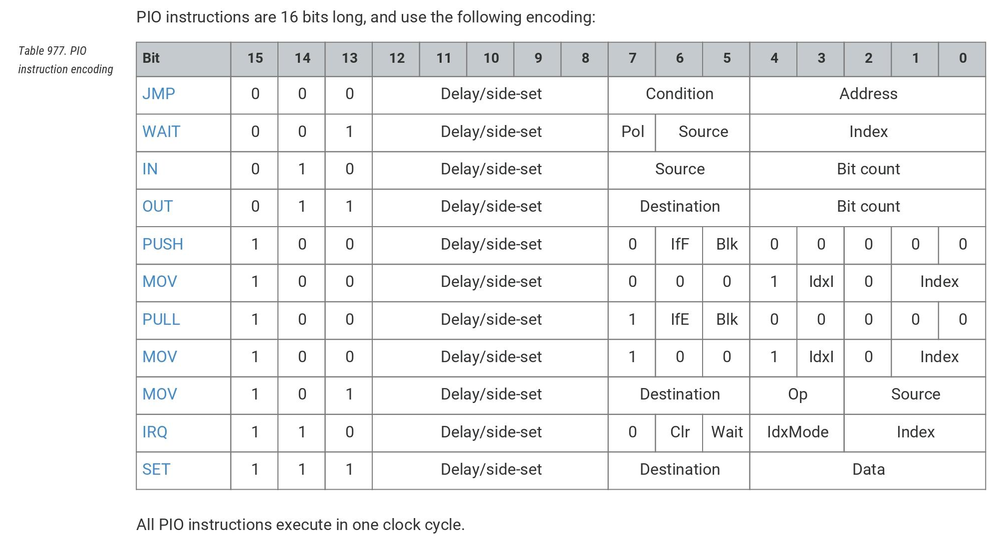
bits(Delay) + bits(side-set) = 5
sideset_count=bits(side-set)

Slide 5
from machine import Pin
import rp2
—---------------------->>>>>>>>>>>>>>>>
# Create and start a StateMachine
# with blink_1hz, outputting on Pin(25)
sm = rp2.StateMachine(
0,
blink_1hz,
freq=2300,
set_base=Pin(25)
)
sm.active(1)
@rp2.asm_pio(set_init=rp2.PIO.OUT_LOW)
def blink_1hz():
# Cycles: 1 + 7 + 32 * (30 + 1) = 1000
set(pins, 1)
set(x, 31) [6]
label("delay_high")
nop() [29]
jmp(x_dec, "delay_high")
# Cycles: 1 + 7 + 32 * (30 + 1) = 1000
set(pins, 0)
set(x, 31) [6]
label("delay_low")
nop() [29]
jmp(x_dec, "delay_low")

Slide 6
nop()
This is a pseudoinstruction that assembles to mov(y, y) and has no effect.

Slide 7
.side(value)
This is a modifier which can be applied to any instruction, and is used to control side-set pin values.
value: the value (bits) to output on the side-set pins
nop().side(1)
.delay(value)
[value]
This is a modifier which can be applied to any instruction, and specifies how many cycles to delay for after the instruction executes.
value: cycles to delay, 0-31 (maximum value reduced if side-set pins are used)
nop() [31]
nop().delay(31)
bits(Delay) + bits(side-set) = 5
sideset_count=bits(side-set)

Slide 8
wrap_target()
Specify the location where execution continues after program wrapping. By default this is the start of the PIO routine.
wrap()
Specify the location where the program finishes and wraps around. If this directive is not used then it is added automatically at the end of the PIO routine. Wrapping does not cost any execution cycles.

Slide 9
jmp(label), jmp(cond, label)
cond: the condition to check, one of:
not_x, not_y: true if register is zero
x_dec, y_dec: true if register is non-zero, and do post decrement
x_not_y: true if X is not equal to Y
pin: true if the input pin is set
not_osre: true if OSR is not empty (hasn’t reached its threshold)
label: label to jump to if condition is true
pin is defined by jmp_pin (rp2.StateMachine)
label(label)
Define a label called label at the current location. label can be a string or integer.

Slide 11
set(dest, data)
Set dest with the value data.
dest: pins, x, y, pindirs
data: value (0-31)
pins are defined by set_base (rp2.StateMachine)

Slide 12
mov(dest, src)
Move into dest the value from src.
dest: one of: pins, x, y, exec, pc, isr, osr
src: one of: pins, x, y, null, status, isr, osr;
this argument can be optionally modified by wrapping it in invert() or reverse() (but not both together)
mov(x, invert(0))
dest_pins are defined by out_base (rp2.StateMachine)
src_pins do not need definition ()

Slide 13


Slide 14


Slide 15
in_(src, bit_count)
Shift data in from src to ISR.
src: one of: pins, x, y, null, isr, osr
bit_count: number of bits to shift in (1-32)

Slide 16
out(dest, bit_count)
Shift data out from OSR to dest.
dest: one of: pins, x, y, pindirs, pc, isr, exec
bit_count: number of bits to shift out (1-32)

Slide 17
push(…)
Push ISR to the RX FIFO, then clear ISR to zero. This instruction takes the following forms:
push(), push(block), push(noblock)
push(iffull), push(iffull, block), push(iffull, noblock)
If block is used then the instruction stalls if the RX FIFO is full. The default is to block. If iffull is used then it only pushes if the input shift count has reached its threshold.

Slide 18
pull(…)
Pull from the TX FIFO into OSR. This instruction takes the following forms:
pull(), pull(block), pull(noblock)
pull(ifempty), pull(ifempty, block), pull(ifempty, noblock)
If block is used then the instruction stalls if the TX FIFO is empty. The default is to block. If ifempty is used then it only pulls if the output shift count has reached its threshold.

Slide 19
irq(…)
Set or clear an IRQ flag. This instruction takes two forms:
irq(index)
index: 0-7, or rel(0) to rel(7)
irq(mode, index)
mode: one of: block, clear
index: 0-7, or rel(0) to rel(7)
If block is used then the instruction stalls until the flag is cleared by another entity. If clear is used then the flag is cleared instead of being set. Relative IRQ indices add the state machine ID to the IRQ index with modulo-4 addition. IRQs 0-3 are visible from to the processor, 4-7 are internal to the state machines.

Slide 20
wait(polarity, src, index)
Block, waiting for high/low on a pin or IRQ line.
polarity: 0 or 1, whether to wait for a low or high value
src: one of: gpio (absolute pin), pin (pin relative to StateMachine’s in_base argument), irq
index: 0-31, the index for src

Slide 21
word(instr, label=None)
Insert an arbitrary 16-bit word in the assembled output.
instr: the 16-bit value
label: if given, look up the label and logical-or the label’s value with instr

Slide 22
# Example using PIO to blink an LED and raise an IRQ at 1Hz.
import time
from machine import Pin
import rp2
—---------------------------------------->>>>>>>>>
# Create the StateMachine with the blink_1hz program, outputting on Pin(25).
sm = rp2.StateMachine(0, blink_1hz, freq=2000, set_base=Pin(25))
# Set the IRQ handler to print the millisecond timestamp.
sm.irq(lambda p: print(time.ticks_ms()))
# Start the StateMachine.
sm.active(1)
@rp2.asm_pio(set_init=rp2.PIO.OUT_LOW)
def blink_1hz():
# Cycles: 1 + 1 + 6 + 32 * (30 + 1) = 1000
irq(rel(0))
set(pins, 1)
set(x, 31) [5]
label("delay_high")
nop() [29]
jmp(x_dec, "delay_high")
# Cycles: 1 + 1 + 6 + 32 * (30 + 1) = 1000
nop()
set(pins, 0)
set(x, 31) [5]
label("delay_low")
nop() [29]
jmp(x_dec, "delay_low")

