Slide 1
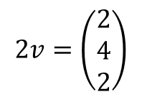
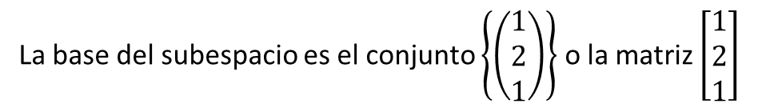

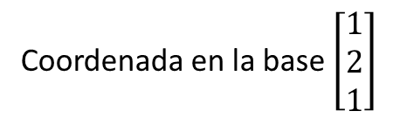
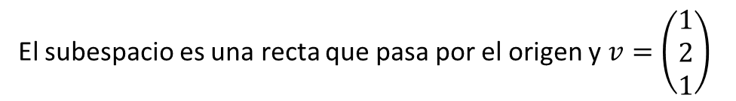

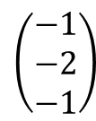

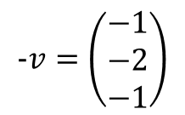


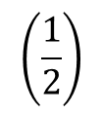
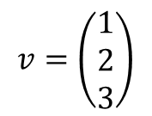
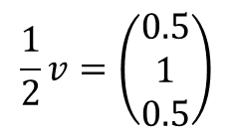

Coordenada en la base $\left[\begin{matrix}1 \\ 2 \\ 1\end{matrix}\right]$
Coordenadas
Vector
$$v=\left(\begin{matrix}1 \\ 2 \\ 3\end{matrix}\right)$$
(1)
El subespacio es una recta que pasa por el origen y $v=\left(\begin{matrix}1 \\ 2 \\ 1\end{matrix}\right)$
$$2v=\left(\begin{matrix}2 \\ 4 \\ 2\end{matrix}\right)$$
(2)
$$\frac{1}{2}v=\left(\begin{matrix}0.5 \\ 1 \\ 0.5\end{matrix}\right)$$
$$\left(\frac{1}{2}\right)$$
La base del subespacio es el conjunto $\left\{\left(\begin{matrix}1 \\ 2 \\ 1\end{matrix}\right)\right\}$ o la matriz $\left[\begin{matrix}1 \\ 2 \\ 1\end{matrix}\right]$
$$-v=\left(\begin{matrix}−1 \\ −2 \\ −1\end{matrix}\right)$$
(-1)
$$2v$$
$$\frac{1}{2}v$$
$$\left(\begin{matrix}2 \\ 4 \\ 2\end{matrix}\right)$$
$$v$$
$$-v$$
$$\left(\begin{matrix}0.5 \\ 1 \\ 0.5\end{matrix}\right)$$
$$\left(\begin{matrix}−1 \\ −2 \\ −1\end{matrix}\right)$$

Slide 2

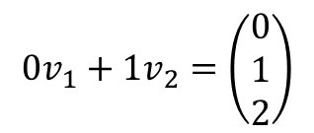




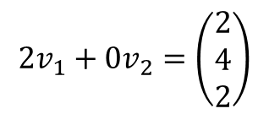
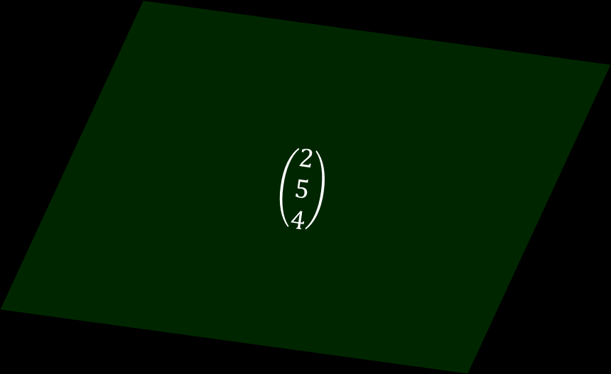

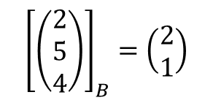

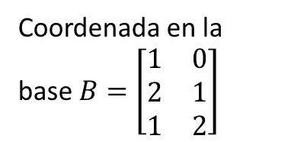

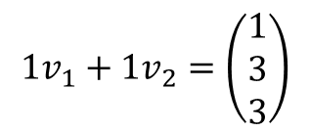
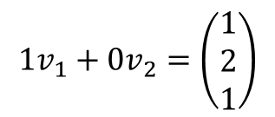
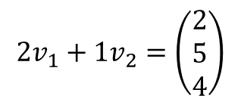
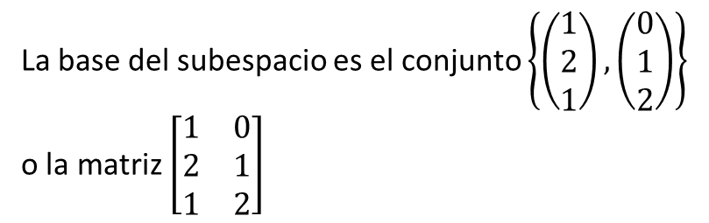


Coordenada en la base $B=\left[\begin{matrix}\begin{matrix}1 \\ 2 \\ 1\end{matrix} & \begin{matrix}0 \\ 1 \\ 2\end{matrix}\end{matrix}\right]$
Vector
La base del subespacio es el conjunto $\left\{\left(\begin{matrix}1 \\ 2 \\ 1\end{matrix}\right),\left(\begin{matrix}0 \\ 1 \\ 2\end{matrix}\right)\right\}$ o la matriz $\left[\begin{matrix}\begin{matrix}1 \\ 2 \\ 1\end{matrix} & \begin{matrix}0 \\ 1 \\ 2\end{matrix}\end{matrix}\right]$
$$1v_{1}+0v_{2}=\left(\begin{matrix}1 \\ 2 \\ 1\end{matrix}\right)$$
$$\left(\begin{matrix}1 \\ 0\end{matrix}\right)$$
$$0v_{1}+1v_{2}=\left(\begin{matrix}0 \\ 1 \\ 2\end{matrix}\right)$$
$$\left(\begin{matrix}0 \\ 1\end{matrix}\right)$$
$${2v}_{1}+v_{2}$$
$$\left(\begin{matrix}2 \\ 5 \\ 4\end{matrix}\right)$$
$$v_{1}+v_{2}$$
$$\left(\begin{matrix}2 \\ 5 \\ 4\end{matrix}\right)$$
$$1v_{1}+1v_{2}=\left(\begin{matrix}1 \\ 3 \\ 3\end{matrix}\right)$$
$$\left(\begin{matrix}1 \\ 1\end{matrix}\right)$$
$$v_{2}$$
$$2v_{1}+0v_{2}=\left(\begin{matrix}2 \\ 4 \\ 2\end{matrix}\right)$$
$$\left(\begin{matrix}2 \\ 0\end{matrix}\right)$$
$$v_{1}$$
$${2v}_{1}$$
$$2v_{1}+1v_{2}=\left(\begin{matrix}2 \\ 5 \\ 4\end{matrix}\right)$$
$${\left[\left(\begin{matrix}2 \\ 5 \\ 4\end{matrix}\right)\right]}_{B}=\left(\begin{matrix}2 \\ 1\end{matrix}\right)$$

Slide 3
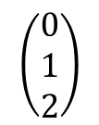

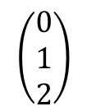

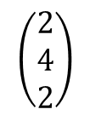

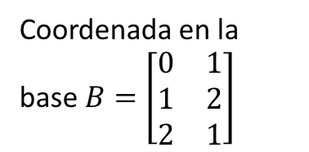
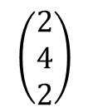
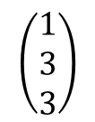
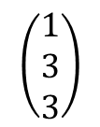
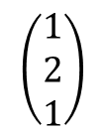
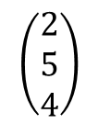

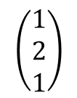
Coordenada en la base $B=\left[\begin{matrix}\begin{matrix}0 \\ 1 \\ 2\end{matrix} & \begin{matrix}1 \\ 2 \\ 1\end{matrix}\end{matrix}\right]$
Vector
La base del subespacio es el conjunto $\left\{\left(\begin{matrix}1 \\ 2 \\ 1\end{matrix}\right),\left(\begin{matrix}0 \\ 1 \\ 2\end{matrix}\right)\right\}$ o la matriz $\left[\begin{matrix}\begin{matrix}1 \\ 2 \\ 1\end{matrix} & \begin{matrix}0 \\ 1 \\ 2\end{matrix}\end{matrix}\right]$
$$\left(\begin{matrix}1 \\ 2 \\ 1\end{matrix}\right)$$
$$\left(\begin{matrix}0 \\ 1\end{matrix}\right)$$
$$\left(\begin{matrix}0 \\ 1 \\ 2\end{matrix}\right)$$
$$\left(\begin{matrix}1 \\ 3 \\ 3\end{matrix}\right)$$
$$\left(\begin{matrix}1 \\ 0\end{matrix}\right)$$
$${2v}_{1}+v_{2}$$
$$\left(\begin{matrix}2 \\ 5 \\ 4\end{matrix}\right)$$
$$v_{1}+v_{2}$$
$$\left(\begin{matrix}2 \\ 5 \\ 4\end{matrix}\right)$$
$$\left(\begin{matrix}1 \\ 3 \\ 3\end{matrix}\right)$$
$$\left(\begin{matrix}1 \\ 1\end{matrix}\right)$$
$$\left(\begin{matrix}0 \\ 1 \\ 2\end{matrix}\right)$$
$$v_{2}$$
$$\left(\begin{matrix}2 \\ 4 \\ 2\end{matrix}\right)$$
$$\left(\begin{matrix}0 \\ 2\end{matrix}\right)$$
$$v_{1}$$
$${2v}_{1}$$
$$\left(\begin{matrix}2 \\ 4 \\ 2\end{matrix}\right)$$
$$\left(\begin{matrix}2 \\ 5 \\ 4\end{matrix}\right)$$
$$\left(\begin{matrix}1 \\ 2 \\ 1\end{matrix}\right)$$
$$\left(\begin{matrix}1 \\ 2\end{matrix}\right)$$

Slide 4
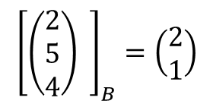

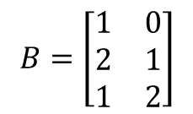

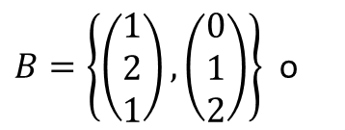
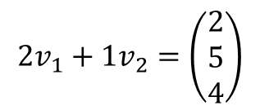
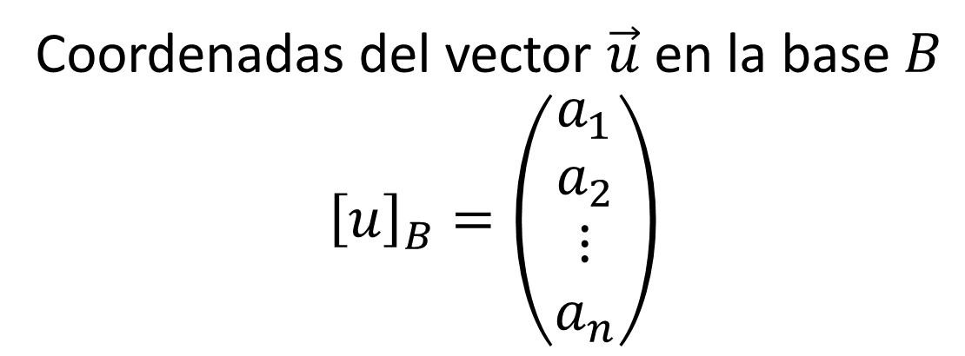
$$a_{1}{\vec{v}}_{1}+a_{2}{\vec{v}}_{2}+…+a_{n}{\vec{v}}_{n}=u$$
$$2v_{1}+1v_{2}=\left(\begin{matrix}2 \\ 5 \\ 4\end{matrix}\right)$$
Base $B=\{ v_{1}, v_{2}, …, v_{n}\}$
$B=\left\{\left(\begin{matrix}1 \\ 2 \\ 1\end{matrix}\right),\left(\begin{matrix}0 \\ 1 \\ 2\end{matrix}\right)\right\}$ o
$$B=\left[\begin{matrix}\begin{matrix}1 \\ 2 \\ 1\end{matrix} & \begin{matrix}0 \\ 1 \\ 2\end{matrix}\end{matrix}\right]$$
Coordenadas del vector $\vec{u}$ en la base $B$
$${\left[u\right]}_{B}=\left(\begin{matrix}a_{1} \\ a_{2} \\ ⋮ \\ a_{n}\end{matrix}\right)$$
$${\left[\left(\begin{matrix}2 \\ 5 \\ 4\end{matrix}\right) \right]}_{B}=\left(\begin{matrix}2 \\ 1\end{matrix}\right)$$

Slide 5
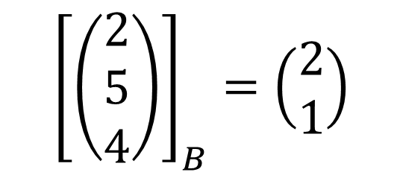
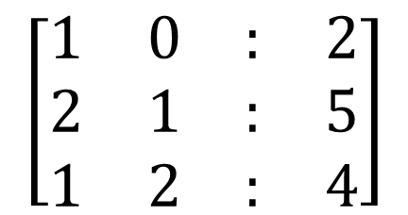
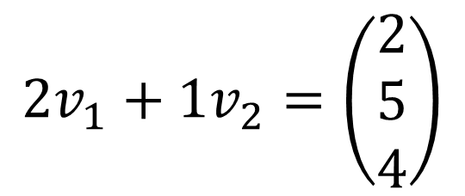
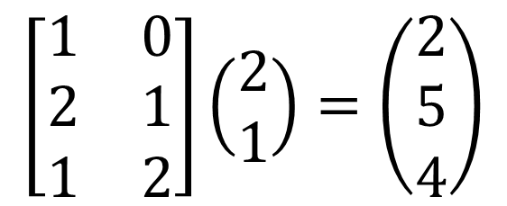
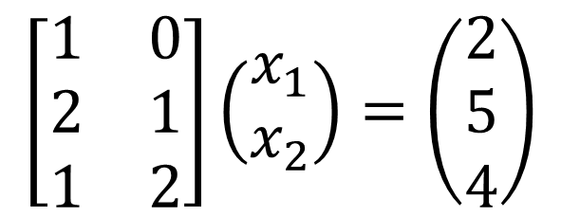
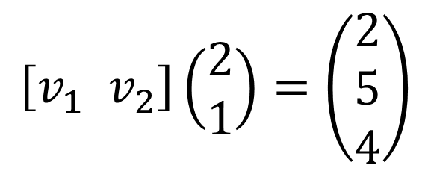
$$2v_{1}+1v_{2}=\left(\begin{matrix}2 \\ 5 \\ 4\end{matrix}\right)$$
$$\left[v_{1} v_{2}\right]\left(\begin{matrix}2 \\ 1\end{matrix}\right)=\left(\begin{matrix}2 \\ 5 \\ 4\end{matrix}\right)$$
$$\left[\begin{matrix}\begin{matrix}1 \\ 2 \\ 1\end{matrix} & \begin{matrix}0 \\ 1 \\ 2\end{matrix}\end{matrix}\right]\left(\begin{matrix}2 \\ 1\end{matrix}\right)=\left(\begin{matrix}2 \\ 5 \\ 4\end{matrix}\right)$$
$${\left[\left(\begin{matrix}2 \\ 5 \\ 4\end{matrix}\right)\right]}_{B}=\left(\begin{matrix}2 \\ 1\end{matrix}\right)$$
$$x_{1}$$
$$x_{2}$$
$$\left[\begin{matrix}\begin{matrix}1 \\ 2 \\ 1\end{matrix} & \begin{matrix}0 \\ 1 \\ 2\end{matrix}\end{matrix}\right]\left(\begin{matrix}x_{1} \\ x_{2}\end{matrix}\right)=\left(\begin{matrix}2 \\ 5 \\ 4\end{matrix}\right)$$
$$\left[\begin{matrix}\begin{matrix}1 \\ 2 \\ 1\end{matrix} & \begin{matrix}0 & : & 2 \\ 1 & : & 5 \\ 2 & : & 4\end{matrix}\end{matrix}\right]$$

