Slide 1
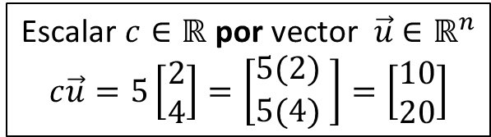
Operaciones entre vectores
Escalar $c∈ℝ$ por vector $\vec{u}$ $∈ℝ^{n}$
$$c\vec{u}=5\left[\begin{matrix}2 \\ 4\end{matrix}\right]=\left[\begin{matrix}5(2) \\ 5(4) \end{matrix}\right]=\left[\begin{matrix}10 \\ 20\end{matrix}\right]$$

Slide 2
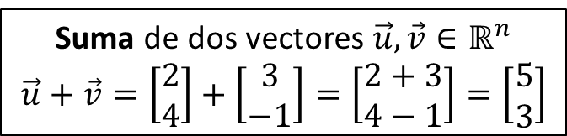
Operaciones entre vectores
Escalar $c∈ℝ$ por vector $\vec{u}$ $∈ℝ^{n}$
$$c\vec{u}=5\left[\begin{matrix}2 \\ 4\end{matrix}\right]=\left[\begin{matrix}5(2) \\ 5(4) \end{matrix}\right]=\left[\begin{matrix}10 \\ 20\end{matrix}\right]$$
Suma de dos vectores $\vec{u},\vec{v}∈ℝ^{n}$
$$\vec{u}+\vec{v}=\left[\begin{matrix}2 \\ 4\end{matrix}\right]+\left[\begin{matrix}3 \\ −1\end{matrix}\right]=\left[\begin{matrix}2+3 \\ 4−1\end{matrix}\right]=\left[\begin{matrix}5 \\ 3\end{matrix}\right]$$

Slide 3
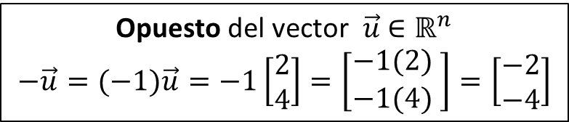
Operaciones entre vectores
Escalar $c∈ℝ$ por vector $\vec{u}$ $∈ℝ^{n}$
$$c\vec{u}=5\left[\begin{matrix}2 \\ 4\end{matrix}\right]=\left[\begin{matrix}5(2) \\ 5(4) \end{matrix}\right]=\left[\begin{matrix}10 \\ 20\end{matrix}\right]$$
Opuesto del vector $\vec{u}$ $∈ℝ^{n}$
$$−\vec{u}=(−1)\vec{u}=−1\left[\begin{matrix}2 \\ 4\end{matrix}\right]=\left[\begin{matrix}−1(2) \\ −1(4) \end{matrix}\right]=\left[\begin{matrix}−2 \\ −4\end{matrix}\right]$$
Suma de dos vectores $\vec{u},\vec{v}∈ℝ^{n}$
$$\vec{u}+\vec{v}=\left[\begin{matrix}2 \\ 4\end{matrix}\right]+\left[\begin{matrix}3 \\ −1\end{matrix}\right]=\left[\begin{matrix}2+3 \\ 4−1\end{matrix}\right]=\left[\begin{matrix}5 \\ 3\end{matrix}\right]$$

Slide 4
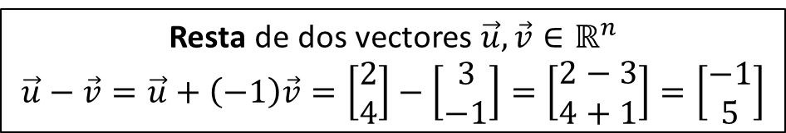
Operaciones entre vectores
Escalar $c∈ℝ$ por vector $\vec{u}$ $∈ℝ^{n}$
$$c\vec{u}=5\left[\begin{matrix}2 \\ 4\end{matrix}\right]=\left[\begin{matrix}5(2) \\ 5(4) \end{matrix}\right]=\left[\begin{matrix}10 \\ 20\end{matrix}\right]$$
Opuesto del vector $\vec{u}$ $∈ℝ^{n}$
$$−\vec{u}=(−1)\vec{u}=−1\left[\begin{matrix}2 \\ 4\end{matrix}\right]=\left[\begin{matrix}−1(2) \\ −1(4) \end{matrix}\right]=\left[\begin{matrix}−2 \\ −4\end{matrix}\right]$$
Suma de dos vectores $\vec{u},\vec{v}∈ℝ^{n}$
$$\vec{u}+\vec{v}=\left[\begin{matrix}2 \\ 4\end{matrix}\right]+\left[\begin{matrix}3 \\ −1\end{matrix}\right]=\left[\begin{matrix}2+3 \\ 4−1\end{matrix}\right]=\left[\begin{matrix}5 \\ 3\end{matrix}\right]$$
Resta de dos vectores $\vec{u},\vec{v}∈ℝ^{n}$
$$\vec{u}−\vec{v}=\vec{u}+\left(−1\right)\vec{v}=\left[\begin{matrix}2 \\ 4\end{matrix}\right]−\left[\begin{matrix}3 \\ −1\end{matrix}\right]=\left[\begin{matrix}2−3 \\ 4+1\end{matrix}\right]=\left[\begin{matrix}−1 \\ 5\end{matrix}\right]$$

Slide 5
Producto punto
Enviar preguntas a
gmunoz@udistrital.edu.co

Slide 6









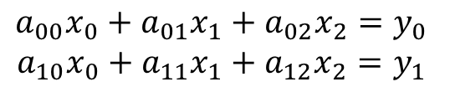

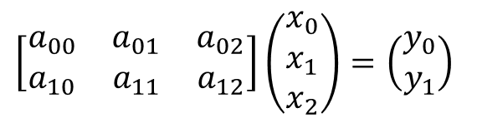


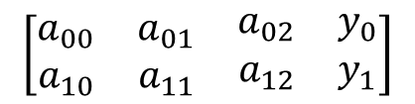




Matriz por vector
$$\left[\begin{matrix}a_{00} & a_{01} & a_{02} \\ a_{10} & a_{11} & a_{12}\end{matrix}\right]\left(\begin{matrix}x_{0} \\ x_{1} \\ x_{2}\end{matrix}\right)=\left(\begin{matrix}y_{0} \\ y_{1}\end{matrix}\right)$$
Sistema de ecuaciones
Transformación Matricial
Encontrar$\vec{y}$
$$\begin{matrix}a_{00}x_{0}+a_{01}x_{1}+a_{02}x_{2}=y_{0} \\ a_{10}x_{0}+a_{11}x_{1}+a_{12}x_{2}=y_{1}\end{matrix}$$
$$T_{A}\left(\begin{matrix}x_{0} \\ x_{1} \\ x_{2}\end{matrix}\right)=\left(\begin{matrix}y_{0} \\ y_{1}\end{matrix}\right)$$
Encontrar$\vec{x}$
Composición
Álgebra
Lineal
Perceptrón lineal
Algoritmos
Encontrar la matriz $A$
$$x_{0}$$
Matriz extendida
$$a_{00}$$
$$a_{01}$$
$$y_{0}$$
$$\left[\begin{matrix}a_{00} & a_{01} & \begin{matrix}a_{02} & y_{0}\end{matrix} \\ a_{10} & a_{11} & \begin{matrix}a_{12} & y_{1}\end{matrix}\end{matrix}\right]$$
Visualización
geométrica
$$x_{1}$$
$$a_{02}$$
$$a_{10}$$
$$a_{11}$$
$$y_{1}$$
$$a_{12}$$
$$x_{2}$$
Combinación lineal
$$x_{0}\left(\begin{matrix}a_{00} \\ a_{10}\end{matrix}\right)+x_{1}\left(\begin{matrix}a_{01} \\ a_{11}\end{matrix}\right)+x_{2}\left(\begin{matrix}a_{02} \\ a_{12}\end{matrix}\right)=\left(\begin{matrix}y_{0} \\ y_{1}\end{matrix}\right)$$

Slide 7
Matriz por vector
$$\left[\begin{matrix}a_{00} & a_{01} & a_{02} \\ a_{10} & a_{11} & a_{12}\end{matrix}\right]\left(\begin{matrix}x_{0} \\ x_{1} \\ x_{2}\end{matrix}\right)=\left(\begin{matrix}y_{0} \\ y_{1}\end{matrix}\right)$$
Sistema de ecuaciones
Transformación Matricial
Encontrar$\vec{y}$
$$\begin{matrix}a_{00}x_{0}+a_{01}x_{1}+a_{02}x_{2}=y_{0} \\ a_{10}x_{0}+a_{11}x_{1}+a_{12}x_{2}=y_{1}\end{matrix}$$
$$T_{A}\left(\begin{matrix}x_{0} \\ x_{1} \\ x_{2}\end{matrix}\right)=\left(\begin{matrix}y_{0} \\ y_{1}\end{matrix}\right)$$
Encontrar$\vec{x}$
Composición
Perceptrón lineal
Algoritmos
Encontrar la matriz $A$
$$x_{0}$$
Matriz extendida
$$a_{00}$$
$$a_{01}$$
$$y_{0}$$
$$\left[\begin{matrix}a_{00} & a_{01} & \begin{matrix}a_{02} & y_{0}\end{matrix} \\ a_{10} & a_{11} & \begin{matrix}a_{12} & y_{1}\end{matrix}\end{matrix}\right]$$
Visualización
geométrica
$$x_{1}$$
$$a_{02}$$
$$a_{10}$$
$$a_{11}$$
$$y_{1}$$
$$a_{12}$$
$$x_{2}$$
Combinación lineal
$$x_{0}\left(\begin{matrix}a_{00} \\ a_{10}\end{matrix}\right)+x_{1}\left(\begin{matrix}a_{01} \\ a_{11}\end{matrix}\right)+x_{2}\left(\begin{matrix}a_{02} \\ a_{12}\end{matrix}\right)=\left(\begin{matrix}y_{0} \\ y_{1}\end{matrix}\right)$$

Slide 8

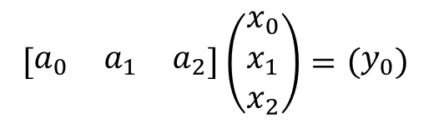






Matriz por vector
$$\left[\begin{matrix}a_{0} & a_{1} & a_{2}\end{matrix}\right]\left(\begin{matrix}x_{0} \\ x_{1} \\ x_{2}\end{matrix}\right)=\left(\begin{matrix}y_{0}\end{matrix}\right)$$
Sistema de ecuaciones
Transformación Matricial
Encontrar$\vec{y}$
$$\begin{matrix}a_{0}x_{0}+a_{1}x_{1}+a_{2}x_{2}=y_{0}\end{matrix}$$
$$T_{A}\left(\begin{matrix}x_{0} \\ x_{1} \\ x_{2}\end{matrix}\right)=\left(\begin{matrix}y_{0}\end{matrix}\right)$$
Encontrar$\vec{x}$
Composición
Producto
Punto
Perceptrón lineal
Algoritmos
Encontrar la matriz $A$
$$x_{0}$$
Matriz extendida
$$a_{0}$$
$$a_{1}$$
$$y_{0}$$
$$\left[\begin{matrix}a_{0} & a_{1} & \begin{matrix}a_{2} & y_{0}\end{matrix}\end{matrix}\right]$$
Visualización
geométrica
$$x_{1}$$
$$a_{2}$$
$$x_{2}$$
Combinación lineal
$$x_{0}\left(\begin{matrix}a_{0}\end{matrix}\right)+x_{1}\left(\begin{matrix}a_{1}\end{matrix}\right)+x_{2}\left(\begin{matrix}a_{2}\end{matrix}\right)=\left(\begin{matrix}y_{0}\end{matrix}\right)$$

Slide 9
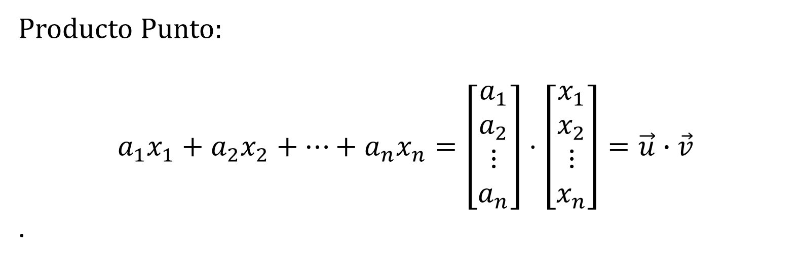
Producto Punto:
$$a_{1}x_{1}+a_{2}x_{2}+⋯+a_{n}x_{n}=\left[\begin{matrix}\begin{matrix}a_{1} \\ a_{2}\end{matrix} \\ \begin{matrix}⋮ \\ a_{n}\end{matrix}\end{matrix}\right]⋅\left[\begin{matrix}\begin{matrix}x_{1} \\ x_{2}\end{matrix} \\ \begin{matrix}⋮ \\ x_{n}\end{matrix}\end{matrix}\right]=\vec{u}∙\vec{v}$$
.

Slide 10
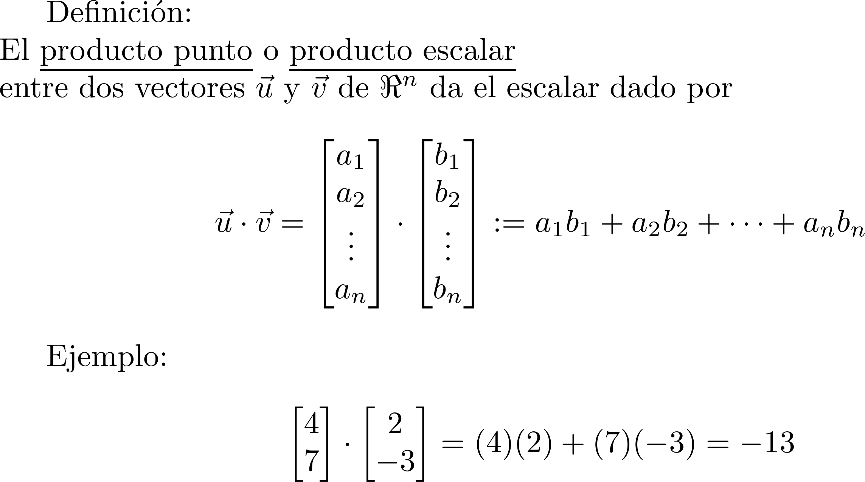
Definición de producto punto

Slide 11
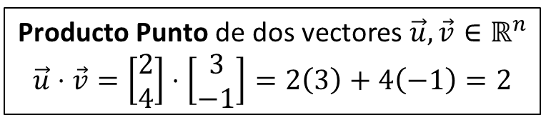
Operaciones entre vectores
Escalar $c∈ℝ$ por vector $\vec{u}$ $∈ℝ^{n}$
$$c\vec{u}=5\left[\begin{matrix}2 \\ 4\end{matrix}\right]=\left[\begin{matrix}5(2) \\ 5(4) \end{matrix}\right]=\left[\begin{matrix}10 \\ 20\end{matrix}\right]$$
Opuesto del vector $\vec{u}$ $∈ℝ^{n}$
$$−\vec{u}=(−1)\vec{u}=−1\left[\begin{matrix}2 \\ 4\end{matrix}\right]=\left[\begin{matrix}−1(2) \\ −1(4) \end{matrix}\right]=\left[\begin{matrix}−2 \\ −4\end{matrix}\right]$$
Suma de dos vectores $\vec{u},\vec{v}∈ℝ^{n}$
$$\vec{u}+\vec{v}=\left[\begin{matrix}2 \\ 4\end{matrix}\right]+\left[\begin{matrix}3 \\ −1\end{matrix}\right]=\left[\begin{matrix}2+3 \\ 4−1\end{matrix}\right]=\left[\begin{matrix}5 \\ 3\end{matrix}\right]$$
Resta de dos vectores $\vec{u},\vec{v}∈ℝ^{n}$
$$\vec{u}−\vec{v}=\vec{u}+\left(−1\right)\vec{v}=\left[\begin{matrix}2 \\ 4\end{matrix}\right]−\left[\begin{matrix}3 \\ −1\end{matrix}\right]=\left[\begin{matrix}2−3 \\ 4+1\end{matrix}\right]=\left[\begin{matrix}−1 \\ 5\end{matrix}\right]$$
Producto Punto de dos vectores $\vec{u},\vec{v}∈ℝ^{n}$
$$\vec{u}⋅\vec{v}=\left[\begin{matrix}2 \\ 4\end{matrix}\right]⋅\left[\begin{matrix}3 \\ −1\end{matrix}\right]=2\left(3\right)+4\left(−1\right)=2$$

Slide 12
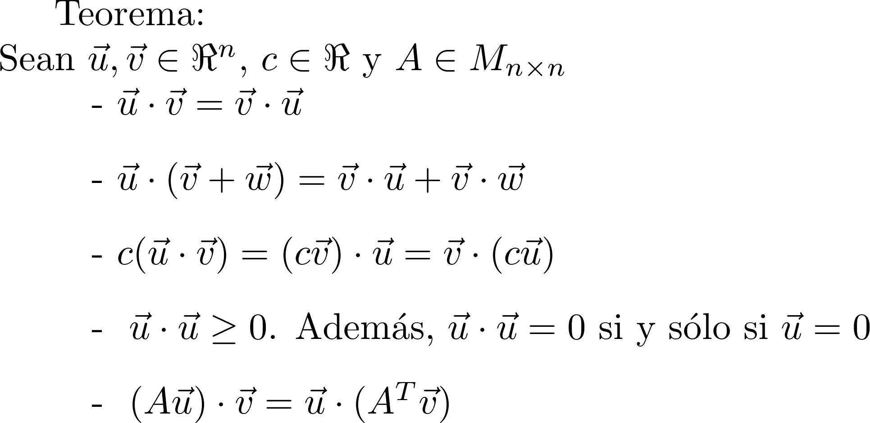
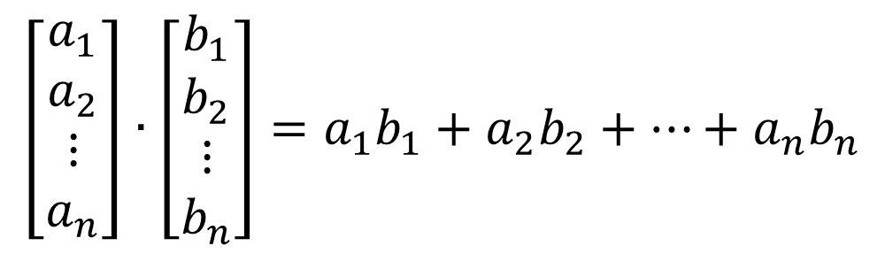
Propiedades del producto punto
$$\left[\begin{matrix}\begin{matrix}a_{1} \\ a_{2}\end{matrix} \\ \begin{matrix}⋮ \\ a_{n}\end{matrix}\end{matrix}\right]∙\left[\begin{matrix}\begin{matrix}b_{1} \\ b_{2}\end{matrix} \\ \begin{matrix}⋮ \\ b_{n}\end{matrix}\end{matrix}\right]=a_{1}b_{1}+a_{2}b_{2}+⋯+a_{n}b_{n}$$

Slide 13

Propiedades del producto punto
$$A\left(B+C\right)=AB+AC$$

Slide 14
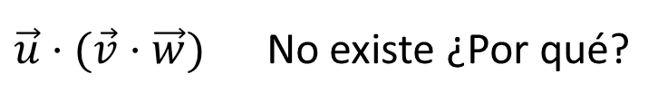
Propiedades del producto punto
$\vec{u}⋅$ $(\vec{v}⋅$ $\vec{w})$ No existe ¿Por qué?

Slide 15
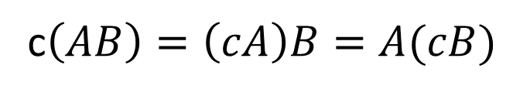
Propiedades del producto punto
c$\left(AB\right)=\left(cA\right)B=A(cB)$

Slide 16
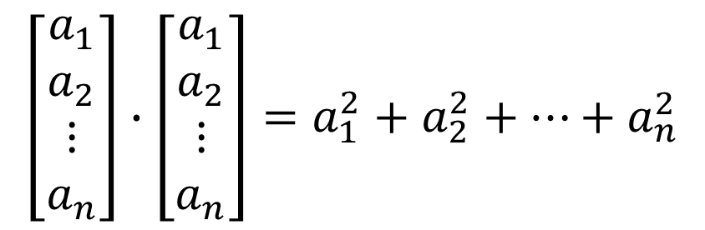
Propiedades del producto punto
$$\left[\begin{matrix}\begin{matrix}a_{1} \\ a_{2}\end{matrix} \\ \begin{matrix}⋮ \\ a_{n}\end{matrix}\end{matrix}\right]∙\left[\begin{matrix}\begin{matrix}a_{1} \\ a_{2}\end{matrix} \\ \begin{matrix}⋮ \\ a_{n}\end{matrix}\end{matrix}\right]=a_{1}^{2}+a_{2}^{2}+⋯+a_{n}^{2}$$

Slide 17

Propiedades del producto punto
$(A\vec{u})⋅$ $\vec{v}={\left(A\vec{u}\right)}^{T}\vec{v}$
$={(\vec{u}}^{T}A^{T})\vec{v}=$ ${\vec{u}}^{T}\left(A^{T}\vec{v}\right)$
$$=\vec{u}⋅\left(A^{T}\vec{v}\right)$$

Slide 18
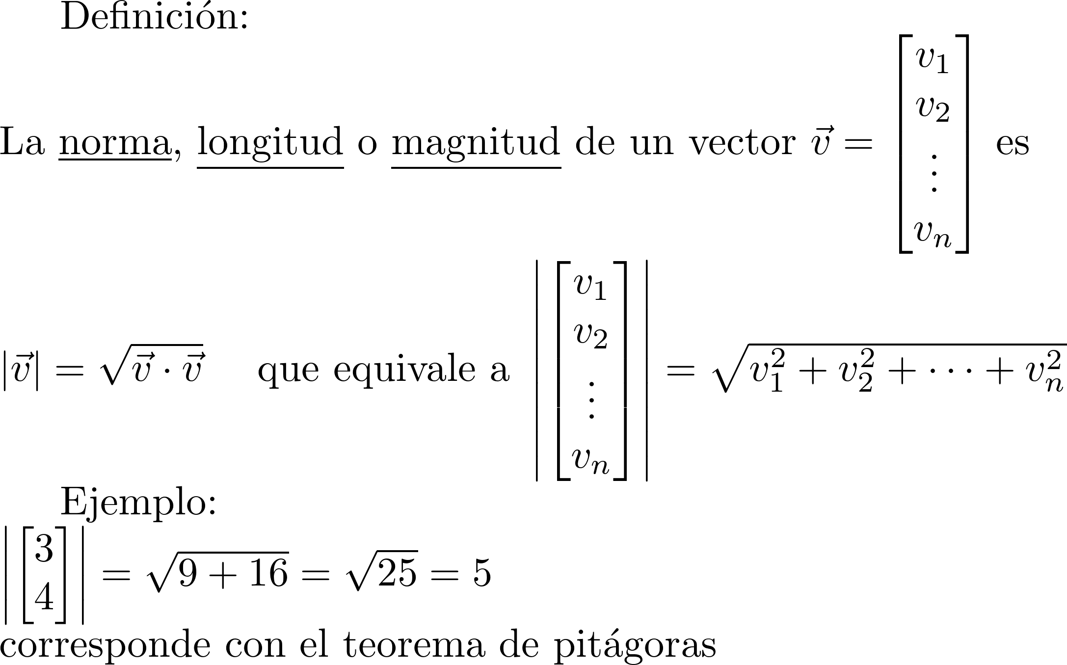
Definición de magnitud
5
4
3

Slide 19

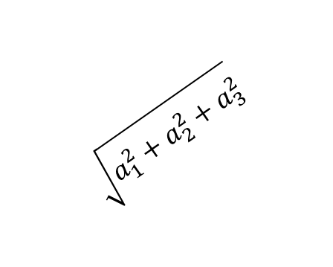
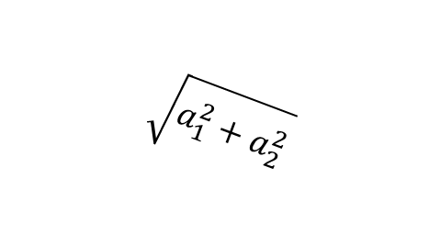


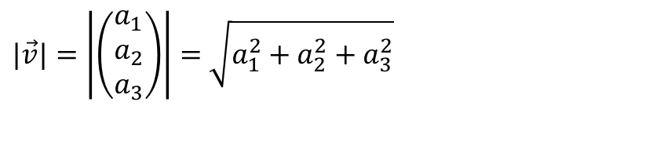
$$\vec{v}$$
$|\vec{v}|=\left|\left(\begin{matrix}a_{1} \\ a_{2} \\ a_{3}\end{matrix}\right)\right|=$ $\sqrt{a_{1}^{2}+a_{2}^{2}+a_{3}^{2}}$
$$\sqrt{a_{1}^{2}+a_{2}^{2}+a_{3}^{2}}$$
$$a_{3}$$
$$\vec{o}$$
$$a_{1}$$
$$\sqrt{a_{1}^{2}+a_{2}^{2}}$$
$$a_{2}$$

Slide 20
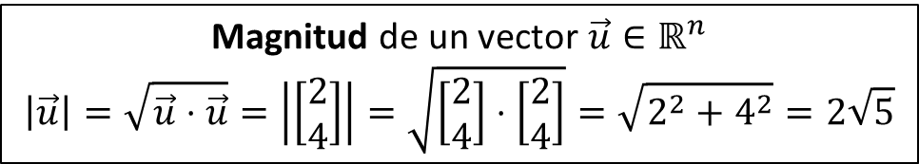
Operaciones entre vectores
Escalar $c∈ℝ$ por vector $\vec{u}$ $∈ℝ^{n}$
$$c\vec{u}=5\left[\begin{matrix}2 \\ 4\end{matrix}\right]=\left[\begin{matrix}5(2) \\ 5(4) \end{matrix}\right]=\left[\begin{matrix}10 \\ 20\end{matrix}\right]$$
Opuesto del vector $\vec{u}$ $∈ℝ^{n}$
$$−\vec{u}=(−1)\vec{u}=−1\left[\begin{matrix}2 \\ 4\end{matrix}\right]=\left[\begin{matrix}−1(2) \\ −1(4) \end{matrix}\right]=\left[\begin{matrix}−2 \\ −4\end{matrix}\right]$$
Suma de dos vectores $\vec{u},\vec{v}∈ℝ^{n}$
$$\vec{u}+\vec{v}=\left[\begin{matrix}2 \\ 4\end{matrix}\right]+\left[\begin{matrix}3 \\ −1\end{matrix}\right]=\left[\begin{matrix}2+3 \\ 4−1\end{matrix}\right]=\left[\begin{matrix}5 \\ 3\end{matrix}\right]$$
Resta de dos vectores $\vec{u},\vec{v}∈ℝ^{n}$
$$\vec{u}−\vec{v}=\vec{u}+\left(−1\right)\vec{v}=\left[\begin{matrix}2 \\ 4\end{matrix}\right]−\left[\begin{matrix}3 \\ −1\end{matrix}\right]=\left[\begin{matrix}2−3 \\ 4+1\end{matrix}\right]=\left[\begin{matrix}−1 \\ 5\end{matrix}\right]$$
Producto Punto de dos vectores $\vec{u},\vec{v}∈ℝ^{n}$
$$\vec{u}⋅\vec{v}=\left[\begin{matrix}2 \\ 4\end{matrix}\right]⋅\left[\begin{matrix}3 \\ −1\end{matrix}\right]=2\left(3\right)+4\left(−1\right)=2$$
Magnitud de un vector $\vec{u}∈ℝ^{n}$
$$\left|\vec{u}\right|=\sqrt{\vec{u}⋅\vec{u}}=\left|\left[\begin{matrix}2 \\ 4\end{matrix}\right]\right|=\sqrt{\left[\begin{matrix}2 \\ 4\end{matrix}\right]⋅\left[\begin{matrix}2 \\ 4\end{matrix}\right]}=\sqrt{2^{2}+4^{2}}=2\sqrt{5}$$

Slide 21
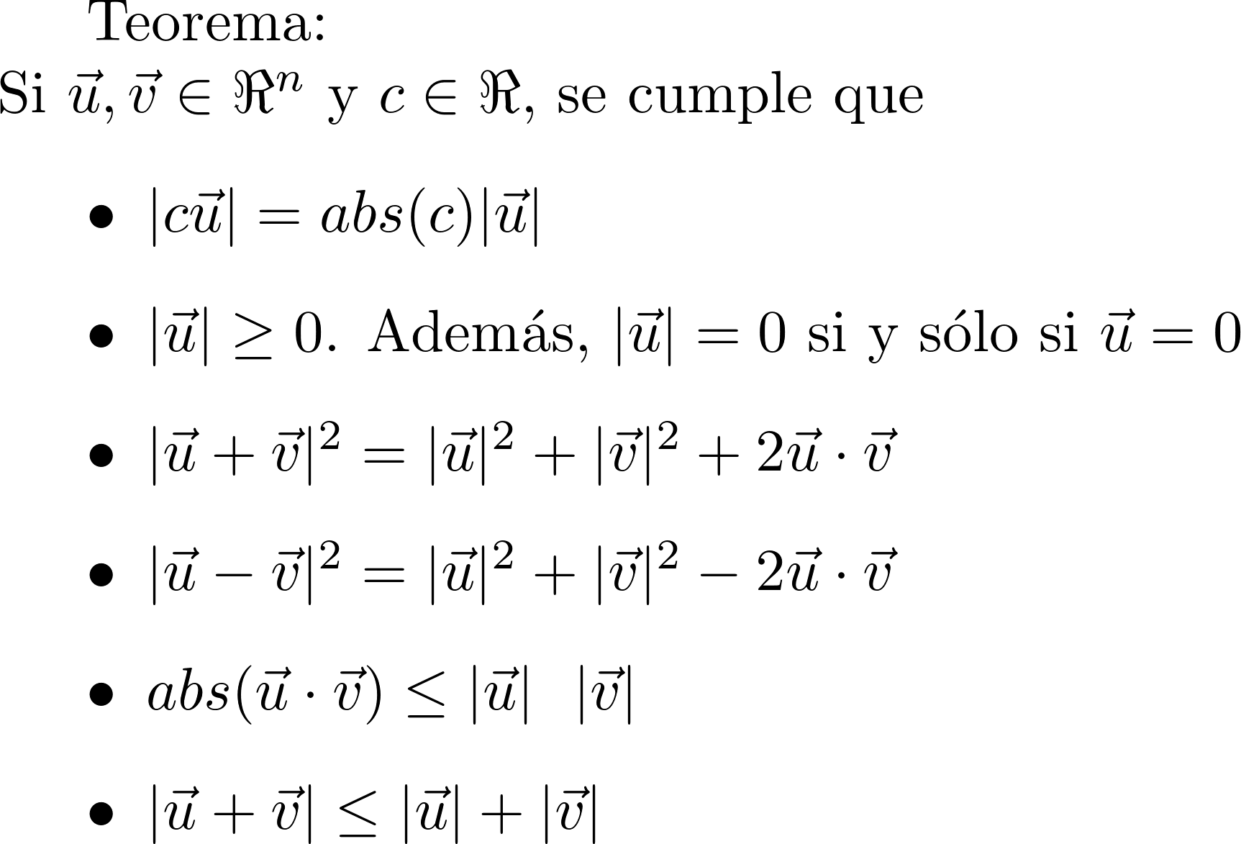




Propiedades de la magnitud
|$c\vec{u}| =\left|\left[\begin{matrix}\begin{matrix}{ca}_{1} \\ {ca}_{2}\end{matrix} \\ \begin{matrix}⋮ \\ {ca}_{n}\end{matrix}\end{matrix}\right]\right|$
$$=\sqrt{{c^{2}a}_{1}^{2}+{c^{2}a}_{2}^{2}+⋯+{c^{2}a}_{n}^{2}}$$
$=\sqrt{{c^{2}(a}_{1}^{2}+a_{2}^{2}+⋯+a_{n}^{2})}$
$=\text{a}\text{bs}(c)\sqrt{{ (a}_{1}^{2}+a_{2}^{2}+⋯+a_{n}^{2})}$
8
10
4
5
-3
5
3
6
-4
$$\left|\left(\begin{matrix}3 \\ 4\end{matrix}\right)\right|=5$$
$$\left|−1\left(\begin{matrix}3 \\ 4\end{matrix}\right)\right|=abs\left(−1\right)5=5$$
$$\left|2\left(\begin{matrix}3 \\ 4\end{matrix}\right)\right|=abs\left(2\right)5=10$$

Slide 22

Propiedades de la magnitud
$$\sqrt{\left[\begin{matrix}\begin{matrix}a_{1} \\ a_{2}\end{matrix} \\ \begin{matrix}⋮ \\ a_{n}\end{matrix}\end{matrix}\right]∙\left[\begin{matrix}\begin{matrix}a_{1} \\ a_{2}\end{matrix} \\ \begin{matrix}⋮ \\ a_{n}\end{matrix}\end{matrix}\right]}=\sqrt{a_{1}^{2}+a_{2}^{2}+⋯+a_{n}^{2}}$$

Slide 23




Propiedades de la magnitud
$${\left|\vec{u}−\vec{v}\right|}^{2}={\left(\sqrt{\left(\vec{u}−\vec{v}\right)⋅\left(\vec{u}−\vec{v}\right)}\right)}^{2}$$
$=\left(\vec{u}−\vec{v}\right)⋅\left(\vec{u}−\vec{v}\right)$
= $\left(\vec{u}−\vec{v}\right)⋅\vec{u}−\left(\vec{u}−\vec{v}\right)⋅\vec{v}$
$=\vec{u}⋅\vec{u}−\vec{v}⋅\vec{u}−\vec{u}⋅\vec{v}+\vec{v}⋅\vec{v}$
$={\left|\vec{u}\right|}^{2}+{\left|\vec{v}\right|}^{2}−2\vec{u}⋅\vec{v}$
$$=\vec{v}⋅\vec{v}$$
$${\left|\vec{w}\right|}^{2}=\vec{w}⋅\vec{w}$$

Slide 24
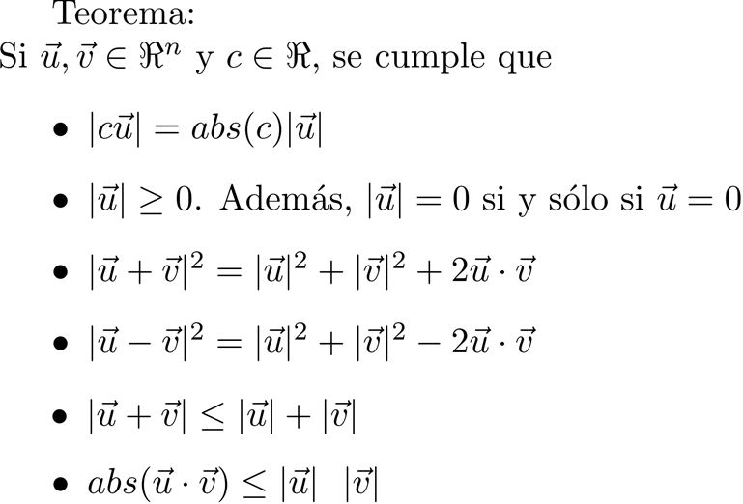



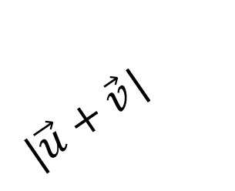

Propiedades de la magnitud
$$\vec{u}+\vec{v}$$
$$|\vec{v}|$$
$$\vec{v}$$
$|\vec{u}+\vec{v}$|
$$\vec{u}$$
$$|\vec{u}|$$
Desigualdad triangular

Slide 25
Propiedades de la magnitud

Slide 26
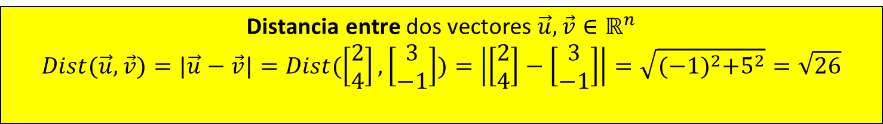
Operaciones entre vectores
Escalar $c∈ℝ$ por vector $\vec{u}$ $∈ℝ^{n}$
$$c\vec{u}=5\left[\begin{matrix}2 \\ 4\end{matrix}\right]=\left[\begin{matrix}5(2) \\ 5(4) \end{matrix}\right]=\left[\begin{matrix}10 \\ 20\end{matrix}\right]$$
Opuesto del vector $\vec{u}$ $∈ℝ^{n}$
$$−\vec{u}=(−1)\vec{u}=−1\left[\begin{matrix}2 \\ 4\end{matrix}\right]=\left[\begin{matrix}−1(2) \\ −1(4) \end{matrix}\right]=\left[\begin{matrix}−2 \\ −4\end{matrix}\right]$$
Suma de dos vectores $\vec{u},\vec{v}∈ℝ^{n}$
$$\vec{u}+\vec{v}=\left[\begin{matrix}2 \\ 4\end{matrix}\right]+\left[\begin{matrix}3 \\ −1\end{matrix}\right]=\left[\begin{matrix}2+3 \\ 4−1\end{matrix}\right]=\left[\begin{matrix}5 \\ 3\end{matrix}\right]$$
Resta de dos vectores $\vec{u},\vec{v}∈ℝ^{n}$
$$\vec{u}−\vec{v}=\vec{u}+\left(−1\right)\vec{v}=\left[\begin{matrix}2 \\ 4\end{matrix}\right]−\left[\begin{matrix}3 \\ −1\end{matrix}\right]=\left[\begin{matrix}2−3 \\ 4+1\end{matrix}\right]=\left[\begin{matrix}−1 \\ 5\end{matrix}\right]$$
Producto Punto de dos vectores $\vec{u},\vec{v}∈ℝ^{n}$
$$\vec{u}⋅\vec{v}=\left[\begin{matrix}2 \\ 4\end{matrix}\right]⋅\left[\begin{matrix}3 \\ −1\end{matrix}\right]=2\left(3\right)+4\left(−1\right)=2$$
Distancia entre dos vectores $\vec{u},\vec{v}∈ℝ^{n}$
$$Dist(\vec{u},\vec{v})=|\vec{u}−\vec{v}|=Dist(\left[\begin{matrix}2 \\ 4\end{matrix}\right],\left[\begin{matrix}3 \\ −1\end{matrix}\right])=\left|\left[\begin{matrix}2 \\ 4\end{matrix}\right]−\left[\begin{matrix}3 \\ −1\end{matrix}\right]\right|=\sqrt{{(−1)}^{2}+5^{2}}=\sqrt{26}$$
Magnitud de un vector $\vec{u}∈ℝ^{n}$
$$\left|\vec{u}\right|=\sqrt{\vec{u}⋅\vec{u}}=\left|\left[\begin{matrix}2 \\ 4\end{matrix}\right]\right|=\sqrt{\left[\begin{matrix}2 \\ 4\end{matrix}\right]⋅\left[\begin{matrix}2 \\ 4\end{matrix}\right]}=\sqrt{2^{2}+4^{2}}=2\sqrt{5}$$

Slide 27
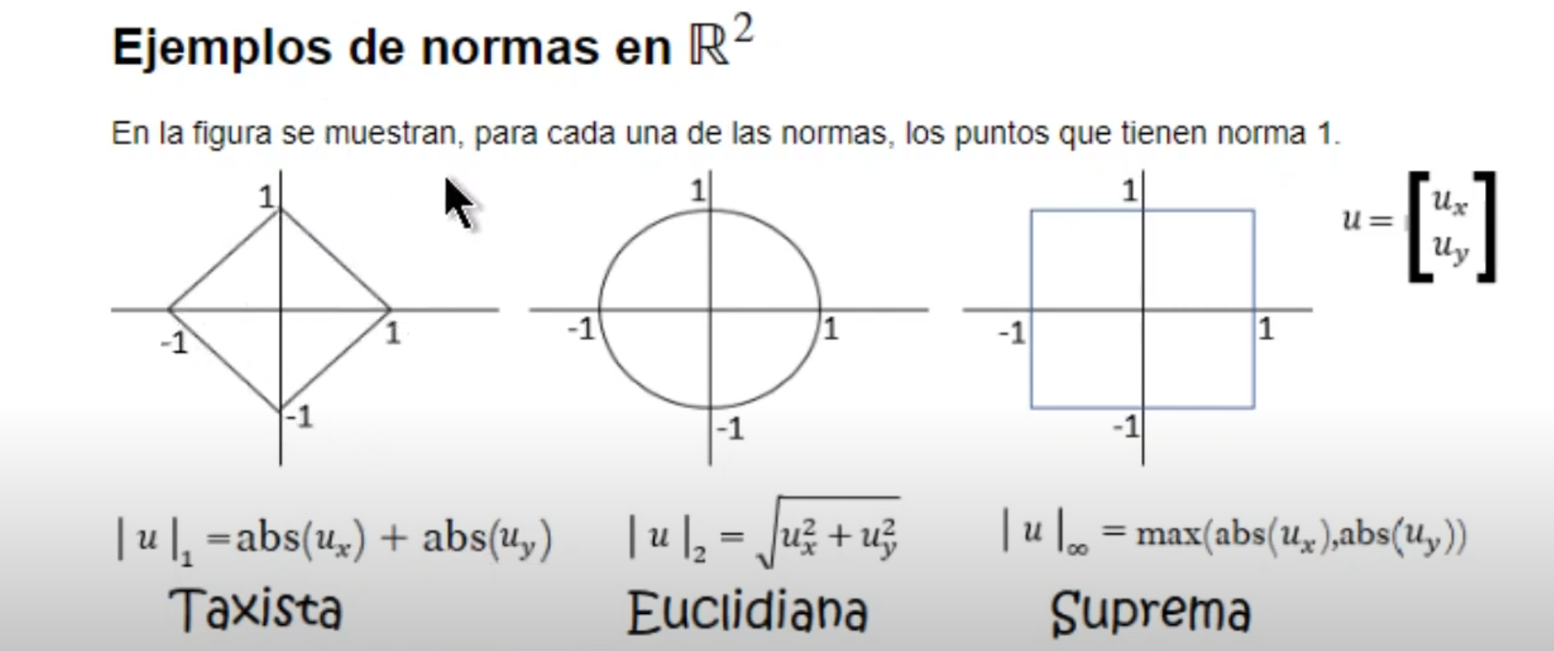

Slide 28
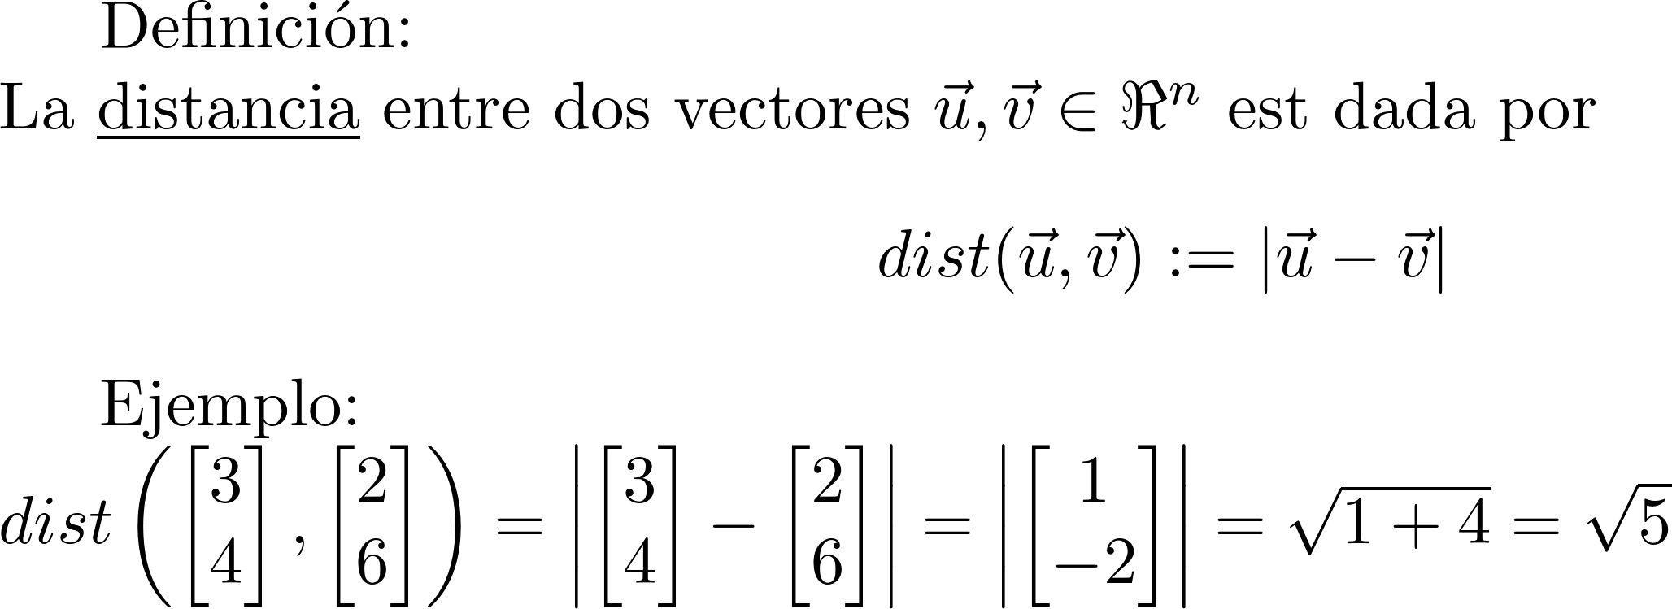


Distancia entre vectores
$$\vec{v}$$
$$\vec{u}$$

Slide 29


Distancia entre vectores
$$\vec{v}$$
$$\vec{u}$$
$$|\vec{u}−\vec{v}|$$
$$\vec{u}−\vec{v}$$

Slide 30

Distancia entre vectores
$$\vec{v}$$
$$|\vec{u}−\vec{v}|$$
$$\vec{u}$$
$$|\vec{u}−\vec{v}|$$
$$\vec{u}−\vec{v}$$

Slide 31
Distancia entre vectores
$$\vec{v}$$
$$|\vec{u}−\vec{v}|$$
$$\vec{u}$$
$$|\vec{u}−\vec{v}|$$
$$\vec{u}−\vec{v}$$

Slide 32
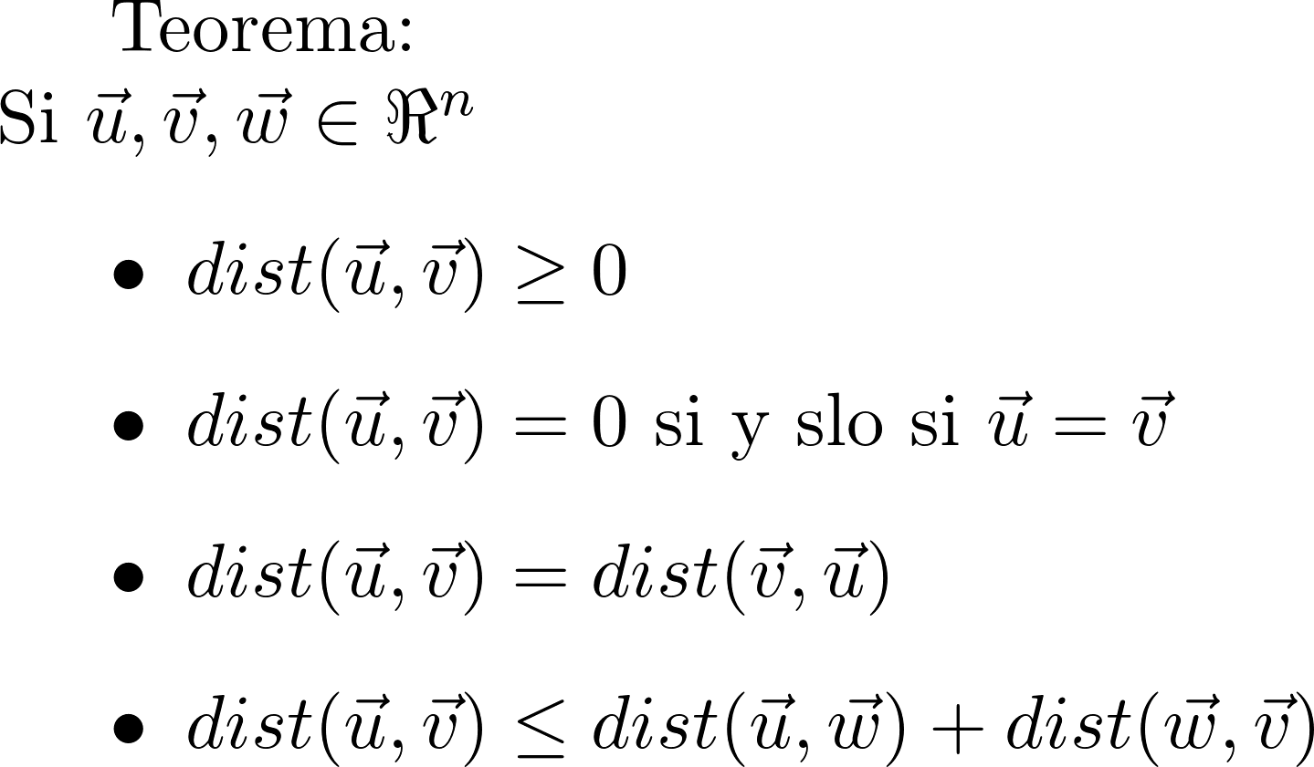
Propiedades de la distancia

Slide 33
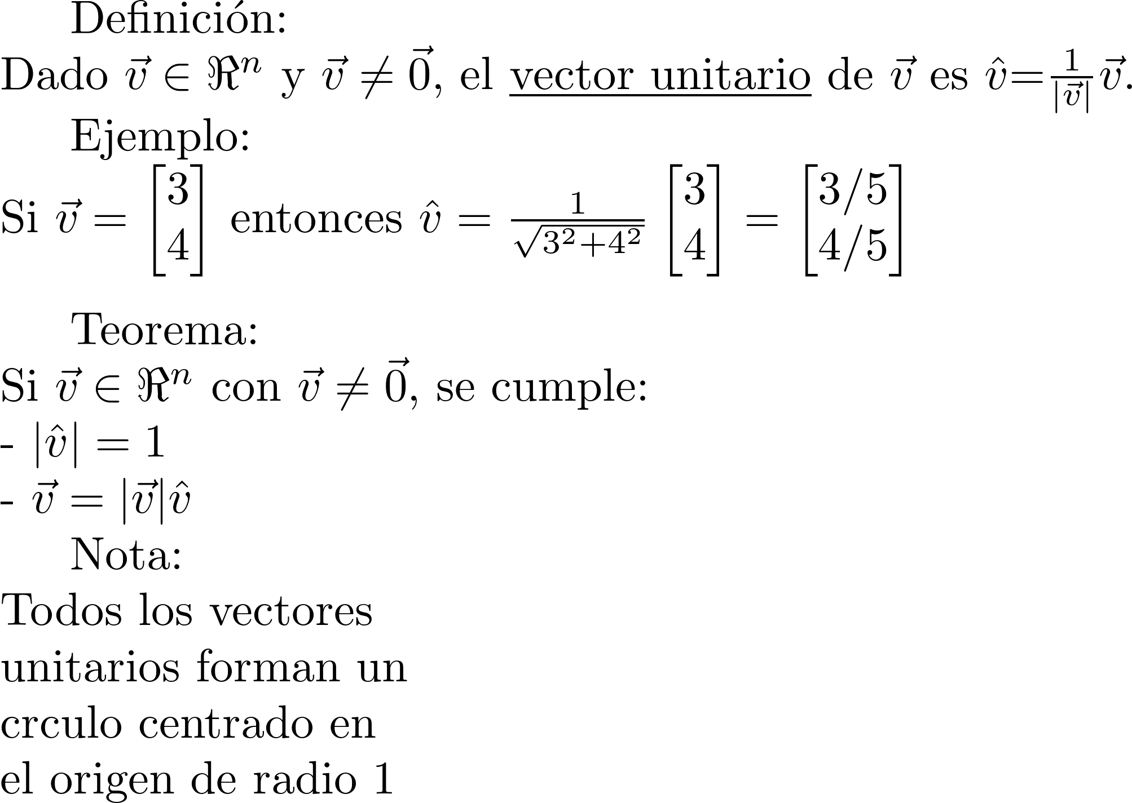
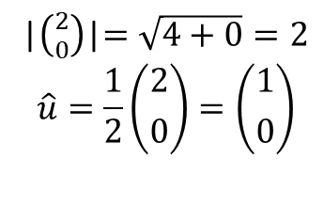

Vector unitario
1
$$\vec{u}=\left({2 \atop 0}\right)$$
-1
1
2
3
|$\left({2 \atop 0}\right)$|$=\sqrt{4+0}=2$
$$\hat{u}=\frac{1}{2}\left({2 \atop 0}\right)=\left({1 \atop 0}\right)$$
-1

Slide 34
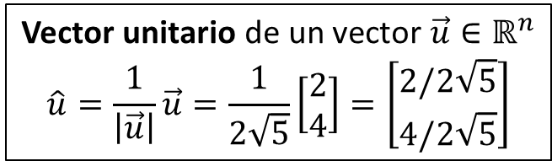
Operaciones entre vectores
Escalar $c∈ℝ$ por vector $\vec{u}$ $∈ℝ^{n}$
$$c\vec{u}=5\left[\begin{matrix}2 \\ 4\end{matrix}\right]=\left[\begin{matrix}5(2) \\ 5(4) \end{matrix}\right]=\left[\begin{matrix}10 \\ 20\end{matrix}\right]$$
Opuesto del vector $\vec{u}$ $∈ℝ^{n}$
$$−\vec{u}=(−1)\vec{u}=−1\left[\begin{matrix}2 \\ 4\end{matrix}\right]=\left[\begin{matrix}−1(2) \\ −1(4) \end{matrix}\right]=\left[\begin{matrix}−2 \\ −4\end{matrix}\right]$$
Suma de dos vectores $\vec{u},\vec{v}∈ℝ^{n}$
$$\vec{u}+\vec{v}=\left[\begin{matrix}2 \\ 4\end{matrix}\right]+\left[\begin{matrix}3 \\ −1\end{matrix}\right]=\left[\begin{matrix}2+3 \\ 4−1\end{matrix}\right]=\left[\begin{matrix}5 \\ 3\end{matrix}\right]$$
Resta de dos vectores $\vec{u},\vec{v}∈ℝ^{n}$
$$\vec{u}−\vec{v}=\vec{u}+\left(−1\right)\vec{v}=\left[\begin{matrix}2 \\ 4\end{matrix}\right]−\left[\begin{matrix}3 \\ −1\end{matrix}\right]=\left[\begin{matrix}2−3 \\ 4+1\end{matrix}\right]=\left[\begin{matrix}−1 \\ 5\end{matrix}\right]$$
Producto Punto de dos vectores $\vec{u},\vec{v}∈ℝ^{n}$
$$\vec{u}⋅\vec{v}=\left[\begin{matrix}2 \\ 4\end{matrix}\right]⋅\left[\begin{matrix}3 \\ −1\end{matrix}\right]=2\left(3\right)+4\left(−1\right)=2$$
Distancia entre dos vectores $\vec{u},\vec{v}∈ℝ^{n}$
$$Dist(\vec{u},\vec{v})=|\vec{u}−\vec{v}|=Dist(\left[\begin{matrix}2 \\ 4\end{matrix}\right],\left[\begin{matrix}3 \\ −1\end{matrix}\right])=\left|\left[\begin{matrix}2 \\ 4\end{matrix}\right]−\left[\begin{matrix}3 \\ −1\end{matrix}\right]\right|=\sqrt{{(−1)}^{2}+5^{2}}=\sqrt{26}$$
Magnitud de un vector $\vec{u}∈ℝ^{n}$
$$\left|\vec{u}\right|=\sqrt{\vec{u}⋅\vec{u}}=\left|\left[\begin{matrix}2 \\ 4\end{matrix}\right]\right|=\sqrt{\left[\begin{matrix}2 \\ 4\end{matrix}\right]⋅\left[\begin{matrix}2 \\ 4\end{matrix}\right]}=\sqrt{2^{2}+4^{2}}=2\sqrt{5}$$
Vector unitario de un vector $\vec{u}∈ℝ^{n}$
$$\hat{u}=\frac{1}{\left|\vec{u}\right|}\vec{u}=\frac{1}{2\sqrt{5}}\left[\begin{matrix}2 \\ 4\end{matrix}\right]=\left[\begin{matrix}2/2\sqrt{5} \\ 4/2\sqrt{5}\end{matrix}\right]$$

Slide 35
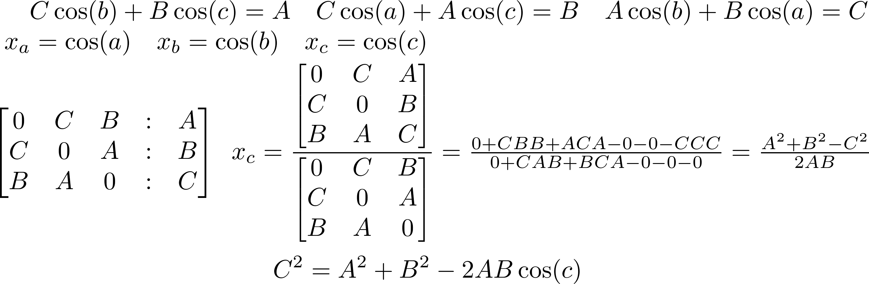
Teorema del coseno
a
a
a
C
B
C
B
C
B
b
c
b
A
c
b
A
c
A

Slide 36
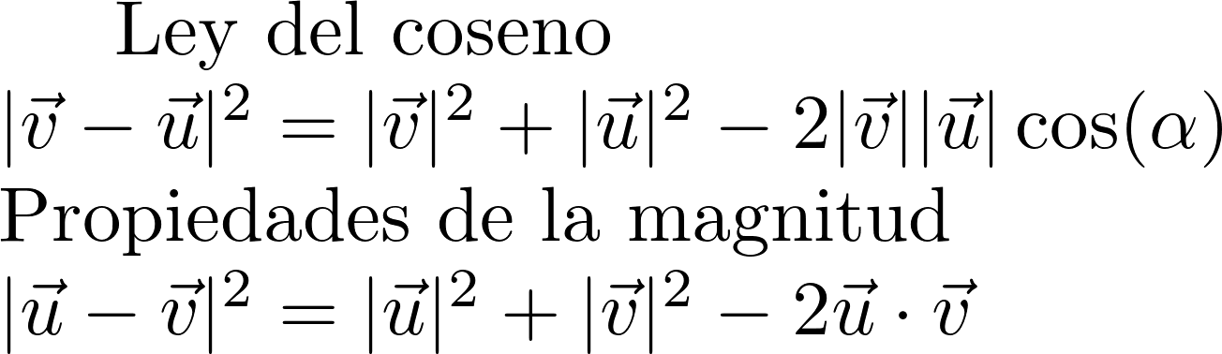



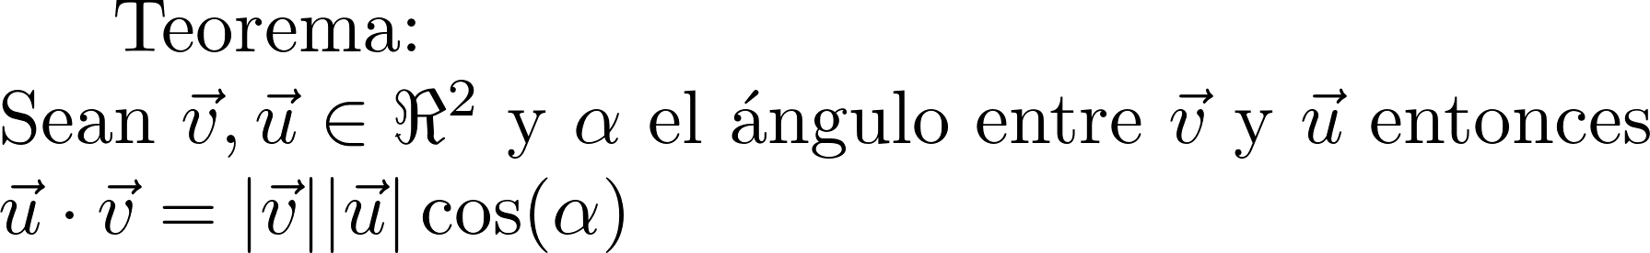
(Otro) significado del producto punto

Slide 37
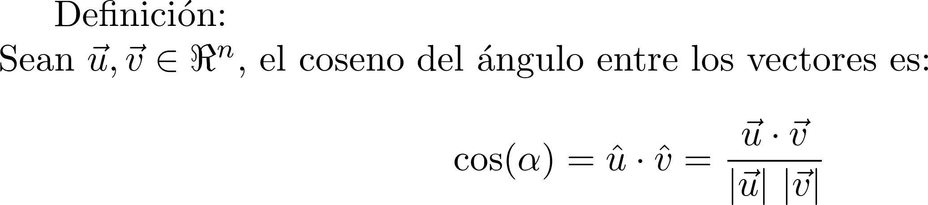

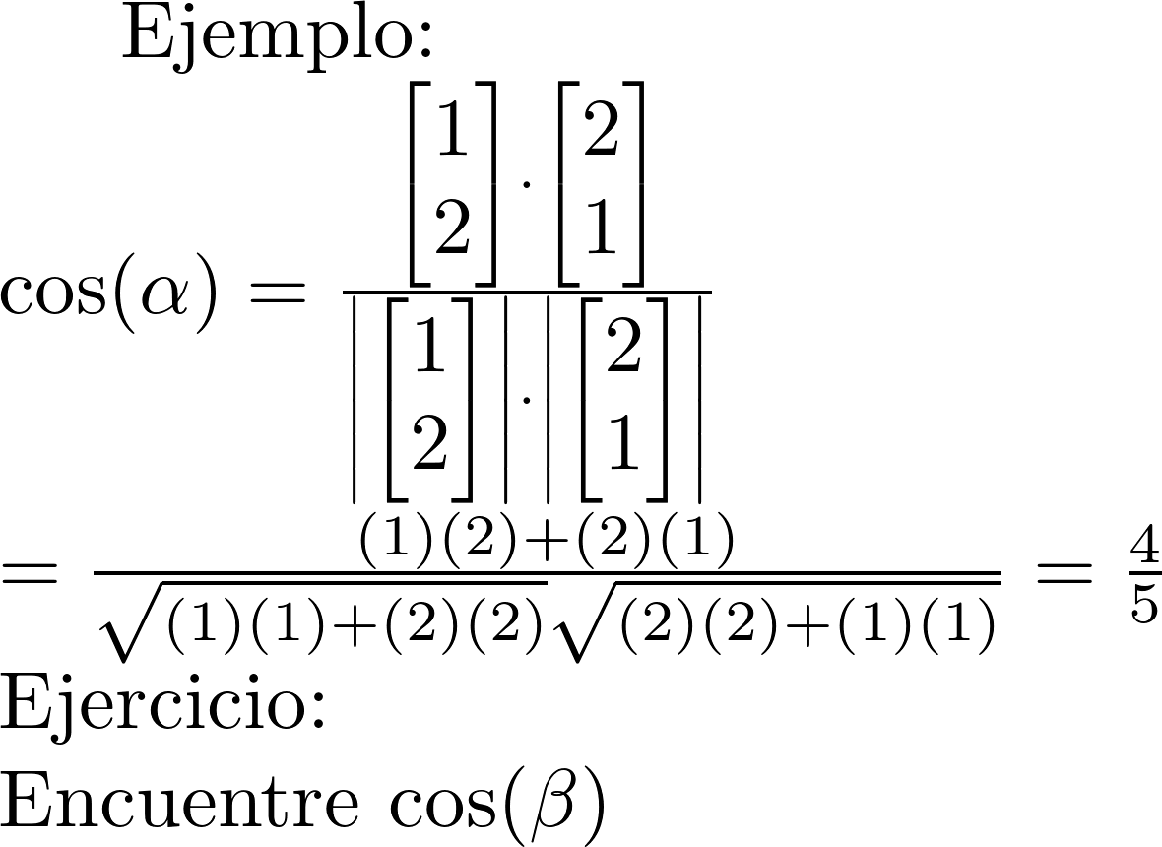


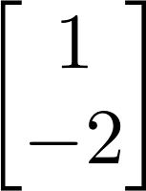
Coseno

Slide 38
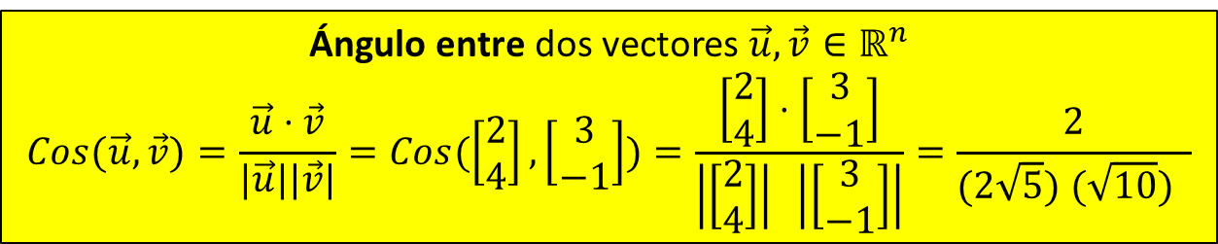
Operaciones entre vectores
Escalar $c∈ℝ$ por vector $\vec{u}$ $∈ℝ^{n}$
$$c\vec{u}=5\left[\begin{matrix}2 \\ 4\end{matrix}\right]=\left[\begin{matrix}5(2) \\ 5(4) \end{matrix}\right]=\left[\begin{matrix}10 \\ 20\end{matrix}\right]$$
Opuesto del vector $\vec{u}$ $∈ℝ^{n}$
$$−\vec{u}=(−1)\vec{u}=−1\left[\begin{matrix}2 \\ 4\end{matrix}\right]=\left[\begin{matrix}−1(2) \\ −1(4) \end{matrix}\right]=\left[\begin{matrix}−2 \\ −4\end{matrix}\right]$$
Suma de dos vectores $\vec{u},\vec{v}∈ℝ^{n}$
$$\vec{u}+\vec{v}=\left[\begin{matrix}2 \\ 4\end{matrix}\right]+\left[\begin{matrix}3 \\ −1\end{matrix}\right]=\left[\begin{matrix}2+3 \\ 4−1\end{matrix}\right]=\left[\begin{matrix}5 \\ 3\end{matrix}\right]$$
Resta de dos vectores $\vec{u},\vec{v}∈ℝ^{n}$
$$\vec{u}−\vec{v}=\vec{u}+\left(−1\right)\vec{v}=\left[\begin{matrix}2 \\ 4\end{matrix}\right]−\left[\begin{matrix}3 \\ −1\end{matrix}\right]=\left[\begin{matrix}2−3 \\ 4+1\end{matrix}\right]=\left[\begin{matrix}−1 \\ 5\end{matrix}\right]$$
Producto Punto de dos vectores $\vec{u},\vec{v}∈ℝ^{n}$
$$\vec{u}⋅\vec{v}=\left[\begin{matrix}2 \\ 4\end{matrix}\right]⋅\left[\begin{matrix}3 \\ −1\end{matrix}\right]=2\left(3\right)+4\left(−1\right)=2$$
Distancia entre dos vectores $\vec{u},\vec{v}∈ℝ^{n}$
$$Dist(\vec{u},\vec{v})=|\vec{u}−\vec{v}|=Dist(\left[\begin{matrix}2 \\ 4\end{matrix}\right],\left[\begin{matrix}3 \\ −1\end{matrix}\right])=\left|\left[\begin{matrix}2 \\ 4\end{matrix}\right]−\left[\begin{matrix}3 \\ −1\end{matrix}\right]\right|=\sqrt{{(−1)}^{2}+5^{2}}=\sqrt{26}$$
Magnitud de un vector $\vec{u}∈ℝ^{n}$
$$\left|\vec{u}\right|=\sqrt{\vec{u}⋅\vec{u}}=\left|\left[\begin{matrix}2 \\ 4\end{matrix}\right]\right|=\sqrt{\left[\begin{matrix}2 \\ 4\end{matrix}\right]⋅\left[\begin{matrix}2 \\ 4\end{matrix}\right]}=\sqrt{2^{2}+4^{2}}=2\sqrt{5}$$
Ángulo entre dos vectores $\vec{u},\vec{v}∈ℝ^{n}$
$$Cos(\vec{u},\vec{v})=\frac{\vec{u}⋅\vec{v}}{|\vec{u}||\vec{v}|}=Cos(\left[\begin{matrix}2 \\ 4\end{matrix}\right],\left[\begin{matrix}3 \\ −1\end{matrix}\right])=\frac{\left[\begin{matrix}2 \\ 4\end{matrix}\right]⋅\left[\begin{matrix}3 \\ −1\end{matrix}\right]}{\left|\left[\begin{matrix}2 \\ 4\end{matrix}\right]\right| \left|\left[\begin{matrix}3 \\ −1\end{matrix}\right]\right|}=\frac{2}{(2\sqrt{5}) (\sqrt{10}) }$$
Vector unitario de un vector $\vec{u}∈ℝ^{n}$
$$\hat{u}=\frac{1}{\left|\vec{u}\right|}\vec{u}=\frac{1}{2\sqrt{5}}\left[\begin{matrix}2 \\ 4\end{matrix}\right]=\left[\begin{matrix}2/2\sqrt{5} \\ 4/2\sqrt{5}\end{matrix}\right]$$

Slide 39
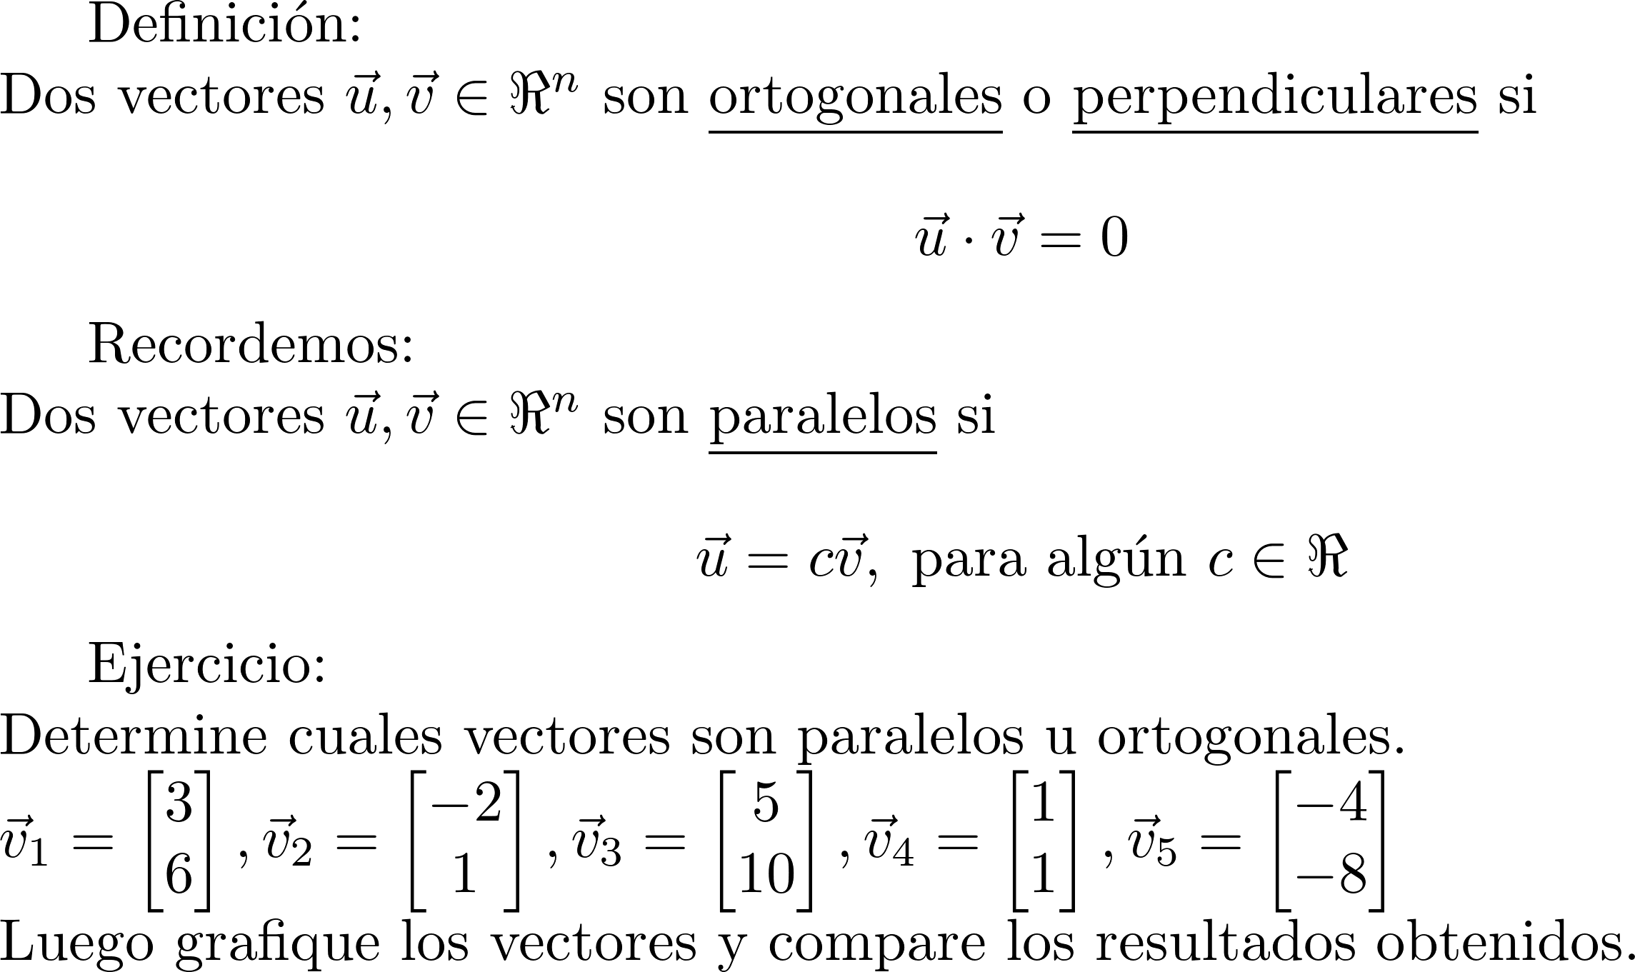
Perpendicular y paralelo

Slide 40
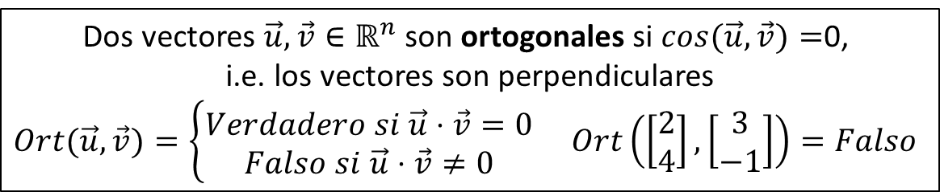
Operaciones entre vectores
Escalar $c∈ℝ$ por vector $\vec{u}$ $∈ℝ^{n}$
$$c\vec{u}=5\left[\begin{matrix}2 \\ 4\end{matrix}\right]=\left[\begin{matrix}5(2) \\ 5(4) \end{matrix}\right]=\left[\begin{matrix}10 \\ 20\end{matrix}\right]$$
Opuesto del vector $\vec{u}$ $∈ℝ^{n}$
$$−\vec{u}=(−1)\vec{u}=−1\left[\begin{matrix}2 \\ 4\end{matrix}\right]=\left[\begin{matrix}−1(2) \\ −1(4) \end{matrix}\right]=\left[\begin{matrix}−2 \\ −4\end{matrix}\right]$$
Suma de dos vectores $\vec{u},\vec{v}∈ℝ^{n}$
$$\vec{u}+\vec{v}=\left[\begin{matrix}2 \\ 4\end{matrix}\right]+\left[\begin{matrix}3 \\ −1\end{matrix}\right]=\left[\begin{matrix}2+3 \\ 4−1\end{matrix}\right]=\left[\begin{matrix}5 \\ 3\end{matrix}\right]$$
Resta de dos vectores $\vec{u},\vec{v}∈ℝ^{n}$
$$\vec{u}−\vec{v}=\vec{u}+\left(−1\right)\vec{v}=\left[\begin{matrix}2 \\ 4\end{matrix}\right]−\left[\begin{matrix}3 \\ −1\end{matrix}\right]=\left[\begin{matrix}2−3 \\ 4+1\end{matrix}\right]=\left[\begin{matrix}−1 \\ 5\end{matrix}\right]$$
Producto Punto de dos vectores $\vec{u},\vec{v}∈ℝ^{n}$
$$\vec{u}⋅\vec{v}=\left[\begin{matrix}2 \\ 4\end{matrix}\right]⋅\left[\begin{matrix}3 \\ −1\end{matrix}\right]=2\left(3\right)+4\left(−1\right)=2$$
Distancia entre dos vectores $\vec{u},\vec{v}∈ℝ^{n}$
$$Dist(\vec{u},\vec{v})=|\vec{u}−\vec{v}|=Dist(\left[\begin{matrix}2 \\ 4\end{matrix}\right],\left[\begin{matrix}3 \\ −1\end{matrix}\right])=\left|\left[\begin{matrix}2 \\ 4\end{matrix}\right]−\left[\begin{matrix}3 \\ −1\end{matrix}\right]\right|=\sqrt{{(−1)}^{2}+5^{2}}=\sqrt{26}$$
Magnitud de un vector $\vec{u}∈ℝ^{n}$
$$\left|\vec{u}\right|=\sqrt{\vec{u}⋅\vec{u}}=\left|\left[\begin{matrix}2 \\ 4\end{matrix}\right]\right|=\sqrt{\left[\begin{matrix}2 \\ 4\end{matrix}\right]⋅\left[\begin{matrix}2 \\ 4\end{matrix}\right]}=\sqrt{2^{2}+4^{2}}=2\sqrt{5}$$
Ángulo entre dos vectores $\vec{u},\vec{v}∈ℝ^{n}$
$$Cos(\vec{u},\vec{v})=\frac{\vec{u}⋅\vec{v}}{|\vec{u}||\vec{v}|}=Cos(\left[\begin{matrix}2 \\ 4\end{matrix}\right],\left[\begin{matrix}3 \\ −1\end{matrix}\right])=\frac{\left[\begin{matrix}2 \\ 4\end{matrix}\right]⋅\left[\begin{matrix}3 \\ −1\end{matrix}\right]}{\left|\left[\begin{matrix}2 \\ 4\end{matrix}\right]\right| \left|\left[\begin{matrix}3 \\ −1\end{matrix}\right]\right|}=\frac{2}{(2\sqrt{5}) (\sqrt{10}) }$$
Vector unitario de un vector $\vec{u}∈ℝ^{n}$
$$\hat{u}=\frac{1}{\left|\vec{u}\right|}\vec{u}=\frac{1}{2\sqrt{5}}\left[\begin{matrix}2 \\ 4\end{matrix}\right]=\left[\begin{matrix}2/2\sqrt{5} \\ 4/2\sqrt{5}\end{matrix}\right]$$
Dos vectores $\vec{u},\vec{v}∈ℝ^{n}$ son ortogonales si $cos(\vec{u},\vec{v})=$0,
i.e. los vectores son perpendiculares
$Ort(\vec{u},\vec{v})=\left\{\begin{aligned}Verdadero si \vec{u}⋅\vec{v}=0 \\ Falso si \vec{u}⋅\vec{v}≠0\end{aligned}\right.$ $Ort\left(\left[\begin{matrix}2 \\ 4\end{matrix}\right],\left[\begin{matrix}3 \\ −1\end{matrix}\right]\right)=Falso$

Slide 41
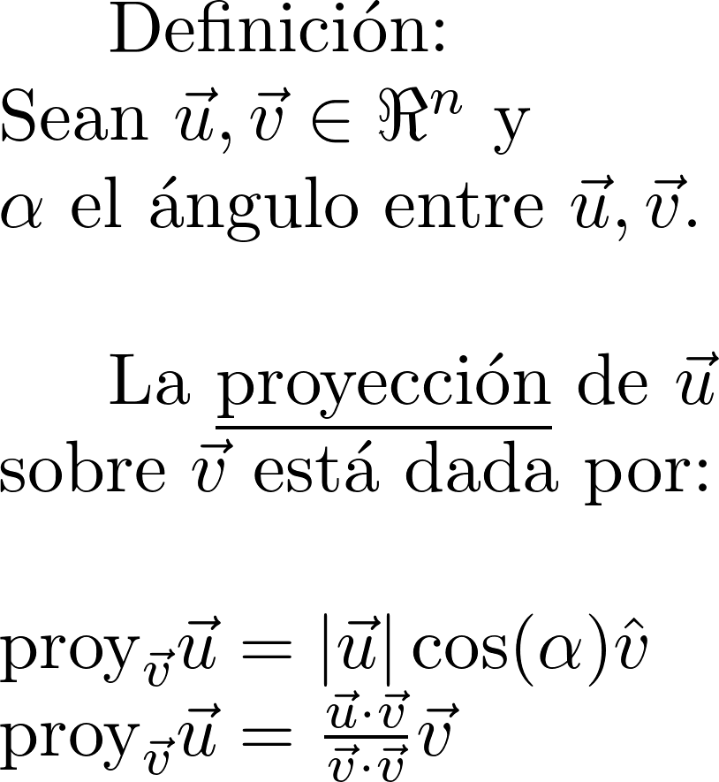

Proyección

Slide 42
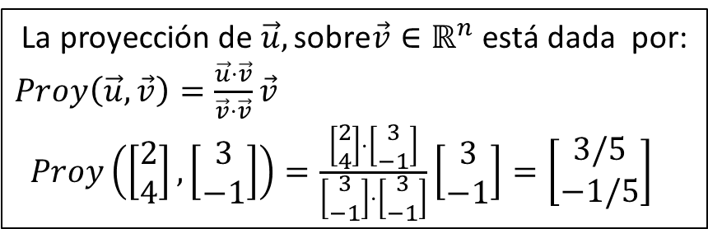
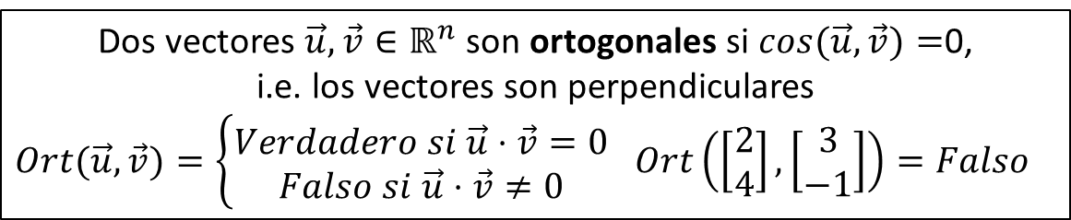


Operaciones entre vectores
Escalar $c∈ℝ$ por vector $\vec{u}$ $∈ℝ^{n}$
$$c\vec{u}=5\left[\begin{matrix}2 \\ 4\end{matrix}\right]=\left[\begin{matrix}5(2) \\ 5(4) \end{matrix}\right]=\left[\begin{matrix}10 \\ 20\end{matrix}\right]$$
Opuesto del vector $\vec{u}$ $∈ℝ^{n}$
$$−\vec{u}=(−1)\vec{u}=−1\left[\begin{matrix}2 \\ 4\end{matrix}\right]=\left[\begin{matrix}−1(2) \\ −1(4) \end{matrix}\right]=\left[\begin{matrix}−2 \\ −4\end{matrix}\right]$$
Suma de dos vectores $\vec{u},\vec{v}∈ℝ^{n}$
$$\vec{u}+\vec{v}=\left[\begin{matrix}2 \\ 4\end{matrix}\right]+\left[\begin{matrix}3 \\ −1\end{matrix}\right]=\left[\begin{matrix}2+3 \\ 4−1\end{matrix}\right]=\left[\begin{matrix}5 \\ 3\end{matrix}\right]$$
Resta de dos vectores $\vec{u},\vec{v}∈ℝ^{n}$
$$\vec{u}−\vec{v}=\vec{u}+\left(−1\right)\vec{v}=\left[\begin{matrix}2 \\ 4\end{matrix}\right]−\left[\begin{matrix}3 \\ −1\end{matrix}\right]=\left[\begin{matrix}2−3 \\ 4+1\end{matrix}\right]=\left[\begin{matrix}−1 \\ 5\end{matrix}\right]$$
Producto Punto de dos vectores $\vec{u},\vec{v}∈ℝ^{n}$
$$\vec{u}⋅\vec{v}=\left[\begin{matrix}2 \\ 4\end{matrix}\right]⋅\left[\begin{matrix}3 \\ −1\end{matrix}\right]=2\left(3\right)+4\left(−1\right)=2$$
Distancia entre dos vectores $\vec{u},\vec{v}∈ℝ^{n}$
$$Dist(\vec{u},\vec{v})=|\vec{u}−\vec{v}|=Dist(\left[\begin{matrix}2 \\ 4\end{matrix}\right],\left[\begin{matrix}3 \\ −1\end{matrix}\right])=\left|\left[\begin{matrix}2 \\ 4\end{matrix}\right]−\left[\begin{matrix}3 \\ −1\end{matrix}\right]\right|=\sqrt{{(−1)}^{2}+5^{2}}=\sqrt{26}$$
Magnitud de un vector $\vec{u}∈ℝ^{n}$
$$\left|\vec{u}\right|=\sqrt{\vec{u}⋅\vec{u}}=\left|\left[\begin{matrix}2 \\ 4\end{matrix}\right]\right|=\sqrt{\left[\begin{matrix}2 \\ 4\end{matrix}\right]⋅\left[\begin{matrix}2 \\ 4\end{matrix}\right]}=\sqrt{2^{2}+4^{2}}=2\sqrt{5}$$
Ángulo entre dos vectores $\vec{u},\vec{v}∈ℝ^{n}$
$$Cos(\vec{u},\vec{v})=\frac{\vec{u}⋅\vec{v}}{|\vec{u}||\vec{v}|}=Cos(\left[\begin{matrix}2 \\ 4\end{matrix}\right],\left[\begin{matrix}3 \\ −1\end{matrix}\right])=\frac{\left[\begin{matrix}2 \\ 4\end{matrix}\right]⋅\left[\begin{matrix}3 \\ −1\end{matrix}\right]}{\left|\left[\begin{matrix}2 \\ 4\end{matrix}\right]\right| \left|\left[\begin{matrix}3 \\ −1\end{matrix}\right]\right|}=\frac{2}{(2\sqrt{5}) (\sqrt{10}) }$$
Vector unitario de un vector $\vec{u}∈ℝ^{n}$
$$\hat{u}=\frac{1}{\left|\vec{u}\right|}\vec{u}=\frac{1}{2\sqrt{5}}\left[\begin{matrix}2 \\ 4\end{matrix}\right]=\left[\begin{matrix}2/2\sqrt{5} \\ 4/2\sqrt{5}\end{matrix}\right]$$
La proyección de $\vec{u},\text{sobre}\vec{v}∈ℝ^{n}$ está dada por:
$Proy\left(\vec{u},\vec{v}\right)=\frac{\vec{u}⋅\vec{v}}{\vec{v}⋅\vec{v}}\vec{v}$
$Proy\left(\left[\begin{matrix}2 \\ 4\end{matrix}\right],\left[\begin{matrix}3 \\ −1\end{matrix}\right]\right)=\frac{\left[\begin{matrix}2 \\ 4\end{matrix}\right]⋅\left[\begin{matrix}3 \\ −1\end{matrix}\right]}{\left[\begin{matrix}3 \\ −1\end{matrix}\right]⋅\left[\begin{matrix}3 \\ −1\end{matrix}\right]}\left[\begin{matrix}3 \\ −1\end{matrix}\right]=\left[\begin{matrix}3/5 \\ −1/5\end{matrix}\right]$
Dos vectores $\vec{u},\vec{v}∈ℝ^{n}$ son ortogonales si $cos(\vec{u},\vec{v})=$0,
i.e. los vectores son perpendiculares
$Ort(\vec{u},\vec{v})=\left\{\begin{aligned}Verdadero si \vec{u}⋅\vec{v}=0 \\ Falso si \vec{u}⋅\vec{v}≠0\end{aligned}\right.$ $Ort\left(\left[\begin{matrix}2 \\ 4\end{matrix}\right],\left[\begin{matrix}3 \\ −1\end{matrix}\right]\right)=Falso$

Slide 43
Ejercicios
Ejercicios:\\
Sección 2.2 de Nakos

Slide 44
Producto Interno

Slide 45



$$R$$
$$R^{2}$$
$$R^{n}$$

Slide 46







Espacios Vectoriales
$$u+v, cu$$
A1, A2, A3, A4, A5
M1, M2, M3, M4, M5
$$R$$
$$R^{2}$$
$$R^{n}$$
$$R^{Z}$$
$$R^{R}$$
$$\left\{1,2\right\}→ℝ$$
$$\left\{1,2, …, n\right\}→ℝ$$
$$ℤ→ℝ$$
$$ℝ →ℝ$$

Slide 47






Espacios Vectoriales
$$u+v, cu$$
$$P_{2}$$
$$P_{n}$$
$$F(R)$$
$$P_{1}$$
$$P$$
$$R$$
$$R^{2}$$
$$R^{n}$$
$$R^{Z}$$
$$R^{R}$$

Slide 48





Espacios Vectoriales
$$u+v, cu$$
Espacios Vectoriales de dimensión finita
$$P_{2}$$
$$P_{n}$$
$$P$$
$$F(R)$$
$$P_{1}$$
$$R$$
$$R^{2}$$
$$R^{n}$$
$$R^{Z}$$
$$R^{R}$$

Slide 49


Espacios Métricos
Espacios Vectoriales
$$u+v, cu$$
Espacios Vectoriales de dimensión finita
$$P_{2}$$
$$F(R)$$
$$P_{n}$$
$$P$$
$$P_{1}$$
$$R$$
$$R^{2}$$
$$R^{n}$$
$$R^{Z}$$
$$R^{R}$$

Slide 50


Espacios Métricos
$$d(u,v)$$
Espacios Vectoriales
$$u+v, cu$$

Slide 51

Espacios Métricos
$$d(u,v)$$
Espacios Normados
$$|u|$$
Espacios Vectoriales
$$u+v, cu$$

Slide 52

Espacios Métricos
$$d(u,v)$$
Espacios Normados
$$|u|$$
Espacios con producto interno
$$\left\langle u,v\right\rangle$$
Espacios Vectoriales
$$u+v, cu$$

Slide 53

Espacios Métricos
$$d(u,v)$$
Espacios Normados
$$|u|$$
$R^{n}$ con
producto punto
Espacios con producto interno
$$\left\langle u,v\right\rangle$$
Espacios Vectoriales
$$u+v, cu$$

Slide 54




Espacios Métricos
Recordemos que la distancia entre dos vectores $\vec{u}$ y $\vec{v}$ de $ℝ^{n}$ cumple las siguientes propiedades:
Si en un conjunto $S$ es posible medir la distancia $d(a,b)$ entre los elementos $a,b∈S$;
y además la distancia cumple las anteriores propiedades se dice que el conjunto $S$ es un espacio métrico.
Por ejemplo:
El conjunto $C[0,1]$ de las funciones continuas entre 0 y 1 con la métrica
$$d_{1}\left(f,g\right)=\int_{0}^{1}{abs\left(f\left(x\right)−g\left(x\right)\right)dx}$$
f
$$d_{1}\left(f,g\right)$$
g
http://www-groups.mcs.st-andrews.ac.uk/~john/analysis/Lectures/L15.html
$C[0,1]$

Slide 56

En espacio $ℝ^{n}$ se pueden definir varias métricas
$$d_{1}\left(\vec{u},\vec{v}\right)=\sum_{i=1}^{n}{abs(u_{i}−v_{i})}$$
$$d_{2}\left(\vec{u},\vec{v}\right)=\sum_{i=1}^{n}{abs(u_{i}−v_{i})}$$
$$d_{1}\left(\vec{u},\vec{v}\right)=\sum_{i=1}^{n}{abs(u_{i}−v_{i})}$$

