Slide 1
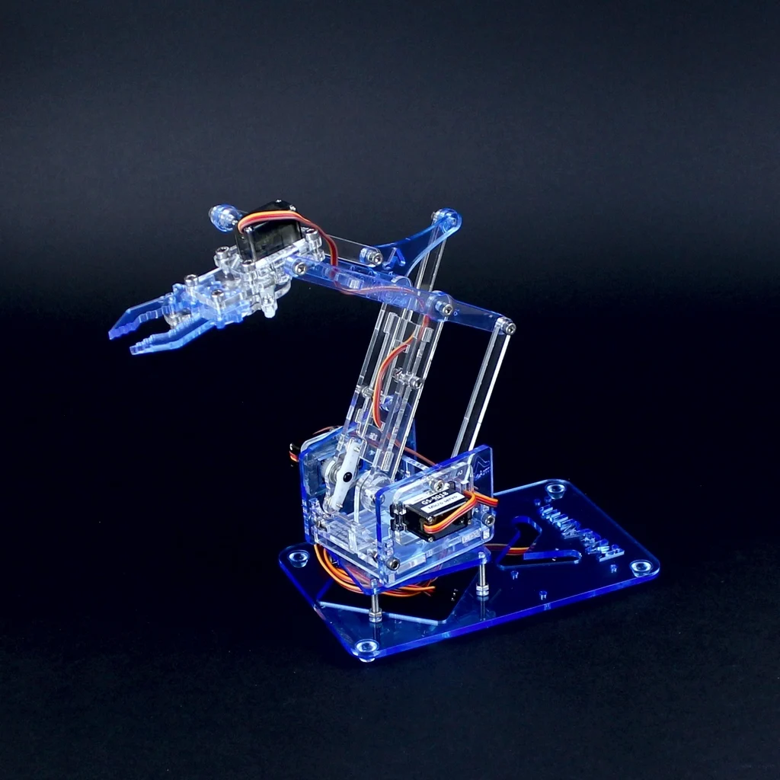
MeArm

Slide 2
Links
Official MeArm resources
https://shop.mearm.com/pages/resources-and-files
Model
https://sketchfab.com/3d-models/mearm-v10-robot-arm-8d8d0a43e0ba4ee5808e703da62fff28
Simulator
https://gerardomunoz.github.io/embedded/virtual/mearm_seq.html

Slide 3
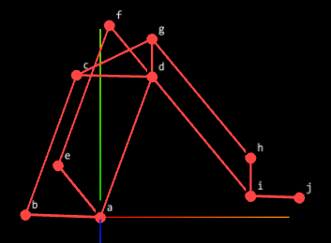
MeArm Links and Joins
Is M parallel to A?
E
H
I
C
F
L
D
B
J
K
G
M
A

Slide 4
MeArm Constant angles
What would happen if β0 changed?
β1
β2
β0

Slide 5
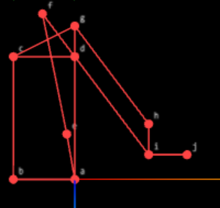
Parallelogram vs Four-bar linkage

Slide 6
Four-bar linkage, examples
https://www.youtube.com/watch?v=ohPwT1TYvqE&list=PL3p-xXY-sN6GKWr1vW_iW8NHEkeZBoL3T&index=133
https://youtu.be/vzM_-Rr5mtw?list=PL3p-xXY-sN6GKWr1vW_iW8NHEkeZBoL3T&t=431
https://www.youtube.com/watch?v=5ecQ2bxHRjI
https://www.youtube.com/watch?v=NM4q-f68TlY
https://www.youtube.com/watch?v=nhd0NdZDjWw
https://www.youtube.com/watch?v=JFmNAI-4cQo&list=PL3p-xXY-sN6GKWr1vW_iW8NHEkeZBoL3T&index=63
https://www.youtube.com/watch?v=NdIk5hIsBmg&list=PL3p-xXY-sN6GKWr1vW_iW8NHEkeZBoL3T&index=57
https://www.youtube.com/watch?v=74T0LF2l5Ck&list=PL3p-xXY-sN6GKWr1vW_iW8NHEkeZBoL3T&index=44
https://www.youtube.com/watch?v=VbSL5W8Ua6M&list=PL3p-xXY-sN6GKWr1vW_iW8NHEkeZBoL3T&index=135
https://www.youtube.com/watch?v=7hBNs4Xqdy4

Slide 7
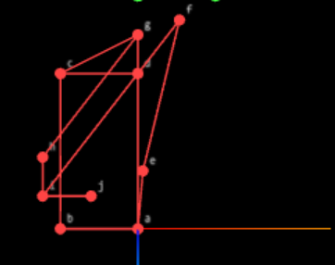
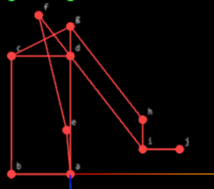
Four-bar linkage, two solutions

Slide 8
Four-bar linkage, algorithm
function fbl(A, D, B, L2, L3, elbow = 1) {
const AB = new THREE.Vector3().subVectors(B, A);
const BD = new THREE.Vector3().subVectors(D, B);
const d = BD.length();
const ex = BD.clone().normalize();
const a = (L2 * L2 - L3 * L3 + d * d) / (2 * d);
const h2 = L2 * L2 - a * a;
if (h2 < 0) return null;
const h = Math.sqrt(h2);
const P = B.clone().add(ex.clone().multiplyScalar(a));
const normal = new THREE.Vector3()
.crossVectors(AB, BD)
.normalize();
const ey = new THREE.Vector3()
.crossVectors(normal, ex)
.normalize();
return P.clone().add(ey.multiplyScalar(elbow * h));
}

Slide 9
Direct Kinematics
computePoints_deg(alphas, ctes) {
const pts = {};
// --- helpers ---
const rotZ = (angle) => new THREE.Vector3(Math.cos(angle), Math.sin(angle), 0);
const angleBetween = (p1, p2) => {
const v = new THREE.Vector3().subVectors(p1, p2);
return Math.atan2(v.y, v.x);
};
// --- base point ---
pts.a = new THREE.Vector3(0, 0, 0);
const dir = rotZ(ctes.beta1);
pts.b = new THREE.Vector3().copy(pts.a).addScaledVector(dir, this.model.li.A.l);
console.log('b',dir, this.model.li.A.l,pts.a,pts.b)
const dir = rotZ(alphas.alpha1);
pts.d = new THREE.Vector3().copy(pts.a).addScaledVector(dir, this.model.li.B.l);
pts.c= fbl(pts.a,pts.b,pts.d,this.model.li.C.l,this.model.li.D.l,-1)
const dir = rotZ(alphas.alpha2);
pts.e = new THREE.Vector3().copy(pts.a).addScaledVector(dir, this.model.li.G.l);
pts.f= fbl(pts.a,pts.e,pts.d,this.model.li.E.l,this.model.li.F.l,-1)
const ang = angleBetween(pts.d, pts.c) + ctes.beta2;
const dir = rotZ(ang);
pts.g = new THREE.Vector3().copy(pts.d).addScaledVector(dir, this.model.li.I.l);
const ang = angleBetween(pts.d, pts.f);
const dir = rotZ(ang);
pts.i = new THREE.Vector3().copy(pts.d).addScaledVector(dir, this.model.li.J.l);
pts.h= fbl(pts.d,pts.i,pts.g,this.model.li.J.l,this.model.li.I.l,-1)
const ang = angleBetween(pts.i, pts.h) + ctes.beta3;
const dir = rotZ(ang);
pts.j = new THREE.Vector3().copy(pts.i).addScaledVector(dir, this.model.li.M.l);
return pts;
}
θ2
α2
α1=θ1

Slide 10
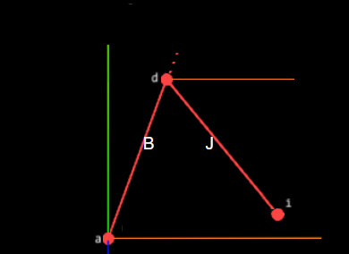
Inverse kinematics, two steps
θ2
θ2
α2
α2
gamma1
r1
P
r1
P
α1=θ1
r2
r2
α1

Slide 11
Two links, two joins inverse kinematics
function inv_kin_2links_rad(P) {
const a1 = 0
const a2 = model1.li.B.l
const a3 = model1.li.J.l
const x03 = P.x;
const z03 = P.y;
const y03 = -P.z;
const alpha0 = Math.atan2(y03, x03);
const r1 = Math.sqrt(x03 ** 2 + y03 ** 2);
const r2 = -(z03 - a1);
const phi2 = Math.atan2(r2, r1);
const r3 = Math.sqrt(r1 ** 2 + r2 ** 2);
const phi1 = Math.acos((a3 ** 2 - a2 ** 2 - r3 ** 2) /
(-2 * a2 * r3));
const alpha1 = phi1 - phi2;
const phi3 = Math.acos((r3 ** 2 - a2 ** 2 - a3 ** 2) /
(-2 * a2 * a3));
const alpha2 = phi3 - Math.PI / 2;
return [alpha0, alpha1, alpha2];
}
θ2
α2
r1
P
α1=θ1
r2

Slide 12
MeArm inverse kinematics
function mearm_inverseKinematics(finalPoint) {
const [alpha0, alpha1, alpha2] = inv_kin_2links(finalPoint)
const gamma0 = alpha0
const gamma1 = alpha1
const a = new THREE.Vector3(0, 0, 0)
const d = new THREE.Vector3(model1.li.B.l, 0, 0)
d.applyAxisAngle(new THREE.Vector3(0, 0, 1), alpha1)
d.add(a)
const f = new THREE.Vector3(model1.li.E.l, 0, 0)
f.applyAxisAngle(new THREE.Vector3(0, 0, 1), alpha2 + Math.PI)
f.add(d)
const e = fbl(d, a, f, model1.li.F.l, model1.li.G.l, -1)
const gamma2 = Math.atan2(e.y - a.y, e.x - a.x)
return [gamma0, gamma1, gamma2]
}
θ2
α2
gamma1
r1
P
r2
α1

