Slide 1

Continuous integration
Git Repository

Slide 2

DO YOU kNOW?

Slide 3

how integrate all?
Retrieved from https://elearningindustry.com/wp-content/uploads/2014/10/Top-9-Tips-to-Boost-Collaboration-Within-Your-eLearning-Team.jpg

Slide 4

Make it easy for everyone!!!
Retrieved from https://codingbash.com/Images/Snippets/1/0aca92ef-de4a-4739-bfb6-56db1ed91202.png

Slide 5
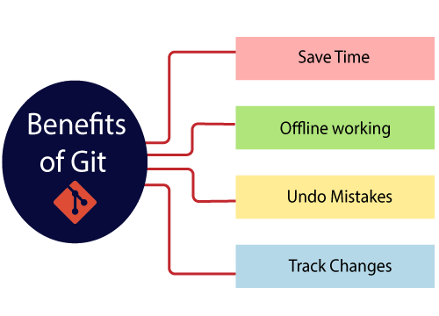
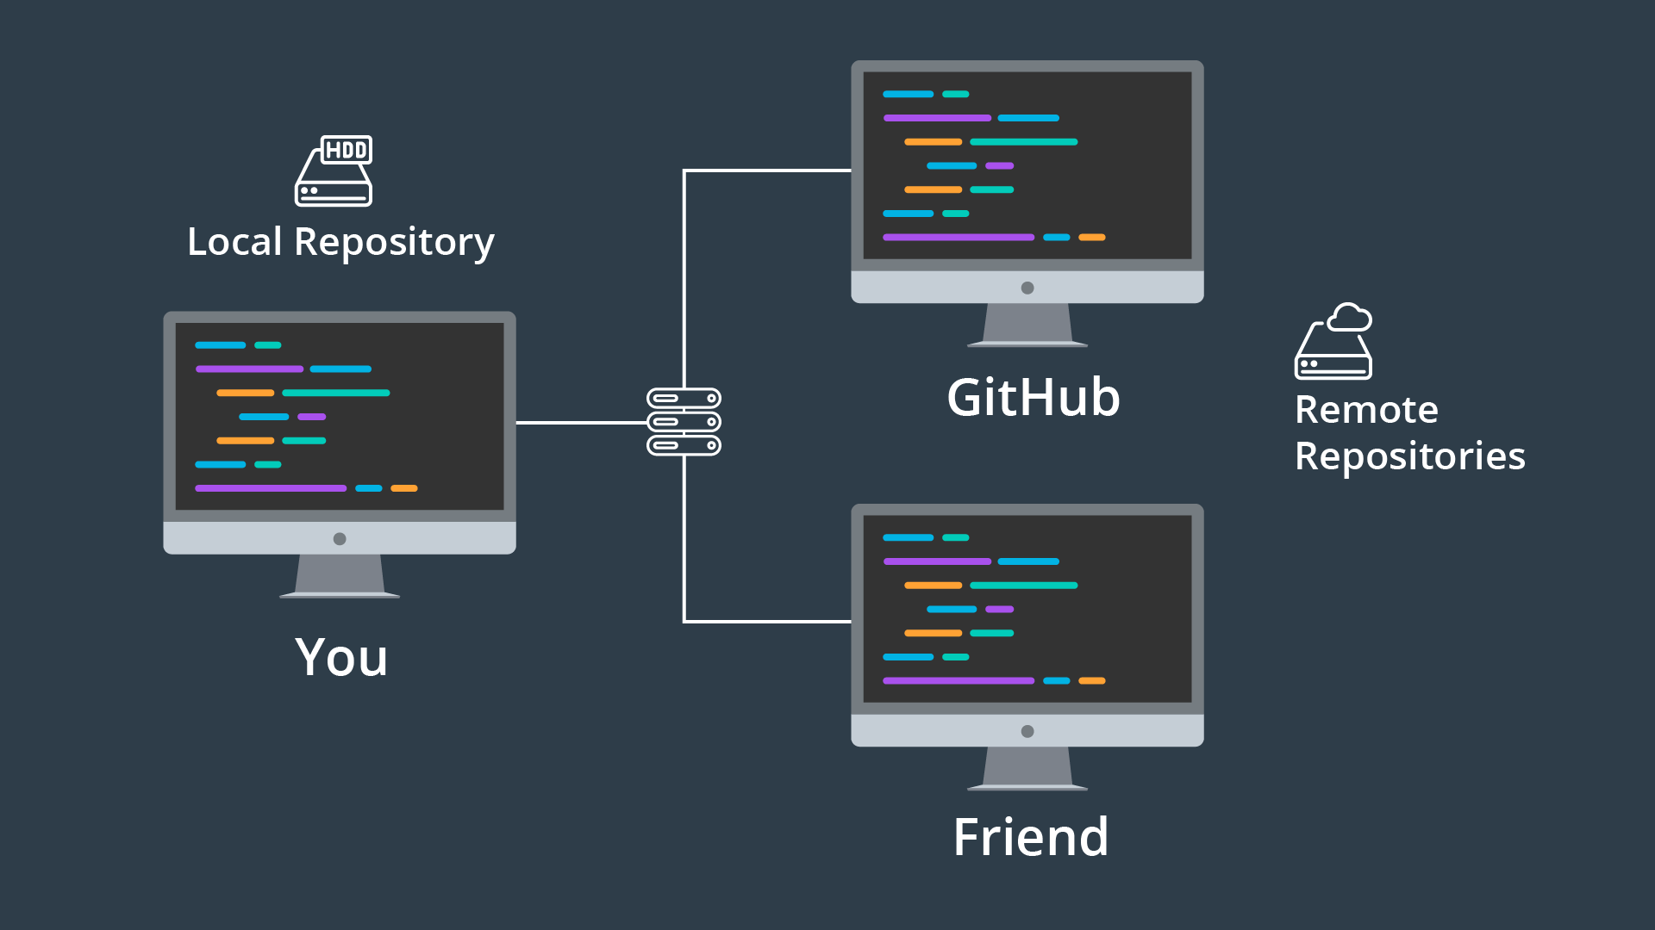
Don’t worry!!!
Image retrieved from https://www.udacity.com/blog/wp-content/uploads/2017/05/GitHubCollaboration.png
Image retrieved from https://static.javatpoint.com/tutorial/git/images/git-benefits.png

Slide 6

Start today!!!
Image retrieved from https://www.linode.com/docs/guides/how-to-install-git-on-linux-mac-and-windows/how-to-install-git.jpg

Slide 7

Thank you!

