Slide 1

SPM622 class presentation
CampusBook
A web app for booking lecturer consultations at CTU
SE2 Group 3
Willem Gerber, Oscar, Thomas, Lebohang and Gerhardus
CTU Training Solutions | 29 October 2026
Notes:
Suggested speaker: Willem
Good morning everyone. We are Group 3, and this is CampusBook.
[Pause] Quick question first: who here has ever messaged a lecturer about a consultation and then waited days for an answer? [Let hands go up.]
That is the problem we set out to fix. In the next few minutes we will show you the problem, what we built, a live demo, the problems we ran into along the way, and our results.

Slide 2








THE PROBLEM
Booking a consultation is messy today
How students ask today
What goes wrong
Teams message
Nobody can see when a lecturer is free
Asking in class
→
Students wait days for a reply
Office visit
Meetings are forgotten, missed or double-booked
WhatsApp
Lecturers do not know who is coming or why
It is worst before tests and assignment deadlines, exactly when students need help most.
Notes:
Suggested speaker: Willem
Right now there is no one way to book a consultation. You send a Teams message, you catch the lecturer after class, you walk to the office, or you WhatsApp them.
So what goes wrong? Nobody can see when a lecturer is actually free. You wait days for a reply. Meetings get forgotten, or two students turn up at the same time. And the lecturer has no idea who is coming or why.
And it is worst right before tests and deadlines, exactly when you need help most.
We did not want to just assume this, so we asked students.

Slide 3



THE EVIDENCE
We asked 13 students. This is what they said
8 of 13
10 of 13
7 of 13
cannot tell when a lecturer is free
wait 1 to 2 days to get a confirmed time
have given up on getting a consultation
Seven out of thirteen gave up. Students are going without help because asking is too hard.
Source: Group 3 student survey, 13 anonymous answers, 22 October 2026
Notes:
Suggested speaker: Willem
We ran an anonymous survey, and 13 students answered.
Three numbers stood out.
8 of 13 cannot tell when a lecturer is free.
10 of 13 wait one to two days just to get a time confirmed.
And 7 of 13, more than half, have given up on getting a consultation at all.
That means students are going without help simply because asking is too hard.

Slide 4



THE EVIDENCE
The survey told us what to build
So CampusBook must:
What students want most (out of 13)
Show each lecturer’s open times
Confirm the booking straight away
Send a reminder before the meeting
Let students change or cancel
4.2 out of 5 average for "Would you use an online booking system?" 9 of 13 gave 4 or 5.
Notes:
Suggested speaker: Willem
We also asked what they would want.
Number one, by far: see the lecturer's free times. 11 of 13 chose that. Then an email reminder, then instant confirmation, then an easy way to change or cancel.
So we did not guess our features. These four answers became our list.
And when we asked if they would use a system like this, the average was 4.2 out of 5.
Gerhardus will take you through what we set out to do.

Slide 5
THE PLAN
Our aim and five objectives
1
Find out how consultations work now
A survey of students
OUR AIM
Build and test a web system where students book, change and cancel consultations, and lecturers manage the time they are free.
2
Compare existing booking tools
Microsoft Bookings, Calendly and Moodle
3
Build the six must-have features
Working on a live database
4
Test it
Check that every feature works, fast, on a phone and a laptop
5
Evaluate it with real users
User testing with students and lecturers
Notes:
Suggested speaker: Gerhardus
So our aim was simple: build and test a web system where students book, change and cancel consultations, and lecturers manage their free time.
We turned that into five objectives you can measure: survey at least ten students, compare three tools, build six must-have features, test it against clear targets, and evaluate it with real users.
At the end we will come back to all five and tell you how we did.

Slide 6
THE RESEARCH
Why not use a tool that already exists?
Microsoft Bookings
Calendly
Moodle Scheduler
Good: syncs with Outlook and Teams
Good: polished and easy to use
Good: made for teaching
But: built for businesses, has no idea of students or modules, needs an administrator to set up
But: reminders cost about 10 US dollars per lecturer per month, and every lecturer has a separate link
But: only works inside one course and needs an administrator to install it
THE GAP
None of them gives every CTU student one free place to book any lecturer.
Notes:
Suggested speaker: Gerhardus
We looked at three tools that already do booking.
Microsoft Bookings works well with Outlook and Teams, but it is made for businesses, not students and modules, and it needs an administrator to set up.
Calendly is polished, but reminders cost about ten dollars per lecturer per month, and you need a different link for every lecturer.
Moodle Scheduler is made for teaching, but it only works inside one course.
So we kept what they do well: open slots, instant confirmation and reminders. But none of them gives every CTU student one free place to book any lecturer. That is the gap CampusBook fills.

Slide 7
THE PLAN
Requirements and how we worked
WHAT IT MUST DO
HOW WE WORKED
9 functional requirements
Agile Scrum in one-week sprints
Log in as a student or a lecturer
Lecturers publish, edit and remove their slots
Students book, change or cancel with a reason
No double bookings
Confirmation and reminder emails, and booking history
Sprint 0 | 16 to 19 Oct
Requirements, SRS and design
0
1
Sprint 1 | 20 to 23 Oct
Build the six features and first tests
7 non-functional requirements
2
Sprint 2 | 24 to 29 Oct
User testing, fixes and the final report
Quick to book and pages that load fast
Works on a phone and a laptop
Hashed passwords, and each user only sees their own data
Each member worked on a GitHub branch, and pull requests were reviewed before merging into main.
Notes:
Suggested speaker: Gerhardus
Our requirements came from three places: our own experience of booking consultations, feedback from our lecturer on the proposal, and the comparison of existing tools. The survey then confirmed them.
We ended up with nine functional requirements, the things the system must do, like logging in with a role, publishing slots, booking with a reason, no double bookings and emails. And seven non-functional requirements, how well it must do them: fast, on a phone, and secure.
We worked in Agile Scrum with one-week sprints. Sprint 0 was requirements and design, Sprint 1 was building the features, and Sprint 2 was user testing, fixes and the final report. Every member worked on their own GitHub branch and pull requests were reviewed before merging.
Lebohang will show you what we built.

Slide 8




THE SOLUTION
CampusBook: six must-have features
Two roles
Lecturer slots
Book with a reason
Students and lecturers log in and each sees their own pages
Lecturers publish the times they are free each week
Students book, change or cancel and say why they are coming
Email and reminder
Booking history
Phone and laptop
A confirmation straight away and a reminder before the meeting
Both roles see upcoming and past bookings
Every page works on a small phone screen and a laptop
Notes:
Suggested speaker: Lebohang
These are the six features every version of CampusBook had to have.
Two roles: students and lecturers each log in and only see their own pages.
Lecturers publish the times they are free.
Students book a time and give a reason, so the lecturer can prepare. They can also change or cancel.
Both people get a confirmation email, and a reminder before the meeting.
Everyone can see their booking history.
And it works on a phone, because 7 of our 13 students said they would book from their phone.

Slide 9





THE BUILD
How it is built
WHAT YOU SEE
THE RULES
THE DATA
React web app
→
Node.js and Express API
→
MySQL database
The pages in the browser: log in, book a slot, my bookings, lecturer slots
Checks who you are and what you may do, then applies the booking rules
Stores users, lecturers, slots, bookings and emails in five tables
Emails
Nodemailer sends the confirmation. A timer job checks every minute and sends reminders 60 minutes before.
Security
Passwords are stored scrambled (bcrypt). After logging in, each request carries a token that proves who you are.
Notes:
Suggested speaker: Lebohang
CampusBook has three parts.
What you see is a React web app in the browser.
The rules live in our API, built with Node.js and Express. It checks who you are, what you are allowed to do, and applies the booking rules.
The data is in a MySQL database with five tables. Only the API can talk to it.
For emails we use Nodemailer, and a small timer job checks every minute and sends reminders 60 minutes before a meeting.
Passwords are never stored as plain text, only scrambled with bcrypt.
The key idea: the rules are on the server, not on the screen, so nobody can get around them.

Slide 10
THE SOLUTION
One booking, step by step
STEP 1
STEP 2
STEP 3
STEP 4
STEP 5
STEP 6
Lecturer publishes a free time
Student picks a lecturer and an open time
Student adds a reason and confirms
Both get a confirmation email
Reminder email before the meeting
Change or cancel opens the time again
No messages back and forth. The moment a time is booked, no other student can take it.
Notes:
Suggested speaker: Lebohang
Here is what one booking looks like.
The lecturer publishes a free time. The student picks that lecturer and an open time, adds a reason and confirms. Both get an email straight away, and a reminder goes out before the meeting. If the student changes or cancels, that time opens up again for someone else.
No messages back and forth, and once a time is booked, nobody else can take it.
Oscar will explain the hardest part of the build.

Slide 11
THE BUILD
The hard part: two students, one slot
OUR TEST
The slot is locked while it is booked
8 requests
The second request waits for the first to finish, then sees the slot is taken.
for the same slot at the same moment, from three students
The database is the safety net
Even if the code had a bug, the database refuses a second booking for the same slot.
1 booking
The other 7 saw "Sorry, that slot is no longer available"
Lecturers cannot break a booking
A slot that is already booked cannot be edited or removed, and slots cannot overlap or be in the past.
Notes:
Suggested speaker: Oscar
The hardest problem was this: what if two students click Book on the same slot at the same second?
If both went through, two students would arrive for one meeting, which is exactly what we set out to stop.
We solved it in two layers. First, the slot is locked while a booking is being made, so the second request waits and then sees it is taken. Second, the database itself refuses a second booking for the same slot, so even a bug in our code cannot break it.
We tested it by sending eight booking requests for one slot at the same moment. One booking went through and the other seven got a clear message.
Lecturers also cannot edit or delete a slot once someone has booked it.

Slide 12

THE BUILD
Testing found 10 problems. We fixed all of them
Two pages showed no times
Dates moved by one day
The Lecturer slots and Book a slot pages used different names for the times than the API. We matched the names.
A time-zone conversion shifted some dates. The database now sends the date as plain text.
No way to change a booking
Passwords could be guessed forever
My bookings only had Cancel. We added a Change time button that moves the booking.
After 10 wrong passwords in 15 minutes, the login now blocks more tries for a while.
Lesson: most bugs were at the joins between our parts, so agree on names and test the joins early.
Notes:
Suggested speaker: Oscar
When we joined everyone's work together and tested it, we found ten problems. We fixed all ten and tested them again.
Here are the four that mattered most.
Two pages showed no times at all, because the page and the API used different names for the same data.
Some dates moved by one day because of a time-zone conversion.
Students could cancel but not change a booking, so we added a Change time button.
And anyone could keep guessing passwords, so now the login blocks more tries after ten wrong passwords.
The big lesson: most problems were where different people's work joined together.

Slide 13
THE RESULTS
What the testing showed
USER TESTING
9 of 9
10 of 10
4 students and 2 lecturers
4 of 6
functional requirements met
defects fixed, none left open
rated it easy to use
389 ms
1 of 8
4.5 out of 5
students’ average ease rating (lecturers 2.5)
slowest page load
booking requests for the same slot got through
Also passed: students cannot see each other’s bookings, and every page works on a phone and a laptop.
Notes:
Suggested speaker: Oscar
After the fixes, here is where we ended up.
All nine functional requirements were met. All ten defects were fixed, none left open. The slowest page loaded in 389 milliseconds, against a target of three seconds. And eight booking requests at once still gave only one booking.
Then I ran the user testing. We tested it with real users on 28 October: four students and two lecturers, who answered a Google Form afterwards.
Four of the six rated it easy or very easy to use. The students were very positive: an average of 4.5 out of 5, and all four said finding a slot was easy and the confirmation was clear.
The two lecturers could publish and manage their slots, but they rated it 3 and 2. That tells us the lecturer page is where we need to improve next, mainly clearer navigation.
On average, testers rated 3.7 out of 5 for using CampusBook instead of Teams or WhatsApp.
Thomas will take us back to our objectives.

Slide 14
THE RESULTS
Did we meet our objectives?
1
Find out how consultations work now
13 students answered the survey
Achieved
2
Compare existing booking tools
Bookings, Calendly and Moodle Scheduler
Achieved
3
Build the six must-have features
All 9 functional requirements met
Achieved
4
Test it
35 of 36 tests pass, pages under 0.4 s
Mostly achieved
5
Evaluate it with real users
4 of 6 found it easy to use
Partly achieved
Notes:
Suggested speaker: Thomas
So, back to our five objectives.
One: we surveyed 13 students, more than our target of ten.
Two: we compared three existing tools.
Three: we built all six features, and every functional requirement was met.
Four is mostly achieved: 35 of 36 tests pass and pages load in under half a second. The one test we could not complete is the timed booking, because we did not time the bookings during user testing.
Five is partly achieved: we tested with four students and two lecturers, and four of the six found it easy to use. Our target was 80 percent, so we fell a little short, and the feedback shows us exactly why: the lecturer page.

Slide 15


WHAT WE LEARNED
Five things we learned
Start with the users
The survey, not our guesses, decided the features.
Agree on the details first
Most bugs came from parts using different names for the same data.
Put the rules on the server
Screens can be bypassed. The API and database cannot.
Test early and test the joins
Joining everyone’s work is where the problems showed up.
Work in branches
Each member worked on a GitHub branch and merged with pull requests.
Notes:
Suggested speaker: Thomas
Finally, five things this project taught us.
Start with the users: the survey, not our guesses, decided what we built.
Agree on the details first: most of our bugs came from parts using different names for the same data.
Put the rules on the server, because a screen can be bypassed.
Test early, especially where people's work joins.
And working in GitHub branches with pull requests let five people build at the same time without overwriting each other.
Lebohang will now show you CampusBook live.

Slide 16
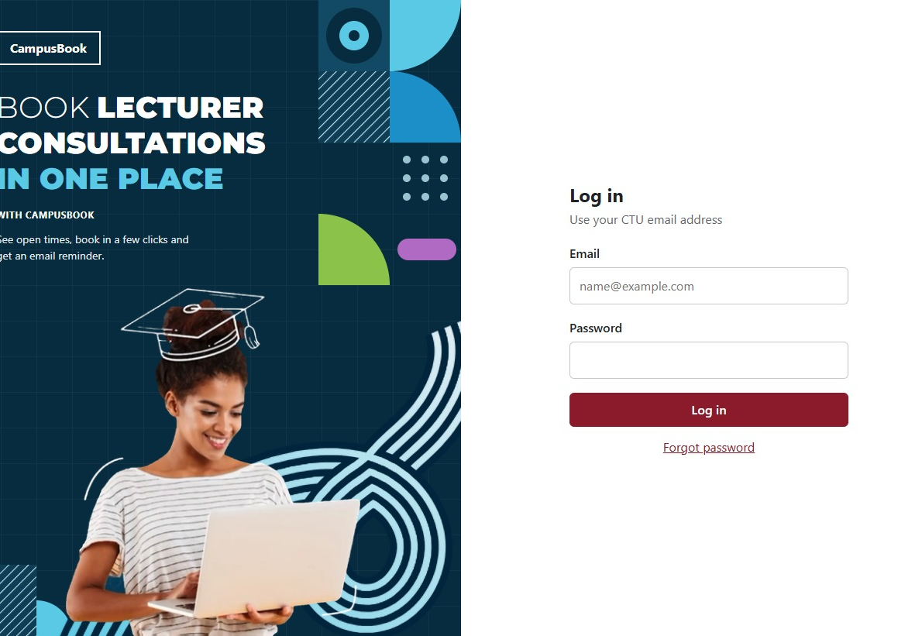
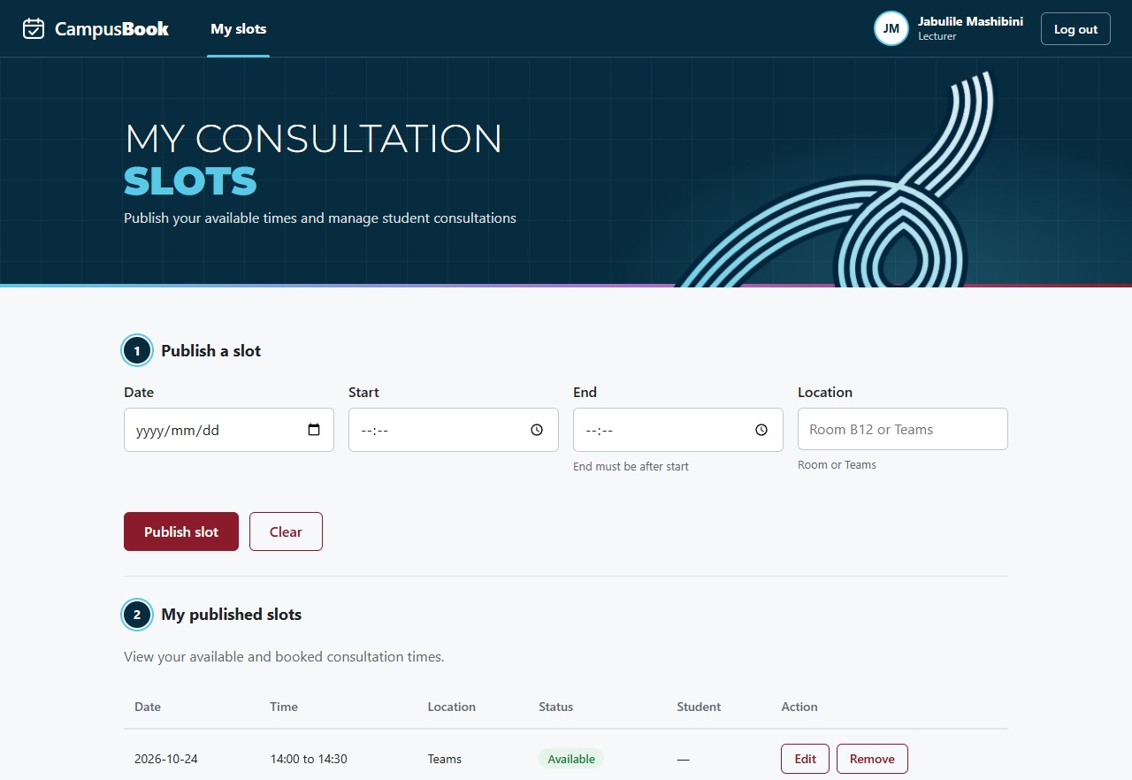
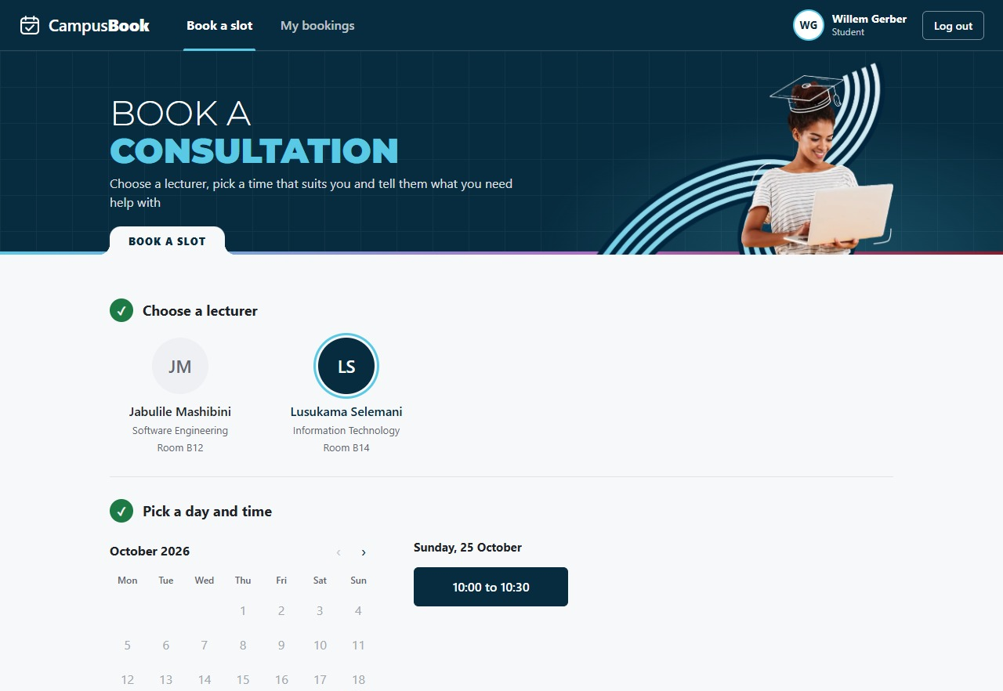
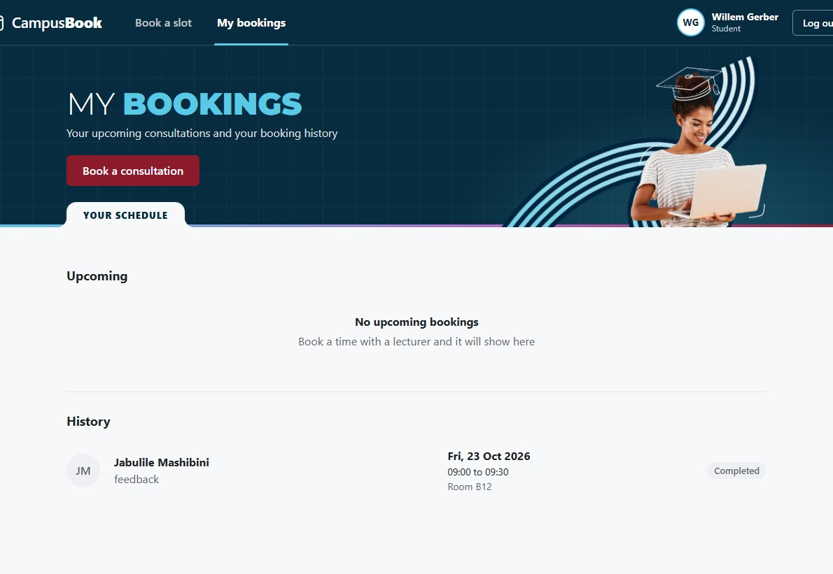
LIVE DEMO
Let us show you CampusBook
WHAT WE WILL SHOW
Lecturer logs in and publishes a free time
Student logs in, finds that time and books it with a reason
The confirmation email arrives and the time is gone for others
Student changes the time, then cancels
The slot is open again on the lecturer page
Log in
Lecturer slots
Book a slot
My bookings
Notes:
Suggested speaker: Lebohang (drives the app)
[Switch to the running app. Keep it to about four minutes.]
1. Log in as the lecturer and publish a free time.
2. Log out, log in as a student, pick that lecturer and book the time with a reason.
3. Show the confirmation email and that the time is no longer open.
4. Use Change time to move the booking, then cancel it.
5. Back on the lecturer page, show the time is open again.
If anything fails live, play the backup video and talk through the same steps.
Hand back to Thomas to close.

Slide 17
Thank you
Questions?
CampusBook: book lecturer consultations in one place
Notes:
Suggested speaker: Thomas
Thank you for listening. We are happy to take any questions.
Who answers what:
Double booking and testing fixes: Willem. Survey, research and lessons: Lebohang. Lecturer page: Thomas. Running the live demo: Lebohang. Emails, reminders and the user testing: Oscar. Database design and demo data: Gerhardus.
If asked about limits: the survey had 13 students from one campus and no lecturers, the user testing had six people and the bookings were not timed, and the speed was measured on one computer, not over the campus network.
If asked what you would improve: the lecturer page first (lecturers rated it 3 and 2), then a weekly calendar view with notifications for new free times, both asked for by testers.

