Slide 1
Sentence Generator Presentation
Jake Kurlander

Slide 2
Introduction
I planned on creating a few sentence-generating programs, which would, given a text file input, create sentences.
Main difficulties: English grammar
Expected lessons:
  Trees
  Algorithms

Slide 3
The Algorithms
Markov Chain
Syntax Tree
Break a text down into words
Put each word at the head of a tree
Each tree has a branch to every word that follows the word.
Go from one word to the next until you hit a period.
Choose a random configuration of Clauses and conjunctions
Fill in clauses with phrases
Fill in phrases with random words of the right parts of speech.

Slide 4
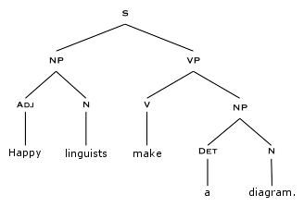


Slide 5
Demo
Markov Chain (Frankenstein)
Syntax Tree
I attempted to admire and encourage him, and a thousand celestial observations that possessed me; I when he thought of an English may not hate.
I not sufficient to support my rage was my temper to each day in collecting my welfare and played above all my fancy amiable and rude an ill entrench.
The family evenly baked, now that the deer gracefully gathered an abandoned mother for a sea.
The bath lands the spy for the confused chicken.
A goose hastily escaped.
The aunt sternly promised, only if a jam itches.
Though the adventurous food obeys the dimwitted hook for the food, the bedroom honestly scatters a whispered scale to a big-hearted week.

Slide 6
Results
Everything worked as expected
  Markov chains do not create real sentences
  Syntax trees usually create okay sentences
Complications
  Markov Tree
  .txt formatting

Slide 7
Future work
Markov Tree punctuation
N-level Markov Trees
More complex sentence structures

Slide 8
For more information
http://www.cs.princeton.edu/courses/archive/spr05/cos126/assignments/markov.html
http://www.onthelambda.com/2014/02/20/how-to-fake-a-sophisticated-knowledge-of-wine-with-markov-chains/
http://allthingslinguistic.com/post/102131750573/how-to-draw-a-syntax-tree-part-8-a-step-by-step

