Slide 1
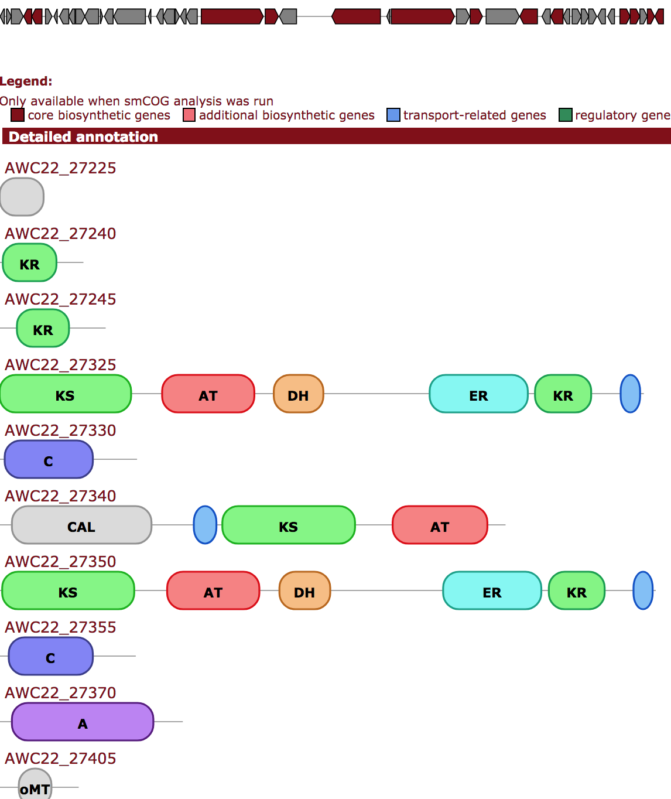
Identifying pks clusters harboring a self-resistant target gene
Step 1: BLAST search for KS homologs.
Using 8 diverse KS query sequences, e-value < 1
199,894 proteins; 110,174 NCBI nucleotide records/genomes
tblastn
11 NCBI nucleotide
databases
KS
Step 2: Run antismash to verify and annotate PKS gene clusters on all 110k nucleotide records
Antismash t1pks genes database
Step 3: Extract KS and gene sequences from all PKS clusters and make a database
Step 4. Blast search for a target in a PKS cluster
Using 12 experimentally verified targets, e-value <1
4,404 proteins
Step 5. Filter blast hits
Using e-value <1e-8 and sequence identity > 30%
806 proteins
blastp
Antismash t1pks genes database
12 targets
< 10kb
Step 6: Require tandem KS+target pair <10kb apart
252 pairs, 250 unique nucleotide records
KS
Target
Notes:
Step 2.
antismash_output$ find . -name "geneclusters.js"|wc
52480 52480 1599452
antismash_output_assemblies_all$ find . -name "geneclusters.js"|wc
26573 26573 930384
Step 3. 30k gbids of t1pks annotated clusters
cat cluster_genes.all.fasta | grep ">" |cut -d"|" -f1,2 | sort -u |wc
29987 29987 692154
0.84% discovery rate
Probably missing some misannotated clusters, like andrimid

