Slide 1
Data Science using Stata: Complete Beginners Course YouTube Special
Professor Gerhard Kling

Slide 2
Background
https://uk.linkedin.com/in/gerhard-kling
https://twitter.com/GerhardklingS
About the course:
Academic version: Analysing Qualitative and Quantitative Data (SOAS University of London): 2015-2019
Applied version: HMRC: 2012-2015
This version is a very applied and hands-on experience in data science – modified for YouTube
Why Stata?
Feedback
DMs open on Twitter
Leave a comment – as YouTubers say: «hit the like button and subscribe!» ☺
Dr Gerhard Kling
1

Slide 3
Overview
Lecture 1: Introduction to statistical models and Stata
Lecture 2: Exploring data
Lecture 3: Regression analysis
Lecture 4: Post estimation analysis
Lecture 5: Analysing panel data
Lecture 6: Binary choice models
Lecture 7: Model specification
Lecture 8: Measuring the immeasurable: CFA and SEM
Dr Gerhard Kling
1

Slide 4
What will you learn?
On successful completion of this course, participants will be able to:
Analyse structured data
Interpret statistical output
Visualise data
Use Stata
Solve problems applying analytical tools
Problem-based learning in workshops
Analysing data
Using Stata
Organising your work using do-files
Interpretation of output
Material
GitHub, which I will update regularly
Dr Gerhard Kling
2

Slide 5
Getting Stata
You do not need the latest version 17 of Stata; earlier versions (even Stata 8) will be sufficient
You can convert Stata datasets using Python (see my video)
LINK:
http://www.timberlake.co.uk/software/stata/educational/students/students.html
The best version would be Stata/BE for £165 (perpetual). You can also select aversion for £65 per year
You can also get a free version (for 30 days) following this link:
http://www.stata.com/customer-service/evaluate-stata/
Should you learn Stata (see my video?)
Dr Gerhard Kling
2

Slide 6
Lecture 1: Introduction to statistical models and Stata

Slide 7
Statistics, econometrics, data science…?
E.g., econometrics based on statistical methods for estimating economic relationships
It does not have to be an economic relationship
Knowing statics helps you to analyse any relationship using data
Purpose
Testing economic theory
Evaluation of government and business policy
Forecasting
Example: Collis, J., Grayson, A. and S. Johal (2010) ‘Econometric Analysis of Alcohol Consumption in the UK’, HMRC Working Paper 10
What happens to alcohol consumption if prices increase (e.g. taxes, minimum price)?
Data: Expenditure and Food Survey
Method: Tobit model
Dr Gerhard Kling
3

Slide 8
Theory and empirical models
To be honest, most empirical work does not refer to any theoretical model
Empirical models (e.g. regression models) imply causality; one variable (or several) affects another variable (or several)
Causality is only implied – but not guaranteed
Before you start an empirical analysis
Think about the underlying “theory” (e.g. draw associations)
Develop hypotheses
Use theory to derive hypotheses, which can be tested empirically
Consumption of alcohol (labelled Y) is a function of income (I), price of alcohol (P) and other variables (S)
Y = f(I, P, S)
Dr Gerhard Kling
4

Slide 9
Data structure
How is information collected?
Primary data: survey, interviews
Secondary data: annual reports, stock market data
Experiments: controlled environment
APIs: social media etc. (Python is the way!)
Dimensions
Cross-section: (random) variable y is observed for N number of cases (e.g. firms); observations are also called realisations; so we have y_{i} for i=1,…,N
Time series: (random) variable y is observed over time t from t=0 to t=T; so we obtain a series {y_{t}}
Panel data: (random) variable y is observed over time t for N number of cases (e.g. firms); so we have y_{it} for i=1,…,N and t=0,…,T
Sampling
Randomness
Sample selection
Dr Gerhard Kling
5

Slide 10
Data structure
Why does the data structure matter?
Depending on dimensions, a dataset has to be reorganised so that Stata is able to understand its structure
Example: Panel data
Country | Year | GDP growth | Inflation | …
A | 2009 | 1.2% | 2.1%
A | 2010 | -0.2% | 0.6%
B | 2009 | 0.8% | 1.2%
B | 2010 | 0.2% | 0.9%
Dr Gerhard Kling
6

Slide 11
Causality and ceteris paribus
Models imply a direction of influence (causality); hence, it is important to consider the theoretical underpinning of the implied causal relationship
If a time dimension is available, we can test for so-called Granger causality
Main idea: the past affects the present but the present does not affect the past
Ceteris paribus mean that we can change one variable and hold all other variables constant to observe the partial impact on the dependent variable
Dr Gerhard Kling
7

Slide 12
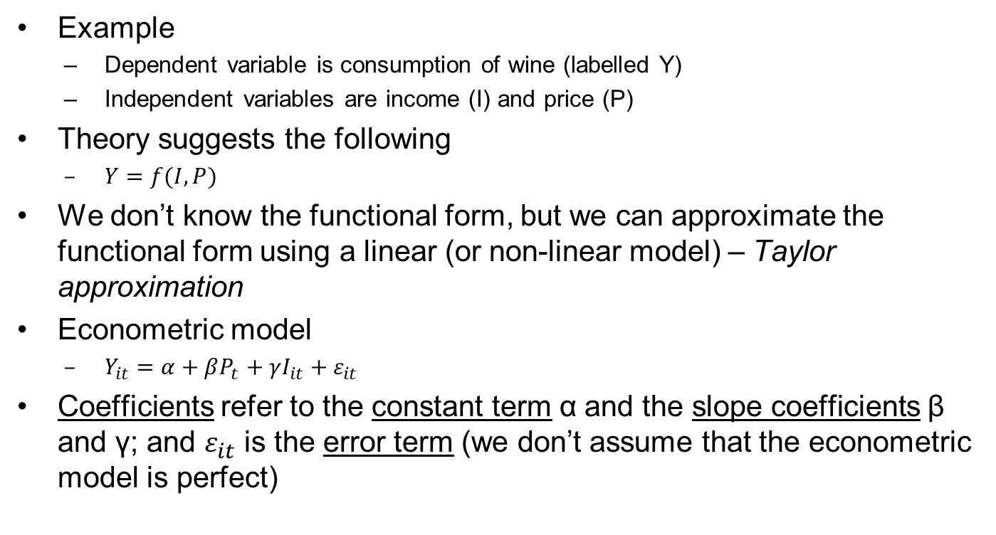
Causality and ceteris paribus
Dr Gerhard Kling
8

Slide 13
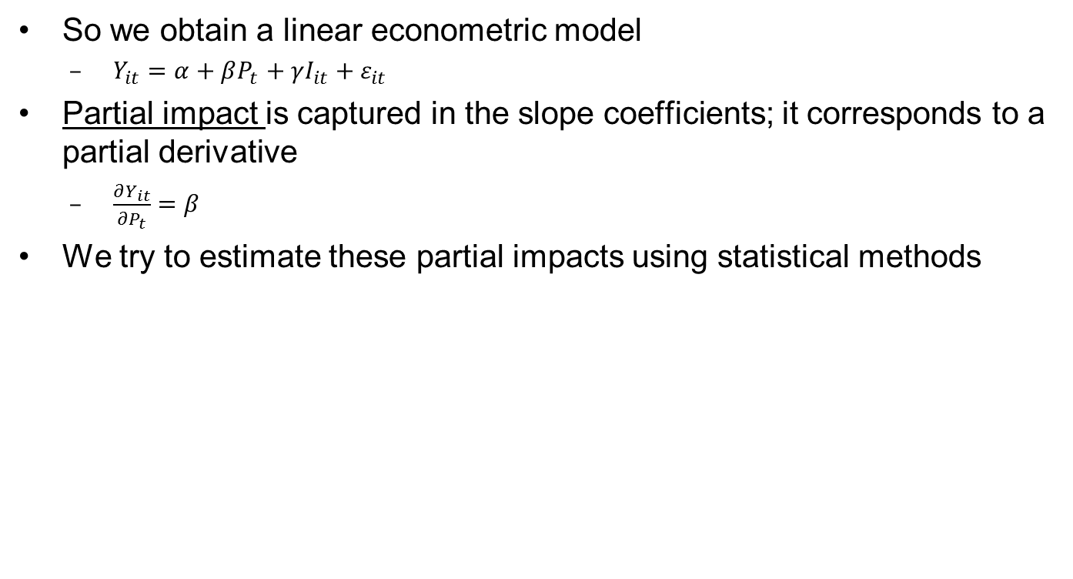
Partial impact
Y
α
β
1
P
Dr Gerhard Kling
9

Slide 14
Introduction to Stata
Stata is only a tool – it does some work for you but it refuses to think on your behalf!
Working with do-files
Work can be replicated
Easy way to update analysis (e.g. new data)
Never overwrite original dataset!
Working with ado-files
Write your own commands
Useful for advanced statistical methods
Dr Gerhard Kling
10

Slide 15
Stata and data management
Many datasets are available in Stata format
You can use the insheet command to read csv files in Stata
First convert your Excel file into a csv file (comma delimited)
Missing values have to be an empty cell!
Change the cell format into general (Stata will otherwise mix up numeric and string formats)
You can use complex self-written commands in Stata to change the data structure
Dr Gerhard Kling
11

Slide 16
Lecture 2: Exploring data

Slide 17
Why is it important?
Many textbooks in econometrics do discuss how to explore data
If your dataset is wrong, even the most sophisticated method will fail
Mistakes (e.g. coding) and outliers have a considerable impact on empirical models
Understanding your data is essential before you start any empirical modelling
Dr Gerhard Kling
12

Slide 18
Descriptive statistics
Provide an overview of your variables
What is your dependent variable (the variable you want to explain)?
Define your independent variables
Why are they independent?
How did you select them (e.g. theory, prior empirical research)?
Descriptive statistics that ‘summarise’ data
Mean (average)
Median (why can mean and median differ? What does that mean?)
Standard deviation or variance
Minimum and maximum value (range)
Percentiles (e.g. lowest 5%, top 5%)
Dr Gerhard Kling
13

Slide 19
Sum command
Using the ‘sum’ command, we obtain
The average household size is 2.31 with a standard deviation of 1.24
The range is 8 (maximum 9 and minimum 1)
Variable | Obs | Mean | Std. Dev. | Min | Max
size | 5263 | 2.313889 | 1.240199 | 1 | 9
income | 5263 | 417.647 | 319.4453 | 0 | 1925.882
Dr Gerhard Kling
14

Slide 20
Sum, detail command
Using the ‘sum’ command and the option (after the comma) ‘detail’, we obtain
The table only shows one variable
 | Percentiles | Statistics
1% | 59.056 | Obs | 5263
5% | 101 | Mean | 417.647
10% | 133.1618 | Standard deviation | 319.4453
25% | 204.612 | Variance | 102045.3
50% | 332.31 | Skewness | 2.090577
75% | 531.3333 | Kurtosis | 8.812933
90% | 788.62
95% | 1022.548
99% | 1845.552
Skewness>0 means that there are large outliers (symmetry of distribution)
Kurtosis is a measure of ‘fat tails’ – left and right outliers
Dr Gerhard Kling
15

Slide 21
Histograms
Illustrates the distribution of a variable
Income is not a normally distributed variable
Outliers with large positive values
This can affect our analysis
Dr Gerhard Kling
16

Slide 22
Kernel densities
Continuous approximation of a histogram
Stata command
‘kdensity’
Option (after comma) ‘normal’
Whether you use Kernel densities or histograms is a matter of taste
Dr Gerhard Kling
17

Slide 23
Box-plots
Useful to illustrate the range of a variable, outliers and the distribution
Can be also used to compare sub-groups
Example
We want to compare the household income of households with older people (above the age of 70) compared to all other households
We define the groups first
*Household with older people
*Variable A047
gen older=1 if A047==size
replace older=0 if older==.
Dr Gerhard Kling
18

Slide 24
Comparing sub-groups
We use boxplots for both sub-groups
Stata command
‘graph box income, by(older)’
There is a clear difference in income
Hence, household composition seems to matter, which is not a big surprise
Dr Gerhard Kling
19

Slide 25
Missing values and outliers
Missing values
Usually not a major concern if the total number of observations (N) is large
N>30 is acceptable for running standard regression models
In time series data, missing values can be predicted (e.g. smoothing methods, forecasting)
Outliers
Usually +/- 3 standard deviations can be regarded as an outlier – but there is no widely accepted definition
Outliers affect some econometric models (e.g. standard regression model with Ordinary Least Squares (OLS))
Dr Gerhard Kling
20

Slide 26
Should we remove outliers?
Some textbooks recommend removing outliers
I would be reluctant to remove outliers
Creates a sample selection bias
Information in outliers is not utilised
You can ‘manipulate’ our empirical findings
Except: outlier is due to mistake in dataset (e.g. typos in surveys)
Use more robust methods
E.g. quantile regressions
Run the model with / without outliers and compare the results
Use winsorisation
Remove lowest 1% and highest 1% of observations
Observations are replace by percentiles
This is widely used in applied econometric work
Dr Gerhard Kling
21

Slide 27
Winsorisation in Stata
Let’s see how it can be done in Stata
*Winsorisation
*Use income measure and replace bottom/top 1% of observations
*Generate percentiles
egen p5=pctile(income), p(5)
egen p95=pctile(income), p(95)
*Generate winsorised variable
gen win_income=income if income>=p5 & income<=p95
replace win_income=p5 if income<p5
replace win_income=p95 if income>p95
*Compare both variables
twoway (histogram income) (histogram win_income, color(blue)), ///
legend(label(1 "Income") label(2 "Winsorised Income"))
Dr Gerhard Kling
22

Slide 28
Winsorisation of income
Two-way graph to compare original and winsorised variable
Dr Gerhard Kling
23

Slide 29
Transformations
In some areas of research (e.g. medical research, biostatistics), researchers take the distribution of variables very seriously
They try to achieve a normal distribution by transforming the original variable
In biostatistics, it is very common to use a Box-Cox transformation
In economics, complex transformations are not very common
Standard transformations include
Natural logarithm (ln): useful if variable has large positive outliers; skewness > 0
Power transformation (e.g. square root): less common; needs theoretical underpinning
Warning: transformations also change the alleged linear relationship of variables
Dr Gerhard Kling
24

Slide 30
Ln(income)
Let’s transform income
Simple generate command in Stata
gen ln_income = ln(income)
Transformed variable is very close to a normal distribution
Dr Gerhard Kling
25

Slide 31
Exporting tables from Stata
Copy-paste (using HTML format) works quite well for graphs
It also works if you copy-paste into Excel
There are more sophisticated methods, which you can use to import Stata tables into Word or Latex (or Lyx)
You need ‘esttab’ and ‘estpost’ commands
Update Stata (this does not work if you run it from a server)
Use your own ado-file folder (see example)
Find commands and save ado-files in your ado folder
It is a bit of work – but it saves a lot of time, as you don’t have to type tables
Latex is even better, as tables / figures are automatically updated when you re-run the Stata do-file
Dr Gerhard Kling
26

Slide 32
Esttab command
*You need the commands estpost and esttab
*You can update in Stata (depends on whether you can save ado files)
*You can download commands and include them in your own ado folder
*Setting ado path
sysdir set PERSONAL "C:\Users\gk1n09\Ado"
estpost tabstat size income win_income, s(N mean sd p25 p50 p75) columns(statistics)
esttab . using C:\Users\gk1n09\descriptive.rtf, ///
cells("count mean(fmt(%9.2f)) sd(fmt(%9.2f)) p25(fmt(%9.2f)) p50(fmt(%9.2f)) p75(fmt(%9.2f))") ///
noobs title(Descriptive statistics) compress replace ///
nogap
Dr Gerhard Kling
27

Slide 33
Exercise 1: Living costs and food survey

Slide 34
To-do list (1/2)
Locate the variable B228 (contribution to private pension)
Rename the variable B228 into ‘pension’ (use the Stata help function to find command)
Locate the variable EqIncOp (income)
Generate the variable income, which is equal to EqIncOp
Use the ‘tabstat’ command to display mean, median and standard deviation in columns for the variables income and pension
Define a dummy variable (labelled ‘working_age’) for households with all members below the age of 60 (HINT: you need to use if commands and combine several conditions using logic (&))
How many households in ‘working_age’ do not save for pension?
Can you confirm that more than 80% of households in ‘working_age’ do not contribute to a pension?
Dr Gerhard Kling
28

Slide 35
To-do list (2/2)
Use box-plots to compare the contribution to pension of households in ‘working_age’ with more than 3 children (age 5-18) and less then 3 children (age 5-18)
HINT: create a dummy variable for more than 3 children (age 5-18) (value 1) and less then 3 children (age 5-18) (value 0)
HINT: restrict the dummy variable to households in ‘working_age’ using if commands
Dr Gerhard Kling
29

Slide 36
Lecture 3: Regression analysis

Slide 37
Correlation and scatter plots
Correlation refers to a linear relationship between two variables, which does not imply causality
It is useful to start with a simple correlation matrix to explore whether linear relationships exist (I also refer to our discussion of multicollinearity – next lecture)
Scatter plots are very useful to visualise linear (or non-linear relationships)
It is also a good tool to detect outliers
Moreover, you might be able to observe sub-groups / clusters
Dr Gerhard Kling
30

Slide 38
Correlation matrix
Let’s explore what drives the use of credit cards (interest payments)
Income
Size of household
Number of children
Contribution to pension
Correlation > 0.85 is regarded as ‘meaningful’
 | credit_card | income | size | child | pension
credit_card | 1.0000
income | 0.0551 | 1.0000
size | 0.0628 | 0.0661 | 1.0000
child | 0.0339 | -0.0371 | 0.7115 | 1.0000
pension | 0.0007 | 0.1935 | 0.0341 | 0.0281 | 1.0000
Dr Gerhard Kling
31

Slide 39
Explore distribution
Many zeros (households without credit card or no balance outstanding) – actually a censored variable (we ignore it for now – it will be discussed in a later lecture)
Use ln() transformation
Dr Gerhard Kling
32

Slide 40
Scatter plots
Let’s explore the relationship between credit cards and income
No obvious relationship
Dr Gerhard Kling
33

Slide 41
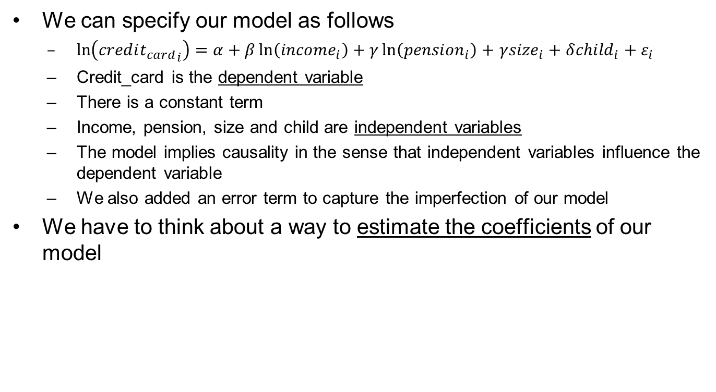
Our econometric model
Dr Gerhard Kling
34

Slide 42
Ordinary Least Squares (OLS)
What is the idea of OLS?
We specify a so-called loss function
A loss function (goes back to decision theory) determines the loss (negative utility) we incur if we make a mistake
The ‘mistakes’ are captured in our error term
BUT: in ‘real life’ the error term is unknown, we can only observe deviations from the linear relationships, which we call residuals
Residuals are estimates for the error term
OLS determines the coefficients so that the sum of squared residuals is minimised
Dr Gerhard Kling
35

Slide 43

Illustration of OLS
Let’s look at a simple example
Minimise sum of squared deviations from predicted regression line
Y
X
Dr Gerhard Kling
36

Slide 44
OLS in Stata
Let’s use the ‘reg’ command in Stata and see what we obtain
An increase in income increases credit card use (interest paid on credit cards)
Dr Gerhard Kling
37

Slide 45
Interpretation of Stata output (1/2)
Coefficients are so-called point estimates and indicate the partial impact (ceteris paribus) of the independent variable on the dependent variable
The standard error refers to the estimated standard deviation of the coefficient; it is a measure for the precision of the point estimate
T-values are test statistics and defined as coefficient divided by standard error; if |t-value| > 2, the coefficient is significantly different from zero
P-values (related to t-value) indicate the probability that the true partial impact is outside the confidence interval; if p<0.05, the coefficient is significantly different from zero with 95% level of confidence
Dr Gerhard Kling
38

Slide 46
Interpretation of Stata output (2/2)
The confidence interval refers to [coefficient +/- 1.96 * standard error]; it determines the range (upper and lower limit) of the true partial impact; hence, with a probability of 95% the true partial impact is element of the confidence interval
Number of observations should be always reported
R-squared and adjusted R-squared (adjusted for degrees of freedom) are measures for the quality of the model (model fit); e.g. an R-squared of 70% means that the model can explain 70% of the observed variability of the dependent variable
NOTE: do not use the R-squared to select ‘good’ models; use F-tests and other specification tests
The F-test refers to a joint null hypothesis that all coefficients are equal to zero (‘model is useless’); if you can reject the null hypothesis (p-value < 0.05), it means that the model has explanatory power
Dr Gerhard Kling
39

Slide 47
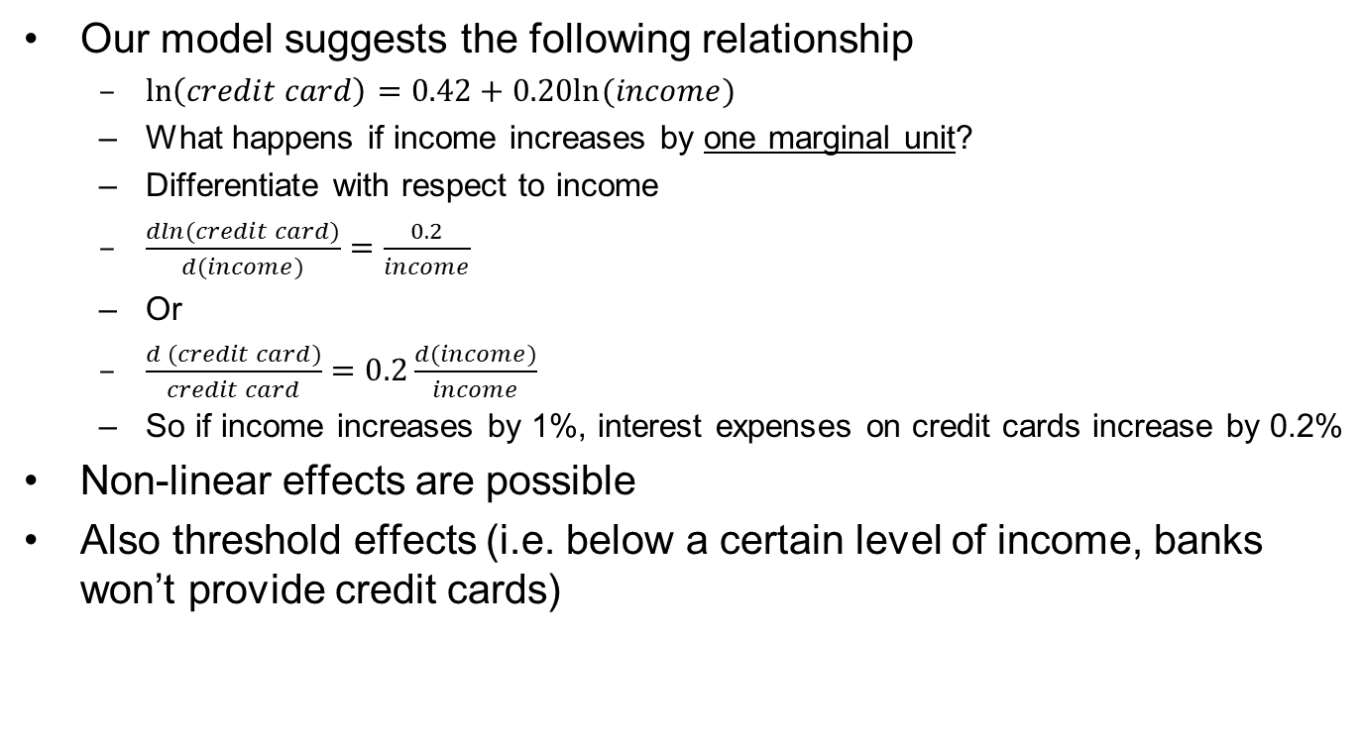
Functional forms
Dr Gerhard Kling
40

Slide 48
Classical Linear Regression model (CLRM)
Our model is the CLRM; hence, the following assumptions apply
Assumptions
Linearity: transformations can help to relax the assumption (e.g. non-linear relationships can be modelled using polynomials; however, we need to modify our hypothesis tests due to multicollinearity)
Strict exogeneity: error term does not depend on any independent variable
Spherical error variance: homoskedasticity and no serial correlation; the variance of the error term does not change with any independent variable (homoskedasticity); error terms are uncorrelated over time or across clusters (no serial correlation)
No multicollinearity: independent variables are not (highly) correlated
We need to check these assumptions after conducting a CLRM
Dr Gerhard Kling
41

Slide 49
Lecture 4: Post estimation analysis

Slide 50
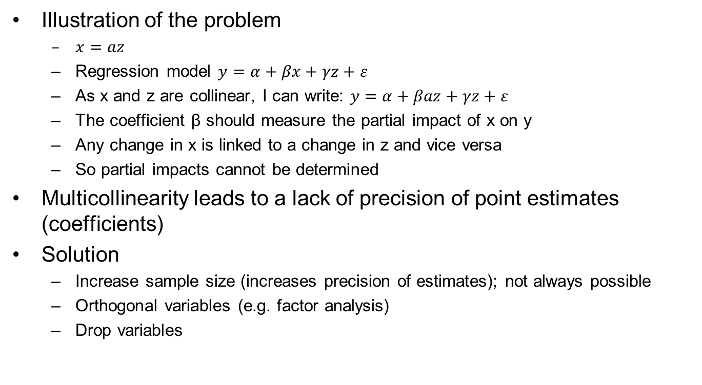
Multicollinearity
Illustration of the problem
$x=az$
Regression model $y=α+βx+γz+ε$
As x and z are collinear, I can write: $y=α+βaz+γz+ε$
The coefficient β should measure the partial impact of x on y
Any change in x is linked to a change in z and vice versa
So partial impacts cannot be determined
Multicollinearity leads to a lack of precision of point estimates (coefficients)
Solution
Increase sample size (increases precision of estimates); not always possible
Orthogonal variables (e.g. factor analysis)
Drop variables
Dr Gerhard Kling
42

Slide 51
How to detect multicollinearity?
The standard approach is to show a correlation matrix
If the correlation coefficients are below 0.85, most researchers would argue that multicollinearity is not present
This method can be misleading, as we only explore the relation between two variables
It is possible that several variables are interlinked, which cannot be detected in a correlation matrix
Nevertheless, in most applications, a correlation matrix is the ‘gold standard’
Dr Gerhard Kling
43

Slide 52
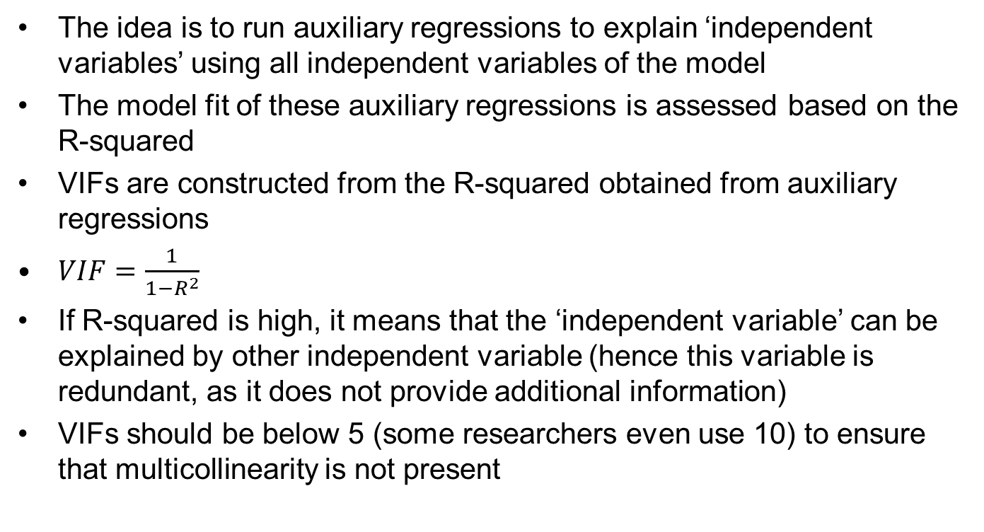
Variance inflation factors (VIF)
The idea is to run auxiliary regressions to explain ‘independent variables’ using all independent variables of the model
The model fit of these auxiliary regressions is assessed based on the R-squared
VIFs are constructed from the R-squared obtained from auxiliary regressions
$VIF=\frac{1}{1−R^{2}}$
If R-squared is high, it means that the ‘independent variable’ can be explained by other independent variable (hence this variable is redundant, as it does not provide additional information)
VIFs should be below 5 (some researchers even use 10) to ensure that multicollinearity is not present
Dr Gerhard Kling
44

Slide 53
VIF example in Stata
We run a standard regression and determine VIFs
VIFs are below 5, so multicollinearity is not an issue
Dr Gerhard Kling
45

Slide 54
Heteroskedasticity
There are standard tests (e.g. White test) that are commonly used
The problem is that these tests are not always reliable, as they also test for other problems (e.g. omitted variables)
I recommend ‘inspecting the residuals’ after a regression has been fitted to see whether they behave according to our assumptions
Patterns in residuals can tell you a lot about the quality of your model (e.g. structural breaks, non-linear relationships)
In Stata, the standard test is the ‘hettest’ after a regression command
Dr Gerhard Kling
46

Slide 55
‘Hettest’ in Stata
Let’s run a simple model to explain food expenditures relative to income (labelled food); households with less income spend most of their money on food
*Simple regression
reg food income
hettest
predict r, res
*Plot residuals and income
scatter r income
*Plot squared residuals
gen r2=r^2
scatter r2 income
Dr Gerhard Kling
47

Slide 56
Residual plot
It is quite obvious that our model fit is not very good for low levels of income
Dr Gerhard Kling
48

Slide 57
Squared residual plot
Moreover, error term variance declines with income
Dr Gerhard Kling
49

Slide 58
How to fix heteroskedasticity?
I recommend exploring the underlying reasons
Non-linear relationship
Bad model fit for certain groups (maybe add more independent variables)
Structural breaks
Standard approach
Weighted least squares: only useful if you know the case of heteroskedasticity; nowadays less common
Robust methods: so-called Huber-White Sandwich estimator
In Stata use the ‘robust’ option separated with a comma from your regression command to obtain the Huber-White Sandwich estimator
Dr Gerhard Kling
50

Slide 59
Serial correlation
In some textbooks also called autocorrelation (in particular, in the context of time series modelling)
There are many ways to test for it
Durbin-Watson test statistic; mainly used in Eviews; in Stata ‘estat dwatson’ - NOTE: it only tests for first-order autocorrelation
Breusch-Godfrey test can be used for high-order autocorrelation; in Stata ‘estat bgodfrey’
I recommend using auxiliary regressions to detect serial correlation
We will address serial correlation when we explore panel data
Dr Gerhard Kling
51

Slide 60
Linearity
Again, I stress the benefits of exploring your data (e.g. using residual plots)
There are some tests to detect non-linearity – but these tests also test for other issues (e.g. omitted variable bias)
The best test is the Ramsey RESET test; in Stata ‘ovtest’
In applied empirical work, I would recommend the following
Ensure that all relevant variables are in the model (based on theories, prior empirical studies); this avoids an omitted variable bias
Always explore residuals and squared residuals after regressions
Use the ‘hettest’ and ‘ovtest’ to confirm your perspective – DO NOT trust tests too much
Include squared or cubic variables into your model and re-run ‘ovtest’
Dr Gerhard Kling
52

Slide 61
Endogeneity
There are hardly any exogenous variables that are determined outside the model and have no relation with the error term (e.g. is income exogenous?)
In applied work, many variables are dependent on other variables – they are endogenous
I would recommend that your empirical model is guided by theoretical considerations
How can we handle endogeneity?
Structural equation models (mainly used in business research)
Simultaneous equation models (mainly used in economics)
Adding a time dimension and using vector autoregressions (VAR)
Dr Gerhard Kling
53

Slide 62
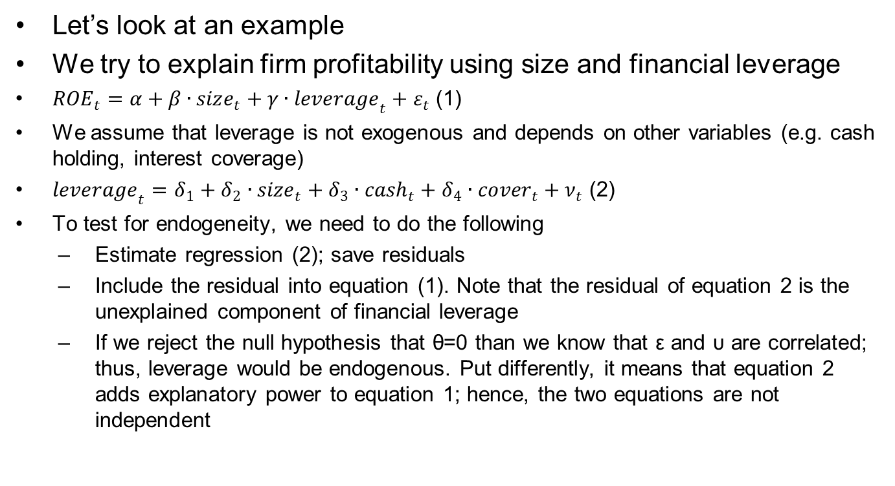
Testing for endogeneity
Let’s look at an example
We try to explain firm profitability using size and financial leverage
${ROE}_{t}=α+β∙{size}_{t}+γ∙{leverage}_{t}+ε_{t}$ (1)
We assume that leverage is not exogenous and depends on other variables (e.g. cash holding, interest coverage)
${leverage}_{t}=δ_{1}+δ_{2}∙{size}_{t}+δ_{3}∙{cash}_{t}+δ_{4}∙{cover}_{t}+ν_{t}$ (2)
To test for endogeneity, we need to do the following
Estimate regression (2); save residuals
Include the residual into equation (1). Note that the residual of equation 2 is the unexplained component of financial leverage
If we reject the null hypothesis that θ=0 than we know that ε and υ are correlated; thus, leverage would be endogenous. Put differently, it means that equation 2 adds explanatory power to equation 1; hence, the two equations are not independent
Dr Gerhard Kling
54

Slide 63
Exercise 2: Profitability of UK firms

Slide 64
To-do list (1/2)
Run the do-file provided to construct variables from the raw data
Create a table that shows the total number of defaults per year (HINT: use the variable ‘default’ and the ‘tabstat’ command)
Generate firm size using ln(total assets)
Use kernel densities and describe the distribution of firm size
Test the hypothesis that smaller firms exhibit better performance measured by return on assets (ROA)
Start with a simple linear model using only firm size as explanatory variable
Explore the residuals
Are there any issues?
Try different specifications
Check your specifications using the tests we discussed
Dr Gerhard Kling
55

Slide 65
To-do list (2/2)
Try different specifications (e.g. include measures for cost efficiency and asset utilisation)
Check your specifications using the tests we discussed
Try the ‘estimates store’ and ‘estimates table’ command to display several regressions in one table
Is there an optimal firm size?
Dr Gerhard Kling
56

Slide 66
Lecture 5: Analysing panel data

Slide 67
Benefits of panel data
Time and cross-sectional dimension
More observations due to pooling
Analysis of heterogeneity
Development in different groups / clusters over time
Analysis of causality
Granger causality: pre-determined (lagged) variables affect current variables
Time effects (e.g. policy change) and implications for different cross-sectional units can be analysed
Analysis of dynamics
Time lags of policy changes
Dr Gerhard Kling
57

Slide 68
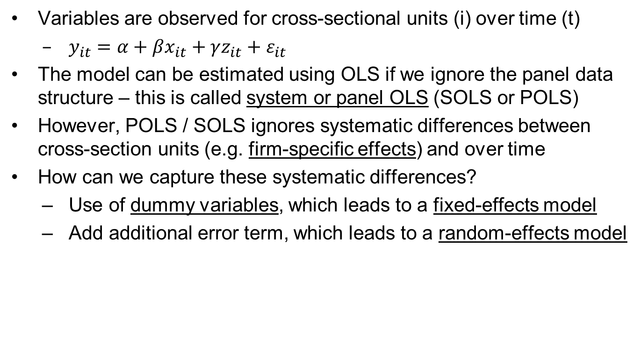
The panel data model
Variables are observed for cross-sectional units (i) over time (t)
$y_{it}=α+βx_{it}+γz_{it}+ε_{it}$
The model can be estimated using OLS if we ignore the panel data structure – this is called system or panel OLS (SOLS or POLS)
However, POLS / SOLS ignores systematic differences between cross-section units (e.g. firm-specific effects) and over time
How can we capture these systematic differences?
Use of dummy variables, which leads to a fixed-effects model
Add additional error term, which leads to a random-effects model
Dr Gerhard Kling
58

Slide 69
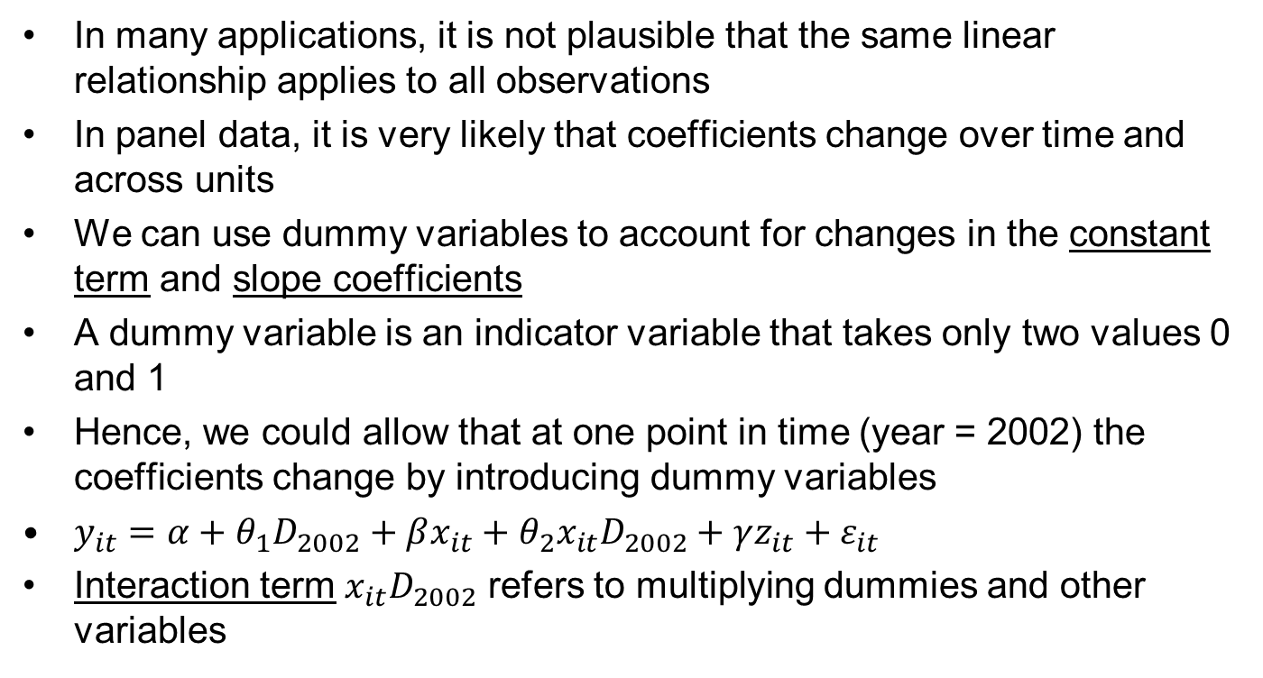
Interaction effects
In many applications, it is not plausible that the same linear relationship applies to all observations
In panel data, it is very likely that coefficients change over time and across units
We can use dummy variables to account for changes in the constant term and slope coefficients
A dummy variable is an indicator variable that takes only two values 0 and 1
Hence, we could allow that at one point in time (year = 2002) the coefficients change by introducing dummy variables
$y_{it}=α+θ_{1}D_{2002}+βx_{it}+θ_{2}x_{it}D_{2002}+γz_{it}+ε_{it}$
Interaction term $x_{it}D_{2002}$ refers to multiplying dummies and other variables
Dr Gerhard Kling
59

Slide 70
An example of interactions (1/2)
Let’s explore the UK firm sample
I winsorise first to reduce the impact of outliers
Please note the loop introduced by ‘foreach’
global var "ROA size r_d_ta WC_ta cover leverage"
foreach y of global var {
egen p1=pctile(`y'), p(1)
egen p99=pctile(`y'), p(99)
gen o_`y'=`y'
replace `y'=`y' if `y'>=p1 & `y'<=p99
replace `y'=p1 if `y'<p1 & `y'!=.
replace `y'=p99 if `y'>p99 & `y'!=.
drop p1 p99
}
Dr Gerhard Kling
60

Slide 71
An example of interactions (2/2)
I define the interaction terms based on the two types (controlled subsidiaries and independent firms)
Then I run the regressions
*Interaction term
gen ind_size=independent*size
gen con_size=control*size
*Shift in constant term
reg ROA control size r_d_ta WC_ta cover leverage
*Shift in constant term and slope coefficient
reg ROA control size con_size r_d_ta WC_ta cover leverage
test control con_size
Dr Gerhard Kling
61

Slide 72
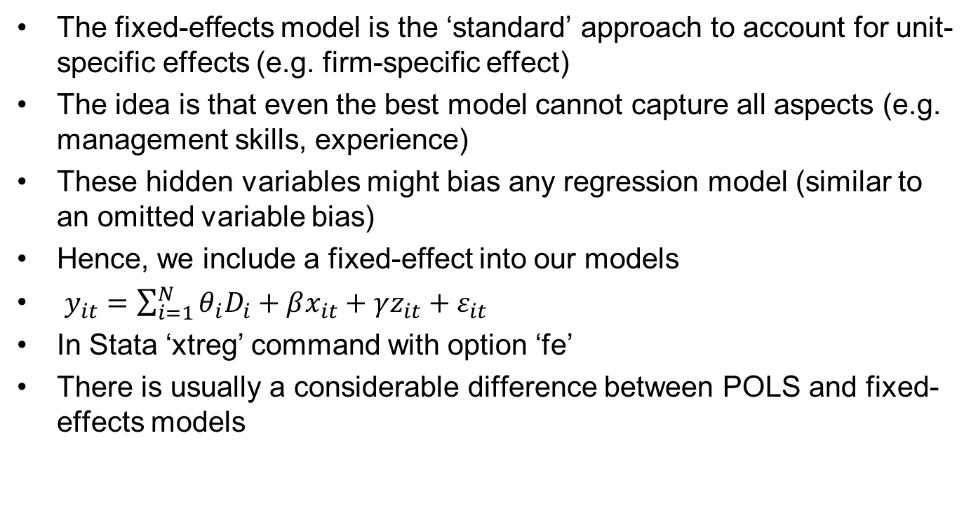
Fixed effects
The fixed-effects model is the ‘standard’ approach to account for unit-specific effects (e.g. firm-specific effect)
The idea is that even the best model cannot capture all aspects (e.g. management skills, experience)
These hidden variables might bias any regression model (similar to an omitted variable bias)
Hence, we include a fixed-effect into our models
$y_{it}=\sum_{i=1}^{N}{θ_{i}D_{i}}+βx_{it}+γz_{it}+ε_{it}$
In Stata ‘xtreg’ command with option ‘fe’
There is usually a considerable difference between POLS and fixed-effects models
Dr Gerhard Kling
62

Slide 73
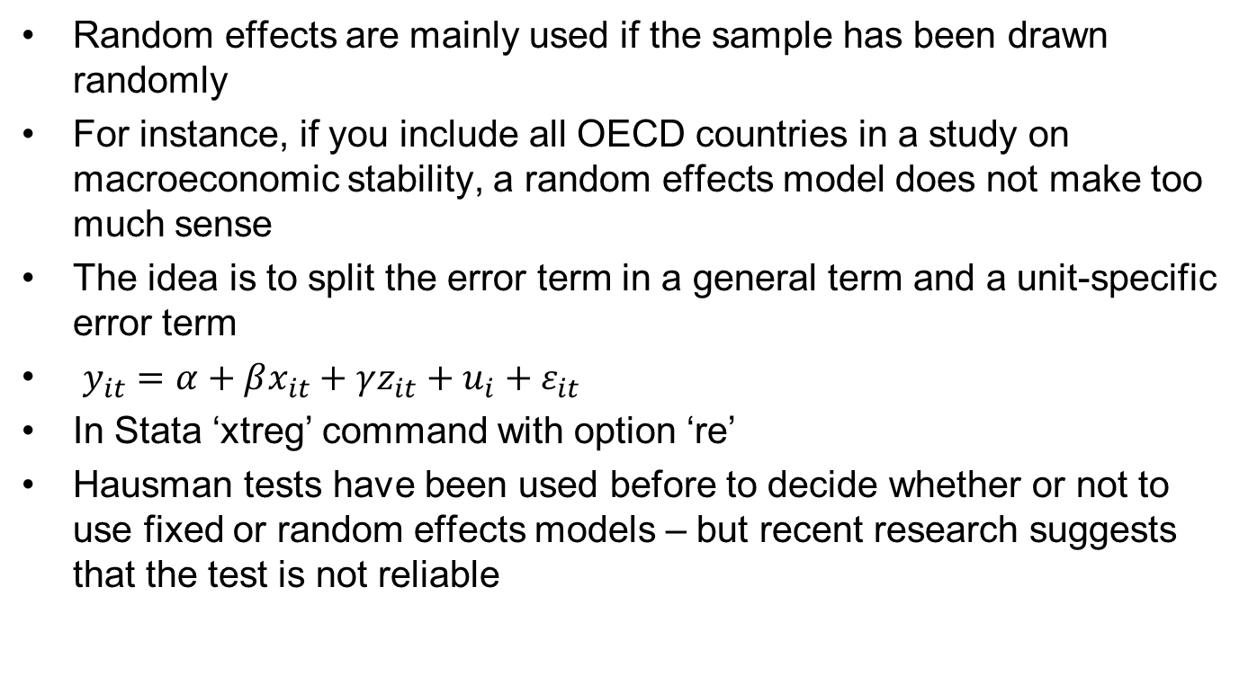
Random effects
Random effects are mainly used if the sample has been drawn randomly
For instance, if you include all OECD countries in a study on macroeconomic stability, a random effects model does not make too much sense
The idea is to split the error term in a general term and a unit-specific error term
$y_{it}=α+βx_{it}+γz_{it}+u_{i}+ε_{it}$
In Stata ‘xtreg’ command with option ‘re’
Hausman tests have been used before to decide whether or not to use fixed or random effects models – but recent research suggests that the test is not reliable
Dr Gerhard Kling
63

Slide 74
POLS, fixed and random effects
I run all models in Stata and combine them in one table to compare the outcomes
You need to ‘tsset’ your data so that Stata understands the data structure
*Panel regressions
tsset code year
reg ROA size r_d_ta WC_ta cover leverage
estimates store A
xtreg ROA size r_d_ta WC_ta cover leverage, fe
estimates store B
xtreg ROA size r_d_ta WC_ta cover leverage, re
estimates store C
estimates table A B C, b(%9.3f) star(.1 .05 .01)
Dr Gerhard Kling
64

Slide 75
Compare specifications
I run all models in Stata and combine them in one table to compare the outcomes
Estimates are consistent except for firm size
Variable | POLS | Fixed-effects | Random-effects
size | 0.009*** | -0.001 | 0.005**
r_d_ta | -0.467*** | -0.626*** | -0.470***
WC_ta | 0.099*** | 0.159*** | 0.118***
cover | 0.000*** | 0.000*** | 0.000***
leverage | -0.000 | -0.000*** | -0.000**
_cons | -0.055*** | 0.059 | -0.015
Dr Gerhard Kling
65

Slide 76
Serial correlation in panel data
It is very likely that profitability is correlated over time
Firm with good performance in t is likely to perform well in t+1
Path dependency
Serial correlation violates our assumptions
After running a panel regression (Wooldridge, 2002)
Run the same regression in first-differences (use the cluster option)
Save residuals
Auxiliary regression of residuals and lagged residuals
If coefficient is close -0.5, serial correlation does not exist
In Stata ‘xtserial’ is available (but you need to install it); it follows the same procedure explained above
Dr Gerhard Kling
66

Slide 77
Testing for serial correlation
Run the model in first-differences (using ‘d.’ before variable name) and use the cluster option (allows for heteroskedasticity)
Run autoregression on residuals and conduct hypothesis test
*Serial correlation test: Wooldridge (2002)
xtreg ROA size r_d_ta WC_ta cover leverage, fe
*Run the model in first-differences
*This removes fixed-effects!
reg d.ROA d.size d.r_d_ta d.WC_ta d.cover d.leverage, cluster(code)
predict res, res
*Auxiliary regression
reg res l.res
test l.res=-0.5
Dr Gerhard Kling
67

Slide 78
‘Fixing’ serial correlation
Again we can use robust estimation; however, the estimation has to be robust for serial correlation
The Newey-West estimator is robust in the presence of unknown forms of heteroskedasticity and autocorrelation; in Stata ‘newey’
Please note that you might need the ‘force’ option in Stata when you try to run ‘newey’
The ‘newey’ command does not consider fixed-effects; you can use the ‘xi:’ and ‘i.code’ routine to do fixed-effects, but this depends on the number of cross-sectional units
Another approach is to use the lagged dependent variable as explanatory variable – this leads to dynamic panel data estimation
Dr Gerhard Kling
68

Slide 79
Lecture 6: Binary choice models

Slide 80
Binary dependent variables
In many cases, we try to understand binary choice – yes or no decisions
Modelling binary choices is very different from analysing a continuous random variable
The observed choice labelled y_{t} has only two (discrete) outcomes, namely 0 (negative event) and 1 (positive event)
Assuming that y_{t} is drawn from a normal distribution is not plausible
So we have to look for alternatives
Dr Gerhard Kling
69

Slide 81
What can be observed?
We have to be aware of the fact that we only observe the outcome of decision making, namely whether a firm (or decision maker) acts or not
However, we do not observe the internal decision process
For instance, we don’t know whether a decision was “clear-cut” or not
Hence, we have to deal with a latent variable problem
The decision process is a black box for outsiders
The literature suggests two alterative density functions; the probit model and the logit model
I will focus on the latter and describe the methodology
Hayashi (2000) discusses the probit model in chapter 7 if you are interested
Understanding logit is sufficient, as the methodology is the same.
Dr Gerhard Kling
70

Slide 82
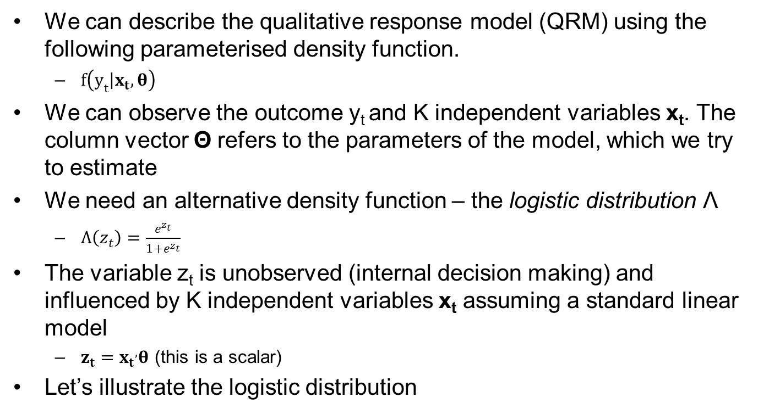
The qualitative response model
We can describe the qualitative response model (QRM) using the following parameterised density function.
$f\left(y_{t}\left|x_{t},θ\right.\right)$
We can observe the outcome y_{t} and K independent variables x_{t}. The column vector Θ refers to the parameters of the model, which we try to estimate
We need an alternative density function – the logistic distribution Λ
$Λ\left(z_{t}\right)=\frac{e^{z_{t}}}{1+e^{z_{t}}}$
The variable z_{t} is unobserved (internal decision making) and influenced by K independent variables x_{t} assuming a standard linear model
$z_{t}={x_{t}}^{,}θ$ (this is a scalar)
Let’s illustrate the logistic distribution
Dr Gerhard Kling
71

Slide 83
The logistic distribution
Let’s illustrate the logistic distribution
The logistic distribution Λ(z_{t}) looks like a probability.
In fact, Λ(z_{t}) is the probability that y_{t} is equal to 1
The negative event y_{t} = 0 has the probability 1- Λ(z_{t})
Dr Gerhard Kling
72

Slide 84
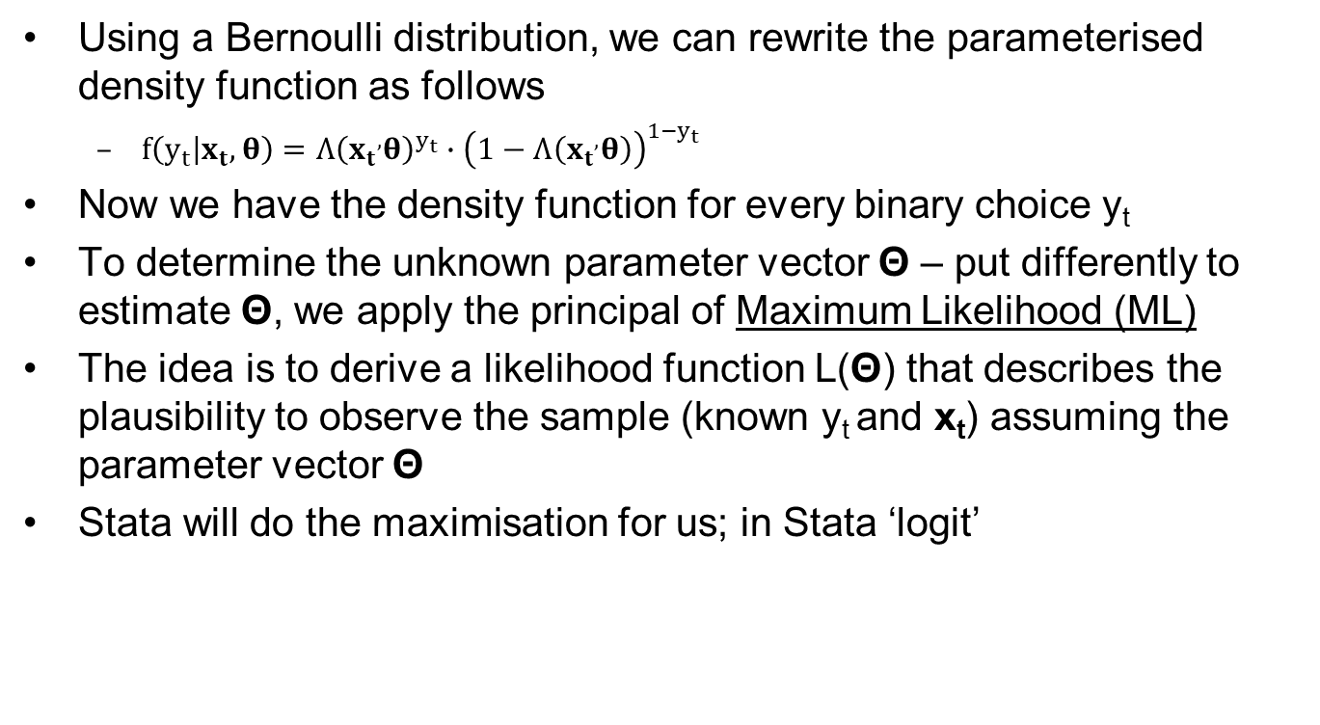
Maximum-likelihood estimation
Using a Bernoulli distribution, we can rewrite the parameterised density function as follows
$f\left(y_{t}\left|x_{t},θ\right.\right)={Λ\left({x_{t}}^{,}θ\right)}^{y_{t}}∙{\left(1−Λ\left({x_{t}}^{,}θ\right)\right)}^{1−y_{t}}$
Now we have the density function for every binary choice y_{t}
To determine the unknown parameter vector Θ – put differently to estimate Θ, we apply the principal of Maximum Likelihood (ML)
The idea is to derive a likelihood function L(Θ) that describes the plausibility to observe the sample (known y_{t} and x_{t}) assuming the parameter vector Θ
Stata will do the maximisation for us; in Stata ‘logit’
Dr Gerhard Kling
73

Slide 85
Logit or probit model
Whether to use logit or probit as mainly a matter of taste
We need to transform the linear model into a model in the range 0 and 1, as we try to model probabilities
Logit and probit propose different transformations that map the linear model to a ‘probability’ in the range 0 and 1
However, probit tends to work better if you have more outliers
In applied work, logit models seem to be more common
ML estimation does not always work (e.g. sometimes the algorithm does not converge)
Changing probit / logit can help
Changing the specification of the model (i.e. independent variables)
Dr Gerhard Kling
74

Slide 86
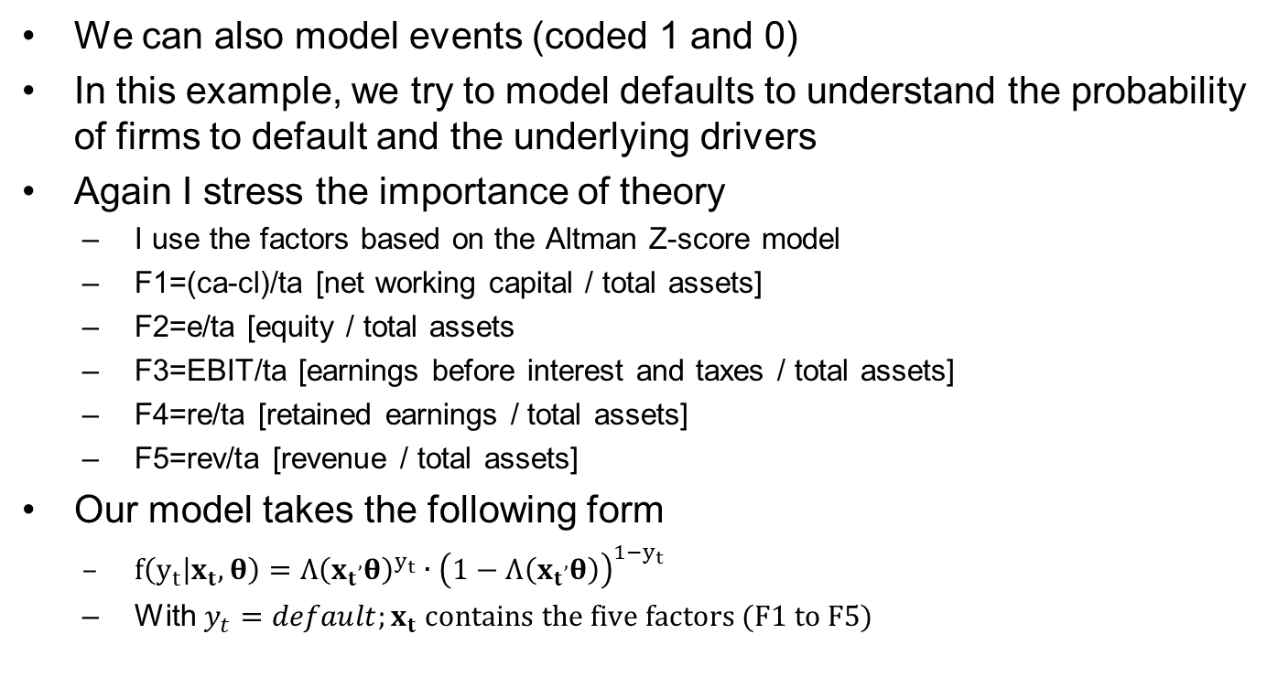
Modelling default risk
We can also model events (coded 1 and 0)
In this example, we try to model defaults to understand the probability of firms to default and the underlying drivers
Again I stress the importance of theory
I use the factors based on the Altman Z-score model
F1=(ca-cl)/ta [net working capital / total assets]
F2=e/ta [equity / total assets
F3=EBIT/ta [earnings before interest and taxes / total assets]
F4=re/ta [retained earnings / total assets]
F5=rev/ta [revenue / total assets]
Our model takes the following form
$f\left(y_{t}\left|x_{t},θ\right.\right)={Λ\left({x_{t}}^{,}θ\right)}^{y_{t}}∙{\left(1−Λ\left({x_{t}}^{,}θ\right)\right)}^{1−y_{t}}$
With $y_{t}=default;x_{t} contains the five factors (F1 to F5)$
Dr Gerhard Kling
75

Slide 87
Standard logit for default risk
First we run a standard logit model in Stata and ignore the fact that we have panel data
The interpretation of Stata output is similar compared to regression tables
BUT: we use a z-statistic instead of t-statistic
Focus on p-values to assess whether effect is significant (p<0.05)
Coefficients have a different meaning
Dr Gerhard Kling
76

Slide 88
How to interpret coefficients?
A positive coefficient means (still) that the independent variable has a positive partial impact on the dependent variable – but the relationship is more complex due to the functional form of the model
In economics, coefficients are usually reported
Odds ratios are frequently used (e.g. medical research)
An odds ratio is the ratio of odds, which means that if an event happens 60% of the time and does not happen 40% of the time, the odds ratios is 60/40 = 1.5
If the odds ratio exceeds 1, then the event (positive response; y=1) is more likely
Odds ratios are derived from coefficients using odds ratio = exp(coefficient)
You can also obtain probabilities from odds ratios as prob = odds ratio / (1+odds ratio)
Stata displays odds ratios if you use ‘logistic’ instead of ‘logit’
Dr Gerhard Kling
77

Slide 89
Let’s look at another example
I add firm size to the logistic regression and obtain the following
The odds ratio for ‘size’ is below 1; hence, larger firms are less likely to default.
Dr Gerhard Kling
78

Slide 90
Predicted probability
Sometimes it is useful to visualise a relationship using predicted probabilities
*Predicted probabilities
logit default F1 F2 F3 F4 /// F5 size
predict prob, pr
*Scatter plot
scatter pr size
Dr Gerhard Kling
79

Slide 91
Assessing model quality
We try to predict an event (e.g. default) by looking at various firm-specific or economic factors
How we know whether we selected a good model?
There are two mistakes
We classify a firm as ‘default case’ but the firm actually does not default (Type I error)
We classify a firm as ‘no default case’ but the firm actually defaults (Type II error)
Common measures
Sensitivity Pr( +| D): probability that we classify as ‘default case’ and the firm defaults
Specificity Pr( -|~D): probability that we classify as ‘no default case’ and the firm does not defaults
Dr Gerhard Kling
80

Slide 92
How good is our model?
We use ‘estat class’ after the logit model
The model needs to be improved!
It does not detect a single case of firms that default
Additional variables are needed to improve the model
And we need to consider the panel structure
Dr Gerhard Kling
81

Slide 93
Panel logit / probit models
Thus far, we ignored the data structure
We can run logit / probit models using panel data similar to fixed and random-effects specifications
First, we need to ‘tsset’ our data
Then we use the ‘xtlogit’ or ‘xtprobit’ command
And specify the options (‘fe’ for fixed-effects and ‘re’ for random-effects)
It might take more time for Stata to provide an estimate
Sometimes the optimisation fails – in this case specify a different model or use different methods (e.g. Bayesian methods such as MCMC)
Commands might not work on older versions of Stata
Dr Gerhard Kling
82

Slide 94
Exercise 3: Modelling default risk

Slide 95
To-do list (1/2)
Run the do-file provided to construct variables from the raw data
Tsset your data using ‘year’ and ‘code’ to define the time and cross-sectional dimensions
Construct firm size (‘size’) defined as ln(total assets)
Start with a simple logit model that explains ‘default’ using ‘size’, ‘leverage’ (defined as financial leverage) and ‘cover’ (defined as EBIT divided by interest expenses)
How good is the model?
Generate a variable to measure ‘cash’ holding (defined as c/ta) and ‘trade’ credit (defined as tc/cl)
Why do we divide by total assets or other variable and hence analyse ratios?
Dr Gerhard Kling
83

Slide 96
To-do list (2/2)
Default risk depends on industry-specific effects
Create a dummy variable that takes the value 1 if the industry (‘sic_code’) experienced more than 10 defaults
HINT: sort your data first using ‘sic_code’
HINT: use the ‘by sic_code : egen’ command to determine the number of defaults in each industry
Based on this information, you should be able to create a dummy variable
Use only lagged independent variables (to account for causality issues); include the ‘ind_dummy’ you created, ‘size’, ‘cash’ and ‘trade’
Modify the model and allow for structural changes in the intercept over time
HINT: use the ‘xi’ command
Use ‘lsens’ to plot sensitivity and specificity
Modify the cut-off point (see options in ‘estat class’) to 0.025; determine the type I error
Dr Gerhard Kling
84

Slide 97
Lecture 7: Model specification

Slide 98
Aims of this session
We saw many different models in action and we specified several models
Now we need to think about how we actually decide which model is the ‘best model’
Moreover, what does ‘best model’ actually mean?
Is it just a ‘trial and error approach’?
The main danger of empirical modelling is that you can get almost any result you want – ‘don’t trust any empirical finding expect you manipulated it yourself’
In social science we don’t have easy access to experimental data; hence, observed data is affected by noise (e.g. measurement error)
Dr Gerhard Kling
85

Slide 99
STEP 1: Understand what the ‘best model’ should be able to do
Forecasting (time horizon: short / long-term)
Multicollinearity does not matter too much
Focus is on the overall model fit
Test your model ‘out-of-sample’ (see later lectures and module 6)
What type of error is acceptable (determine maximum level for type I and II errors)?
Is it about understanding underlying drivers (e.g. firm size affects profitability due to economies of scale and organizational learning)
In this case multicollinearity matters!
Do you want to create an early warning system (e.g. financial stability)?
Do you want to test a theory?
Dr Gerhard Kling
86

Slide 100
STEP 2: What is the underlying theory for the empirical model?
Empirical models give you a false sense of security, as they suggest certain relationships
BUT: most variables used as independent variables are actually not independent
Hence, there is always an issue with endogeneity (more or less significant)
The starting point should be a theoretical framework
Identify relationships based on theoretical considerations (e.g. house prices should be affected by population growth, as the demand for houses increases)
It does not need to be a ‘mathematical model’
But having a mathematical model can be beneficial, as it can be (sometimes) translated into an empirical model just by adding an error term
Dr Gerhard Kling
87

Slide 101
STEP 3: Testing, testing and testing
Once you identified what a good model should do and you understand the underlying theory then you can start with a basic model or a general model
There are two approaches used to specific empirical models, which we discuss later in more detail
From general-to-specific
From specific-to-general
There are several specification tests
Focus on omitted variables: Ramsey RESET (in Stata ‘ovtest’)
Likelihood ratio tests to compare different model specifications
We can use information criteria to assess different model specifications
R-squared and adjusted R-squared are not used to specify models (also difficult to use for ML estimation – there are so-called ‘pseudo R-squares’ but they are different)
Dr Gerhard Kling
88

Slide 102
From general-to-specific
You start with a general model that includes many variables to account for all possible effects
It is unlikely that the general model misses important variables (omitted variable bias is less likely)
Then you test down the model
Remove insignificant independent variables
Specification tests to ensure that they can be removed (sometimes t-tests are not reliable due to multicollinearity) – e.g. likelihood ratio tests
You remove variables until you cannot remove more variables
Then you have identified your ‘best model’
Risk
Number of observations differs; usually the more variables you have the less observations you have
Your ‘best model’ is most likely too complex
Dr Gerhard Kling
89

Slide 103
Example: general-to-specific
We try to explain stock returns of US companies using macroeconomic and firm-specific factors
The underlying theory refers to arbitrage pricing (Fama and French three-factor model) and macroeconomic risk models
The macroeconomic risk models differentiate between expected and unexpected macroeconomic variables
Only unexpected changes trigger a market response
Macroeconomic time series are forecasted using ARIMA model (see Day 3 and module 6)
Unexplained (residuals) and explained components are obtained
Independent variables include: rm (market return), u_ts (term structure), u_rp (risk premium), u_i (inflation), u_ip (GDP), u_oil, r_m_b (market-to-book ratio), r_size
Dr Gerhard Kling
90

Slide 104
How to explain stock returns?
I start with a general model
Every coefficient is significant
Is this the ‘best model’
If N is large, coefficients will be significant
Dr Gerhard Kling
91

Slide 105
Likelihood ratio tests
I run the general model and restrict it by dropping variables (restriction means that coefficient = 0)
We need to have the same number of observations
xtreg return rm r_m_b r_size u_i u_ip u_oil u_ts u_rp, fe
estimates store A
predict r, ue
*We need to have the same number of observations
xtreg return rm if r!=., fe
estimates store B
lrtest A B
*Fama-French model
xtreg return rm r_m_b r_size if r!=., fe
estimates store C
lrtest A C
Dr Gerhard Kling
92

Slide 106
Information criteria
Stata provides information criteria for different models
Information criteria provide a measure for the quality of the model (model fit)
Main idea is to minimise the ‘information loss’ of the model
Look for the model that minimises information criteria
The most common information criteria are
AIC: Akaike information criterion
BIC: Bayesian information criterion: penalty for ‘too many variables’ (reduction of degrees of freedom)
In general, AIC selects more complex models than BIC
Dr Gerhard Kling
93

Slide 107
Example: information criteria
Let’s compare different specifications using information criteria
Model A and D seem to be superior based on AIC and BIC
Dr Gerhard Kling
94

Slide 108
Parameter stability
Another aspect of a good model is whether the parameters (estimated coefficients) are stable over time
If the coefficients change, the model won’t be regarded as reliable
Coefficients can change for many reasons (e.g. structural break)
Usually, a simpler model exhibits more stability
There are different ways to assess parameter stability
Re-estimate model for different time periods; then test whether coefficients are different
Rolling-regressions; run the model for different windows (defined by t-j and t+j); the windows overlap and create a time series of the estimated coefficient
Dr Gerhard Kling
95

Slide 109
Rolling regressions in Stata
Here you see an example of loop commands in Stata
You also see how to retrieve results using matrix commands
gen beta=.
forvalues i=1/358 {
qui: reg return rm if time>=`i' & time<=`i'+10
matrix b=get(_b)
matrix a=b[1,1]
svmat a, n(a)
egen max=max(a1)
replace beta=max if time==`i' & beta==.
matrix drop _all
drop a1 max
}
Dr Gerhard Kling
96

Slide 110
Exercise 4: Modelling M&A decisions

Slide 111
To-do list (1/2)
Explore the variable ‘merger’
What type of variable is it?
Try to explain the variable ‘merger’ using the following variables
rm (stock market index return)
p_i (expected inflation)
u_ts (unexpected change in term structure)
u_rp (unexpected risk premium)
u_i (unexpected inflation)
u_ip (unexpected industrial production)
u_oil (unexpected change in oil price)
book_to_market_1 (market-to-book ratio of acquirer)
l_cap_1 (firm size of acquirer)
cf_assets (profitability of acquirer)
Dr Gerhard Kling
108

Slide 112
To-do list (2/2)
Apply a general-to-specific approach and find a ‘simple’ model
Do you need to consider the panel data structure?
Try a fixed-effects specification
Do you need to consider industry-specific effects?
Based on your ‘best’ model, predict the probability to merge
Determine the average probability to merge in every industry
Dr Gerhard Kling
109

Slide 113
Lecture 8: Measuring the immeasurable: CFA and SEM

Slide 114
What is qualitative data?
Qualitative data is usually regarded as …
Descriptive data
Impossible or hard to measure
Approximations
Not numerical (cannot assign numbers)
Any information including videos, pictures etc.
There is no widely accepted definition and many ideas (see above) are problematic
Examples
Approximations can be quantitative (e.g. Taylor expansion – see approximation theory)
Preference orderings do not have to be numerical
Information processing is ignored
Dr Gerhard Kling
2

Slide 115
How is qualitative data collected?
Interviews
Different methods
Structured interviews (same order of questions) often seen as quantitative method
Probing questions in an unstructured interview usually seen as qualitative method
Questionnaire
Often Likert scale
Pilot study or focus group to facilitate design
Often seen as a quantitative data approach – but this depends on design
Observations (e.g. field study, experiment etc.)
Text based (e.g. content analysis, social media etc.)
Dr Gerhard Kling
3

Slide 116
Main criticism of qualitative research
Generalizability
Small samples (see below)
Use of descriptive methods
Limited possibility to determine causal relationships – counter-argument: qualitative research does not want to do it!
Sample selection
Often ad-hoc
Mostly driven by access and costs
When to stop? No proper theory of sample size
Replication
Subjectivity
Often impossible to replicate
Testable theories
Used to construct theories
But usually not testable
Dr Gerhard Kling
4

Slide 117
Concepts and social constructs
Many concepts used in management and finance research are difficult or impossible to measure
Examples
Cognition (see Penrose)
Overconfidence (see literature on leadership)
Self-interest (see literature on agency theory)
Experience (see literature on CEO performance)
Mood and sentiment (see behavioural finance literature)
Should we attempt to measure such concepts?
Use of proxies
No need to measure
Dr Gerhard Kling
5

Slide 118
Confirmatory Factor Analysis (CFA)
What does CFA do?
Unobserved / latent variables models explicitly
Includes measurement error
Links observed variables / data to latent constructs
Can be combined with structural equation models (SEM)
Main idea
Conduct qualitative research, e.g. interview, questionnaire
Link answers to latent constructs
Empirical tests are possible, e.g. impact of latent variable on other variables (latent or observed)
Dr Gerhard Kling
6

Slide 119
Graphs: example
Dr Gerhard Kling
7

Slide 120
Understanding graphs
Variable names in squares refer to observed variables, e.g. recorded answers to questions
Variable names in oval shapes refer to latent / unobserved variables
Variable names in discs are error terms, capturing measurement errors
Arrows (straight lines) refer to a link (path) between an explanatory variable and a dependent / response variable
Arrows (curved lines with two ends) between error terms symbolise correlation between error terms
Note that the arrow starts at the latent variable and affects the observed variable, e.g. confidence (latent) affects your answer to questions related to confidence (e.g. “do you believe in your abilities?”)
Dr Gerhard Kling
8

Slide 121
Measurement model (1/3)
A measurement model using CFA means that the latent dimension can affect the respondents’ response to questions
Questions tend to be grouped, i.e. researchers should select whether questions are related to the latent variable
After estimating the baseline CFA including all questions in the respective grouping, we assess the goodness of fit using the Chi-square test statistic, the root mean squared error of approximation (RMSEA) and comparative fit index (CFI)
Dr Gerhard Kling
9

Slide 122
Measurement model (2/3)
Following Acock (2013), we argue that a good model should have an insignificant Chi-square test statistic, a RMSEA below 0.05 and a CFI above 0.95
Using these measures of the goodness of fit, we evaluate the baseline CFA model. If the model exhibits poor fit (RMSEA>0.05 or CFI<0.95), we determine modification indices based on Sörbom (1989) and Wooldridge (2010)
To improve model fit, we include the covariance between error terms of questions with the highest modification index (MI)
Dr Gerhard Kling
10

Slide 123
Measurement model (3/3)
After allowing for the covariance between error terms, we test the model fit again. The process is repeated until an acceptable model fit is reached
The Figure on slide 7 illustrates the final model used to estimate the measurement model for the developing resources dimension labelled DEV
This procedure assesses the validity of the six dimensions of resource management. The dimension acquiring resources (ACQ) cannot be confirmed by the CFA; the five other dimensions arise as distinct aspects of resource management exhibiting high factor loadings with standardized coefficients in excess of 0.4 and good model fit
Dr Gerhard Kling
11

Slide 124
Dimensions of latent variable
A latent variable might have different aspects (called dimensions), which you might be able to identify
After conducting your measurement model, you can check the correlation between latent variables
Low correlation indicates that they measure different aspects of an overarching latent variable
Example: Resource management might consist of several dimensions, e.g. developing resources in-house, acquiring resources etc.
Dr Gerhard Kling
12

Slide 125
sem command
*Developing resources
sem (DEV -> v302_1 sv302_2 sv302_3 sv302_4 v302_5), variance(DEV@1) standardized
estat gof, stats(all)
estat mindices
*Consider covariance based on mindices
sem (DEV -> v302_1 sv302_2 sv302_3 sv302_4 v302_5), variance(DEV@1) standardized cov(e.v302_1*e.sv302_2)
estat gof, stats(all)
*Excellent fit!
*Chi-square should not be significant
*Fit RMSEA <= 0.05
*CFI > 0.9 or 0.95
Dr Gerhard Kling
13

Slide 126
Structural equation model (SEM)
We can link latent variables to observed outcomes using a SEM
Assessing direct and indirect effects is possible, e.g. experience might affect performance directly or indirectly through actions
SEMs are very powerful and very common in management resource
SEMs can be used to combine qualitative and quantitative information or to confirm social constructs / concepts in measurement models
Using formal models seems to be a better approach in qualitative research as SEMs can be replicated and there is an established theory (e.g. sampling, statistical inference)
SEMs can be used for hypothesis testing
Dr Gerhard Kling
14

Slide 127
Complex SEM
sem (COG -> DEV DIV BUN LEV SYN) ///
(COG <- size rd age own_govern) ///
(GROWTH <- COG DEV DIV BUN LEV SYN size rd age) ///
(BUN -> v306_1 v306_2 v306_3 v306_4 v307_1 v307_2 v307_3 v307_4 pv308_1 pv308_2 pv308_3), ///
cov(e.pv308_2*e.pv308_3) cov(e.v307_2*e.v307_3) cov(e.pv308_1*e.pv308_2) ///
cov(e.pv308_1*e.pv308_3) cov(e.v306_1*e.v306_3) cov(e.v306_1*e.v306_2) cov(e.v306_1*e.v306_4) ///
cov(e.v306_3*e.v306_4) cov(e.v306_4*e.v307_1) cov(e.v306_4*e.v307_4) cov(e.v306_3*e.v307_2) ///
latent(COG BUN) iter(100)
Dr Gerhard Kling
15

Slide 128
Example SEM
Dr Gerhard Kling
16

Slide 129
Additional reading
Acock, A.C. (2013). Discovering Structural Equation Modeling Using Stata, Stata Press.
Sörbom, D. 1989. Model modification. Psychometrika 54: 371-384.
Wooldridge, J. M. 2010. Econometric Analysis of Cross Section and Panel Data. 2nd ed. Cambridge, MA: MIT Press.
Dr Gerhard Kling
17

