Slide 1
Introduction to Databases and SQL Basics

Slide 2
What you learned in Statistics: Data, Data Sets, Elements, Variables, and Observations
Observation
Variables
Element
Names
Stock Annual Earn/
Exchange Sales($M) Share($)
Company
Dataram
EnergySouth
Keystone
LandCare
Psychemedics
NQ 73.10 0.86
N 74.00 1.67
N 365.70 0.86
NQ 111.40 0.33
N 17.60 0.13
Data Set

Slide 3
What is a Database?
Database: a structure containing categories of information and relationships between these categories
Example: Premiere Products (see next slide)
Categories: sales reps, customers, orders, and parts
Relationships between categories: sales rep-to-customer and customer-to-orders

Slide 4
The Premiere Products Database
Premiere Products is a distributor of appliances, housewares, and sporting goods
Manual system no longer feasible for managing customer, order, and inventory data
Database management system will allow for current, accurate data with useful reports

Slide 5
Required Data for Sales Reps
Number
Last name
First name
Address
Total commission
Commission rate

Slide 6
Required Data for Customer
Customer number
Name
Address
Current balance
Credit limit
Sales rep number

Slide 7
Required Data for Parts
Part number
Description
Number of units on hand
Item class
Number of the warehouse where the item is stored
Unit price for each part in inventory

Slide 8
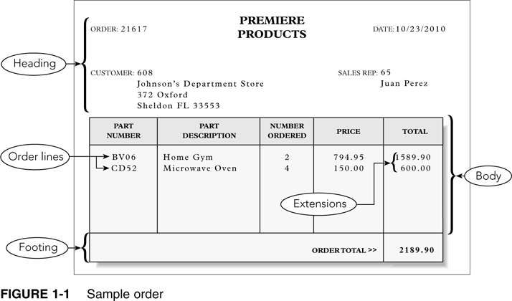

Slide 9
Components of a Sample Order
Heading (top of the order form)
Order number and date
Customer number, name, address
Sales rep number and name
Body (center of the order form)
One or more order lines or line items
Footer (bottom of the order form)
Order total

Slide 10
Components of a Line Item
Part number
Part description
Number of units for the part ordered
Quoted price for the part
Total, or extension, the result of multiplying the number ordered by the quoted price

Slide 11
Items Stored for Each Order in Order Table
Order number
Date of the order
Customer number
Customer name, address, and sales rep information are stored with the customer information
Sales rep name is stored with sales rep information

Slide 12
Items Stored for Each Order in Order_Line Table
Order number
Part number
Number of units ordered
Quoted price
Part description is stored with information on parts
Order total is not stored but is calculated each time order is displayed or printed

Slide 13
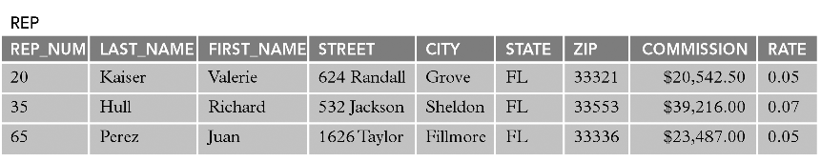
Sample Rep Table

Slide 14
Rep Table Example
Three sales reps in the table identified by number, e.g.,
Sales rep number: 20
Name: Valerie Kaiser
Address: 624 Randall, Grove, FL, 33321
Total commission: $20,542.50
Commission rate: 5% (0.05)

Slide 15
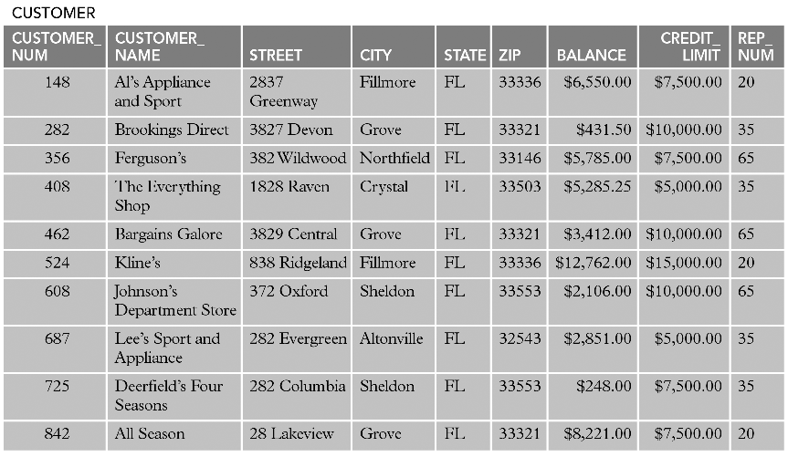
Sample Customer Table

Slide 16
Customer Table Example
Ten customers are identified by number, e.g.,
Number: 148
Name: Al’s Appliance and Sport
Address: 2837 Greenway, Fillmore, FL, 33336
Current balance: $6,550.00
Credit limit: $7,500.00
Sales rep: 20 (Valerie Kaiser)

Slide 17
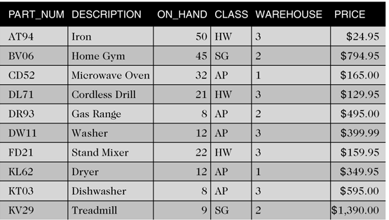
Sample Part Table

Slide 18
Part Table Example
Ten parts are listed by part number, e.g.,
Part number: AT94
Description: Iron
Units on hand: 50
Item class: HW (housewares)
Warehouse: 3
Price: $24.95

Slide 19
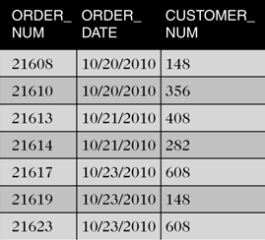
Sample Orders Table

Slide 20
Orders Table Example
Seven orders listed by order number, e.g.,
Order number: 21608
Order date: 10/20/2010
Customer: 148 (Al’s Appliance and Sport)

Slide 21
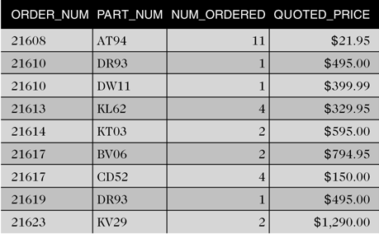
Sample Order_Line Table

Slide 22
Order_Line Table Example
Nine order line items listed by order number, e.g.,
Order number: 21608
Part number: AT94 (iron)
Number ordered: 11
Quoted price: $21.95

Slide 23
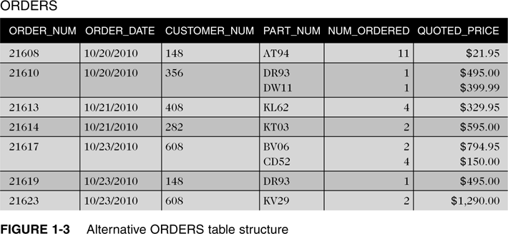
Alternative Orders Table Structure

Slide 24
Alternative Order Table Example
Displays identical data in one table
Each table row contains all of the order lines for each order
Fifth row, order 21617 has two order lines
Part BV06, Qty 2, Quoted price $794.95 each
Part CD52, Qty 4, Quoted price $150.00 each

Slide 25
Issues with Alternative Order Table
Difficult to track information between columns
Other issues
How much room is allowed for multiple entries?
What if an order has more order lines than you have allowed room for?
For a given part, how do you determine which orders contain order lines for that part?

Slide 26
Benefits of Order_Line Table
Table is less complicated when separated
No multiple entries in a single line
Number of order lines is not limited
Finding every order for a given part is simple

Slide 27
Getting Started with SQL Programming
Structured Query Language (SQL)
Most popular and widely used language for retrieving and manipulating database data
Developed in mid 1970s under the name SEQUEL
Prototype was originally developed by IBM using Dr. E.F. Codd’s paper (“A Relational Model of Data for Large Shared Data Banks”) as a model
Renamed SQL in 1980
Used by most DBMSs

Slide 28
Jupyter Notebook
Powerful tool for interactively developing and presenting data science projects.
Two types of cells: code and markdown.
Some of the most important commands:
Toggle between edit and command mode with Esc and Enter, respectively.
Once in command mode:
Scroll up and down your cells with your Up and Down keys.
Press A or B to insert a new cell above or below the active cell.
M will transform the active cell to a Markdown cell.
Y will set the active cell to a code cell.
D + D (D twice) will delete the active cell.
https://www.dataquest.io/blog/jupyter-notebook-tutorial/

Slide 29
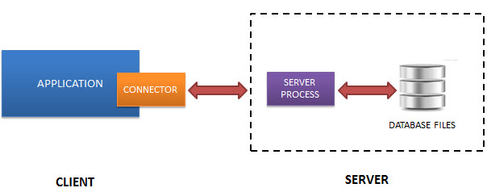
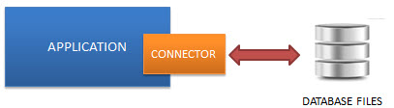
What is SQLite?
Normally, an RDBMS such as MySQL, PostgreSQL, etc., requires a separate server process to operate.
SQLite does NOT work this way, instead:
https://www.sqlitetutorial.net/what-is-sqlite/

Slide 30
SQLite in Jupyter Notebook
Enter the following commands in code cells:
Installing SQL module in the notebook !pip install ipython-sql
Loading the SQL module %load_ext sql
The above magic command loads the ipython-sql extension. We can connect to any database which is supported by SQLAlchemy.
Connect to a SQLite database: %sql sqlite://

Slide 31
Creating a Table
Describe the layout of each table in the database
Use CREATE TABLE command
TABLE is followed by the table name
Follow this with the names and data types of the columns in the table
Data types define type and size of data

Slide 32
Creating a Table (cont’d)
Table and column name restrictions
Names cannot exceed 30 characters
Must start with a letter
Can contain letters, numbers, and underscores (_)
Cannot contain spaces

Slide 33
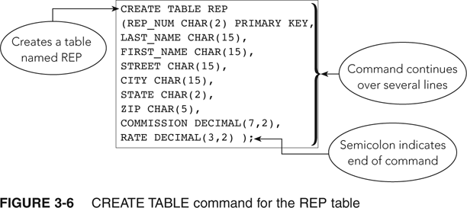
Creating a Table (cont’d)

Slide 34
Creating a Table (cont’d)
Commands are free-format; no rules stating specific words in specific positions
Indicate the end of a command by typing a semicolon
Commands are not case sensitive

Slide 35
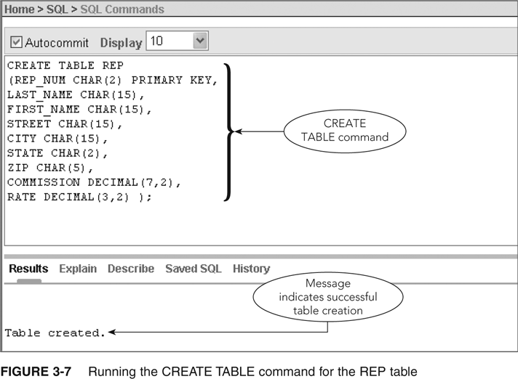
Creating a Table (cont’d)

Slide 36
Dropping a Table
Can correct errors by dropping (deleting) a table and starting over
Useful when table is created before errors are discovered
Command DROP TABLE is followed by the table to be dropped and a semicolon
Any data in table also deleted

Slide 37
Using Data Types
For each column, the type of data must be defined
Common data types (not all supported in SQLite)
CHAR(n) always uses exactly n bytes
VARCHAR(n) uses at most n bytes, stores length
DATE
DECIMAL(p,q) p: total number of digits, q: number of decimal digits to the right of the decimal point
INT
SMALLINT

Slide 38
Using Nulls
A special value to represent a situation when the actual value is not known for a column
Can specify whether to allow nulls in the individual columns
Should not allow nulls for primary key columns

Slide 39
Using Nulls (continued)
Use NOT NULL clause in CREATE TABLE command to exclude the use of nulls in a column
Default is to allow null values
If a column is defined as NOT NULL, system will reject any attempt to store a null value there

Slide 40
Using Nulls (cont’d)
CREATE TABLE REP
(REP_NUM CHAR(2) PRIMARY KEY,
LAST_NAME CHAR(15) NOT NULL,
FIRST_NAME CHAR(15) NOT NULL,
STREET CHAR(15),
CITY CHAR(15),
STATE CHAR(2),
ZIP CHAR(5),
COMMISSION DECIMAL(7,2),
RATE DECIMAL(3,2) );

Slide 41
Adding Rows to a Table
INSERT Command
INSERT INTO followed by table name
VALUES command followed by specific values in parentheses
Values for character columns in single quotation marks

Slide 42
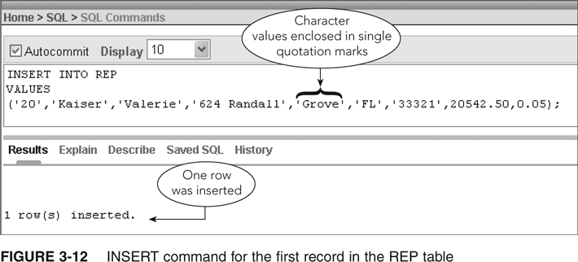
The Insert Command

Slide 43
The INSERT Command (continued)
To add new rows, modify previous insert command
Use same editing techniques as those used to correct errors

Slide 44
Inserting a Row that Contains Nulls
Use a special format of INSERT command to enter a null value in a table
Identify the names of the columns that accept non-null values and then list only the non-null values after the VALUES command

Slide 45
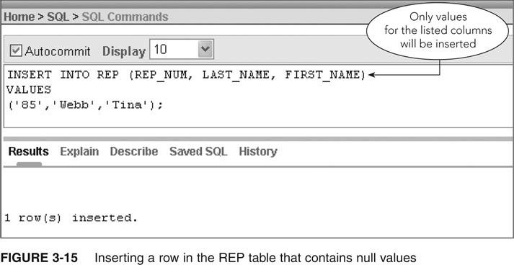
Inserting a Row that Contains Nulls (cont’d)

Slide 46
Viewing Table Data
Use SELECT command
Can display all the rows and columns in a table
SELECT * FROM followed by the name of the table
Ends with a semicolon

Slide 47
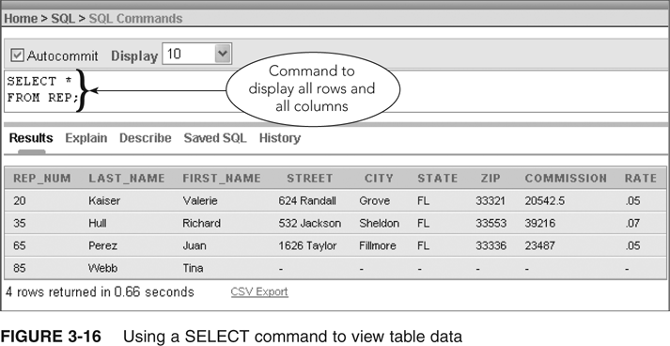
Viewing Table Data (continued)
Please ensure your table is complete! We want to work on more examples using this database.

Slide 48
Correcting Errors in a Table
UPDATE command is used to update a value in a table
DELETE command allows you to delete a record
INSERT command allows you to add a record

Slide 49
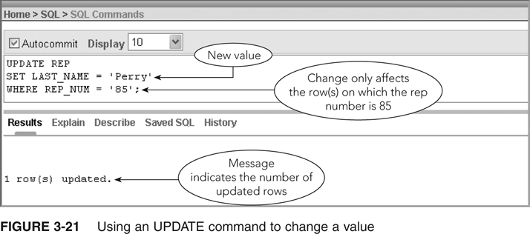
Correcting Errors in a Table (cont’d)

Slide 50
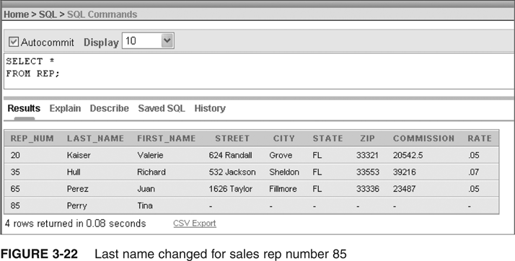
Correcting Errors in a Table (cont’d)

Slide 51
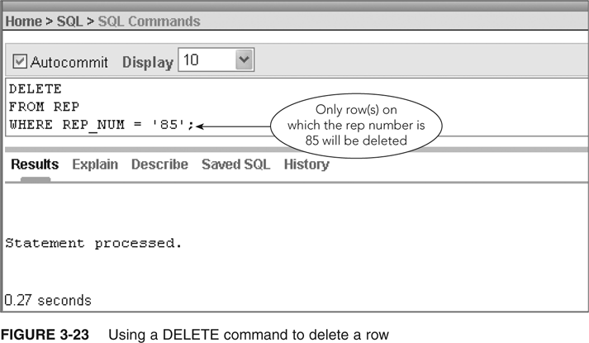
Correcting Errors in a Table (cont’d)

Slide 52
Creating the Remaining Database Tables
Execute appropriate CREATE TABLE and INSERT commands
Save these commands as Jupyter Notebook
Separate multiple commands with a semicolon
Figures 3-25 through 3-32 give additional table information for Premiere Products
Copy/paste into the Jupyter Notebook

Slide 53
Creating the Remaining Database Tables: Figure 3-25
%%sql
CREATE TABLE CUSTOMER
(CUSTOMER_NUM CHAR(3) PRIMARY KEY,
CUSTOMER_NAME CHAR(35) NOT NULL,
STREET CHAR(15),
CITY CHAR(15),
STATE CHAR(2),
ZIP CHAR(5),
BALANCE DECIMAL(8,2),
CREDIT_LIMIT DECIMAL(8,2),
REP_NUM CHAR(2) );

Slide 54
Creating the Remaining Database Tables: Figure 3-26
%%sql
INSERT INTO CUSTOMER
VALUES
('148','Al''s Appliance and Sport','2837 Greenway','Fillmore','FL','33336',6550.00,7500.00,'20'),
('282','Brookings Direct','3827 Devon','Grove','FL','33321',431.50,10000.00,'35'),
('356','Ferguson''s','382 Wildwood','Northfield','FL','33146',5785.00,7500.00,'65'),
('408','The Everything Shop','1828 Raven','Crystal','FL','33503',5285.25,5000.00,'35'),
('462','Bargains Galore','3829 Central','Grove','FL','33321',3412.00,10000.00,'65'),
('524','Kline''s','838 Ridgeland','Fillmore','FL','33336',12762.00,15000.00,'20'),
('608','Johnson''s Department Store','372 Oxford','Sheldon','FL','33553',2106.00,10000.00,'65'),
('687','Lee''s Sport and Appliance','282 Evergreen','Altonville','FL','32543',2851.00,5000.00,'35'),
('725','Deerfield''s Four Seasons','282 Columbia','Sheldon','FL','33553',248.00,7500.00,'35'),
('842','All Season','28 Lakeview','Grove','FL','33321',8221.00,7500.00,'20');

Slide 55
Creating the Remaining Database Tables: Figure 3-27
%%sql
CREATE TABLE ORDERS
(ORDER_NUM CHAR(5) PRIMARY KEY,
ORDER_DATE DATE,
CUSTOMER_NUM CHAR(3) );

Slide 56
Creating the Remaining Database Tables: Figure 3-28
%%sql
INSERT INTO ORDERS
VALUES
('21608','20-OCT-2010','148'),
('21610','20-OCT-2010','356'),
('21613','21-OCT-2010','408'),
('21614','21-OCT-2010','282'),
('21617','23-OCT-2010','608'),
('21619','23-OCT-2010','148'),
('21623','23-OCT-2010','608');

Slide 57
Creating the Remaining Database Tables: Figure 3-29
%%sql
CREATE TABLE PART
(PART_NUM CHAR(4) PRIMARY KEY,
DESCRIPTION CHAR(15),
ON_HAND DECIMAL(4,0),
CLASS CHAR(2),
WAREHOUSE CHAR(1),
PRICE DECIMAL(6,2) );

Slide 58
Creating the Remaining Database Tables: Figure 3-30
%%sql
INSERT INTO PART VALUES
('AT94','Iron',50,'HW','3',24.95),
('BV06','Home Gym',45,'SG','2',794.95),
('CD52','Microwave Oven',32,'AP','1',165.00),
('DL71','Cordless Drill',21,'HW','3',129.95),
('DR93','Gas Range',8,'AP','2',495.00),
('DW11','Washer',12,'AP','3',399.99),
('FD21','Stand Mixer',22,'HW','3',159.95),
('KL62','Dryer',12,'AP','1',349.95),
('KT03','Dishwasher',8,'AP','3',595.00),
('KV29','Treadmill',9,'SG','2',1390.00);

Slide 59
Creating the Remaining Database Tables: Figure 3-31
%%sql
CREATE TABLE ORDER_LINE
(ORDER_NUM CHAR(5),
PART_NUM CHAR(4),
NUM_ORDERED DECIMAL(3,0),
QUOTED_PRICE DECIMAL(6,2),
PRIMARY KEY (ORDER_NUM, PART_NUM) );

Slide 60
Creating the Remaining Database Tables: Figure 3-32
%%sql
INSERT INTO ORDER_LINE VALUES
('21608','AT94',11,21.95),
('21610','DR93',1,495.00),
('21610','DW11',1,399.99),
('21613','KL62',4,329.95),
('21614','KT03',2,595.00),
('21617','BV06',2,794.95),
('21617','CD52',4,150.00),
('21619','DR93',1,495.00),
('21623','KV29',2,1290.00);

Slide 61
Basic SQL Summary
Use the CREATE TABLE command to create tables
Use the DROP TABLE command to delete a table
CHAR, VARCHAR, DATE, DECIMAL, INT, and SMALLINT data types
Some differences, e.g.:
Access does not support DECIMAL https://www.uvm.edu/~bnelson/computer/access2003/howaccesstreatsdecimalplaces.html
Some differences in SQL Date Data Types https://www.w3schools.com/sql/sql_dates.asp

Slide 62
Basic SQL Summary (cont’d)
Null value used when actual value for a column is unknown, unavailable, or not applicable
Use NOT Null clause to identify columns that cannot have a null value
Use INSERT command to add rows
Use SELECT command to view data in a table

Slide 63
Basic SQL Summary (cont’d)
Use UPDATE command to change the value in a column
Use DELETE command to delete a row
Save SQL commands in a script file

Slide 64
Additional Readings
A Guide to SQL, Philip J. Pratt, Mary Z. Last. Publisher: Cengage Learning
SQL [electronic resource] : a beginner's guide / Robert Sheldon. New York : McGraw-Hill/Osborne, c2003. 2nd ed.
SQL [electronic resource] : clearly explained / Jan L. Harrington. Amsterdam ; New York : Morgan kaufmann Publishers, c2003. 2nd ed.
Beginning SQL / John Kauffman, Brian Matsik, Kevin Spencer ; with Ian Herbert, Julian Skinner, Sakhr Youness. Birmingham, UK ; Chicago : Wrox Press, c2001.
SQL Interface within JupyterLab, Parul Pandey
What is SQLite
DataCamp:
Course: Introduction to SQL

Slide 65
Appendix
Alternative versions of Figures 3-25 to 3-32

Slide 66
Creating the Remaining Database Tables: Figures 3-25 & 3-26
%%sql
CREATE TABLE CUSTOMER
(CUSTOMER_NUM CHAR(3) PRIMARY KEY,
CUSTOMER_NAME CHAR(35) NOT NULL,
STREET CHAR(15),
CITY CHAR(15),
STATE CHAR(2),
ZIP CHAR(5),
BALANCE DECIMAL(8,2),
CREDIT_LIMIT DECIMAL(8,2),
REP_NUM CHAR(2) );
%%sql
INSERT INTO CUSTOMER
VALUES
('148','Al''s Appliance and Sport','2837 Greenway','Fillmore','FL','33336',6550.00,7500.00,'20');
INSERT INTO CUSTOMER
VALUES
('282','Brookings Direct','3827 Devon','Grove','FL','33321',431.50,10000.00,'35');
INSERT INTO CUSTOMER
VALUES
('356','Ferguson''s','382 Wildwood','Northfield','FL','33146',5785.00,7500.00,'65');
INSERT INTO CUSTOMER
VALUES
('408','The Everything Shop','1828 Raven','Crystal','FL','33503',5285.25,5000.00,'35');
INSERT INTO CUSTOMER
VALUES
('462','Bargains Galore','3829 Central','Grove','FL','33321',3412.00,10000.00,'65');
INSERT INTO CUSTOMER
VALUES
('524','Kline''s','838 Ridgeland','Fillmore','FL','33336',12762.00,15000.00,'20');
INSERT INTO CUSTOMER
VALUES
('608','Johnson''s Department Store','372 Oxford','Sheldon','FL','33553',2106.00,10000.00,'65');
INSERT INTO CUSTOMER
VALUES
('687','Lee''s Sport and Appliance','282 Evergreen','Altonville','FL','32543',2851.00,5000.00,'35');
INSERT INTO CUSTOMER
VALUES
('725','Deerfield''s Four Seasons','282 Columbia','Sheldon','FL','33553',248.00,7500.00,'35');
INSERT INTO CUSTOMER
VALUES
('842','All Season','28 Lakeview','Grove','FL','33321',8221.00,7500.00,'20');

Slide 67
Creating the Remaining Database Tables: Figures 3-27 & 3-28
%%sql
CREATE TABLE ORDERS
(ORDER_NUM CHAR(5) PRIMARY KEY,
ORDER_DATE DATE,
CUSTOMER_NUM CHAR(3) );
%%sql
INSERT INTO ORDERS
VALUES
('21608','20-OCT-2010','148');
INSERT INTO ORDERS
VALUES
('21610','20-OCT-2010','356');
INSERT INTO ORDERS
VALUES
('21613','21-OCT-2010','408');
INSERT INTO ORDERS
VALUES
('21614','21-OCT-2010','282');
INSERT INTO ORDERS
VALUES
('21617','23-OCT-2010','608');
INSERT INTO ORDERS
VALUES
('21619','23-OCT-2010','148');
INSERT INTO ORDERS
VALUES
('21623','23-OCT-2010','608');

Slide 68
Creating the Remaining Database Tables: Figures 3-29 & 3-30
%%sql
CREATE TABLE PART
(PART_NUM CHAR(4) PRIMARY KEY,
DESCRIPTION CHAR(15),
ON_HAND DECIMAL(4,0),
CLASS CHAR(2),
WAREHOUSE CHAR(1),
PRICE DECIMAL(6,2) );
%%sql
INSERT INTO PART VALUES
('AT94','Iron',50,'HW','3',24.95);
INSERT INTO PART VALUES
('BV06','Home Gym',45,'SG','2',794.95);
INSERT INTO PART VALUES
('CD52','Microwave Oven',32,'AP','1',165.00);
INSERT INTO PART VALUES
('DL71','Cordless Drill',21,'HW','3',129.95);
INSERT INTO PART VALUES
('DR93','Gas Range',8,'AP','2',495.00);
INSERT INTO PART VALUES
('DW11','Washer',12,'AP','3',399.99);
INSERT INTO PART VALUES
('FD21','Stand Mixer',22,'HW','3',159.95);
INSERT INTO PART VALUES
('KL62','Dryer',12,'AP','1',349.95);
INSERT INTO PART VALUES
('KT03','Dishwasher',8,'AP','3',595.00);
INSERT INTO PART VALUES
('KV29','Treadmill',9,'SG','2',1390.00);

Slide 69
Creating the Remaining Database Tables: Figures 3-31 & 3-32
%%sql
CREATE TABLE ORDER_LINE
(ORDER_NUM CHAR(5),
PART_NUM CHAR(4),
NUM_ORDERED DECIMAL(3,0),
QUOTED_PRICE DECIMAL(6,2),
PRIMARY KEY (ORDER_NUM, PART_NUM) );
%%sql
INSERT INTO ORDER_LINE VALUES
('21608','AT94',11,21.95);
INSERT INTO ORDER_LINE VALUES
('21610','DR93',1,495.00);
INSERT INTO ORDER_LINE VALUES
('21610','DW11',1,399.99);
INSERT INTO ORDER_LINE VALUES
('21613','KL62',4,329.95);
INSERT INTO ORDER_LINE VALUES
('21614','KT03',2,595.00);
INSERT INTO ORDER_LINE VALUES
('21617','BV06',2,794.95);
INSERT INTO ORDER_LINE VALUES
('21617','CD52',4,150.00);
INSERT INTO ORDER_LINE VALUES
('21619','DR93',1,495.00);
INSERT INTO ORDER_LINE VALUES
('21623','KV29',2,1290.00);

