Slide 1
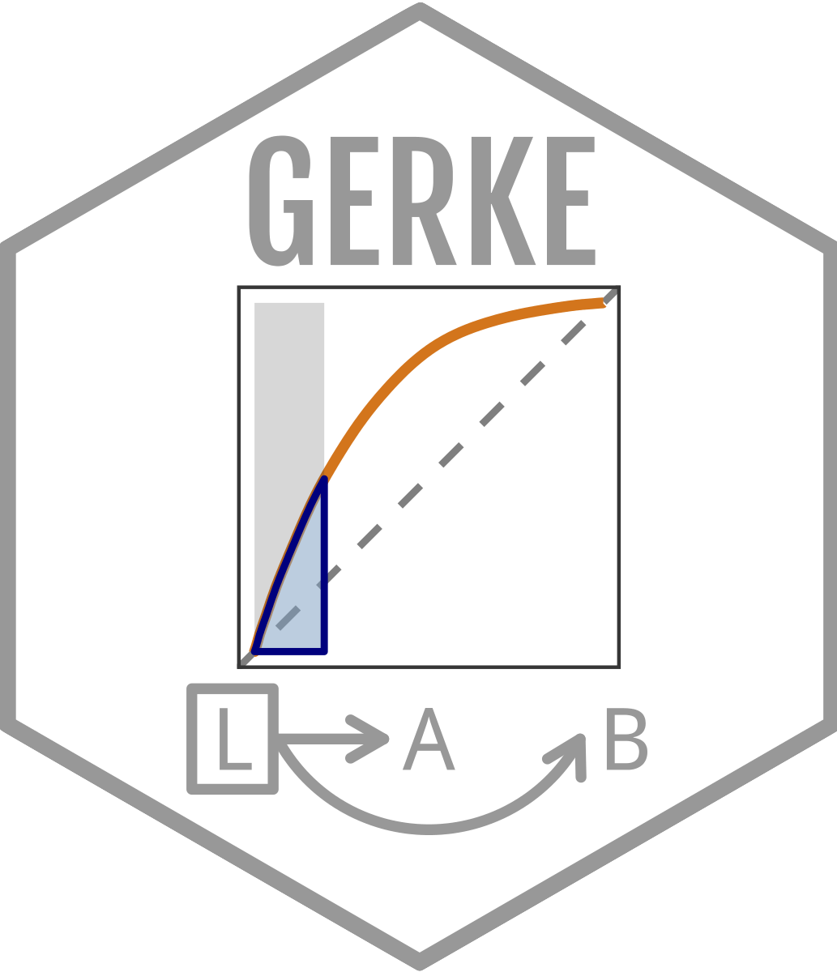
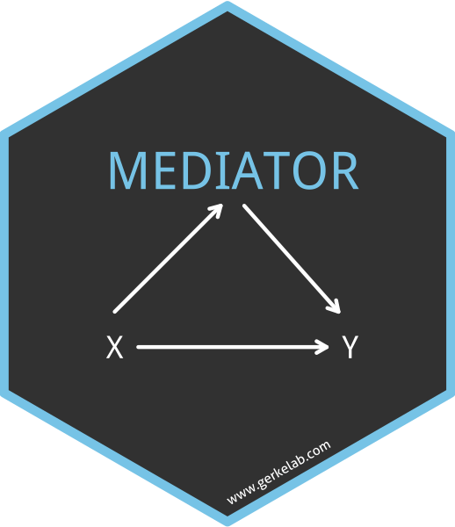
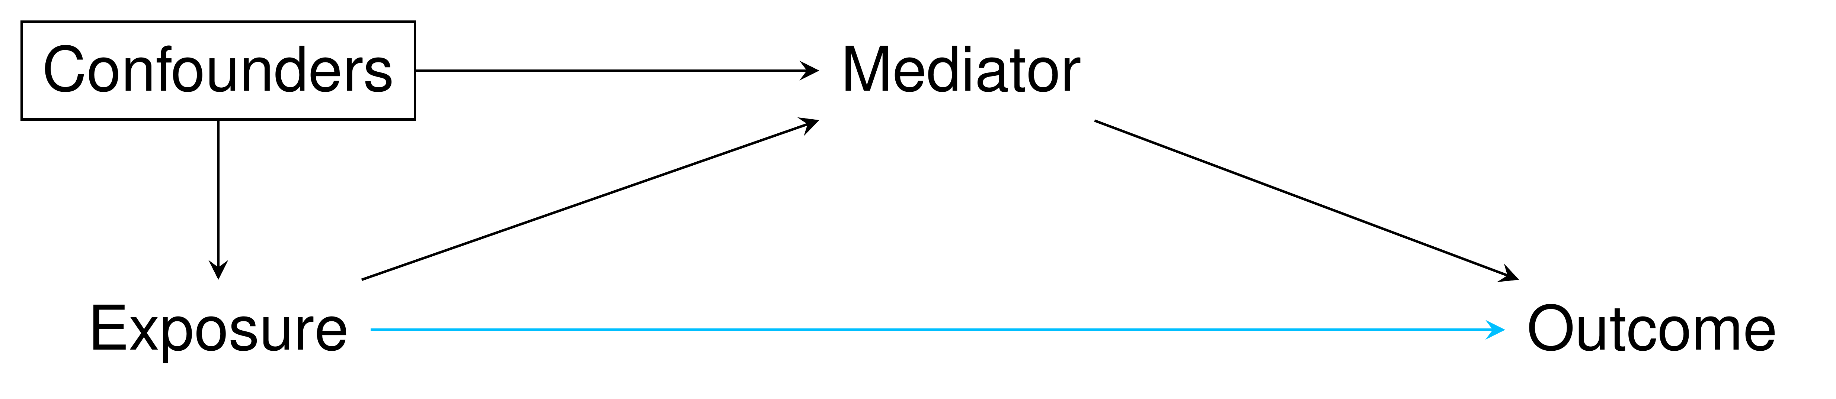
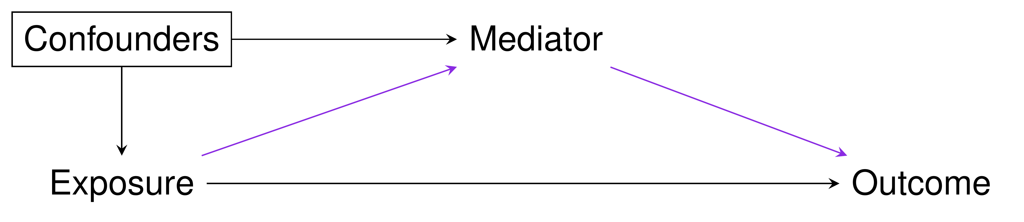
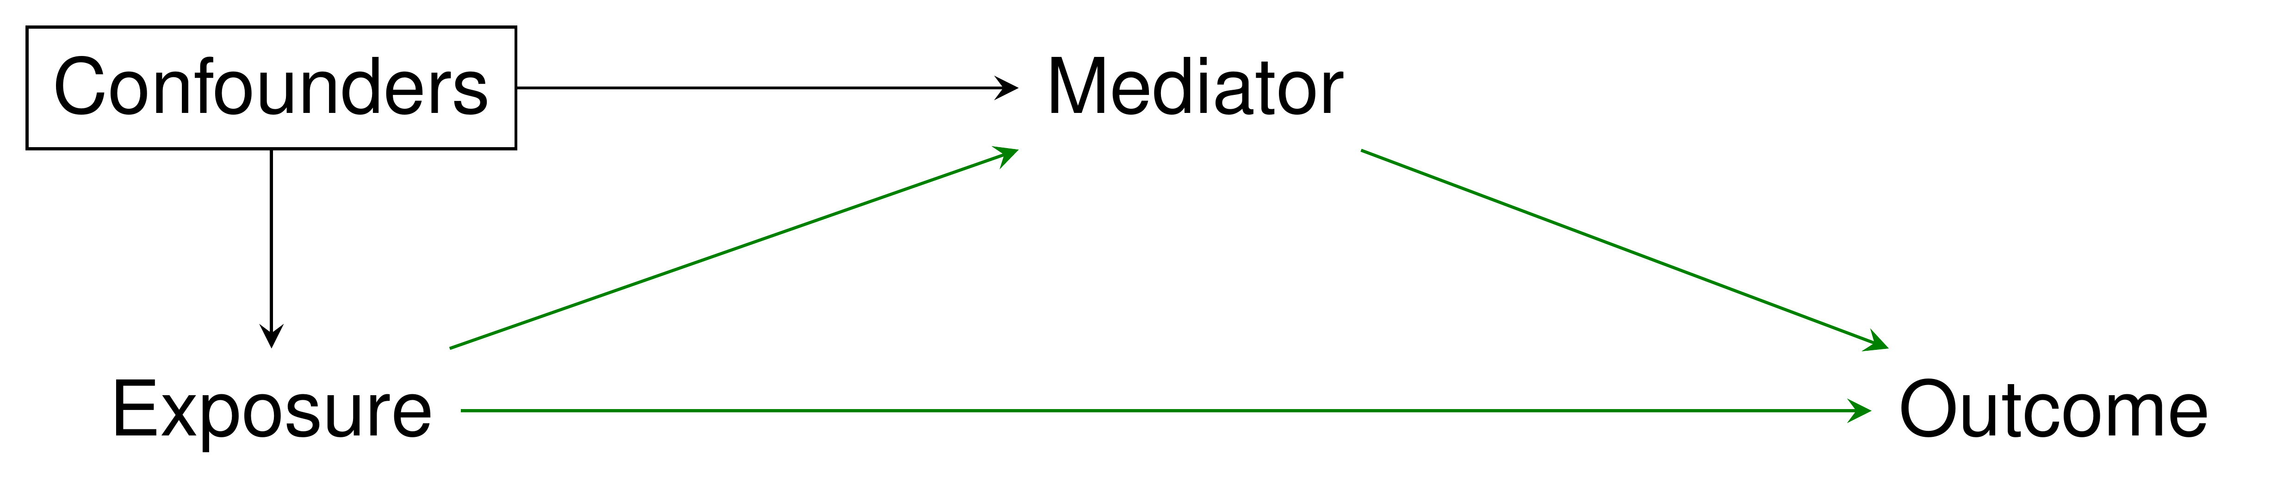
mediator::causal mediation analysis
Performs mediation analysis under the counterfactual framework
What is mediation analysis?
A mediation analysis examines the extent to which the causal relationship between an exposure and outcome operates through an intermediate variable, known as a mediator.
Required Arguments
data
Data set to use for analysis and models
out.model
A fitted model object for the outcome. Can be of class ‘glm’, ‘lm’, or ‘coxph’
med.model
A fitted model object for the mediator. Can be of class ‘glm’ or ‘lm’
treat
Character string indicating name of treatment/exposure variable
Optional Arguments
a
Numeric value indicating the exposure level. Default = 1
a_star
Numeric value indicating the compared exposure level. Default = 0
m
Numeric value indicating the level of the mediator. Default = 1
boot_rep
Numeric value indicating the number of repetitions to use when utilizing bootstrap to calculate confidence intervals. When boot_rep = 0, the Delta method for calculating confidence intervals is used. Default = 0
pm_ci
Logical indicator for calculating the CI for the proportion mediated. Default = FALSE.
Terminology
Controlled Direct Effect (CDE) expresses how much the outcome would change on average if the mediator were controlled at level m uniformly in the population but the treatment were changed from level a=0 to level a=1
Natural Direct Effect (NDE) expresses how much the outcome would change if the exposure were set at level a=1 versus level a=0 but for each individual the mediator were kept at the level it would have taken in the absence of the exposure
Natural Indirect Effect (NIE) expresses how much the outcome would change on average if the exposure were controlled at level a=1, but the mediator were changed from the level if would take if a=0 to the level it would take if a=1
Total Effect (TE) how much the outcome would change overall for a change in the exposure from level a=0 to level a=1
Proportion Mediated the extent to which the total effect of the exposure on the outcome operates through the mediator
Usage
# basic example of mediator usage – using built in example data (mediator_example) available within the package
mediator::mediator(data = mediation_example,
out.model = glm(y ~ x + m + c + x*m,
family = “binomial”,
data = mediation_example),
med.model = lm(m ~ x + c,
data = mediation_example,),
treat = "x")
# A tibble: 5 x 4
Effect Estimate `Lower 95% CI` `Upper 95% CI`
<chr> <dbl> <dbl> <dbl>
1 CDE 1.01 0.314 3.22
2 NDE 0.620 0.224 1.72
3 NIE 0.803 0.506 1.27
4 Total Effect 0.498 0.103 2.40
5 Proportion Mediated 0.244 NA NA
Tips
mediator is pipe compatible
Results are calculated based off the covariates taking either the mean value (continuous) or the most common value (categorical)
There are as many potential values for the CDE as there are levels of the mediator
Comparison to other tools
%mediation()
Language : SAS and SPSS
Binary or continuous covariates only
Mediation
Language : R
Bootstrap confidence intervals only
Mediator * Jordan.H.Creed@moffitt.org * Learn more at https://github.com/GerkeLab/mediator * package version 0.1.0 * Last update: 2019-12-16
Notes:
Other potential sections : example interpretation of results, references, unit tests, rules for conducting mediation analysis

