Slide 1
Team 6: Capstone Project
University of Toronto School of Continuing Studies
Presenters:
Bernie Manu
Jennifer Anno-Kusi
Sandeep Powar
Yuvraj Taneja

Slide 2
Table of Contents
Our Topic
Why This Topic
Metadata
Questions
Data Exploration
Data Analysis

Slide 3
Our Topic
Predicting Insurance Fraud

Slide 4
Why this topic?
To help insurance companies to build robust ML models to assess the risk and reduce insurance fraud.

Slide 5
Description of Data
We are using data set from Kaggle.

Slide 6
Questions:
Ratios of fraud claims by women to men ?
Fraudulent claims by age ?
Decision whether claim is fraudulent or not ?

Slide 7
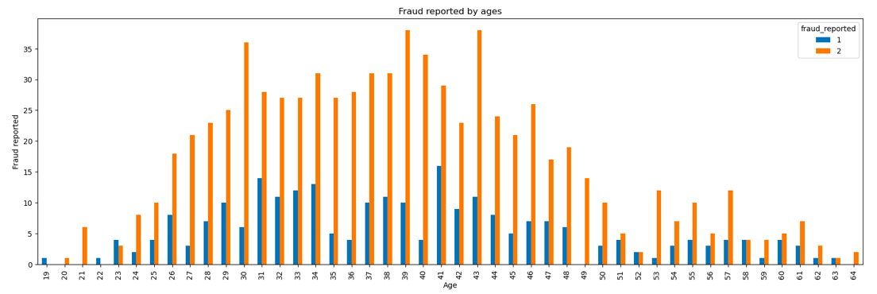
Data Exploration
1: Fraud Reported. 2: Fraud Not Reported

Slide 8
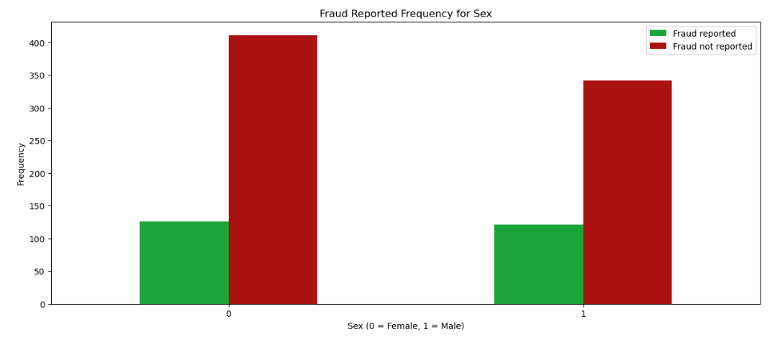

Slide 9
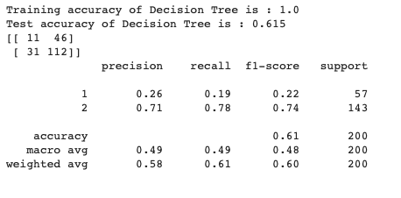
Data Analysis
ML - Decision Tree Model

Slide 10
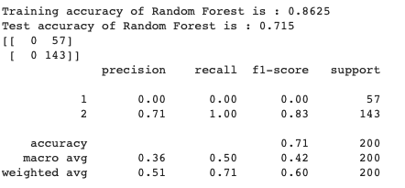
Data Analysis
ML - Random Forest Model

