Slide 1
Team 6: Capstone Project
University of Toronto School of Continuing Studies
Presenters:
Bernie Manu
Jennifer Anno-Kusi
Sandeep Powar
Yuvraj Taneja

Slide 2
Table of Contents
Our Topic
Why This Topic
Metadata
Questions
Data Exploration
Data Analysis
Technologies & Algorithms
Dashboard

Slide 3
Our Topic
Predicting Insurance Fraud

Slide 4
Why this topic?
To help insurance companies to build robust ML models
to assess the risk and reduce insurance fraud.

Slide 5
Description of Data
We are using data set from Kaggle.
We based our analysis on the following columns.
Months as a customer
Age
Policy premium
Postal code
Gender

Slide 6
Questions:
Ratios of fraud claims by women to men ?
Fraudulent claims by age ?
Decision whether claim is fraudulent or not ?

Slide 7
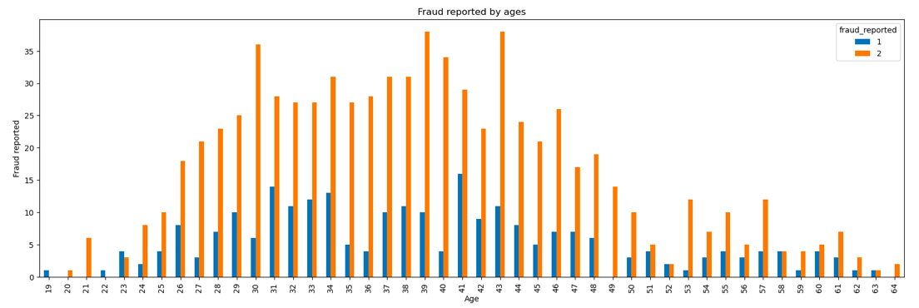
Data Exploration
1: Fraud Reported. 2: Fraud Not Reported

Slide 8
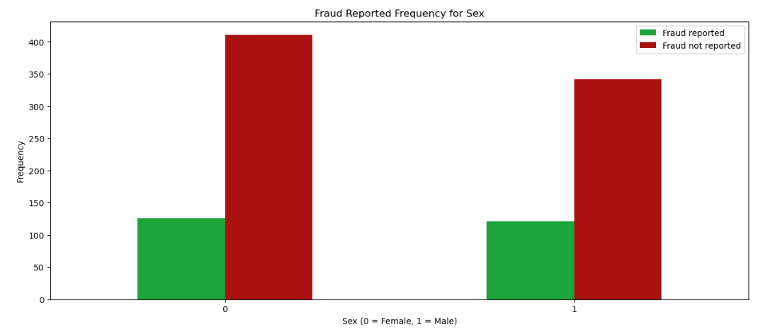

Slide 9
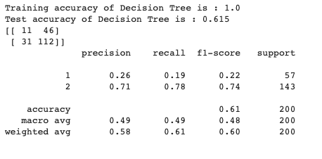
Data Analysis
ML - Decision Tree Model

Slide 10
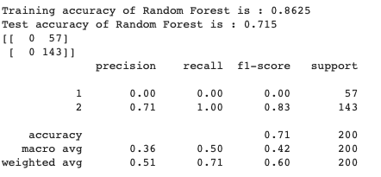
Data Analysis
ML - Random Forest Model

Slide 11
Technologies & Algorithms
Python
Pandas and other libraries
Jupyter notebook
Postgres database
Decision Tree Classifier Model
Random Forest Classifier Model
Tableau and Google slides
Github, Zoom and Slack

Slide 12
Dashboard
Tableau will be used to visualize the following:
Fraud reported by gender
Frauds by state
Fraud reported by age group

