Slide 1
Team 6: Capstone Project
University of Toronto School of Continuing Studies
Presenters:
Bernie Manu
Jennifer Anno-Kusi
Sandeep Powar
Yuvraj Taneja

Slide 2
Table of Contents
Our Topic
Why This Topic
Metadata
Questions
Data Exploration
Data Analysis
Technologies & Algorithms
Dashboard
Future Enhancements

Slide 3
Our Topic
Predicting Insurance Fraud

Slide 4
Why this topic?
To help insurance companies to build robust ML models
to assess the risk and reduce insurance fraud.

Slide 5
Description of Data
We are using data set from Kaggle.
We based our analysis on the following columns.
Months as a customer
Age
Policy premium
Postal code
Gender

Slide 6
Questions:
Ratios of fraud claims by women to men ?
Fraudulent claims by age ?
Decision whether claim is fraudulent or not ?

Slide 7
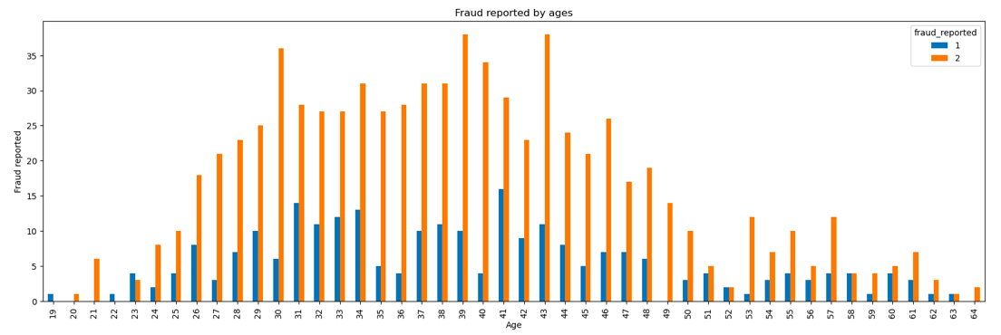
Data Exploration
1: Fraud Reported. 2: Fraud Not Reported

Slide 8
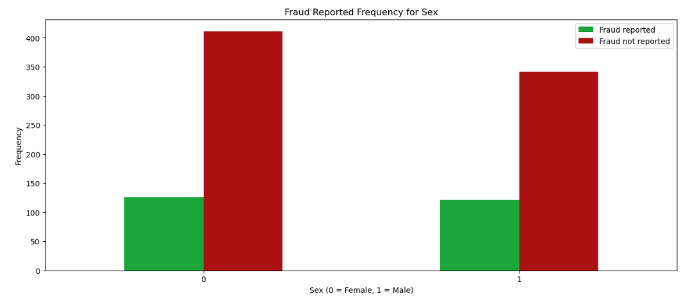

Slide 9
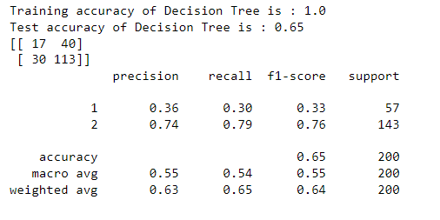
Data Analysis
ML - Decision Tree Model

Slide 10
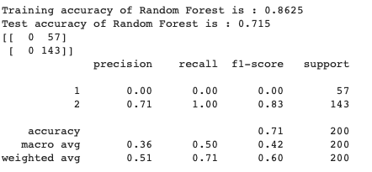
Data Analysis
ML - Random Forest Model

Slide 11
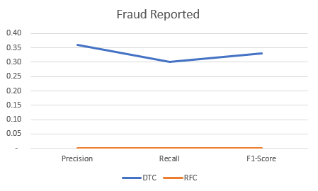
Data Analysis
Fraud reported ML DTC model vs. ML RFC model

Slide 12
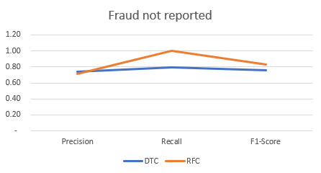
Data Analysis
Fraud not reported ML DTC model vs. ML RFC model

Slide 13
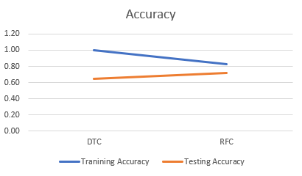
Data Analysis
Accuracy ML DTC model vs. ML RFC model

Slide 14
Technologies & Algorithms
Python
Pandas and other libraries
Jupyter notebook
Postgres database
Decision Tree Classifier Model
Random Forest Classifier Model
Tableau and Google slides
Github, Zoom and Slack

Slide 15
Dashboard
Tableau Dashboard

Slide 16
Future Enhancements
Fraudulent claims grouped by incident severity level.
Fraudulent claims grouped by education level.
To include more datasets to increase the accuracy of ML model.
Current ML model can be refactored to incorporate different insurance analysis e.g. property and health claims

Slide 17
Questions?

