Slide 1
Venues Opportunities in Las Condes (Santiago, Chile)
Germán Donoso Henríquez
February, 2021

Slide 2
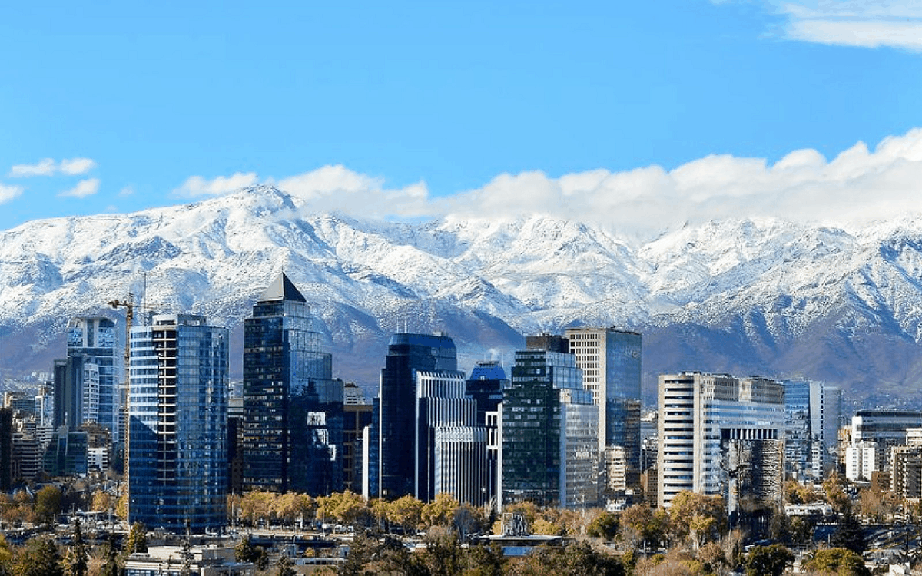
Business Problem
Purpose: The client is interested in opening a new venue in Santiago, specifically in the commune of Las Condes.
We want to evaluate what kind of venues are the best options for the client.

Slide 3
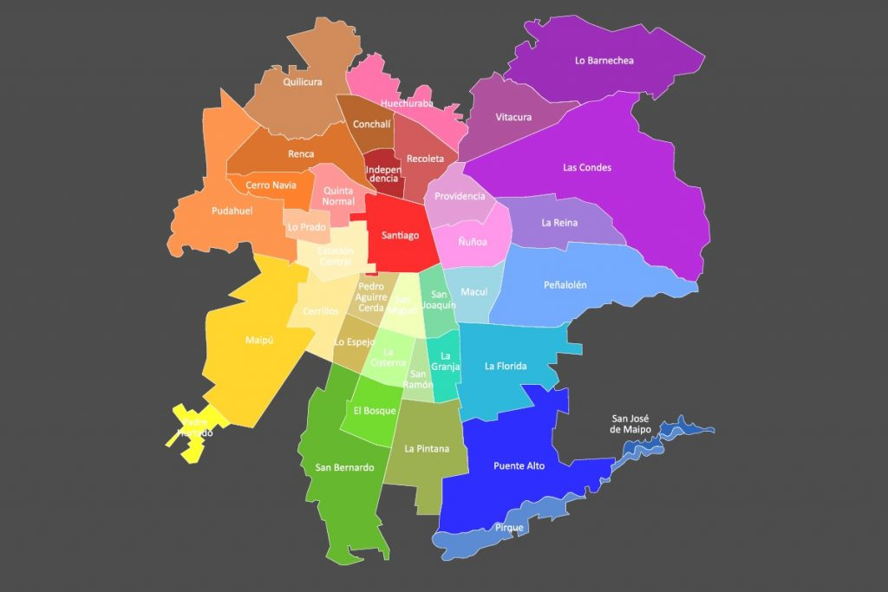
Communes of Santiago
We will explore the main communes of Santiago and then compare with Las Condes to analyze which communes are the most similar to the commune in question.
With this information we can determine the most frequent venues that are present in the similar communes but not in Las Condes, so these venues are possible good options.

Slide 4
Data
1. Venues of the different communes (Foursquare API)
2. Communes parameters: Latitude, longitude, area and population of the different communes
3. UF value per square meter of a property or real estate (in this case departments) of the communes

Slide 5
Parameters of the communes
Commune | Area (km²) | Population | Latitude | Longitude | UF/m²
Santiago | 23,2 | 503.147 | -33,44 | -70,66 | 63,9
Cerrillos | 21 | 88.956 | -33,50 | -70,72 | 41,8
Conchalí | 10,7 | 139.195 | -33,38 | -70,68 | 54,9
Estación Central | 15 | 206.792 | -33,46 | -70,70 | 52,3
Huechuraba | 44,8 | 112.527 | -33,37 | -70,63 | 50
Independencia | 7 | 142.065 | -33,41 | -70,67 | 53
La Cisterna | 10 | 100.434 | -33,53 | -70,66 | 51,8
La Florida | 70,2 | 402.433 | -33,53 | -70,54 | 54,9
La Reina | 23 | 100.252 | -33,44 | -70,53 | 78
Las Condes | 99 | 330.759 | -33,42 | -70,58 | 94,9
Lo Barnechea | 1024 | 124.076 | -33,35 | -70,52 | 92,1
Macul | 12,9 | 134.635 | -33,49 | -70,60 | 58
Maipú | 135,5 | 578.605 | -33,52 | -70,77 | 49,9
Ñuñoa | 16,9 | 250.192 | -33,45 | -70,60 | 79,1
Peñalolén | 54 | 266.798 | -33,49 | -70,53 | 62
Providencia | 14,3 | 157.749 | -33,44 | -70,62 | 91,6
Pudahuel | 197 | 253.139 | -33,43 | -70,72 | 42,9
Quilicura | 58 | 254.694 | -33,36 | -70,73 | 40
Quinta Normal | 13 | 136.368 | -33,43 | -70,70 | 44,5
Recoleta | 16 | 190.070 | -33,41 | -70,64 | 55,1
San Joaquín | 9,7 | 103.485 | -33,49 | -70,63 | 55,2
San Miguel | 10,0 | 133.059 | -33,49 | -70,65 | 55,7
Vitacura | 28,3 | 96.774 | -33,40 | -70,60 | 103

Slide 6
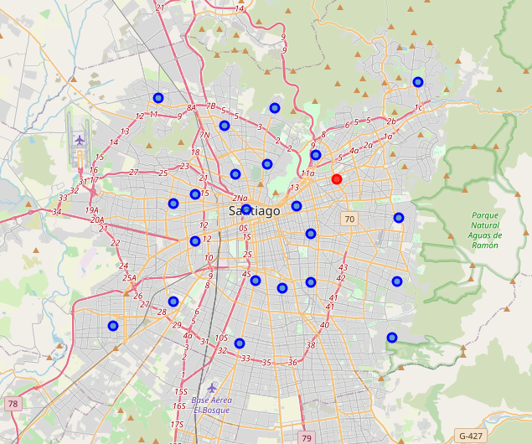
Communes of Santiago

Slide 7
Venues per commune (Foursquare API)
Commune | #Venues
Cerrillos | 45
Conchalí | 21
Estación Central | 69
Huechuraba | 43
Independencia | 34
La Cisterna | 53
La Florida | 45
La Reina | 65
Las Condes | 217
Lo Barnechea | 92
Macul | 73
Maipú | 145
Peñalolén | 58
Providencia | 200
Pudahuel | 179
Quilicura | 59
Quinta Normal | 32
Recoleta | 33
San Joaquín | 27
San Miguel | 71
Santiago | 224
Vitacura | 225
Ñuñoa | 160

Slide 8
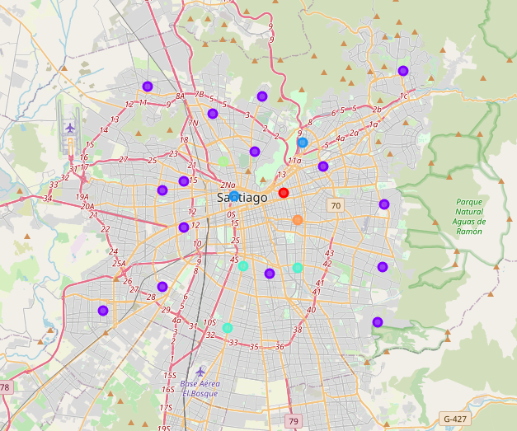
K-Means Algorithm (6 groups)
Commune | Cluster
Cerrillos | 1
Conchalí | 1
Estación Central | 1
Huechuraba | 1
Independencia | 4
La Cisterna | 3
La Florida | 1
La Reina | 1
Las Condes | 1
Lo Barnechea | 1
Macul | 3
Maipú | 1
Peñalolén | 1
Providencia | 0
Pudahuel | 1
Quilicura | 1
Quinta Normal | 1
Recoleta | 1
San Joaquín | 1
San Miguel | 3
Santiago | 2
Vitacura | 2
Ñuñoa | 5

Slide 9
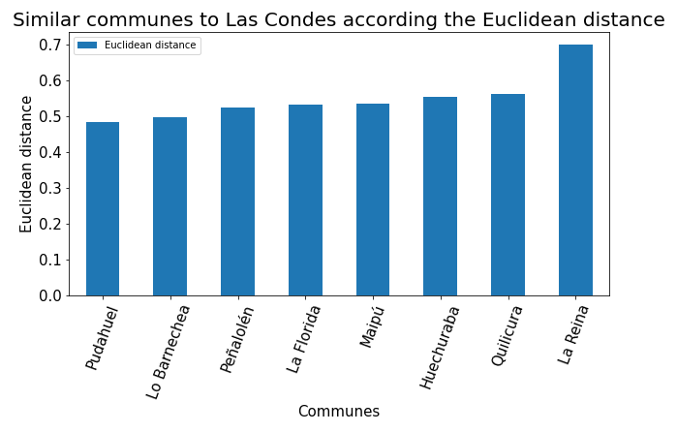
Euclidean Distance
We calculate the Euclidean distance between Las Condes and the other communes using the normalized vectors we used to get the cluster. We obtained that the communes of Las Condes cluster are the same as the 14 most similar communes to Las Condes according the Euclidean distance. We select the 8 most similar communes.

Slide 10
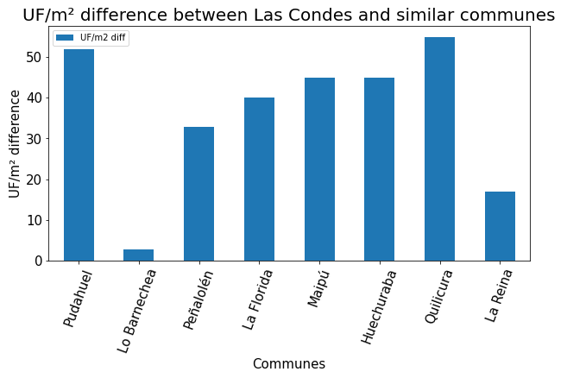
UF/m² difference
We also use the UF/m² difference because this gives us a reference of the similarity in the economic situation of the people who live in the communes. We assume that the target audience of the future venue has similar preferences depending on the economic situation.

Slide 11
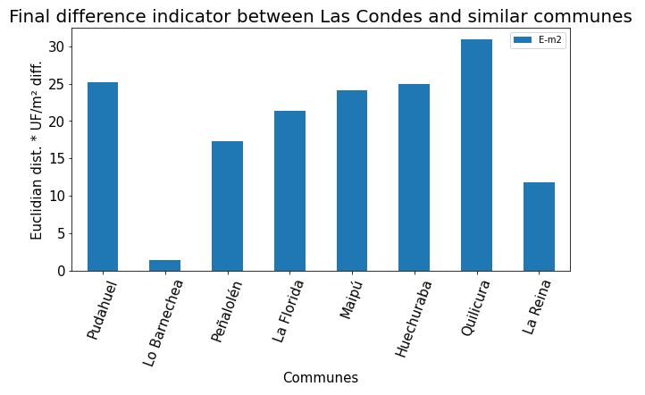
Final indicator
The three most similar communes to Las Condes according to the new indicator are:
Lo Barnechea
La Reina
Peñalolén

Slide 12
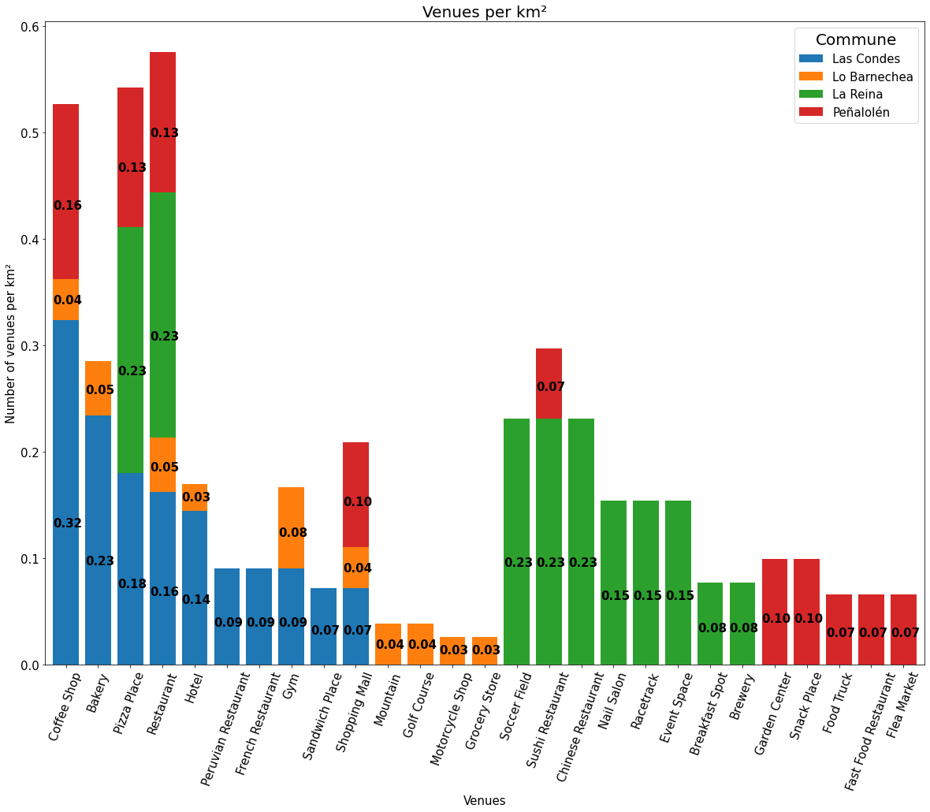
Results
The three most frequent stacked venues are: Restaurant, Pizza Place and Coffee Shop, and they are three of the four most frequent venues of Las Condes, so maybe these venues are not a good option.

Slide 13
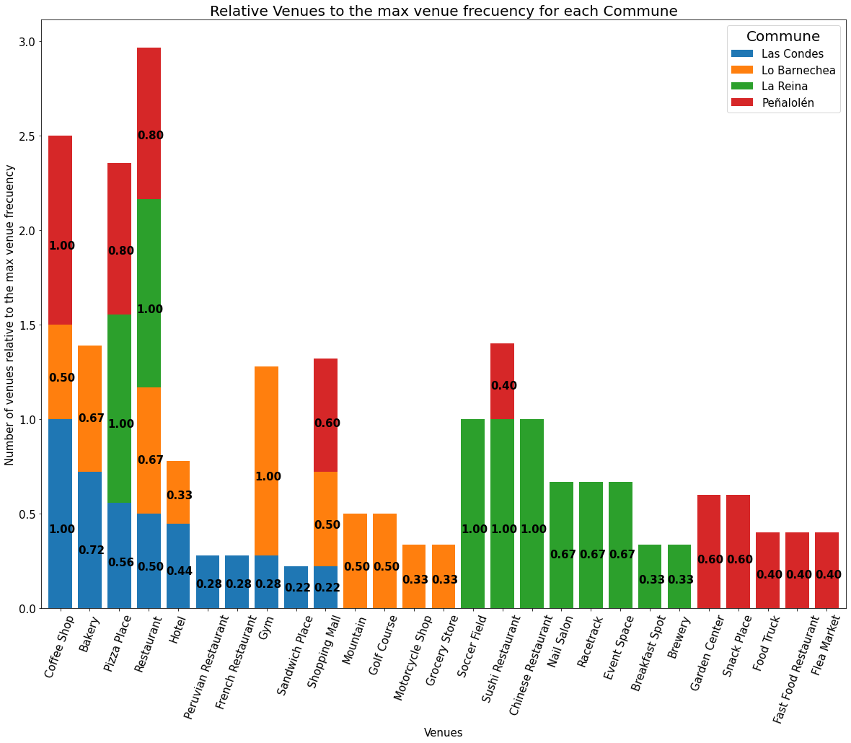
Results (relative frequency)
This chart shows how many venues there are in relation to the most frequent venue per commune.
The Shopping Malls and Gyms are venues that are frequent in Las Condes but it could be space to place one of them if we compare in a relative way with the other communes.

Slide 14
Venues options for each commune
Lo Barnechea: the main possible venues are Grocery Store and Motorcycle Shop.
La Reina: this commune suggests three main options; Soccer field, Sushi Restaurant and Chinese Restaurant. Other less frequent options are; Nail Salon, Racetrack, Event Space, Breakfast Spot and Brewery.
Peñalolén: the two main venues are Garden Center and Snack Place. Other good options are Food Truck, Fast Food Restaurant and Flea Market.
Then the client can rule out the venues that are out of their budget. Finally, we can continue the analysis looking for strategic points in Las Condes that have fewer venues nearby of the same category that the client wants.

Slide 15
Thanks!

