Slide 1
FieldInformer 3.0 Dashboard
Gauges take data from cached report results.
After upgrade from previous version report must be executed at least once in order to create cache. Once cahce is created, report can serve as data source for gauges.
Nightly job refreshes report cache if report serves as data source for one or more gauges.

Slide 2
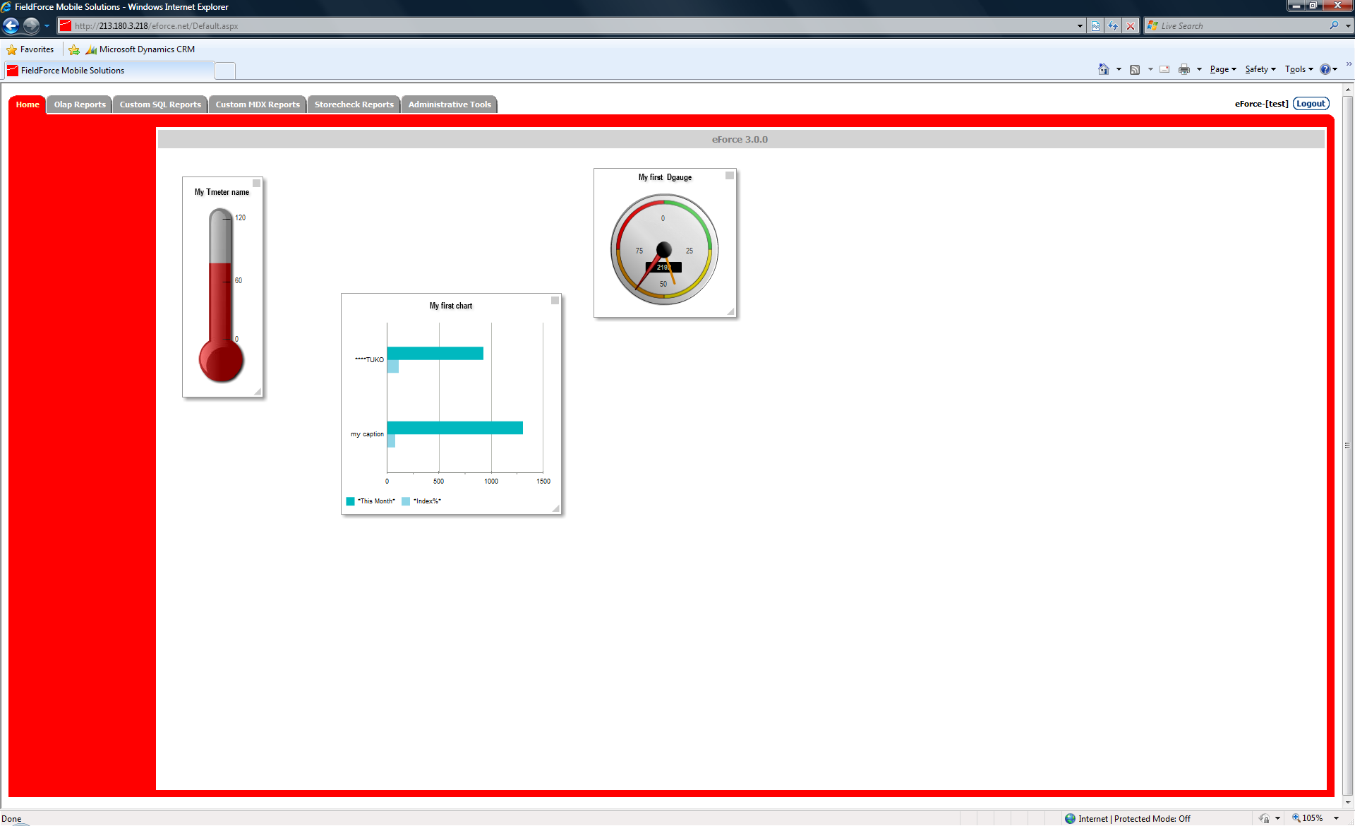

Slide 3
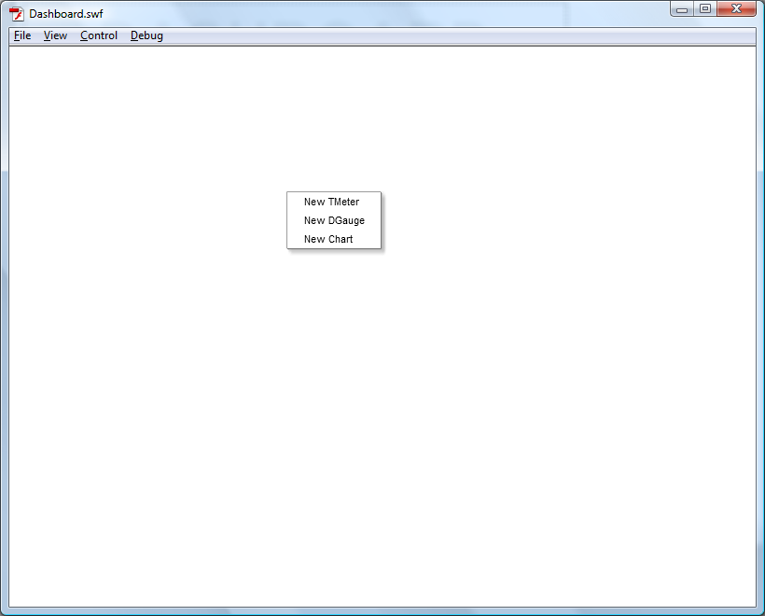
Click on dashboard panel

Slide 4
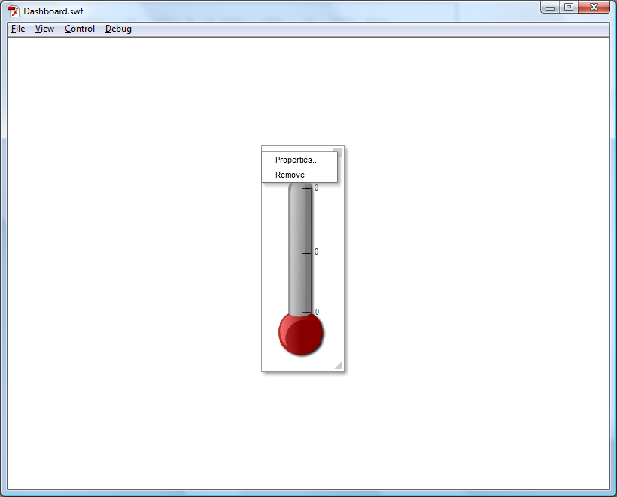
New Tmeter. Gauges have property box square
in upper-right corner (click).
Lower-right rectangle allows resizing
of gauge (drag).

Slide 5
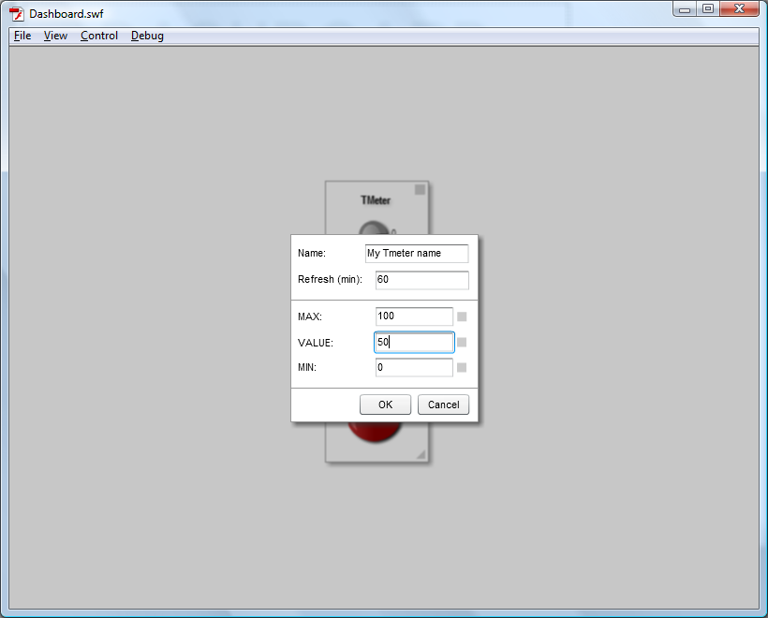
Tmeter properties.
Values can be static (typed in input box)
or dynamic (double click property rectangle)

Slide 6
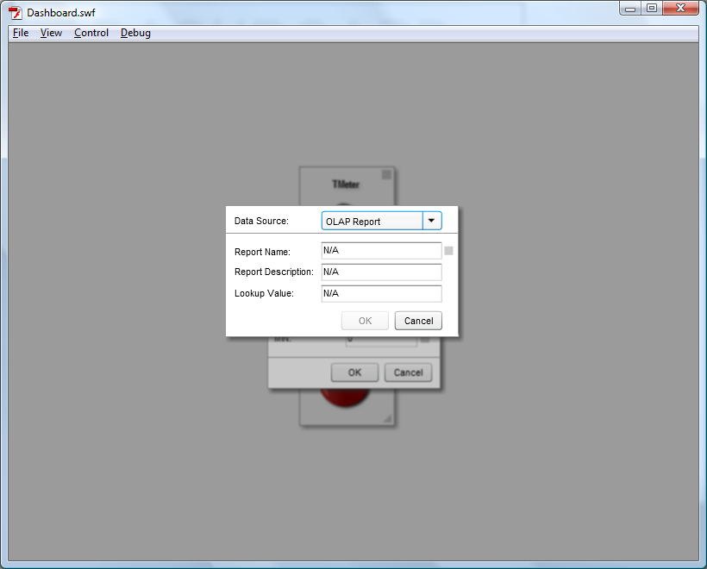
Choosing dynamic value:
Data Source – OLAP Report
User needs to choose report first.

Slide 7
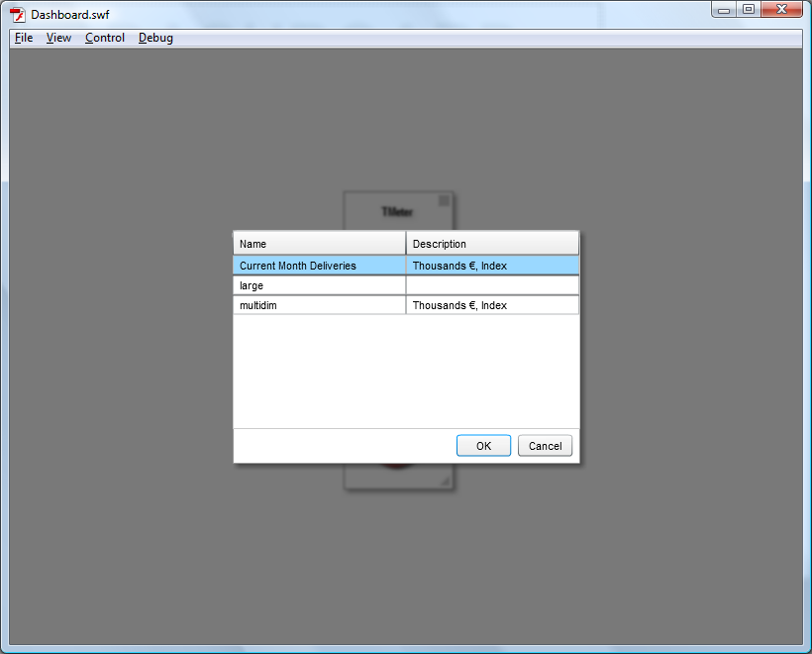
Choosing OLAP report from list.
Press OK or double-click on report in grid.

Slide 8
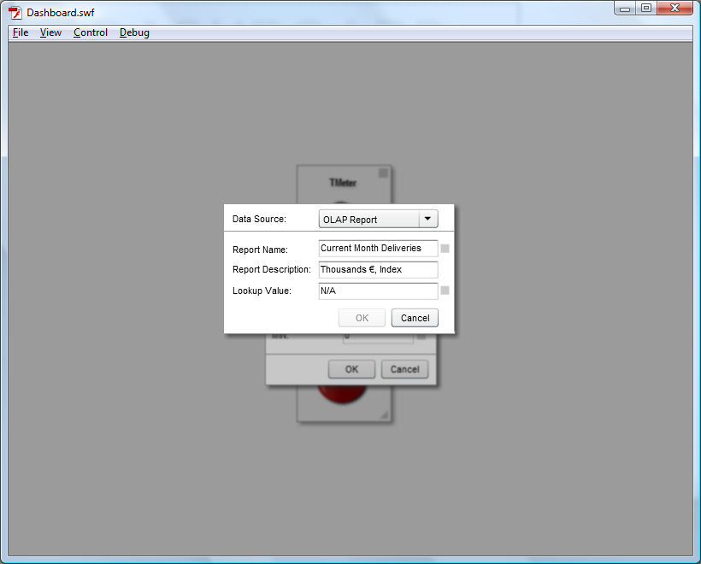
Choosing value from selected OLAP Report (double-click)

Slide 9
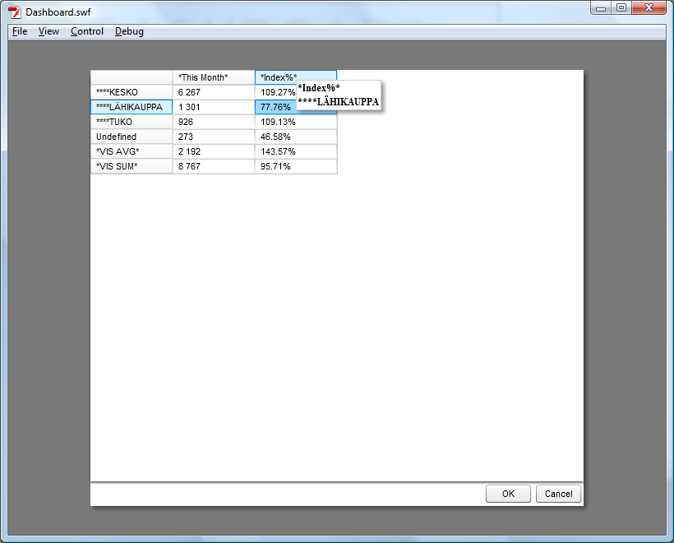
OLAP Report result in grid.
Choose cell and click OK (or double-click cell)

Slide 10

Accept chosen OLAP Report value

Slide 11
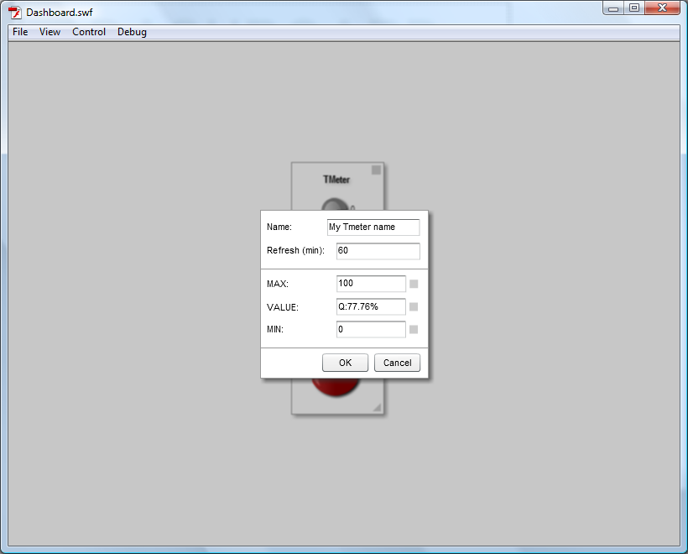
Accept Tmeter properties

Slide 12
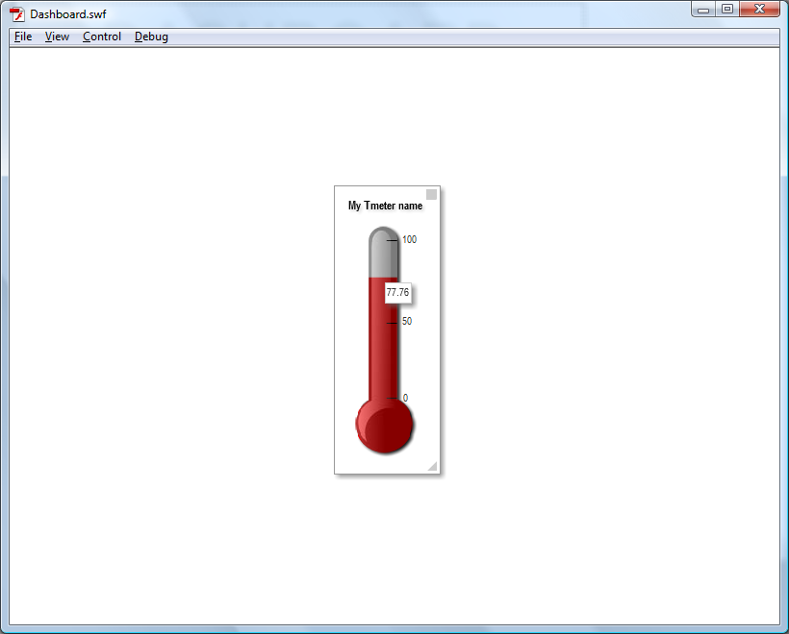
Tmeter with specified properties

Slide 13

Now let’s set MAX value as SQL query.

Slide 14
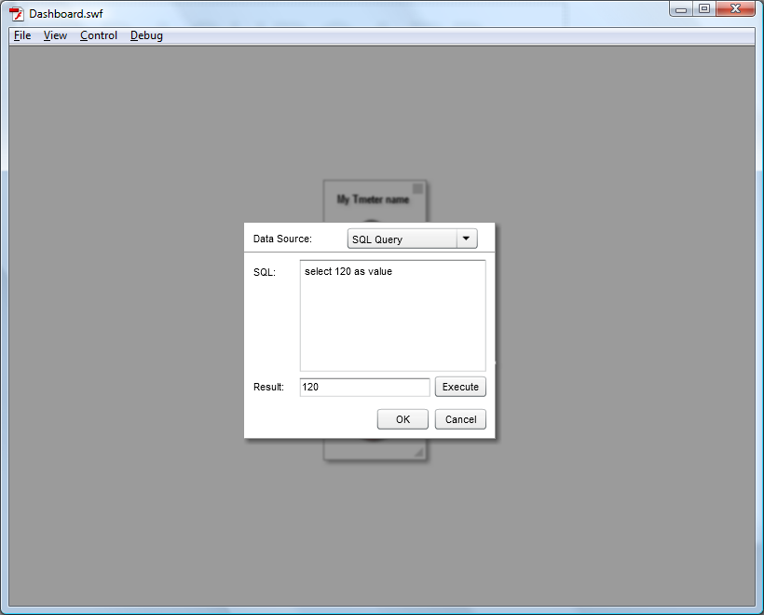
Choose Data Source – SQL Query.
Write query string, press execute to check result
and press OK.

Slide 15

Accept Tmeter properties

Slide 16
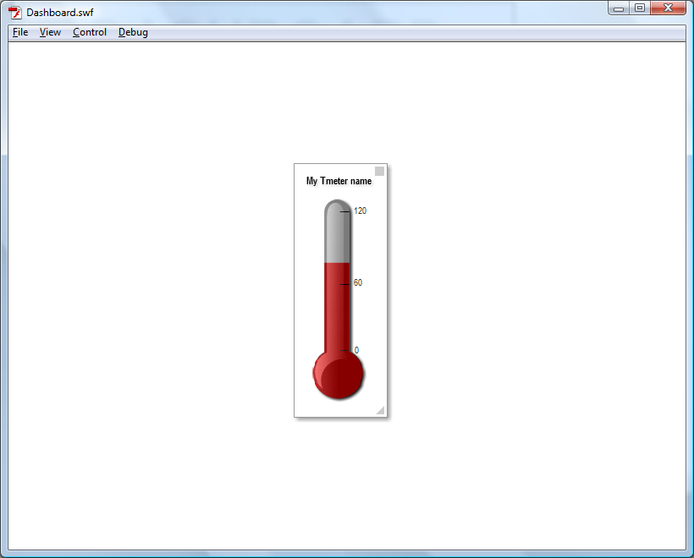
Tmeter with specified properties

Slide 17
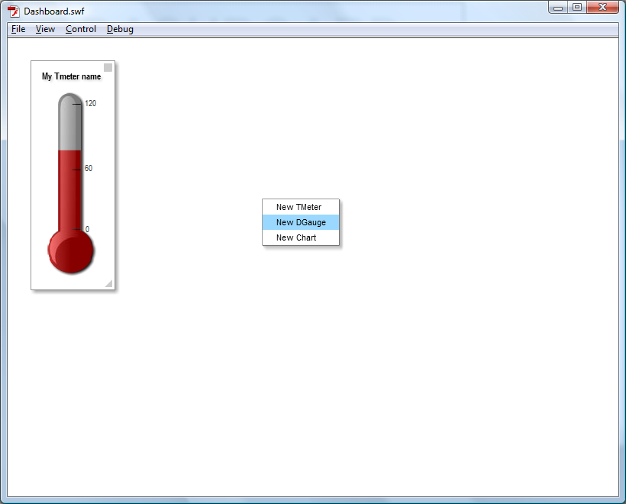
Move Tmeter to panel corner (drag).
Let’s create Dgauge.

Slide 18
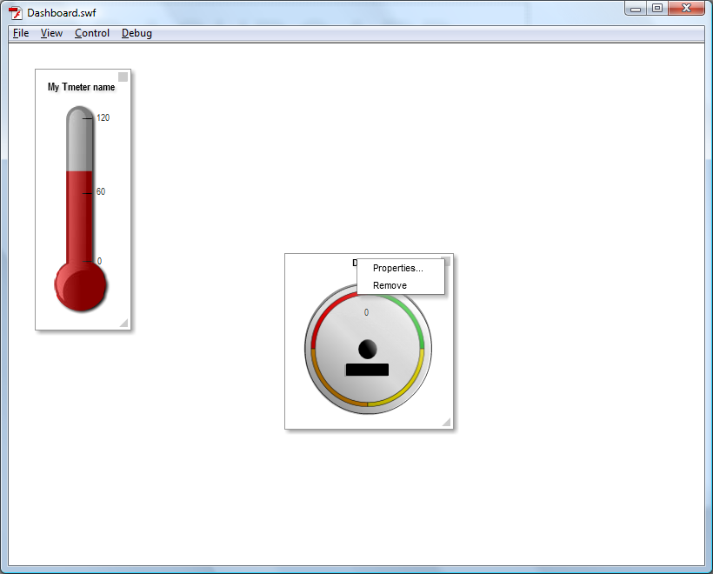
Open Dgauge properties.

Slide 19
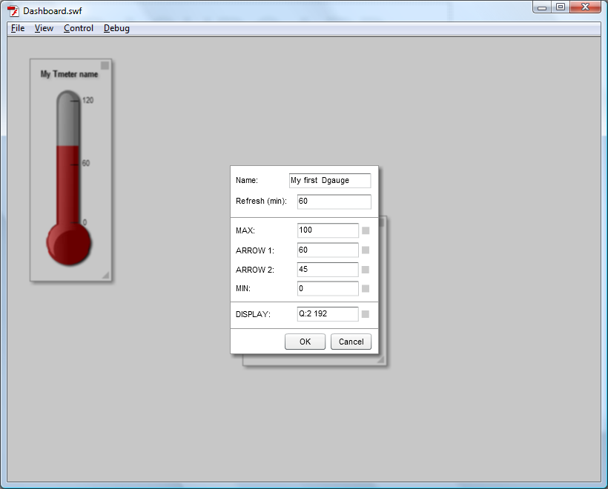
Specify Dgauge properties same way as Tmeter.
Only difference is that Dgauge can display more values:
Two arrows and display value.

Slide 20
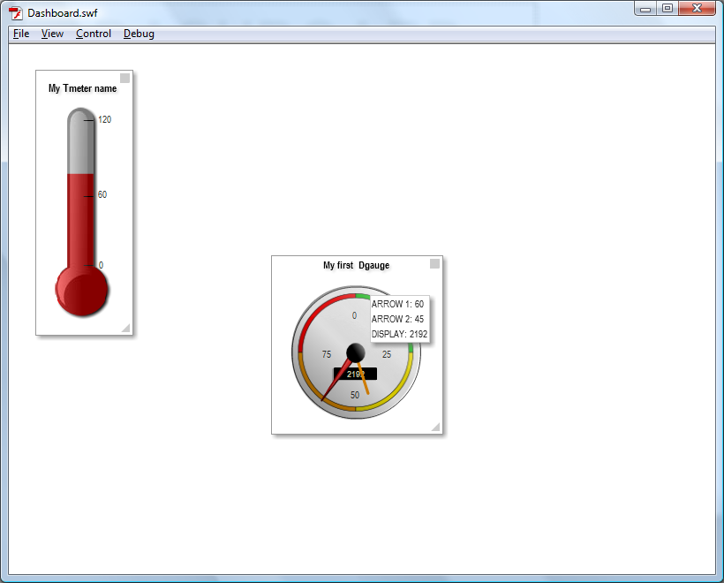
DGauge with specified properties

Slide 21
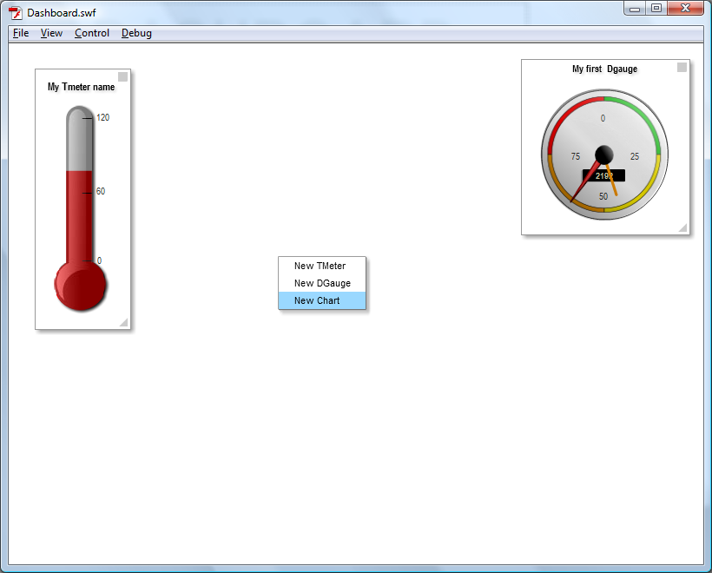
Creating chart gauge

Slide 22
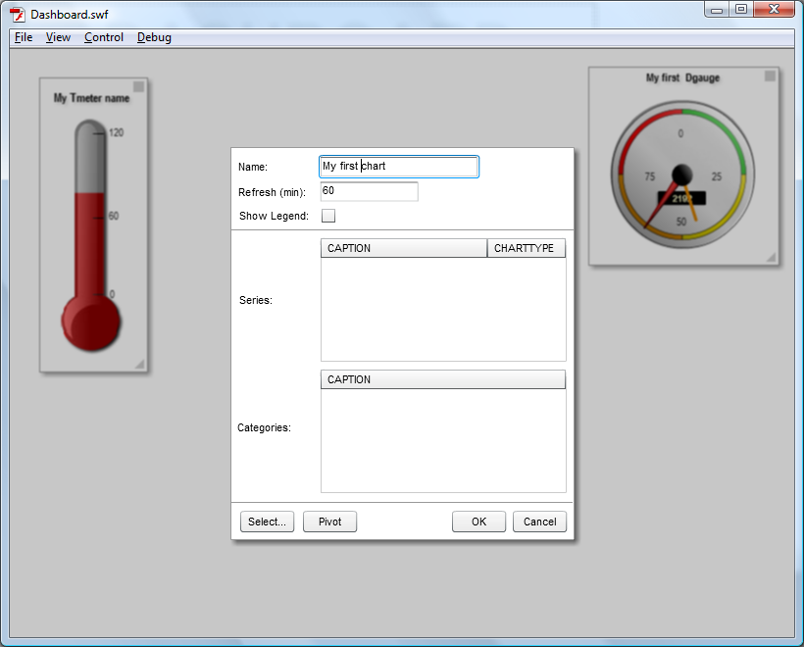
Chart properties:
Series and categories will be selected
from OLAP Report

Slide 23
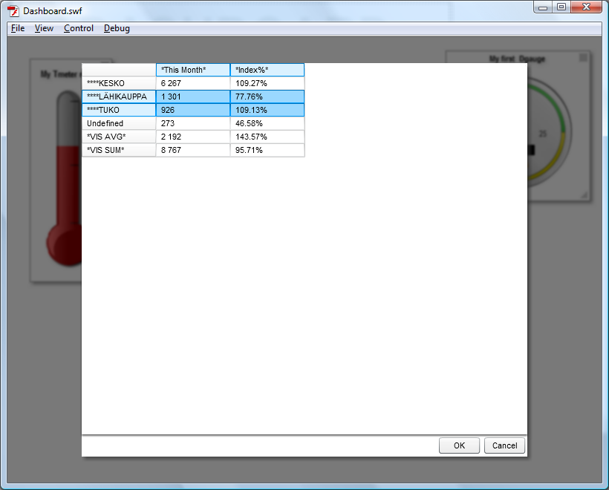
OLAP Report grid allows multiselect

Slide 24
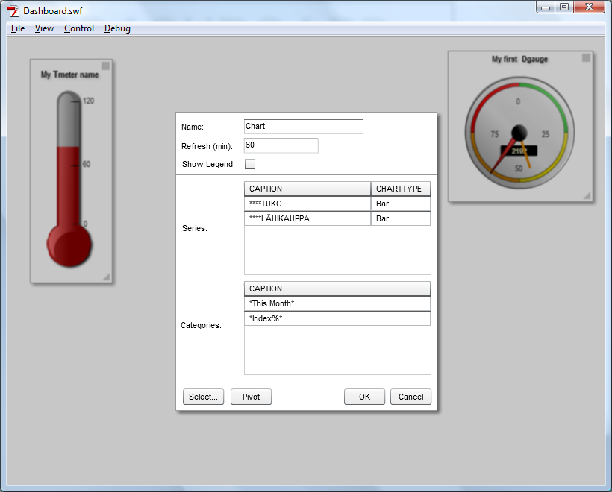
OLAP Report axes are series and categories
of chart

Slide 25
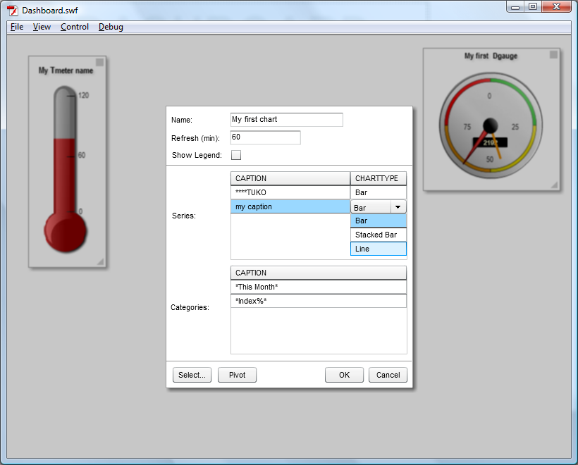
Changing captions and chart type:

Slide 26
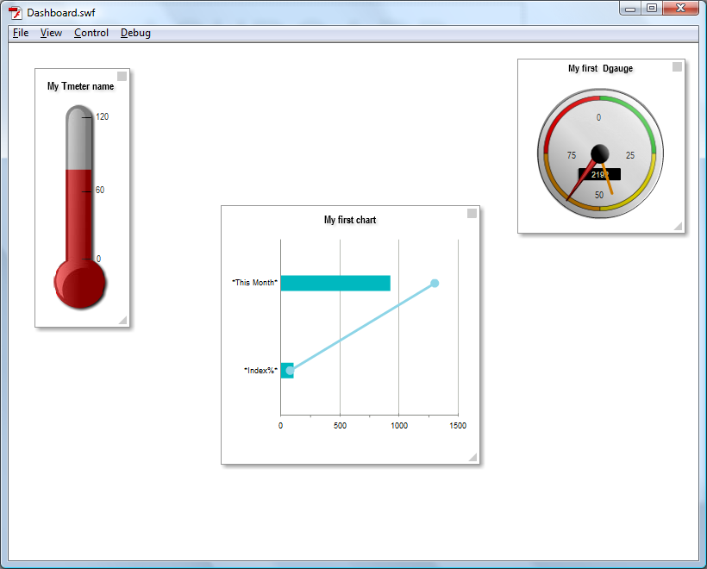
Chart gauge with specified properties

Slide 27

Show legend and pivot

Slide 28
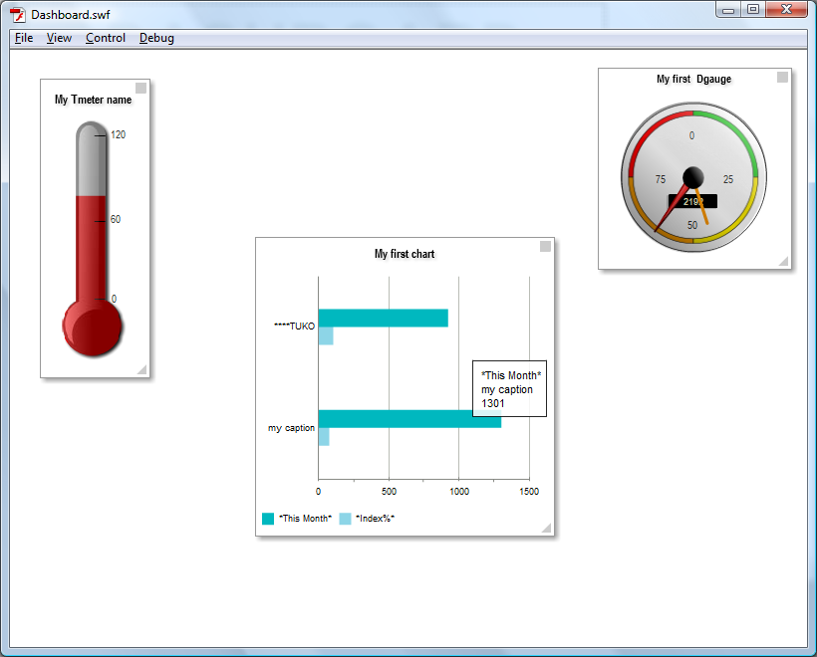
Chart gauge with specified properties

