Slide 1
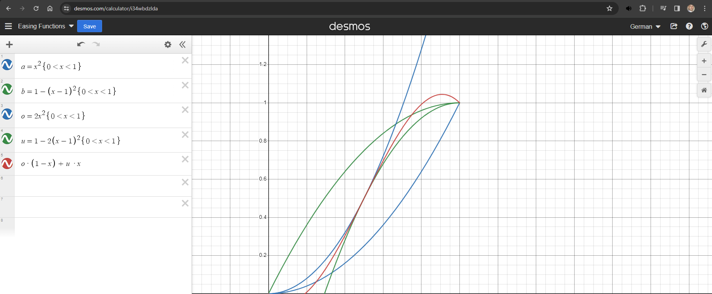
This function when applied to an object
traversing the x plane, will change
directions when the peak is reached
This function when applied to an object
traversing the x plane, will always travel
in the same direction

