Slide 1
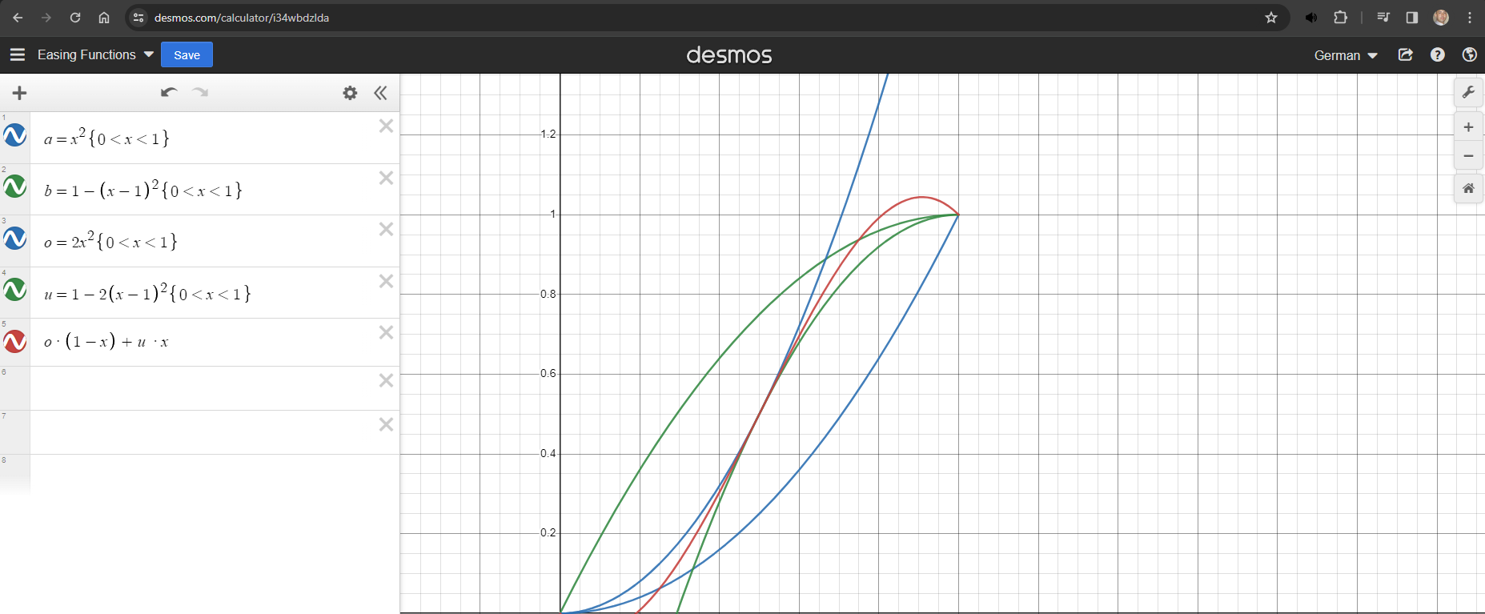
This function when applied to an object
traversing the x plane, will change
directions when the peak is reached
This function when applied to an object
traversing the x plane, will always travel
in the same direction

Slide 2
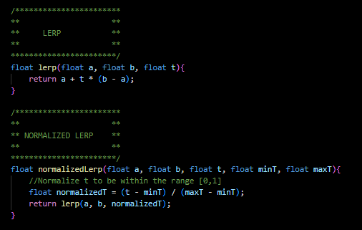
Lerp (Linear interpolation)
For dealing with finite ranges such as;
0.000 to 0.020, its best to “normalize”
said range such that it falls between a
range of 0 and 1. Once its normalized
it can then be fed into a standard lerp
function such that “a” and “b” scaling
can be derived from the normalized
range.
0.000
0.010
0.020
0
0.5
1
0
50
100

