Slide 1
Laparoscopic Cholecystectomy, LC
Department of General Surgery, Qilu Hospital, Shandong University
Zhi Xuting

Slide 2
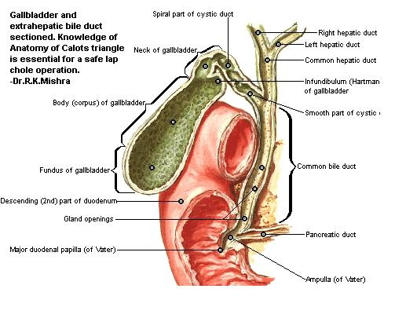
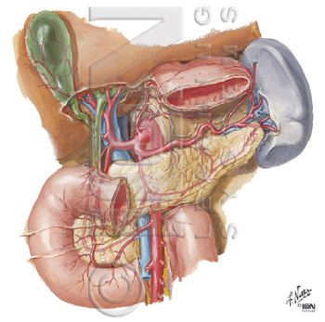
Anatomy of biliary system

Slide 3
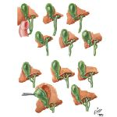
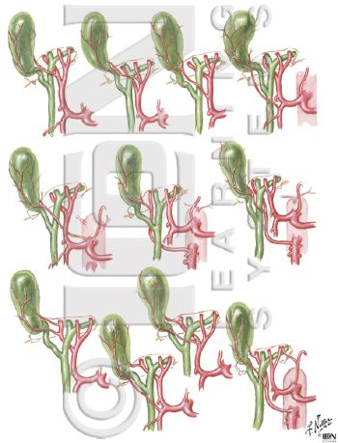
Variation of cystic duct and cystic artery

Slide 4
History, present and future of LC
1.The history of laparoscopic surgery
(1) Diagnostic laparoscopy period(1901~1933)
(2) Theraputic laparoscopy period(1933~1987)
(3) Modern laparoscopic surgery period (1987~now)

Slide 5
History, present and future of LC
2. The arrival of laparoscopic surgery era.
1987.3.15 A memorable day on which Phillipe Mouret from Lyon, France carried out the world's first laparoscopic cholecystectomy.
1988 Dubois from Paris and Perissat from Bordeaux learned LC from Mouret, and started to promote this technique in France, which subsequently shock the world.

Slide 6
The history of laparoscopic surgery in China
1.At the end of 1990, LC started to be carried out in Hongkong;
2. In January,1991, doctors from First Hospital Affiliated to Guangdong Medical College started to carry out LC with the help of doctors from HK;
3.In February,1991,Xun Zuwu from the Second People's Hospital of Qujing,Yunnan completed the first LC of mainland.

Slide 7
The history of laparoscopic surgery in Qilu Hospital
We started to carry out LC from February,1992. Then the technique was subsequently adopted by surgeons from departments of gynaecology, urology, pediatric surgery and thoracic surgery. Many operations which can only be completed by open approach in the past, can now be completed by laparoscoy.

Slide 8
Indications of Laparoscopic Cholecystectomy
Symptomatic gallstone
Simple gallbladder stones
Acute calculus cholecystitis
Gallbladder stones accompanied by gallbladder atrophy
Filled gallbladder stones
Gallbladder stones accompanied by history of abdominal operation
Gallbladder stones of special type (obesity/pregnancy/elderly/children)

Slide 9
Indications of Laparoscopic Cholecystectomy
2. Silent gallbladder stones
3. Acalculus cholecystitis
4. Gallbladder stones accompanied by common bile duct stones

Slide 10
Indications of Laparoscopic Cholecystectomy
5. Polypoid lesions of gallbladder (PLG)
Cholecystic polypus (inflammatory/cholesterol/adenomatous)
Gallbladder cancer of early stage
Pseudotumor of gallbladder (cholesterolosis of gallbladder/ gallbladder adenomyomatosis)

Slide 11
Contraindications of Laparoscopic Cholecystectomy
Acute cholangitis of severe type (ACST)
Severe infection of abdominal cavity
Severe bleeding tendency
Severe cirrhosis and portal hypertension
Diaphragmatic hernia
Severe organic dysfunction
Gallbladder-intestine fistula
Advanced gallbladder cancer
Mirizzi syndrome

Slide 12
Preoperative preparations of LC
1. General preparations
History review; physical examinations;
Ultrasound/ CT/ MRI examinations
2. Special preoperative preparations
Skin preparations; fasting; preoperative medication ,etc
3. Forecasting the difficulty of operation
Body weight; complications; operation history, cardiac and pulmonary function etc

Slide 13
Basic procedures of LC
1. Anesthesia: general anesthesia
2. Positioning of patients and standing position of surgeons
3. Skin disinfection and draping
4. Establishment of pneumoperitoneum (closed or open)
5. Placement of trocar: (3 or 4 pores)
6. Laparoscopic exploration
7. Management of Calot's triangle

Slide 14
Basic procedures of LC
8. Management of cystic duct and cystic artery
9. Dissecting and resection of gallbladder
10. Hemostasis of gallbladder bed and abdominal irrigation
11. Taking out the gallbladder
12. Abdominal drainage?
13. Turning off pneumoperitoneum and suturing incisions

Slide 15
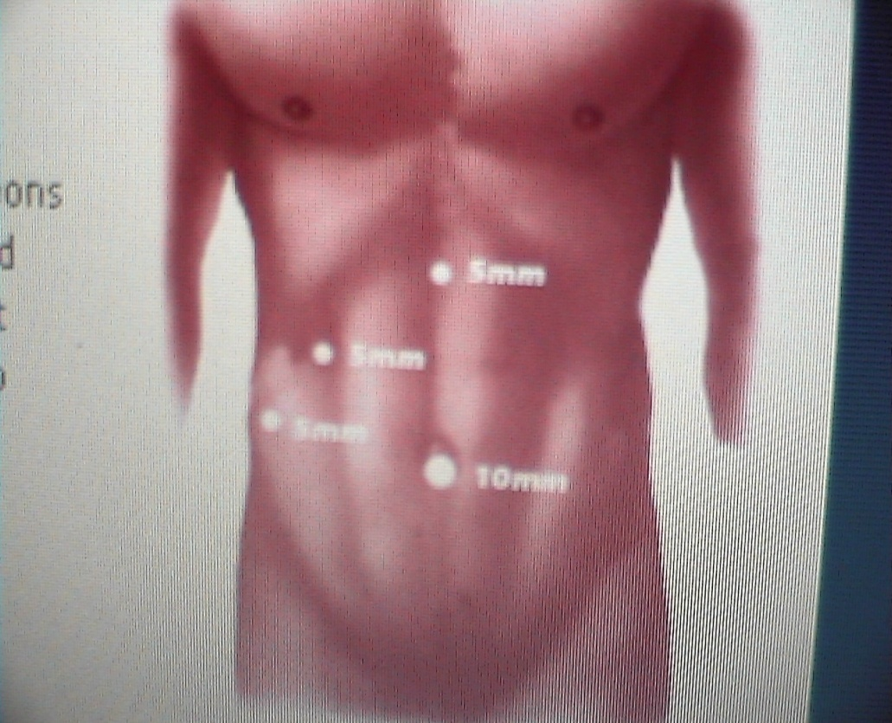
Schematic diagram of operation
Ports sites

Slide 16
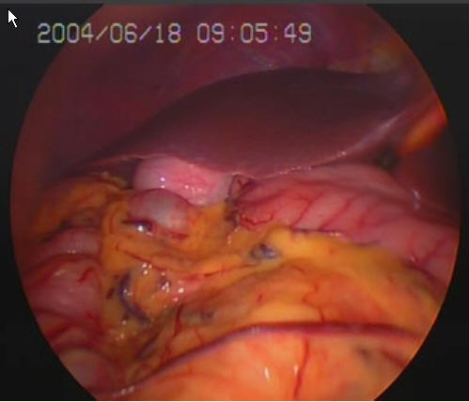
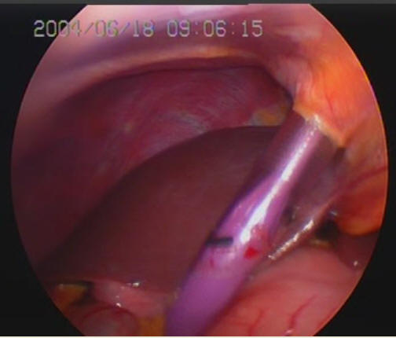
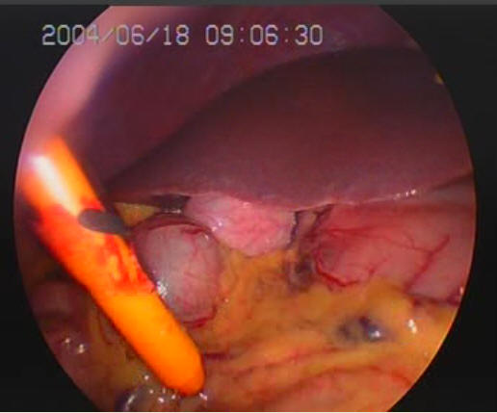
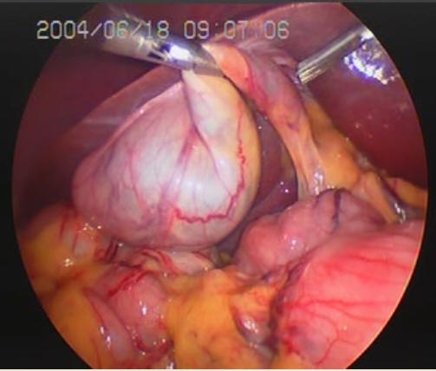
Placement of trocars and exposure of gallbladder

Slide 17
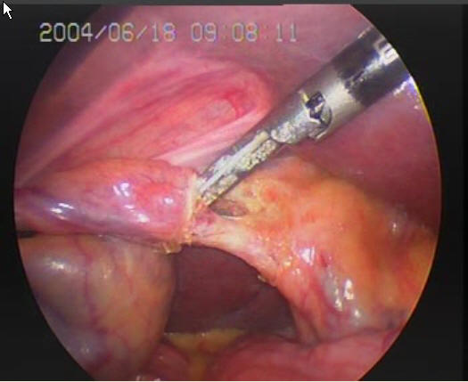
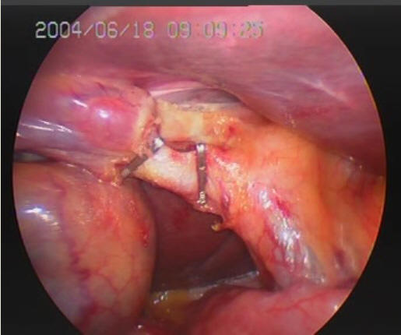
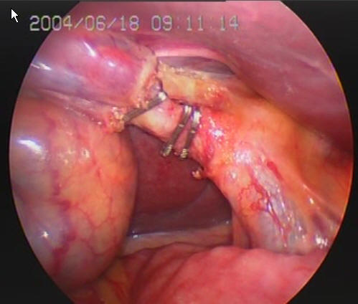
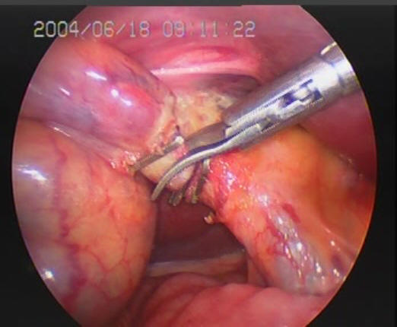
Dissecting Calot's triangle, severing cystic duct and cystic artery

Slide 18
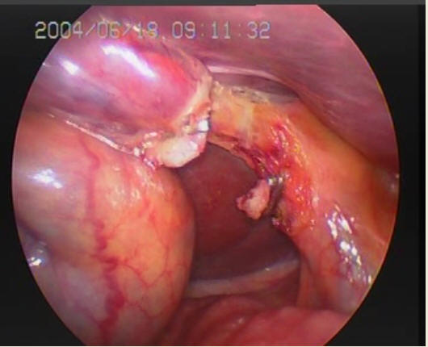
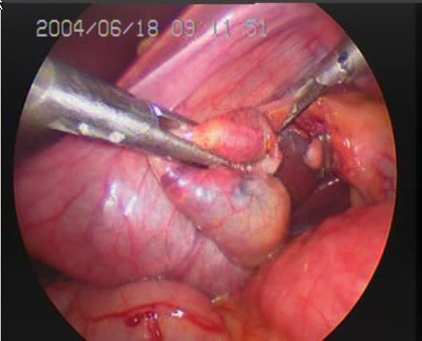
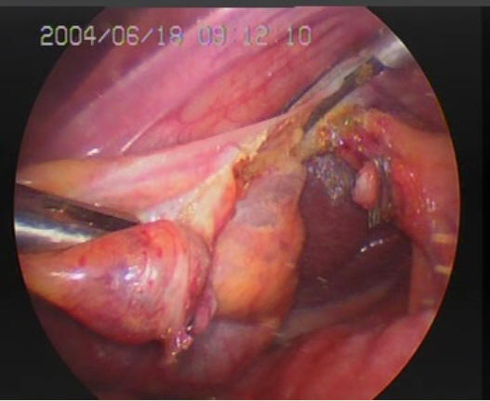
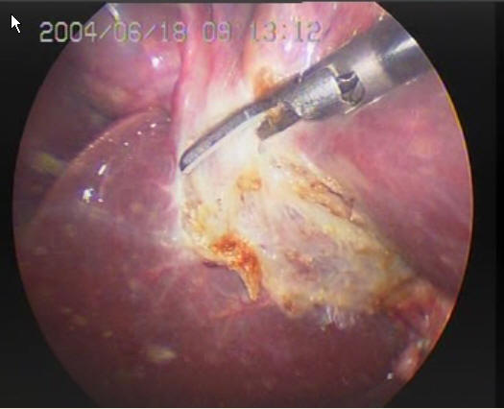
Dissecting and resection of gallbladder

Slide 19
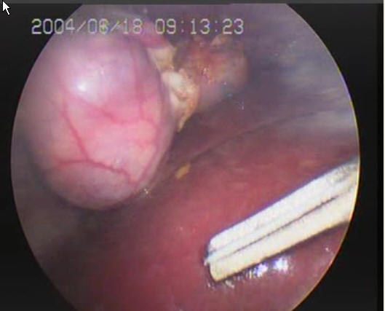
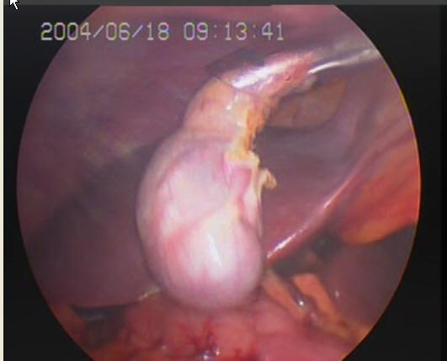
Taking out gallbladder

Slide 20
Conversion to open surgery
Types of
conversion
According to opportunity
immediately
postponed
According to reason
intended
forced

Slide 21
Reasons for conversion to open surgery
1. Complicated conditions of illness
2. Intraoperative complications that can not be dealt by laparoscopy
3. Preoperative missed diagnosis and misdiagnosis
4. Patient not being able to bear pneumoperitoneum
5. Malfunction of equipment that can not be repaired within a short time
6. Surgeons not being qualified for LC

Slide 22
Strategies that help to reduce conversion rates
1. Increase the training of basic laparoscopic skills
2. Controll the indications of laparoscopic surgery
3. Pay attention to preoperative diagnosis

Slide 23
Complications of LC
Bile duct injury and biliary leakage
Intraoperative and postoperative haemorrhage of cystic artery
Residual calculus of common bile duct
Other complications:
Titanic clip migration
Postcholecystectomy syndrome and residual calculus of cystic duct
Postoperative pseudoaneurysm of hepatic artery
Haemorrhage of biliary duct

Slide 24
Assessment of LC
1.Advantage
2.Disadvantage
3. Comprehensive assessment
LC vs OC
cost-effect analysis
risk- effect analysis
LC has become the golden standard for the treatment of benign lesions of gallbladder

Slide 25
THANK YOU

