Slide 1
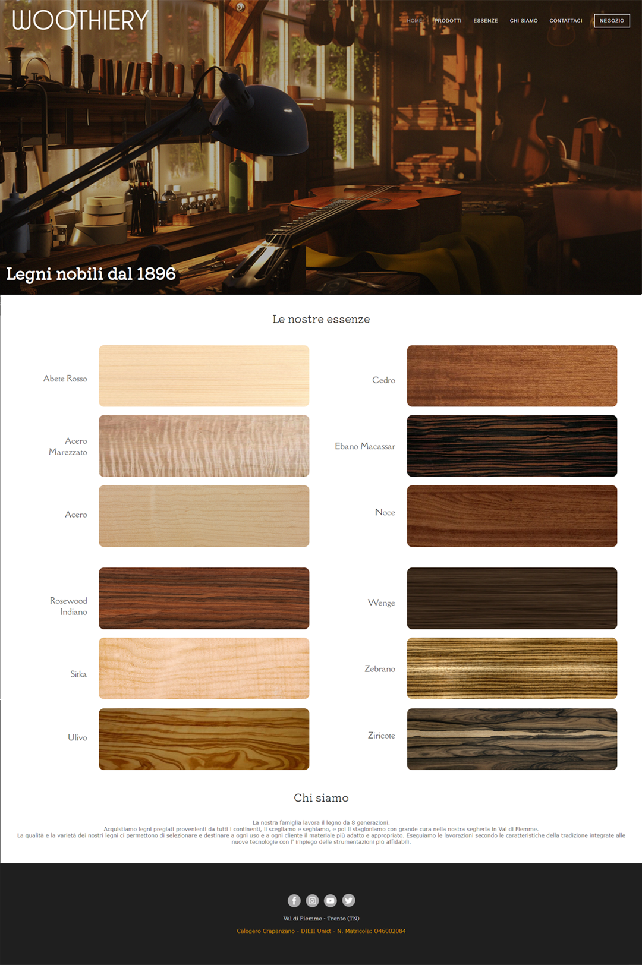
20 px
400 px
LAYOUT 1080p
15 px
30 px
870 px
30 px
1% <body>
2% <.imgessenze>
2% <.innerbox>
2% <.innerbox>
2% <.coupleinnerbox>
2% <body>
75 px
15 px

Slide 2

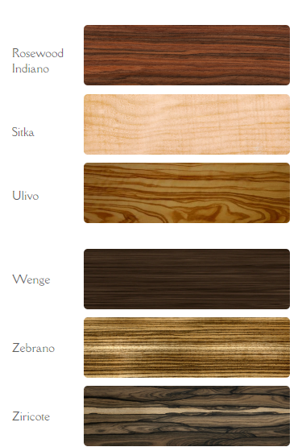
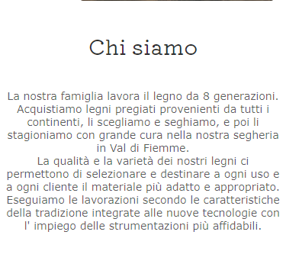
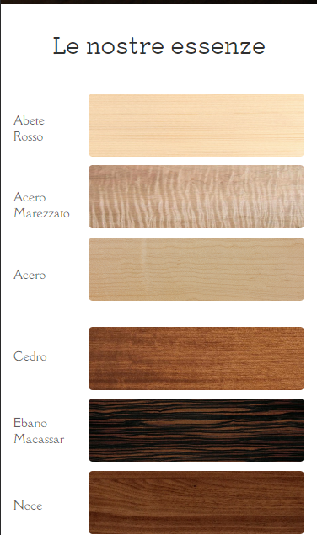
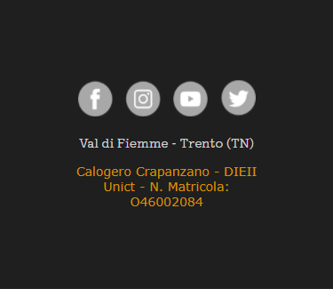
Variation LAYOUT Generic Smartphone
20 px
250 px
675 px
5 px

