Slide 2

Ansible
Basics and how to get started
Gerrit Van Mol
dag/maand/2022

Slide 3
Agenda
What is Ansible
Use cases
Inventory files
Playbooks, plays, tasks
Roles/handlers
Plugins/modules
Installation/run playbook
Authentication
Demo

Slide 4
What is Ansible
1

Slide 5
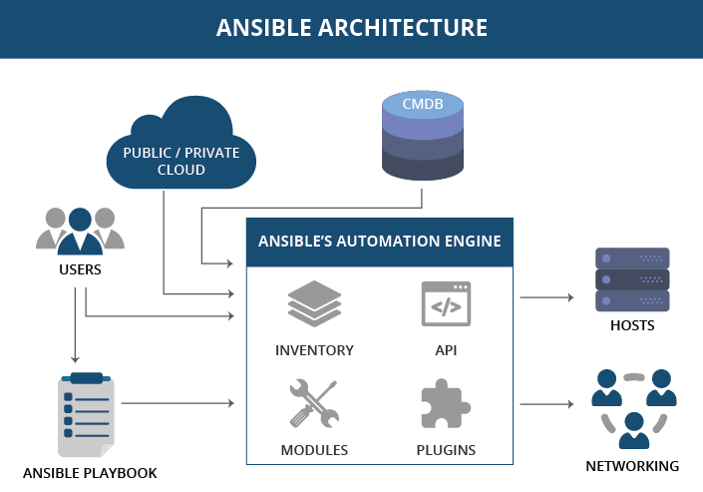

What is Ansible
Open source
Automation engine
Comparable to Chef and Puppet

Slide 6
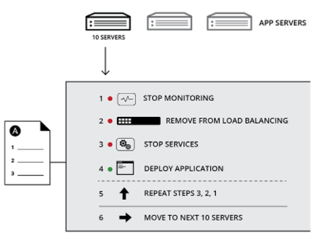
Use cases
For repettitive tasks;
Configuration
management
Deployment
Orchestration
Management

Slide 7
Ansible architecture
2

Slide 8
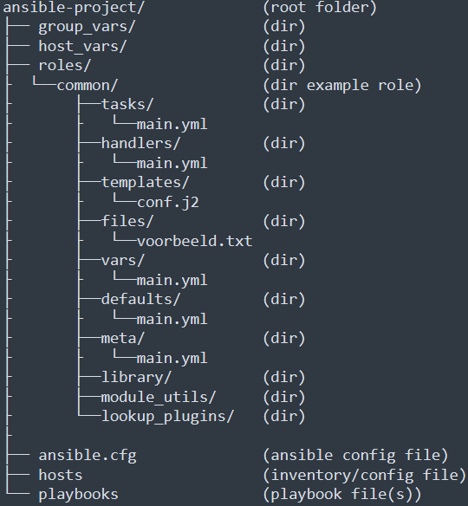
Ansible architecture
Most in portant files
Ansible.cfg
Hosts/inventory
Playbook.yml
What do they contain
Ansible.cfg = config
Hosts = List of nodes
Playbook = instructions to perform

Slide 9
Inventory files
3

Slide 10
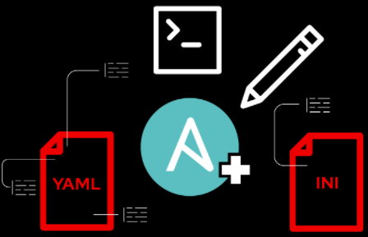
Inventory files
Runs against one/more/group of hosts
Located under “\etc\ansible\hosts”
Can create multiple host files (needs to be specified in .cfg)
Dynamically switch between host files with “-i <file-path>”
Inventrory/host files can be in INI format or YAML
Personal prefference

Slide 11
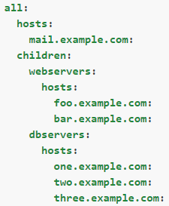
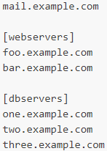
Inventory file formats
YAML
INI

Slide 12
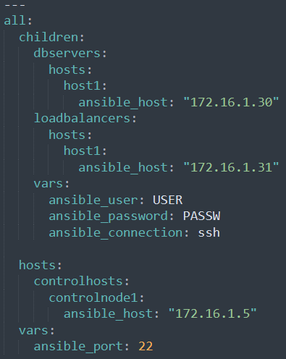
Inventory real world example

Slide 13
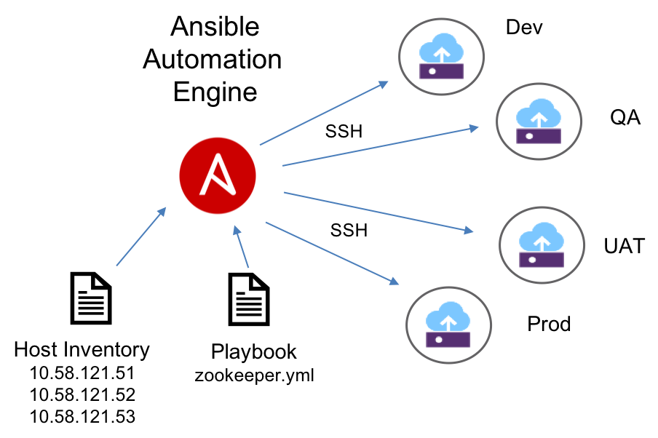

Slide 14
Refferences
- Figure Ansible Architecture: https://www.linkedin.com/pulse/how-industries-solving-challenges-using-ansible-shalini-rana

