Slide 2

Ansible
Basics and how to get started
Gerrit Van Mol
dag/maand/2022

Slide 3
Agenda
What is Ansible
Use cases
Inventory files
Playbooks, plays, tasks
Roles/handlers
Plugins/modules
Installation/run playbook
File encryption
Authentication
Demo

Slide 4
What is Ansible
1.

Slide 5



What is Ansible
Open source
Automation engine
Comparable to Chef and Puppet

Slide 6
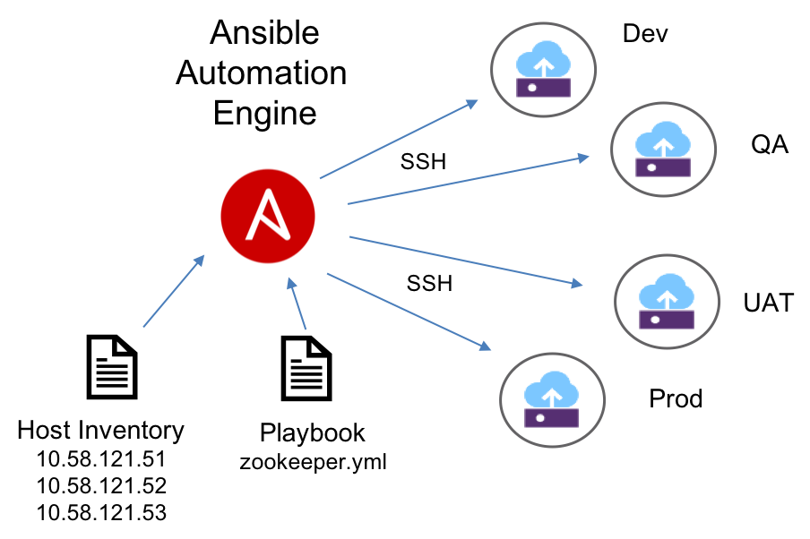
What is Ansible
Brief overview

Slide 7
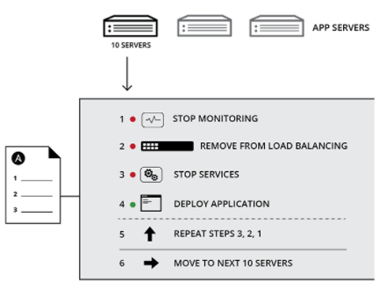
Use cases
For repetitive tasks;
Configuration
Deployment
Orchestration
Management
...

Slide 8
Ansible architecture
2.

Slide 9
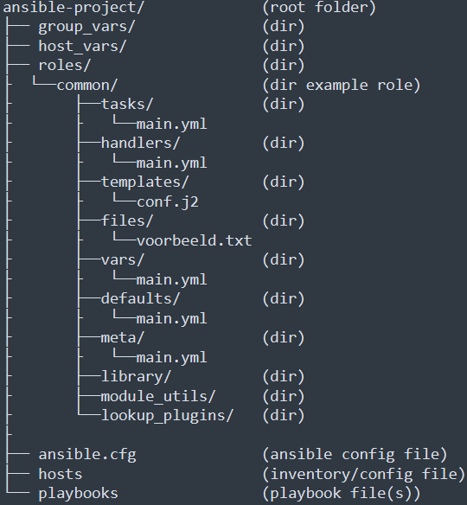
Ansible architecture
Most important files
Ansible.cfg
Hosts/inventory
Playbook.yml
What do they contain
Ansible.cfg = config
Hosts = List of nodes
Playbook = instructions to perform

Slide 10
Inventory files
3.

Slide 11
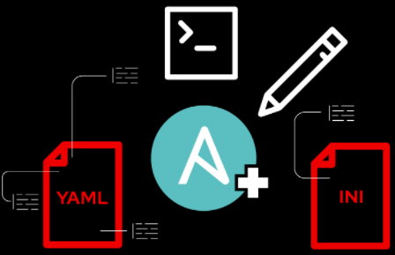
Inventory files
Runs against one/more/group of hosts
Located under “\etc\ansible\hosts”
Can create multiple host files (hosts file location needs to be specified in .cfg)
Dynamically switch between host files with “-i <file-path>”
Inventrory/host files can be in INI format or YAML
Personal prefference

Slide 12
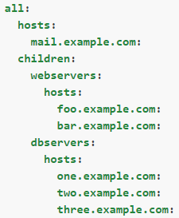
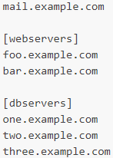
Inventory file formats
YAML
INI

Slide 13
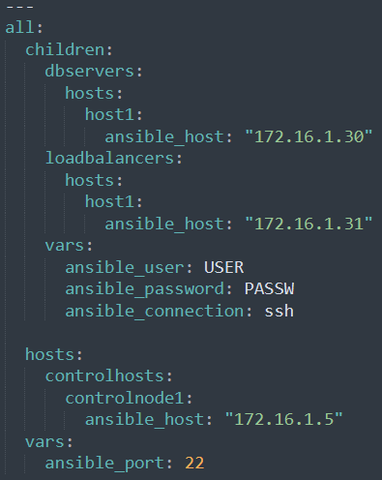
Inventory real world example - YAML
Start of YAML file
Group name
Group variables
Host/node adress
Common variable(s)
YAML indentation

Slide 14
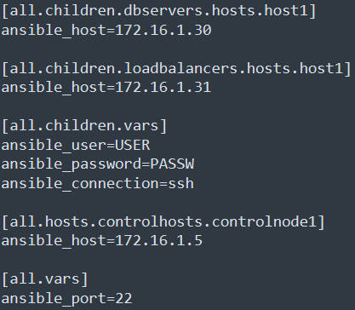
Inventory real world example - INI
Group name
Group variables
Host/node adress
Common variable(s)
No indentaion

Slide 15
Playbooks, plays and tasks
4.

Slide 16
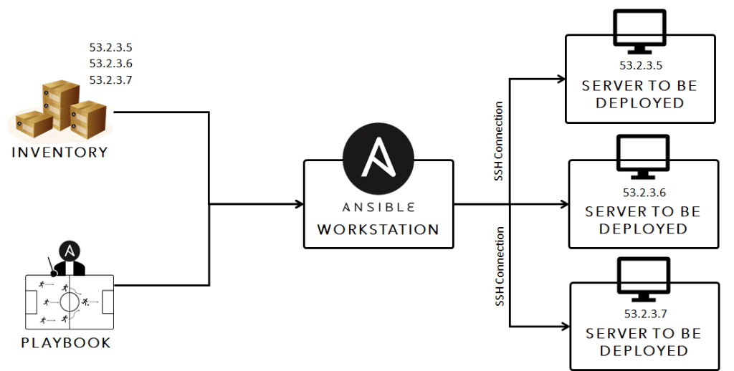
Playbooks
Highest order of hirarchy
Basically, list of plays
Comparable to organized script
Run against host (single host or group)
Contains one or more plays

Slide 17

Plays
Falls under playbook in hirarchy
Environment specific parameters (e.g., host OS)
Mapping between hosts using group or host name (correlates with inventory)
No such thing as a standard play
Contains one or more tasks

Slide 18

Tasks
Falls under play in hirarchy
Smallest unit of action
Executed same order as defined in playbook
Pushes small modules to target node
A task that runs on host define role that host fulfills/performs

Slide 19
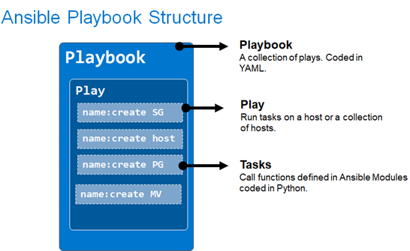
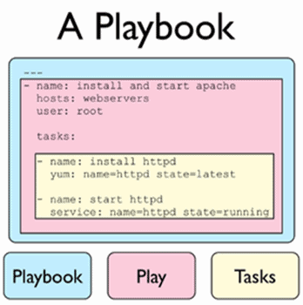
Playbook overview

Slide 20
Roles and handlers
5.

Slide 21
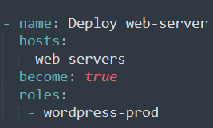
Roles
Hold specific parameters/variables for group of hosts
Separates and organizes groups
Defined in a play
(common)

Slide 22

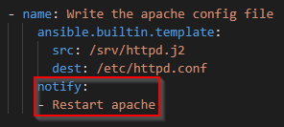
Handlers
Comparable to function/methods in programming
Only gets called when needed
Call handler with “notify: arguement”
Mostly used for system/service restart

Slide 23
Plugins and modules
6.

Slide 24
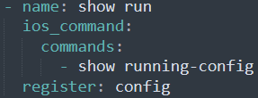
Modules
Keywords defined in task (calls Ansible API)
Reusable standalone scripts and execute on target node
Can take arguments
Displays json output after run
Interacts with target node

Slide 25
Plugins
Pieces of code that add to core functionality of Ansible
Complementary to module
Types of plugins:
Lookup plugins (pull data from source and returns to Ansible)
Caching plugins (store gathered facts for later use - e.g., Json file)
Action (performs prerequisite work, and runs part on ctrl-node)
Shell (Ensures basic commands are run properly by Ansible)
...

Slide 26
Intallation
7.

Slide 27
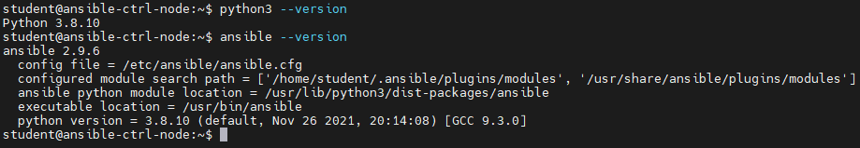
Ansible Installation
1. Update/upgrade the machine:
sudo apt-get update && upgrade -y
Pull Ansible repository:
sudo apt-add-repository ppa:ansible/Ansible
3. Install python:
sudo apt-get install python3 -y
4. Install Ansible:
sudo apt-get install ansible -y

Slide 28
File encryption
8.

Slide 29
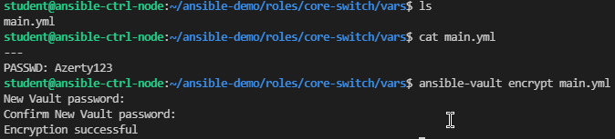
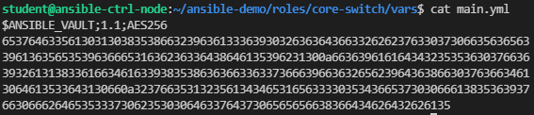
Encrypting existing files
For when file contains sensitive data
Command: ansible-vault encrypt filename

Slide 30
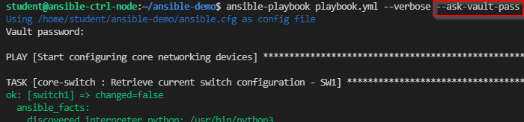
Run playbook with encrypted files
Command: ansible-playbook playbook.yml --verbose --ask-vault-pass

Slide 31
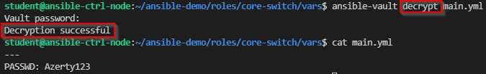
Decrypting files
Command: ansible-vault decrypt filename
No more vault password needed when running playbook

Slide 32
Authentication
9.

Slide 33
Passwordless authentication
Prevents repeatadly manual login at run time
Makes playbook execution seamless
Create an SSH-key: “ssh-keygen -t -rsa”
Copy the public key to remote machine:
“ssh-copy-id -i ~/.ssh/id_rsa.pub user@nodeIP”
3. Connect to machine (no login password should be required).

Slide 34
Template(s)
10.

Slide 35
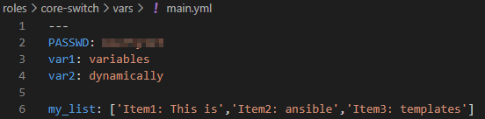

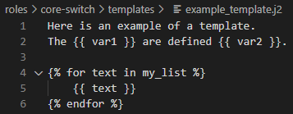
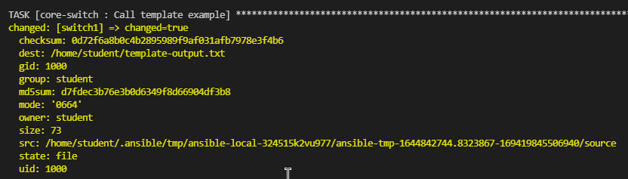
What is a template
Any kind of file
Script/configuration files with dynamic variables
Variables defined for host/role:
Task (call template file and specify dest):
Template (calls defined variables):
Properties of template output file during play execution:

Slide 36
Demo
11.

Slide 37
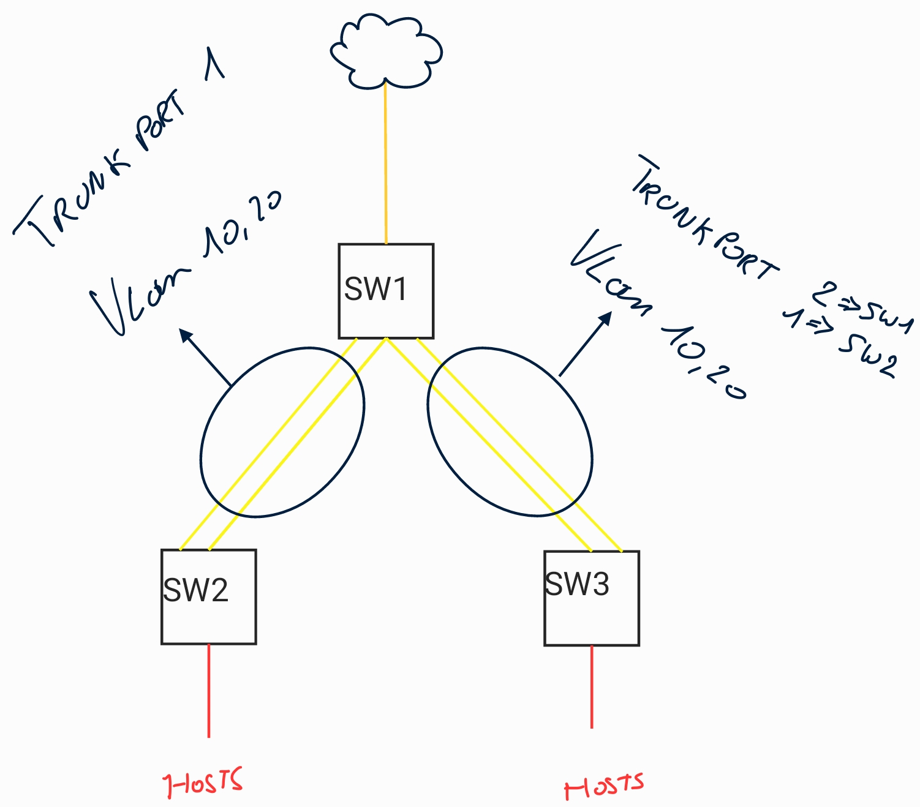
Topology
Purpose of playbook
Check starting configuration
Setup LAG on switches
Add vlan’s (10,20)
Check changes

Slide 38
Purpose of playbook

Slide 39
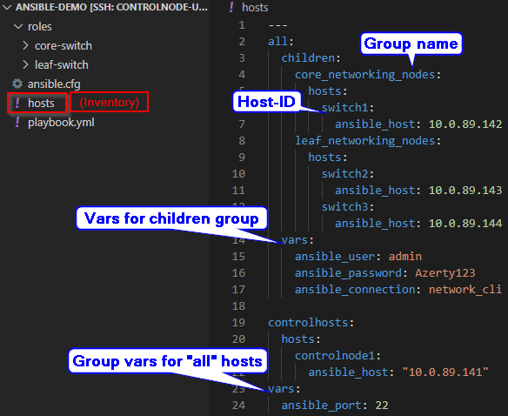
How are devices called upon
With use of the file/inventory file
Host-ID’s are for individual plays/tasks
Group name’s are for common plays
Variables are for groups or
individual hosts (caution for spacing!)

Slide 40
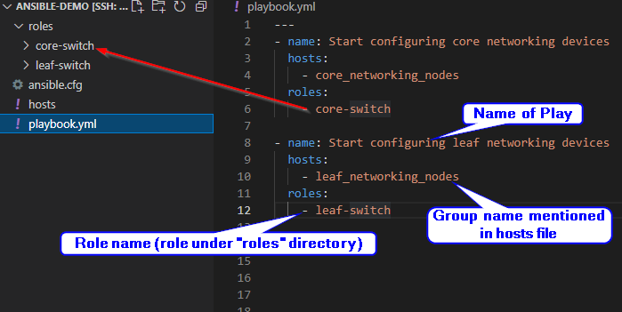
Connect hosts/groups to roles
Roles/groups are linked to each other in the playbook
Roles are linked to a group or host
(Which roles are specified under specific group are own choice)
Playbook can have different name than “playbook”

Slide 41
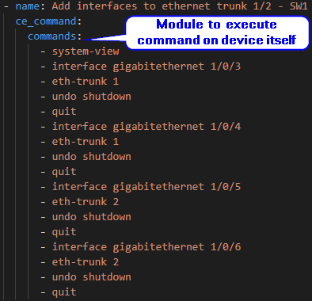
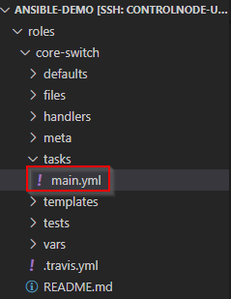
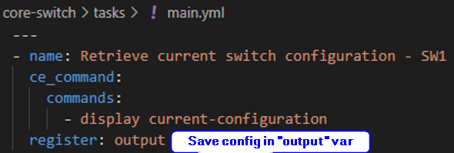
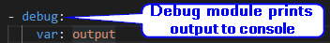
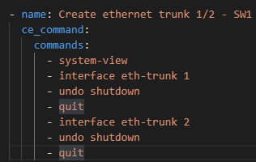
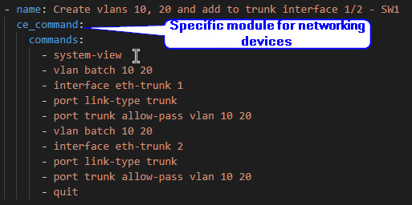
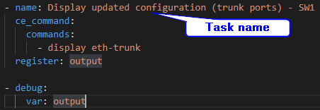
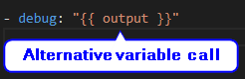
Tasks and used modules
Not in playbook.yml but in task/main.yml

Slide 42
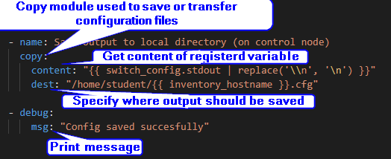
Tasks and used modules

Slide 43
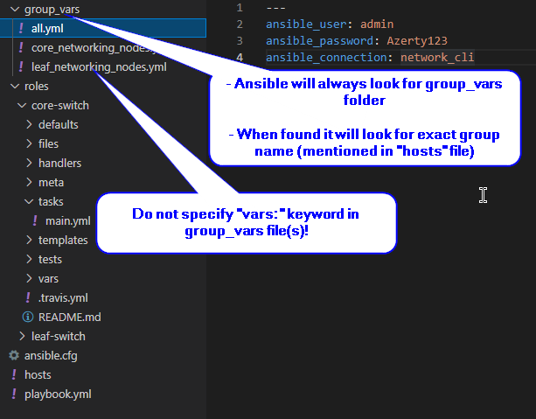
Group/role specific variables
Can be defined:
Under same group-indent (in hosts file) with “vars” keyword
Under vars/main.yml of role in “roles” directory
Under group_vars directory

Slide 44

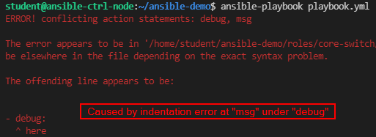
Run playbook
Start playbook with “ansible-playbook plabookName.yml”
Add “--check-syntax” to check playbook for syntax errors
Add “--verbose” to view live output when playbook runs (more for debugging)
Play recap shows quick overview of run playbook:
Play recap of legend:
Yellow = something changed (saved file in this case)
Green = everything is OK no errors occurred
Red = an error occurred (play stops once error occurs):

Slide 45
Refferences
See Ansible paper:
https://www.newupdate.be/wp-content/uploads/2021/11/PaperAnsible_gerritvanmol.pdf

