Slide 2

Ansible
Basics and how to get started
Gerrit Van Mol
dag/maand/2022

Slide 3
Agenda
What is Ansible
Use cases
Inventory files
Playbooks, plays, tasks
Roles/handlers
Plugins/modules
Installation/run playbook
Authentication
Demo

Slide 4
What is Ansible
1

Slide 5
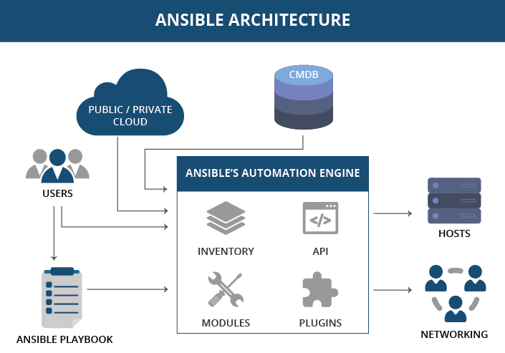
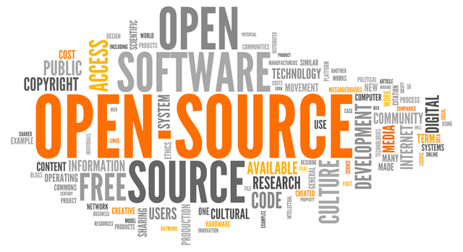
What is Ansible
Open source
Automation engine
Comparable to Chef and Puppet

Slide 6
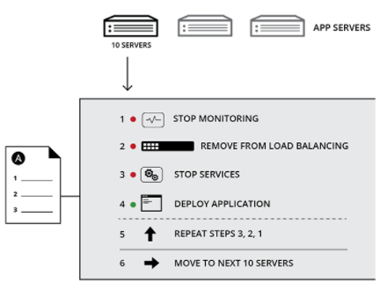
What is Ansible
For repettitive tasks;
Configuration
management
Deployment
Orchestration
Management

Slide 7
Ansible architecture
2

Slide 9
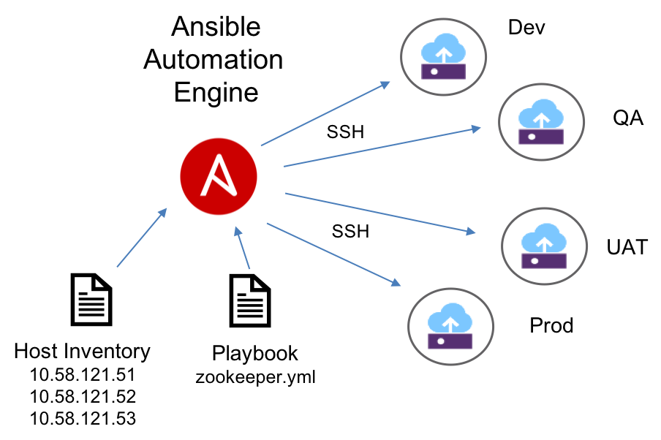

Slide 10
Refferences
- Figure Ansible Architecture: https://www.linkedin.com/pulse/how-industries-solving-challenges-using-ansible-shalini-rana

