Slide 1
VC80Turbo pta report after Power Outage
3 JUL. 2025 | AERP-25-083
PRJ:IS99
Turbo Model: GT4082DL
Ref. Report: Post Test Analysis Report PTA-25-00930
Ref No.: AERP-25-083

Slide 2
IS99 GT40WG Field Sample Unit for LNG Vehicle
Purpose
Standard analysis for collected Sample from the field. No issues on vehicle performance. Note vehicle uses gasified LNG fuel.
Turbo Specification
Isuzu Part Number： 8984842500
Garrett Part Number： 834117-0059
S/N： UJ0101J
Mileage: 370,953 kms
Test Condition & Investigation Requirements
Collected unit long millage sample from field. Investigation per SC0-A25-016.
Conclusion
This turbo was functional with the following findings:
ACT Calibration was 581 mmHg @ 1.0mm. spec minimum is 592 mmHg in new condition.
Turbine housing assy; The WG internal leak was 2031 L/h @ 50kPa, 4038 L/h @ 100kPa. The flatness of the WG port and poppet was within the drawing specifications.
CHRA component parts; The turbine side piston rings had wear, but no other components had any remarkable problems.
WG components; The arm shaft and Bushing had wear and the crank welding angle was outside the drawing specifications.
Overall, the shaft bushing wear did not cause loss of performance. Standard analysis for collected Sample from the field. No issues on vehicle performance. Note vehicle uses gasified LNG fuel.
Reference
PTA-25-082 (1st Unit)
Notes
Unless otherwise requested, parts will be disposed after one year.
Notes:
Body text: use “Indent More” “Indent Less” to control levels. Bullets are added automatically according to the levels.

Slide 3
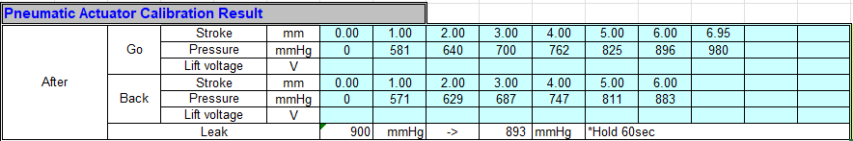
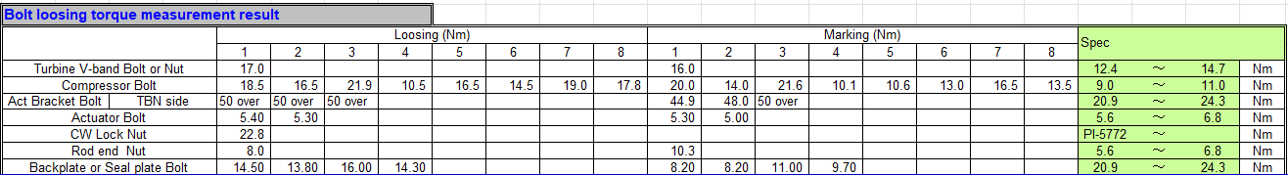

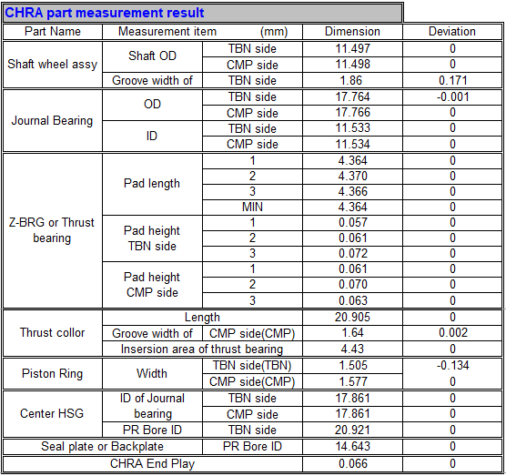
IS99 GT40WG Field Sample Unit for LNG Vehicle
1.Actuator Calibration
2.Torque Check
3.Leak Check
4. CHRA measurements
Notes:
Body text: use “Indent More” “Indent Less” to control levels. Bullets are added automatically according to the levels.

Slide 4
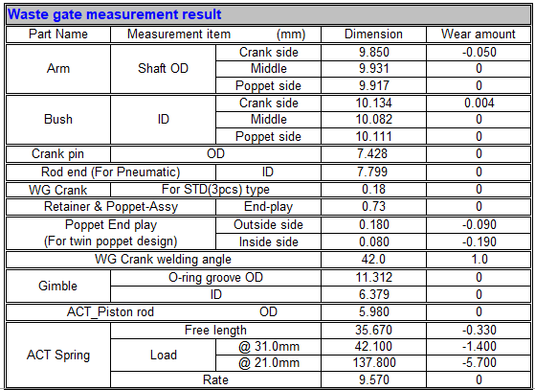


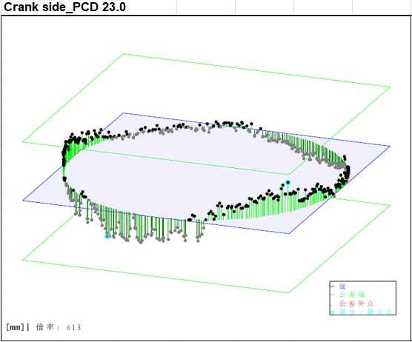
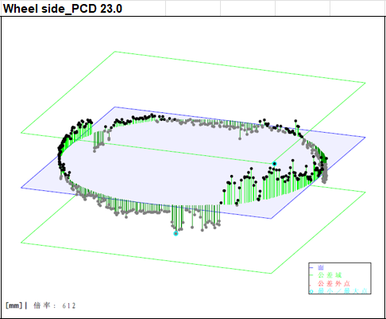
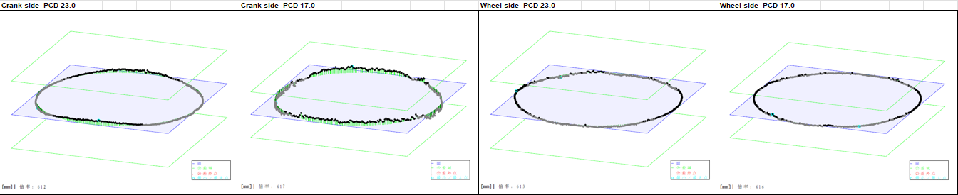
IS99 GT40WG Field Sample Unit for LNG Vehicle
5. WG measurements
6. Poppet and turbine housing WG seat flatness
Notes:
Body text: use “Indent More” “Indent Less” to control levels. Bullets are added automatically according to the levels.

Slide 5
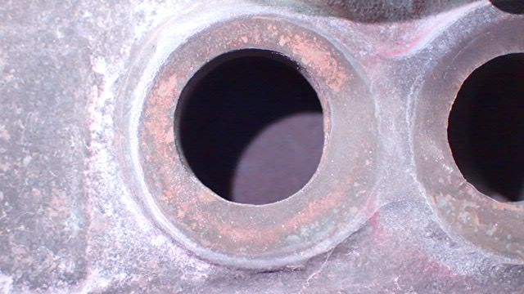
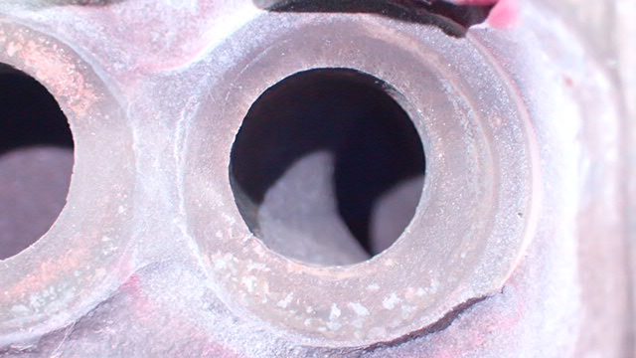
IS99 GT40WG Field Sample Unit for LNG Vehicle
7.Wastegate Crack check
No visible cracks on WG ports.
Leak rate was around the same as unit with crack (AERP-25-082).
Notes:
Body text: use “Indent More” “Indent Less” to control levels. Bullets are added automatically according to the levels.

Slide 6
IS99 GT40WG Field Sample Unit for LNG Vehicle
8. Other components
Refer to attached photo report for details for other components.
No remarkable issues were found. Refer to AERP-25-082 also for 1st unit with WG crack
Notes:
Body text: use “Indent More” “Indent Less” to control levels. Bullets are added automatically according to the levels.

Slide 8

Slide 1
This is the content of slide 1.

Slide 9
Slide 2
This is the content of slide 2.
Bullet point 1
Bullet point 2

Slide 10
Slide 3
This is the content of slide 3.

Slide 11
Slide 4
This is the content of slide 4.
Numbered item 1
Numbered item 2

