Slide 1
EPITOPE PREDICTION FOR VACCINE DEVELOPMENT
KATIKALA DEDEEPYA CB.SC.U4AIE23349
GESHNA B CB.SC.U4AIE2360
MALAVIKA S PRASAD CB.SC.U4AIE23315
VADA GOURI HANSIKA REDDY CB.SC.U4AIE23304

Slide 2
Overview
Epitopes are short regions on antigens that trigger immune responses.
Aim:
Predict whether a peptide is an epitope and rank the predicted epitopes.
Why It Matters:
Identifying promising epitopes speeds up vaccine discovery, reduces experimental costs, and improves immunogenic targeting.
Idea:
Utilize ML and DL models for efficient predictions
Enhances prediction through:
Graph-based modeling of protein-peptide interactions
MinHashing for fast peptide similarity detection
Trie-based motif matching for quick sequence lookups
Models:
ML: Random Forest, XGBoost, LightGBM, GaussianNB, CatBoost
DL: LSTM, FNN
Final goal: A user-friendly web platform to identify and rank biologically significant epitopes for vaccine development.

Slide 3
Dataset Overview
1. input_bcell.csv — Primary Training Dataset
Size: 14,387 rows (14,362 peptides + 757 proteins).
Content: Peptide and protein feature data for training the model.
Peptide Features:
Start & end positions in protein
Peptide sequence
Physicochemical properties (e.g., hydrophobicity, stability, antigenicity)
Usage in Project:
Main training data for ML models.
Used to learn patterns of known epitopes.
Serves as foundation for feature selection and model benchmarking.
2. input_sars.csv — Supplementary Training Dataset
Size: 520 rows (peptide sequences related to SARS virus).
Features: Similar to input_bcell.csv (e.g., sequence, structural scores).
️ Usage in Project:
Augments training set with virus-specific information.
Improves generalization of models across different pathogens.

Slide 4
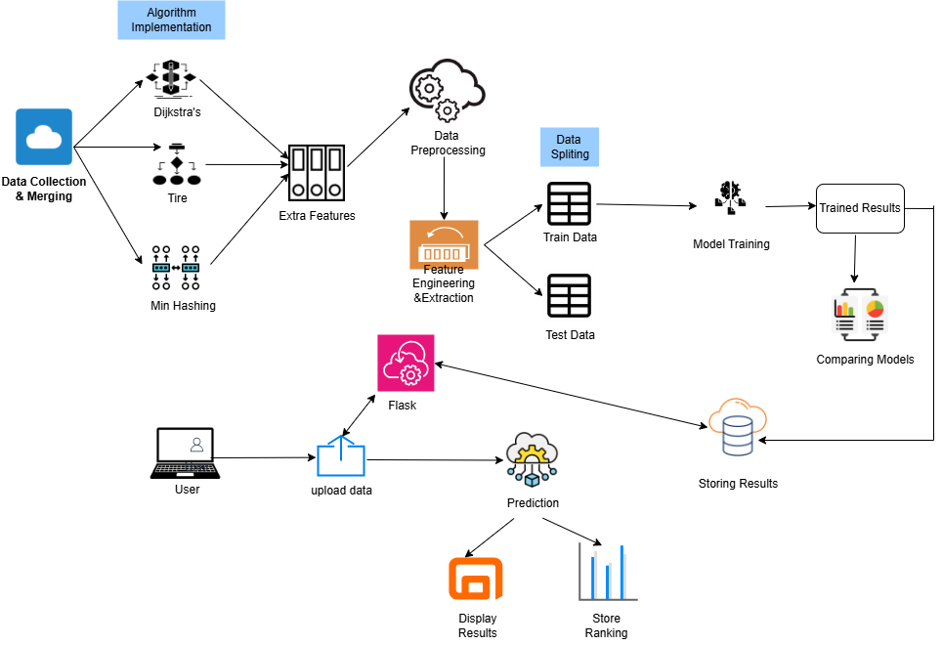
SYSTEM ARCHITECTURE

Slide 5
MinHashing
MinHashing is a probabilistic technique used to estimate the Jaccard Similarity between two sets efficiently. It creates hash signatures of sequences, allowing fast similarity computations.
Why Is t Used In Our Project?
To efficiently detect similar peptides without full pairwise comparison — speeds up similarity-based epitope filtering
How It Works?
Convert each peptide into a set of k-mers
Apply multiple hash functions to each set.
For each hash function, pick the minimum hash value → this forms a signature.
Compare signatures of two peptides → more overlap = higher similarity.
Example:
Peptide 1: "CGTAG" → 3-mers = {CGT, GTA, TAG}
Peptide 2: "GTAGC" → 3-mers = {GTA, TAG, AGC}

Slide 6
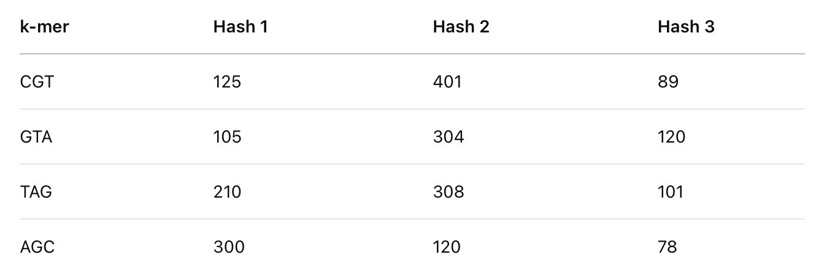
For each 3-mer, we compute 3 hash values:
MinHash Signatures:
Peptide 1 ({CGT, GTA, TAG}): → Min(Hash 1) = 105, Min(Hash 2) = 304, Min(Hash 3) = 89 → Signature = (105, 304, 89)
Peptide 2 ({GTA, TAG, AGC}): → Min(Hash 1) = 105, Min(Hash 2) = 120, Min(Hash 3) = 78 → Signature = (105, 120, 78)
Similarity Estimate:
Estimated Jaccard Similarity = 1/3 = 0.33

Slide 7
PSEUDOCODE
Input:
Peptide dataset with a 'peptide_seq' column
Initialize MinHasher with a fixed number of hash functions (50):
For each peptide sequence in the dataset:
Break the sequence into 3-mer shingles
For each shingle:
Hash it using all hash functions
For each hash function:
Find the minimum hash value across all shingles → this forms the MinHash signature
Store the MinHash signature for the peptide
Add a new column minhash_signature to the DataFrame to store these signatures.
Compare Jaccard similarity of MinHash signatures between pairs of peptides
Form a similarity matrix (N × N)
Save this matrix to a CSV

Slide 8
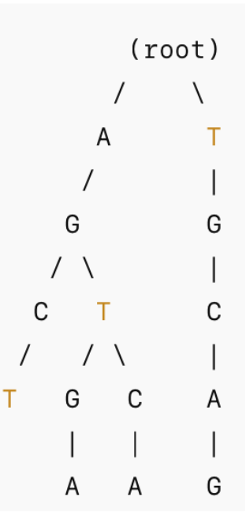
Trie Data structure
What is a Trie?
A tree-based data structure used for fast pattern matching and sequence retrieval.
How It Works?
Stores sequences character by character in a hierarchical structure.
Traversing from the root to a leaf forms a complete sequence.
Enables fast exact matches and motif searches.
Example "AGCT", "AGTGA", "AGTCA", "TGCAG"
Why Use Trie in Our Project?
Efficient Epitope Motif Matching – Quickly finds known B-cell epitope motifs in peptides.
Fast Similarity Searches – Identifies peptides containing motifs with minimal computation.
Feature Extraction for ML Models – Presence of motifs is added as a feature for epitope prediction.

Slide 9
PSEUDOCODE
Normalize all sequences (strip, uppercase, convert to string).
Insert all peptide sequences into the Trie.
Perform automatic analysis
For each peptide:
Check for exact match in Trie.
Check if motif (peptide itself) appears as a subsequence in any other peptide.
Load dataset (CSV file) containing peptide sequences.
Define TrieNode class:
Store children in a dictionary.
Use a flag to mark the end of a sequence.
Define EpitopeTrie class:
Initialize the root TrieNode.
Insert sequences:
For each character in the sequence:
If not in children, add a new TrieNode.
Move to the next node.
Mark the final node as the end of the sequence.
Search for exact sequence:
Traverse the Trie character by character.
If all characters are found and last node is marked as end → return True.
Search for motif (subsequence):
Check if the motif exists as a substring in any peptide in the dataset.
Store and display results:
Save new features (Exact Match Exists, Appears as Subsequence) into the dataset.
Export as CSV.

Slide 10
Dijkstra’s Algorithm
A shortest path algorithm that finds the minimum-cost route between two nodes in a weighted graph.
A path = a sequence of nodes (proteins and peptides) connected by edges.
Graph Components:
Nodes = Entities like peptides and proteins
Edges = Connections between nodes
Protein–Peptide: based on interaction
Protein–Protein: if they share a common peptide
Weight = Protein–Peptide = Antigenicity Score
Protein–Protein = 1 (shared peptide)
Example:
Given Interactions:
Protein A — Peptide P1 → Antigenicity: 0.9
Protein A — Peptide P2 → Antigenicity: 0.7
Peptide P1 — Protein B → Antigenicity: 0.85
Peptide P2 — Protein C → Antigenicity: 0.6
Protein C — Protein B → Common peptide → Weight = 1
Paths from A to B:
A → P1 → B = 0.9 + 0.85 = 1.75
A → P2 → C → B = 0.7 + 0.6 + 1 = 2.3
Shortest Path (Lowest Total Weight):
A → P1 → B (Total = 1.75)

Slide 11
PSEUDOCODE
Create an empty graph G
Add all proteins as nodes in G
Add all peptides as nodes in G
For each (Protein, Peptide) interaction in the dataset:
Add an edge between Protein and Peptide
Assign weight = antigenicity score
For each peptide that connects multiple proteins:
Connect those proteins with an edge (weight = 1)
Select a source protein and a target protein
If a path exists between source and target:
Run Dijkstra’s Algorithm (using antigenicity as edge weight)
Print the shortest path
Else:
Print "No path found"
8) Visualize the graph with proteins and peptides in different colors

Slide 12
PSEUDOCODE
For Most Similar peptide
Input: A dataset containing peptide sequences (peptide_seq) including MinHashing and Trie features
Build a graph using peptide similarity (based on 3-mers):
Treat each peptide as a node in the graph
For each peptide: - Break it into all 3-letter substrings (3-mers) - Store which peptides share each 3-mer
For each 3-mer group: - Compare all pairs of peptides in that group - If similarity is ≥ 0.3, connect them with an edge - More similar = lower edge weight
Run Dijkstra’s algorithm:
For each peptide, compute the shortest path to all others
Find the closest peptide for each one:
Choose the nearest neighbor (excluding itself)
Store the peptide and the path distance
Add results to the dataset and save as a new CSV file

Slide 13
ML MODELS ​
Gaussian Naive Bayes (GNB)
Why "Naïve"?
It naively assumes all features are independent given the class.
Example: Hydrophobicity and antigenicity are treated as unrelated, even though they might be related in reality.
Usefulness:
Simple, interpretable model.
Effective with small-scale epitope datasets.
Fast classification for initial filtering.
Implementation:
Assumes feature independence (e.g., charge & antigenicity).
Estimates Gaussian distribution for each class.
Calculates posterior probabilities.

Slide 14

Random Forest (RF)
What is Random Forest?
It is commonly used for classification and regression tasks, particularly in biological data analysis.
Helps reduce overfitting by averaging the predictions from multiple decision trees.
Works well with high-dimensional data, such as peptide sequences used in epitope prediction.
How It Works in Our Project
Bootstrap Sampling (Data Splitting)
Decision Tree Training
Majority Voting for Classification
Handling Biological Data Challenges
Robust Against Overfitting: Averaging multiple trees prevents overfitting to specific data patterns.
Feature Importance Analysis: Helps identify which peptide properties (e.g., hydrophobicity, charge, antigenicity) are most critical in epitope prediction.
Handles Noisy & Imbalanced Data Well: Works well even when some peptides have missing or incorrect values.

Slide 15
CatBoost (Categorical Boosting)
CatBoost (Categorical Boosting) is a gradient boosting algorithm designed to handle categorical features efficiently.
How it Works
Uses ordered boosting, which prevents target leakage during training.
Converts categorical features into numerical representations using embeddings.
Handles Categorical Data: Useful for protein IDs, peptide sequences, and motif patterns.
Less Overfitting: Reduces the risk of overfitting compared to other gradient boosting models.
Great for Small Datasets: Works well even with limited training data.

Slide 16
LightGBM (LGBM)
What is LightGBM?
Unlike Random Forest, which averages multiple independent trees, LightGBM uses gradient boosting to correct errors from previous trees.
It is designed to handle large datasets efficiently, making it useful for epitope prediction with large numbers of peptides.
How It Works in Our Project
Gradient-Based One-Side Sampling (GOSS)
Leaf-Wise Tree Growth (Instead of Level-Wise)
Histogram-Based Learning
Automatic Feature Selection
Higher Accuracy: Boosting corrects errors from previous trees, making it more accurate than Random Forest.
Less Overfitting Compared to Traditional Boosting Methods: Learns efficiently while preventing overfitting to training data.

Slide 17
XGBoost
Usefulness:
High accuracy and efficiency.
Learns complex relations in peptide features.
Uses regularization to prevent overfitting.
Implementation:
Builds trees sequentially (each fixes previous errors).
Applies L1/L2 regularization to reduce model complexity.
Generates feature importance charts.
Objective function with regularization:

Slide 18
DEEP LEARNING MODELS
Capture complex, non-linear patterns in the data.
Automatically learn feature interactions that might be missed by traditional models.
Improve prediction accuracy, especially on large and high-dimensional biological data.
1. Feedforward Neural Network (FNN)
Basic architecture of DL; input flows forward through layers. Consists of:
Input layer (peptide & protein features)
1 or more hidden layers (ReLU activation)
Output layer (Sigmoid for binary classification)
Learns patterns in static features (e.g., hydrophobicity, isoelectric point).
Does not consider sequence order.

Slide 19
FNN Workflow
Input: Feature vector for each peptide.
Layers:
Input layer
Hidden layer(for regularization)+Relu(activation function)
Output layer+ Sigmoid
Output: Probability of being an epitope (0 to 1).
2. Long Short-Term Memory (LSTM)
Specialized RNN designed to handle sequential data (like peptides).
Remembers both short-term and long-term dependencies.
Learns motifs and patterns from amino acid sequences.
Ideal for ordered peptide information.

Slide 20



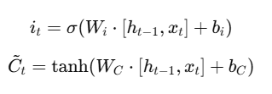
LSTM Architecture
Inputs: One amino acid at a time (embedded vector)
Internal components:
Forget Gate: decides what to forget
Input Gate: decides what to learn
Cell State: carries long-term memory
Output Gate: what to output
Final hidden state → used for prediction

Slide 21
Ranking Predicted Epitopes
Why Ranking Is Important
Not all predicted epitopes are equally effective
Helps prioritize the best candidates for vaccine development
Biological Features Used
Kolaskar–Tongaonkar (Antigenicity)
Emini (Surface Accessibility)
Parker (Hydrophobicity)
Epitope Score = 0.5 × Antigenicity
+ 0.3 × Accessibility
+ 0.2 × Hydrophobicity
How Ranking Is Done
Filter peptides with prediction = 1
Normalize feature values
Compute composite score
Sort peptides by score (descending)

Slide 22
Web Application Overview
Purpose of the Web App
Provide a user-friendly platform for epitope prediction
Allow researchers to upload sequences and get instant predictions
Automate ranking and scoring for vaccine prioritization
Key Features
File upload for peptide sequences (CSV format)
Model selection dropdown (CatBoost, LSTM, etc.)
Instant epitope prediction (Label: 1 = epitope, 0 = non-epitope)
Ranking of predicted epitopes based on biological scores
Downloadable result files (predictions + ranked list)
Visualization: bar graph of top-ranked peptides

Slide 23
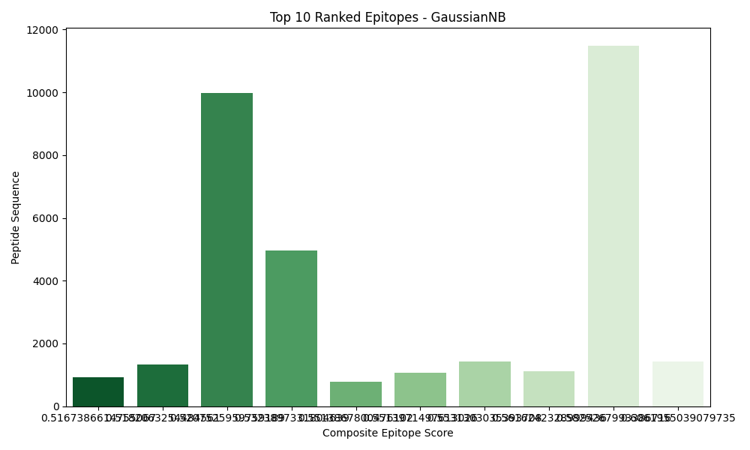
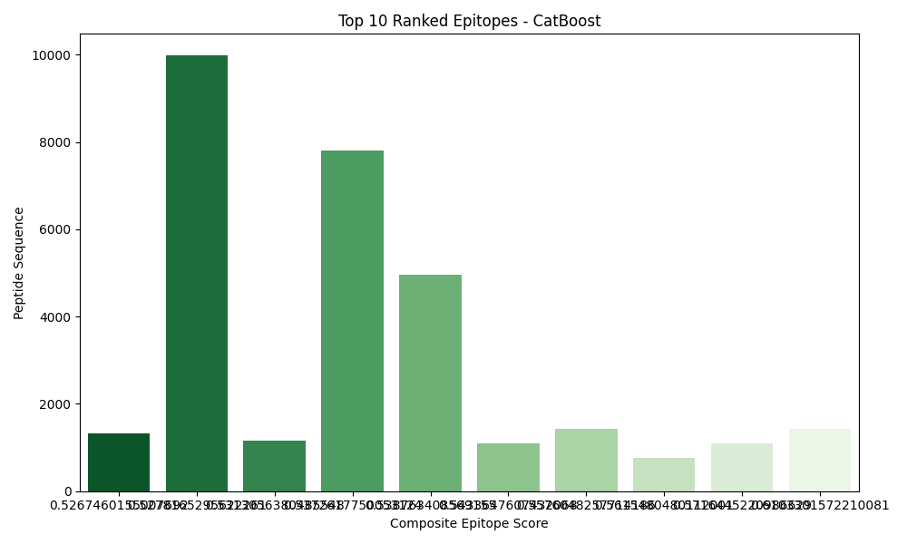
Results

Slide 24
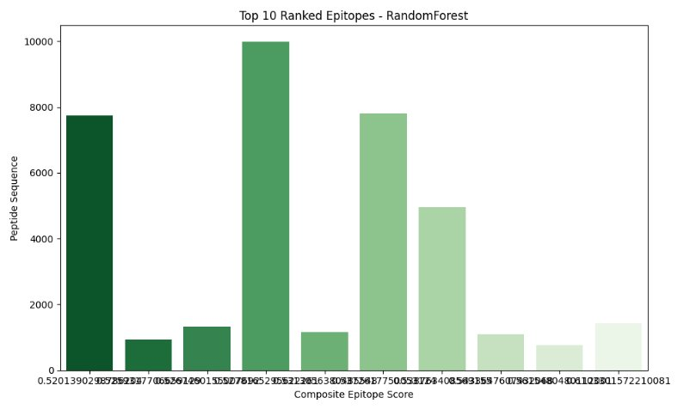

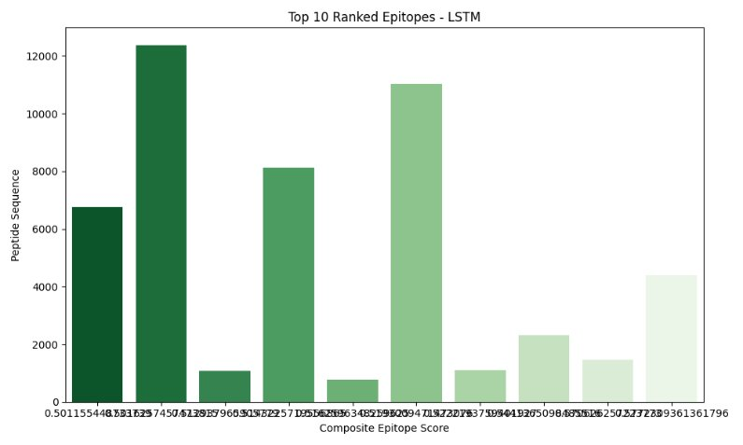

Slide 25
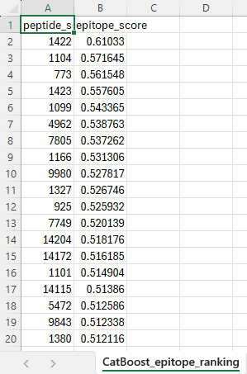
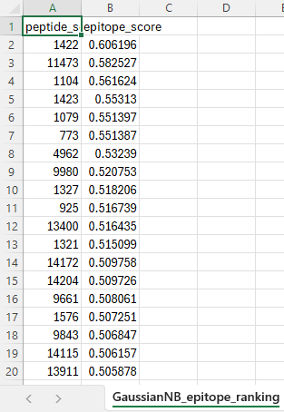
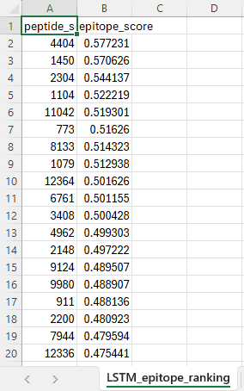
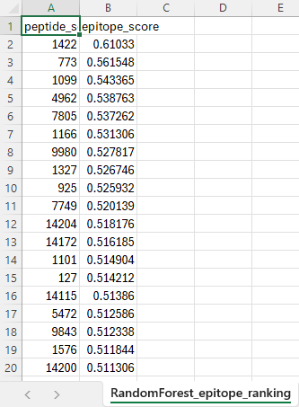

Slide 26
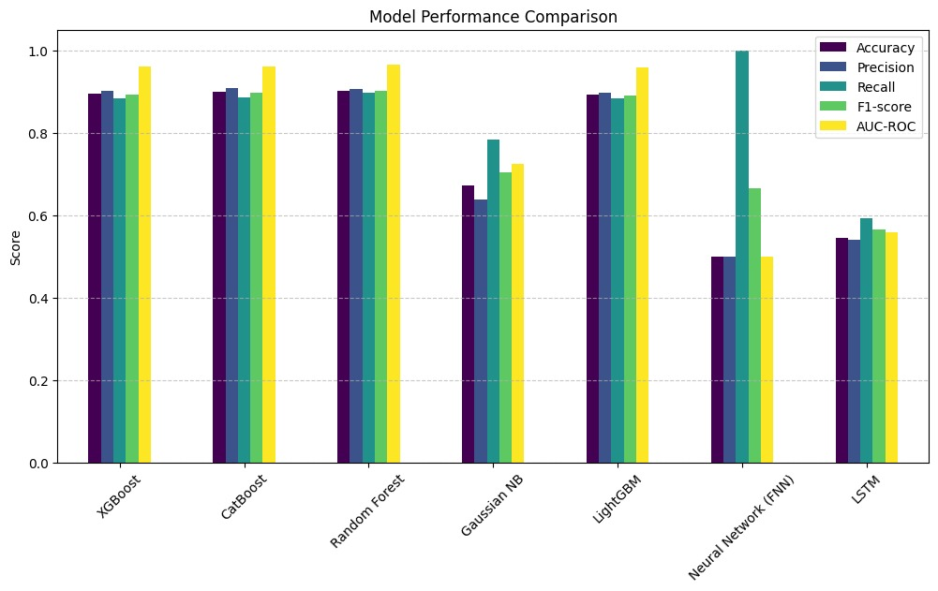

Slide 27
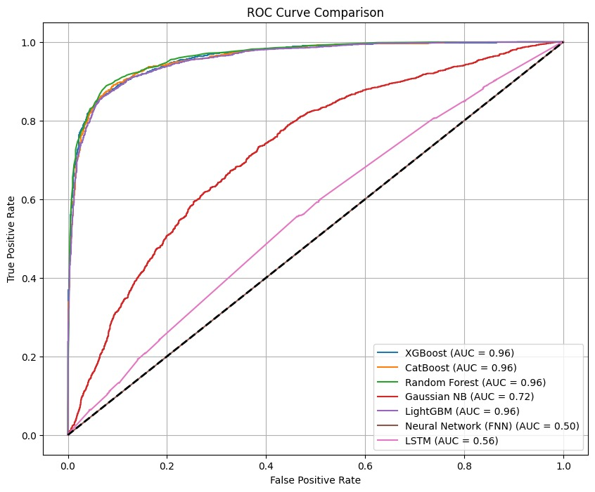

Slide 28
Live demo
Thankyou !

