Slide 1
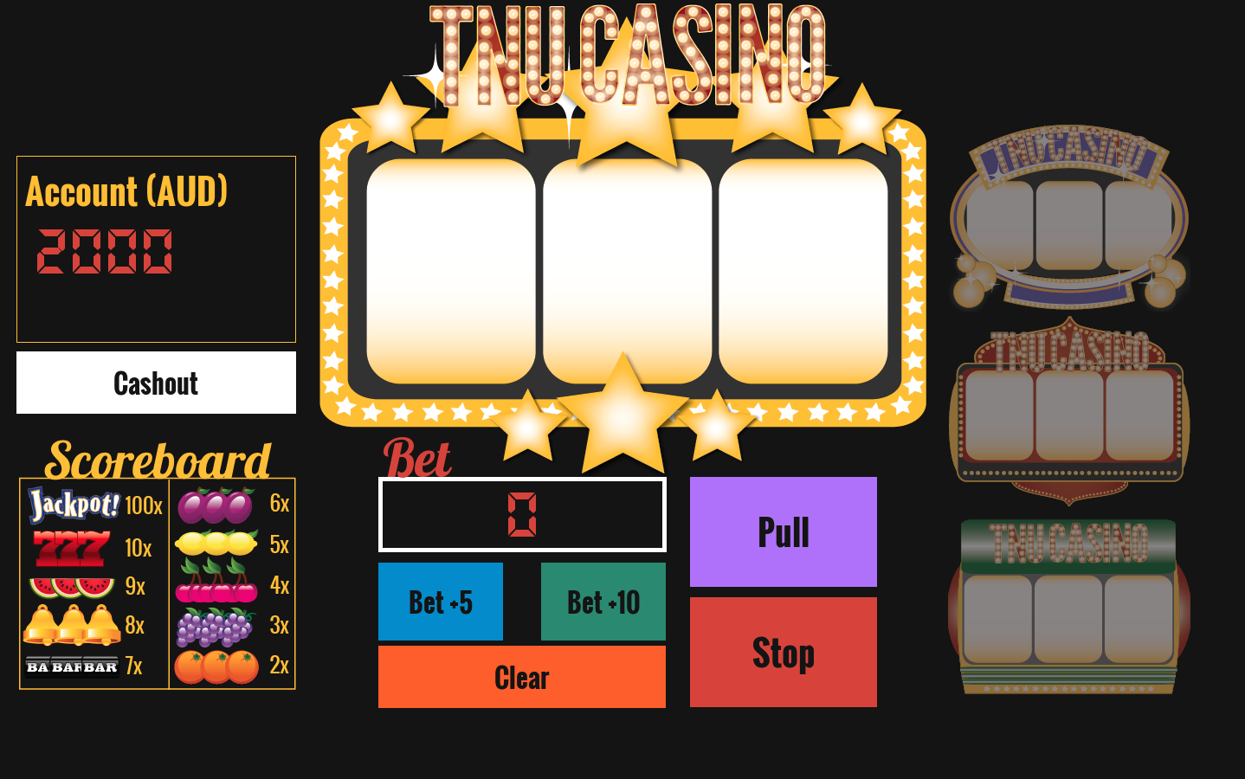
Instructions
Welcome to the TNU Casino. In this task, you will play a virtual slot machine in a virtual casino. You are given 2000 AUD to bet, and can increase your bet size, change machines, pull and stop the wheels of the machine, and “cashout” of the casino on a given “day”. When you cash out, you will be brought back to the casino and will start a new gambling day, with the same account balance as when you cashed out. Here is a description of features in the slot machine screen.
Change machines if and when you choose throughout the game
Displayed here is the total amount of money in your account
This button allows you to cash out of the casino and return the next “day”.
The scoreboard tells you how much each sequence is worth
Add as much money to your bet as you’d like, in increments of $5 and $10. Press clear to delete your additions.
Press pull to spin the wheels and stop to stop the wheels and see the result. The wheels will stop on their own if stop is not pressed.
Good luck!

