Slide 1


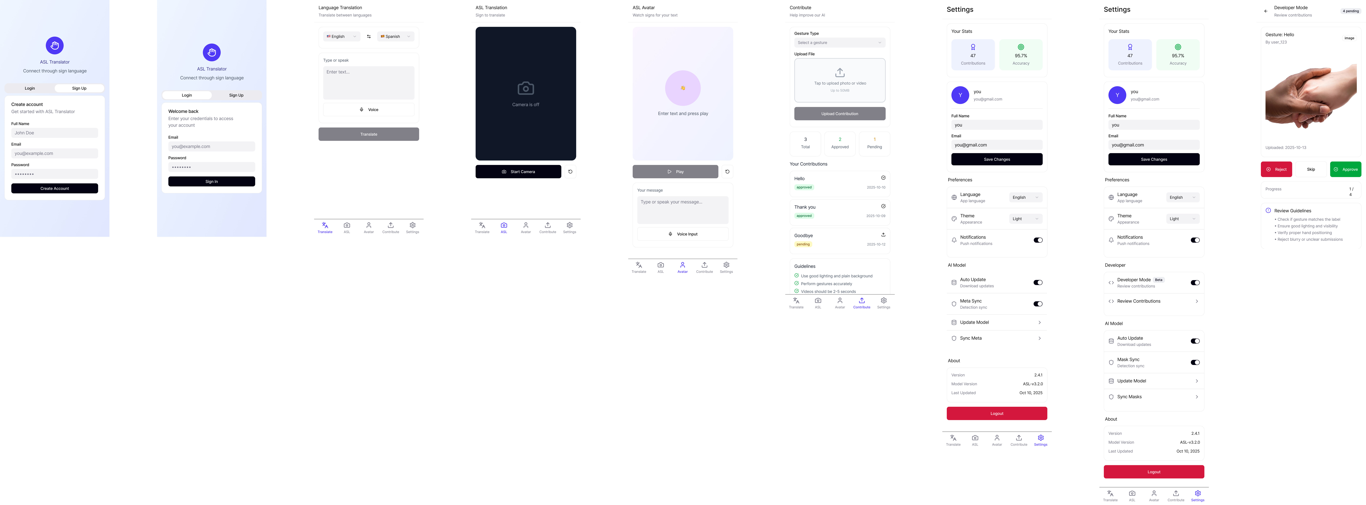


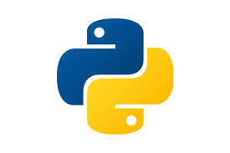
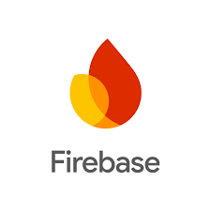
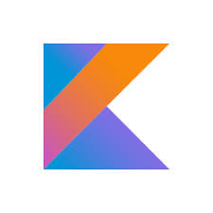
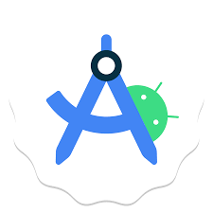


Gestura: AI-Powered Mobile Application for Inclusive Communication
Raven Mott
Department of Computer Science ,College of Engineering ,Virginia State University, Petersburg, VA
INTRODUCTION & MOTIVATION
Accomplishments or Progress
METHODOLOGY
Growing up, I witnessed firsthand how communication barriers affect everyday life. My aunt is hard of hearing, and my mother and her siblings learned ASL so the family could communicate with her. Their dedication—and the challenges they faced finding accessible, modern ASL tools—inspired me to develop Gestura, a mobile application that uses artificial intelligence to make American Sign Language translation more intuitive, portable, and inclusive.
Today, ASL technology remains fragmented, inaccurate, or inaccessible. Many tools only support isolated gestures, rely on bulky hardware, or fail to bridge the gap between Deaf, hard-of-hearing, and multilingual users. Gestura seeks to change that by integrating real-time ASL recognition, natural-language generation, animated ASL avatar output, and multilingual translation into one unified platform.
Gestura’s mission is simple: Empower communication—anywhere, anytime—for everyone.
Mobile App Development
Completed authentication, bottom navigation, dark mode, and accessibility support.
Built ASL Caption Mode: upload a video → timeline captions with confidence scores.
Fully implemented Reviewer Mode with Approve/Reject workflows.
Added “Sync AI Model” button with version history.
AI & Backend
We initialized our ASL sequence classifier using open-source LSTM weights released by Team Semaphore (Synaera). Using TensorFlow, we extracted a structured summary of all layer tensors and confirmed that the model contains 597,005 trainable parameters across three stacked LSTM layers and three dense layers (Figure 1). These weights serve as a baseline that we adapt and integrate into Gestura’s ASL captioning pipeline.
Successfully integrated gloss → English with OpenAI.
Implemented backend for ASL submissions, model logs, and validation results.
Avatar Integration
Avatar Tab UI completed; connected to AWS GenASL stub pending live endpoint.
Built full request/response contract for rendering ASL video animations.
User Guidance & Community Dataset
Designed guided ASL capture flow with framing/lighting checks.
Built contributor dashboard to track accepted gestures and pass rates.
Documentation & Research
Completed proposal, literature review, technical diagrams, and GitHub README.
Weekly logs (W1–W12) completed with evidence and advisor alignment.
1. ASL Recognition Pipeline
MediaPipe Holistic → Landmark extraction
Lightweight 3D-CNN / Temporal models (TFLite optimized)- ASL model weights released by Team Semaphore (Synaera Project)
Gloss assembly from gesture predictions
Firebase validation + data ingestion for model retraining
2. Natural Language Processing
ASL gloss → English sentence generation using OpenAI
Contextual smoothing to handle incomplete or ambiguous gloss sequences
Optional multilingual translation layer (text-to-text & TTS)
3. Mobile Application (Kotlin, Android Studio)
On-device inference using TensorFlow Lite
Bottom navigation workflow (Translate, Avatar, ASL, Contribute, Settings)
Reviewer mode for vetting incoming ASL submissions
4. Cloud Integration
Firebase Auth + Firestore + Storage + Cloud Functions
User-contributed dataset with on-device pre-checks
AWS “GenASL” avatar for generating ASL video from text
Weekly/quarterly retraining pipeline (planned)
5. Research-Driven Development
Iterative AGILE development
Literature-informed modeling and UI practices
Continuous benchmarking for model accuracy, latency, and accessibility compliance
Primary Goals
Develop a mobile app that performs real-time ASL-to-text and text-to-ASL translation.
Enable multilingual support for English, Spanish, Japanese, and more.
Create an intuitive user interface that is fully accessible (dark mode, captions, high contrast, large touch targets).
Build a cloud-based model update pipeline that allows automatic model syncing and user-contributed data.
Provide an animated ASL avatar for reverse translation (spoken/typed → ASL video).
Secondary Goals
Support community-driven dataset growth through guided user submissions.
Explore Meta Smart Glasses integration for hands-free translation.
Design a scalable technical foundation that can serve classrooms, families, and global accessibility needs.
{
"users": {
"uid_123": {
"userEmail": "admin@gmail.com",
"acceptedContributions": 3,
"pendingContributions": 0,
"totalContributions": 3,
"accuracy": 100.0
}
},
"asl_review"
"rev_001": {
"id": "rev_001",
"userEmail": "admin@gmail.com",
"predictedLabel": "HELLO",
"word": "Hello",
"keypoints": [0.5039, 0.3341, 0.0276, "..."],
"confidence": 0.96,
"createdAt": "2025-11-18T02:30:00Z",
"status": "pending"
}
},
"asl_accepted": {
"acc_001": {
"id": "acc_001",
"predictedLabel": "HELLO",
"word": "Hello",
"keypoints": [0.5039, 0.3341, 0.0276, "..."],
"confidence": 0.96,
"createdAt": "2025-11-18T02:35:00Z"
}
},
"asl_reference": {
"hello": {
"Word": "Hello",
"storagePath": "reference_videos/hello.mp4"
}
}
}
OBJECTIVES
WHAT’S NEXT? / FUTURE PLANS
Primary Goals
Develop a mobile app that performs real-time ASL-to-text and text-to-ASL translation.
Enable multilingual support for English, Spanish, Japanese, and more.
Create an intuitive user interface that is fully accessible (dark mode, captions, high contrast, large touch targets).
Build a cloud-based model update pipeline that allows automatic model syncing and user-contributed data.
Provide an animated ASL avatar for reverse translation (spoken/typed → ASL video).
Secondary Goals
Support community-driven dataset growth through guided user submissions.
Explore Meta Smart Glasses integration for hands-free translation.
Design a scalable technical foundation that can serve classrooms, families, and global accessibility needs.
Short-Term
Connect Avatar Tab to the live AWS GenASL service.
Expand ASL recognition to more signs and dynamic sequences.
Add demo videos and finalize UI polish.
Complete security rules and reviewer validation.
Medium-Term
Deploy cloud retraining pipeline for quarterly model updates.
Add multilingual captions and spoken output.
Improve real-time performance with temporal attention models.
Long-Term Vision
Integrate with Meta Smart Glasses for hands-free ASL recognition.
Support real-time ASL ↔ Speech conversations.
Build educator tools for ASL learning and assessment.
Scale contributions to grow a diverse ASL training dataset.
Gestura’s long-term mission is to provide a unified, accessible communication bridge for Deaf, hard-of-hearing, and multilingual communities.
Figure 1. Pretrained ASL sequence model from Team Semaphore used as an initialization point for Gestura. The network consists of a 3-layer LSTM stack (64 → 128 → 64 units) followed by three dense layers, producing probabilities over 13 ASL gloss classes. In total, the model contains 597,005 trainable parameters, which we further adapt and fine-tune for Gestura’s video-based ASL captioning pipeline.
Blocka | Layer type | Units | Parameters
LSTM-1 | LSTM (time-series encoder) | 64 | 442,112
LSTM-2 | LSTM (temporal expansion) | 128 | 98,816
LSTM-3 | LSTM (temporal compression) | 64 | 49,408
Dense-1 | Fully connected (feature mixing) | 64 | 4,160
Dense-2 | Fully connected (bottleneck) | 32 | 2,080
Output | Softmax classification (13 glosses) | 13 | 429
Total | — | — | 597,005
REFERENCES
Bantupalli, K., & Xie, Y. (2018). American Sign Language Recognition Using Deep Learning and Computer Vision. IEEE Big Data.
Roh, Y., Heo, G., & Whang, S. E. (2021). A Survey on Data Collection for Machine Learning: A Big Data–AI Integration Perspective. IEEE TKDE.
Miljkovic, K. et al. (2024). Agile Multi-tier Android Application Development With Firebase. Sinteza 2024.
Firdousi, M., & Team Semaphore (2022). Synaera: Android application for sign language to text translation. GitHub.
Koishigawa, N. O. (2019). Machine Learning Projects for Mobile Applications. Packt Publishing.
CONTACT
¹Rmot1202@students.vsu.edu
²Mottravenbusiness@gmail.com
Figure 2. Simplified Firebase Firestore schema for Gestura. Reviewer-validated ASL submissions move from asl_review to asl_accepted, while users tracks contributor statistics and asl_reference stores canonical example videos for key signs.

