Slide 1



QGIS - from Desktop to the Web, to Mobile and back again
FunGIS Conference - 2022
George Corea, Data Manager

Slide 2

Please download and extract the following while we go through the intro.
https://github.com/Mangoesmapping-GeorgeCorea/FunGIS2022
Click on CODE then download zip

Slide 3

Why This & Why Me
Worked with QGIS and FOSS4G for years
Applied experience leveraging these technologies
Reckon they might be really handy for you
BTW – Wanna know more? Hit me up afterwards, or https://www.mangoesmapping.com.au/services/workforce-training-development – We offer formal and detailed training courses in QGIS and related tech stack for end-users and administrators
https://github.com/Mangoesmapping-GeorgeCorea/FunGIS2022
Notes:
Collage of Web interface shots. Demo using
or
https://projects.gisquick.org/?PROJECT=georgecorea%2Fworkshop%2FWorkshop_Base

Slide 4
Structure for Today’s Workshop
Publish a Web Map (~35 mins)
Pushing Data and Projects to GISQuick
Reassign Symbology and Print Layouts
View and configure data views
Build a Mobile Data Collection Form for Field Use (~45 mins)
Syncing Data and Projects to QFieldCloud
Basics of QField on your mobile device.
Creating Data Entry Forms
https://github.com/Mangoesmapping-GeorgeCorea/FunGIS2022
Notes:
Collage of Web interface shots. Demo using
or
https://projects.gisquick.org/?PROJECT=georgecorea%2Fworkshop%2FWorkshop_Base

Slide 5
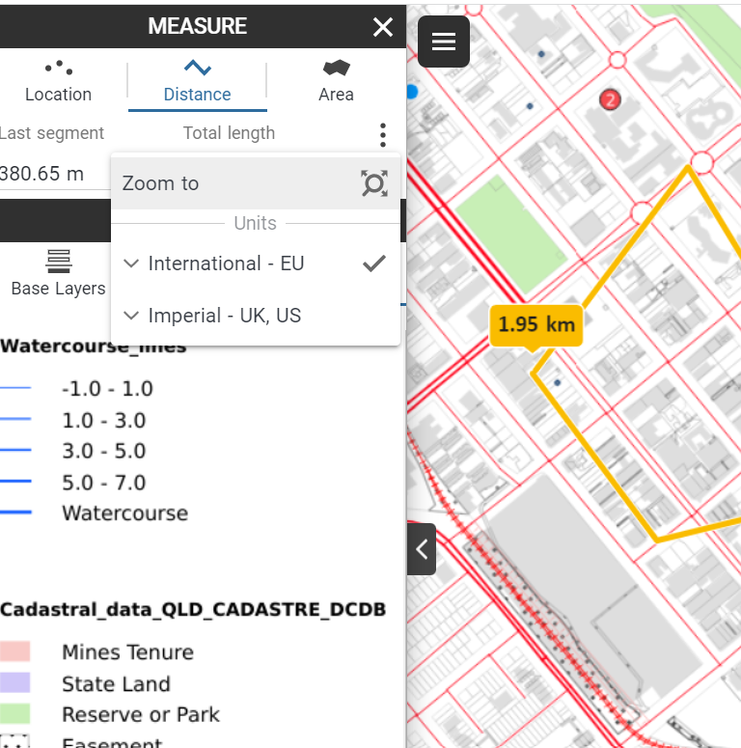
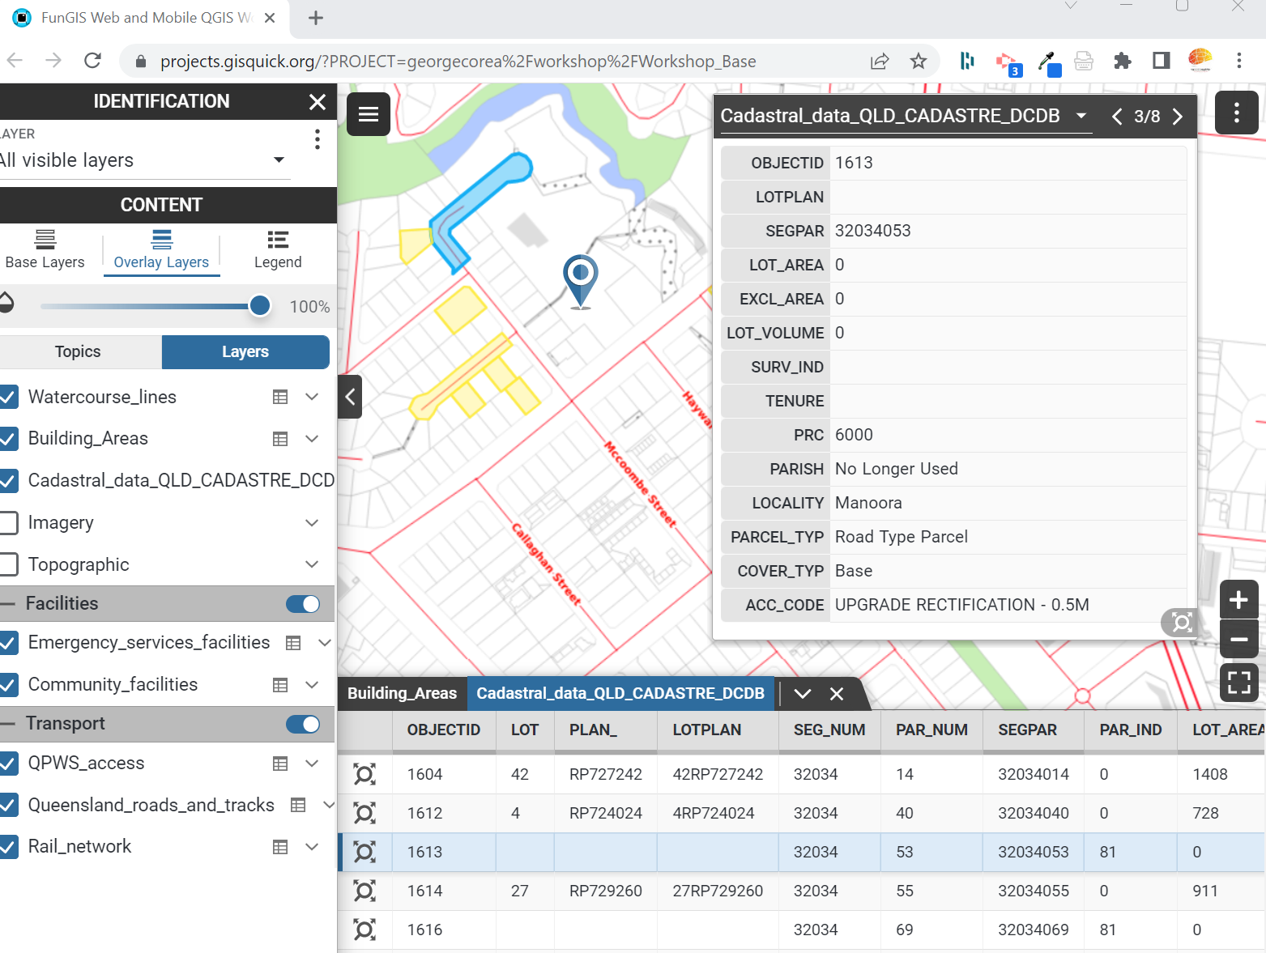
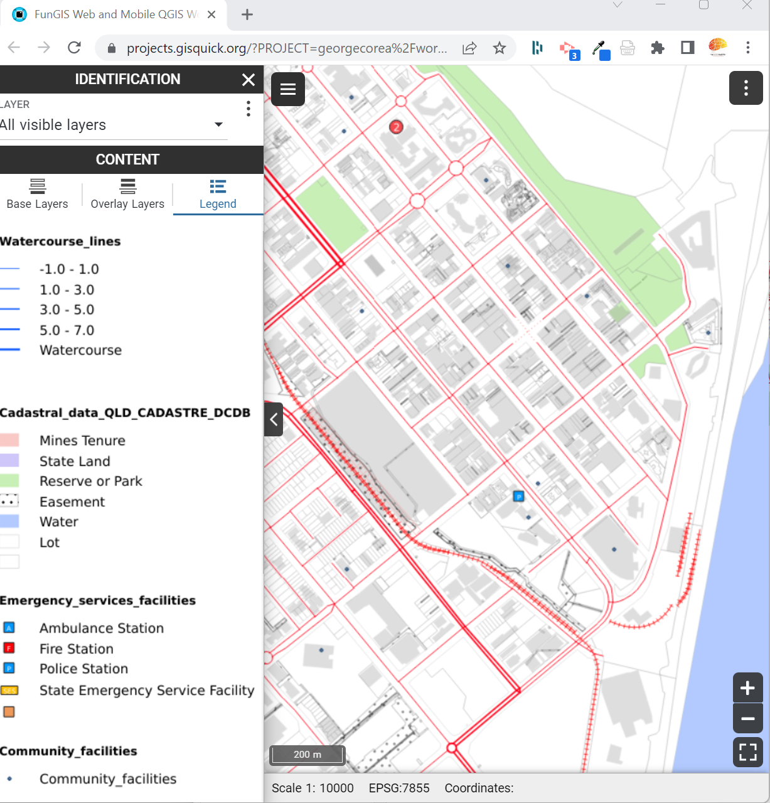
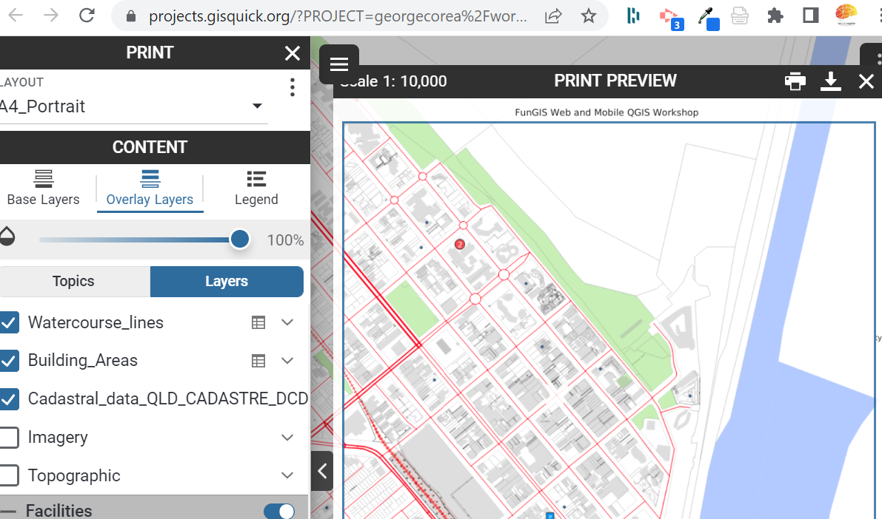
Start with the end in mind… Web
Measure and Print
Scaled Legend, Pop-Ups, Search and Attributes
Notes:
Collage of Web interface shots. Demo using
https://dev.gisquick.org/?PROJECT=mgmdata/FunGIS2022
or
https://projects.gisquick.org/?PROJECT=georgecorea%2Fworkshop%2FWorkshop_Base

Slide 6
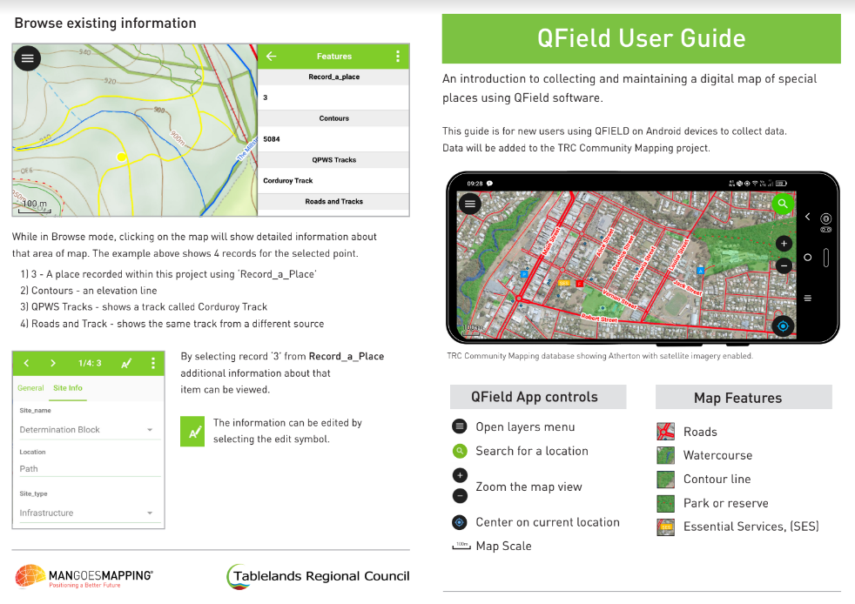
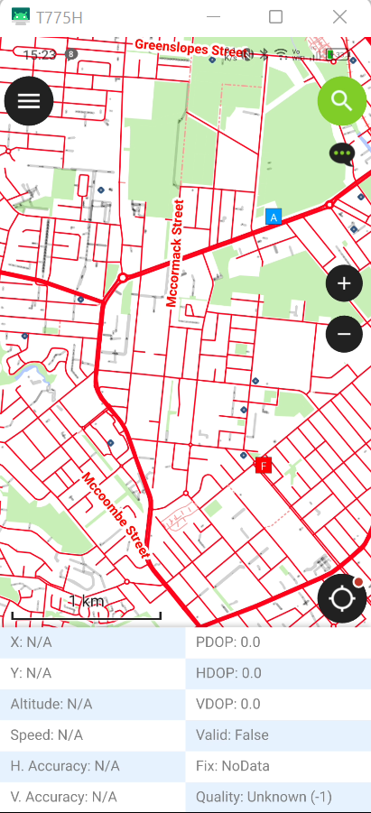
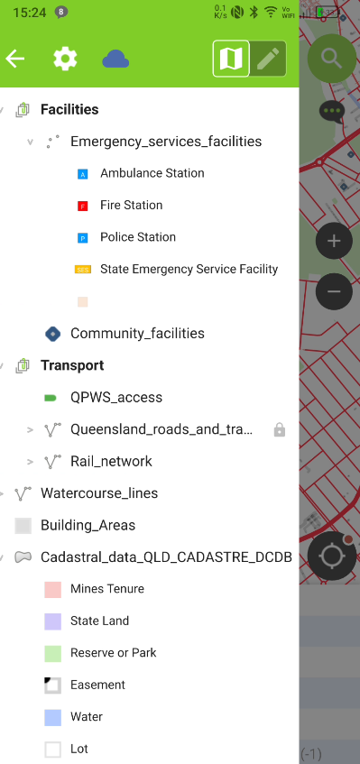
Start with the end in mind… Mobile
Map View
Layer View
Notes:
Collage of Mobile interface shots - Demo using mobile device

Slide 7
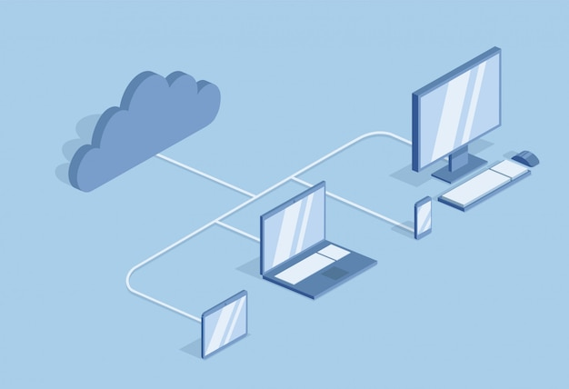







Slide 8
⭡ GISQuick
(Free) system for quickly viewing projects online

Slide 9
GISQuick
Create an account with https://projects.gisquick.org or https://dev.gisquick.org
GISQuick have options for hosting your data. Alternatively, use your own Docker instance to host GISQuick and your data
Login to https://projects.gisquick.org/user/publish/qgis/general or https://dev.gisquick.org/user/publish
Download the plugin (only available from the above link - avoid using the version in the QGIS plugins)
Notes:
Max 50mb project on the test server from the company.
You can host your own if you get a linux server from AWS or similar
The screen grabs below are for their production system but the authors have given me access to a dev instance which will launch later this month so I am demoing in that.

Slide 10
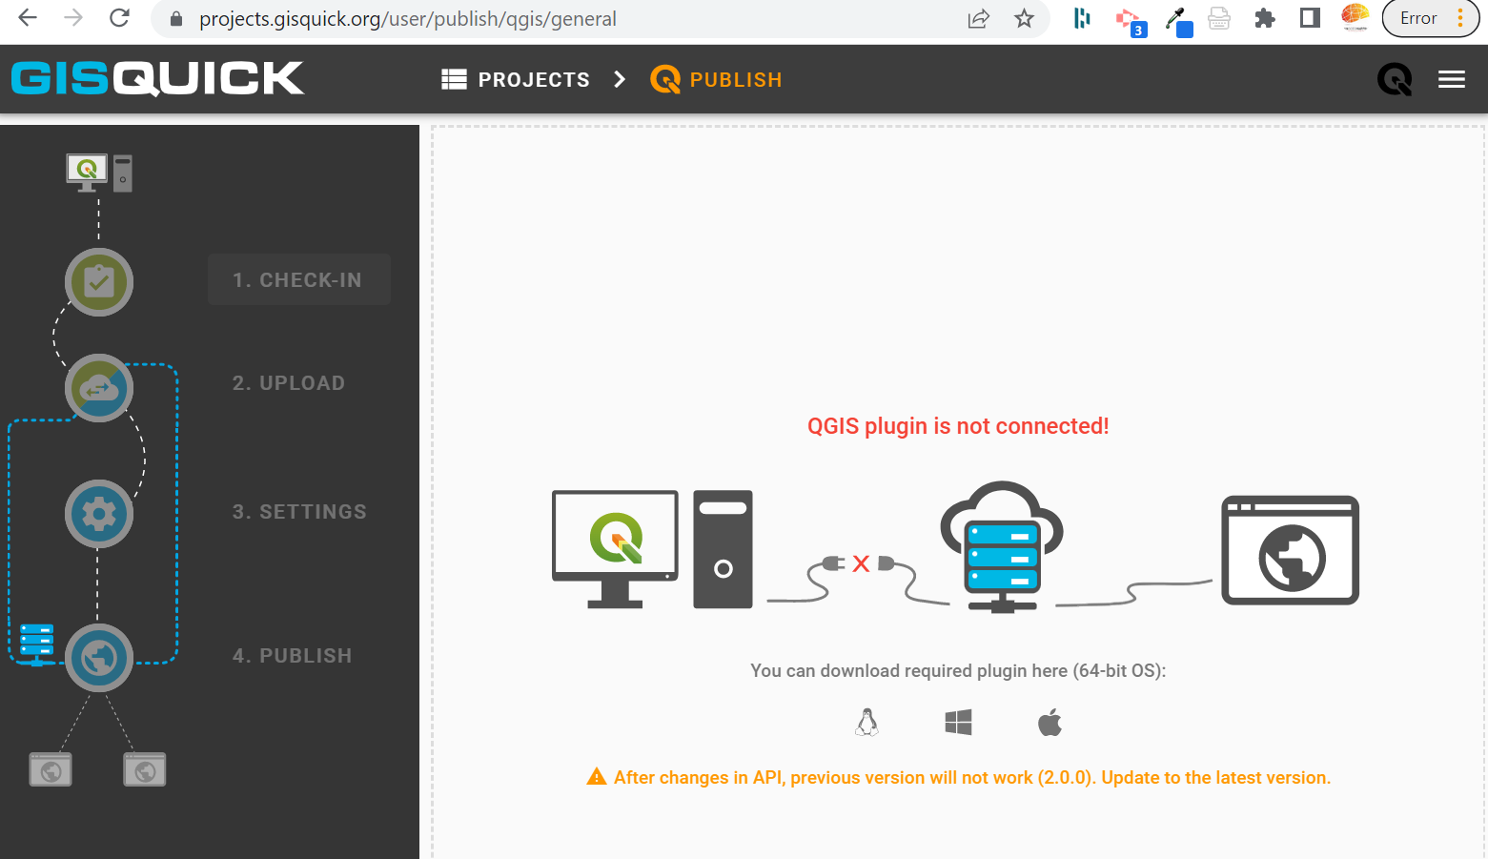
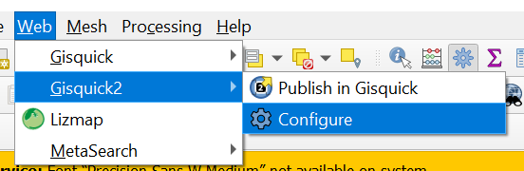
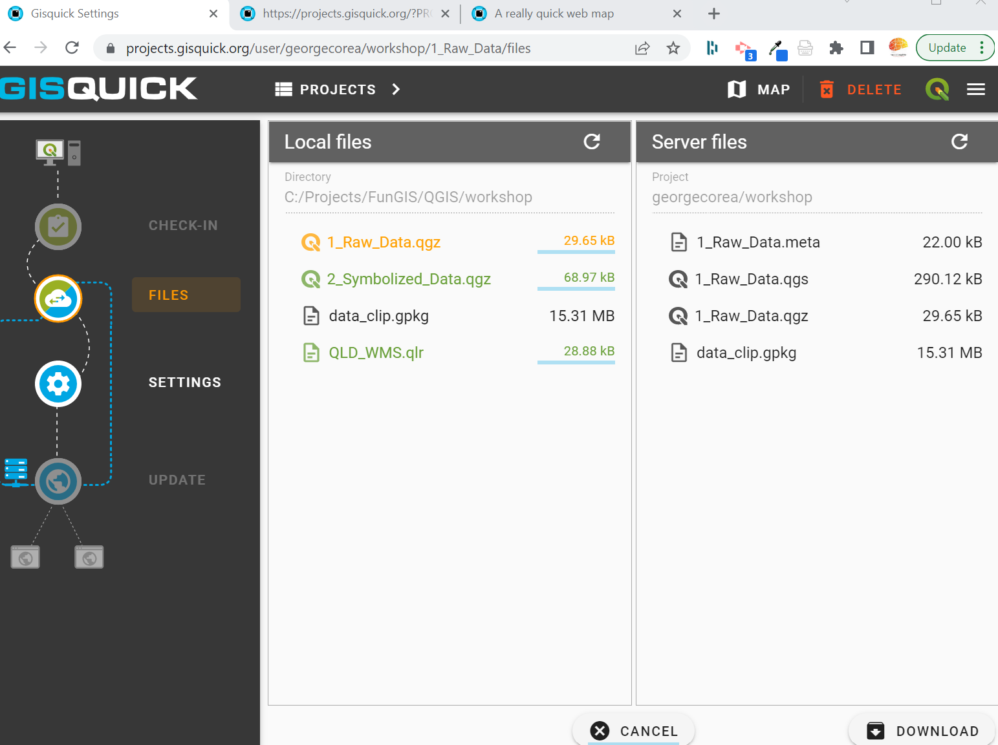
GISQuick
Dev Plugin
Notes:
Download the plugin from here for your windows, iOS or linux system.
Login to the plugin in QGIS
Once connected the steps will get highlighted as you properly configure the project in QGIS Desktop
Data MUST be
– in same folder as project
– ideally in one projection
– ideally in gpkg
– project title must be set

Slide 11
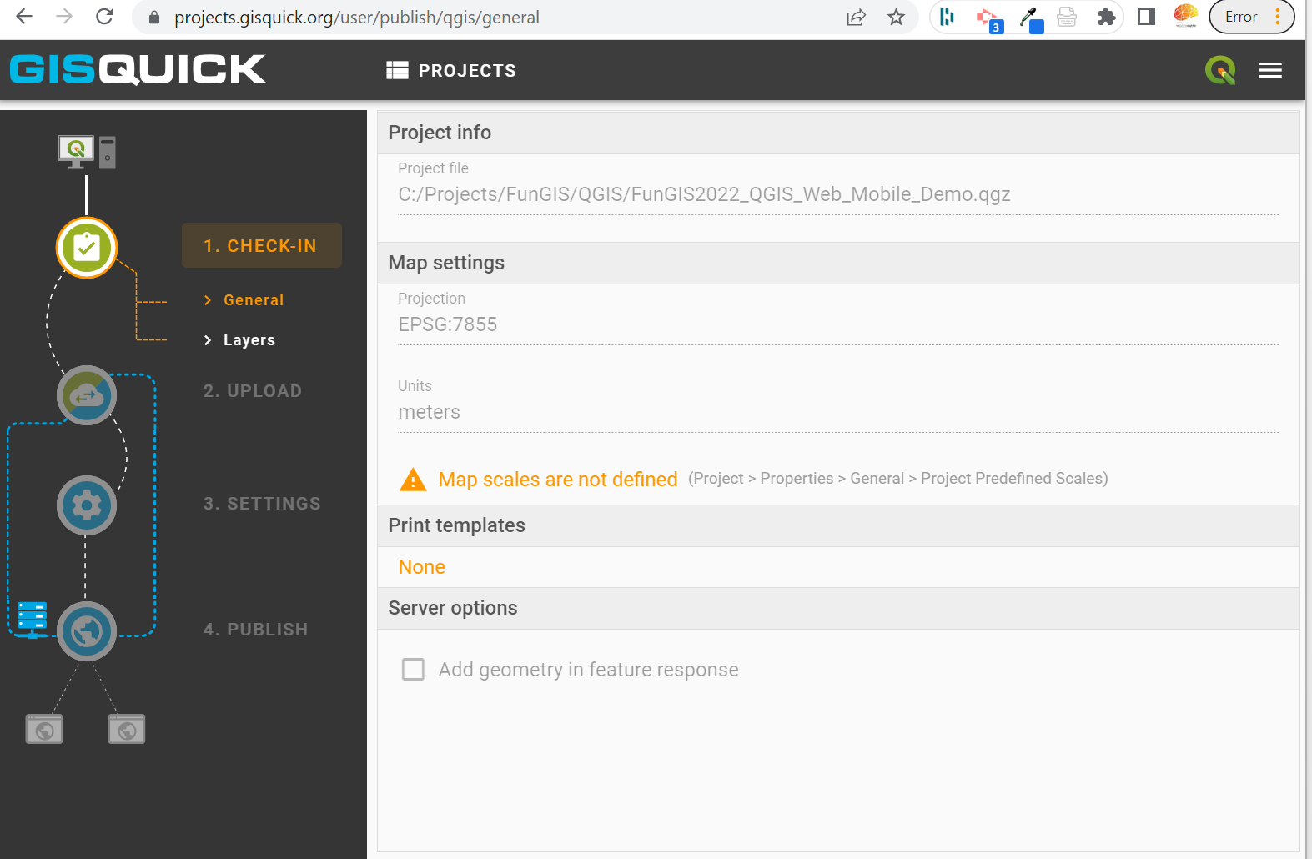
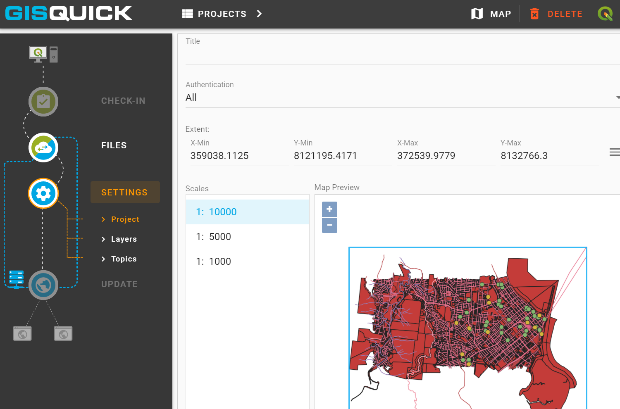
GISQuick
Notes:
It will let you know what can/should be changed.
At MINIMUM you must have scales defined (1:1000,5000,10000,25k, 50k etc depending on your data)
We’ll finalize this for now and then go back and look at improving the clients experience.
Click Update and then the “Map” icon on the right of the top bar.
You can only have one QGIS project open but you may have multiple project files in the folder but just upload what you need.
For the INFO tool to work you have to set it as per the Attributes slide (in this presentation)
You can set who is able to see the map (access restrictions), set the extents and scales under the layers tab. In the settings tab you can set contexts (collections of layers), base maps (what to show underneath) and configure which attributes of which tables are visible in the table view and info view.

Slide 12
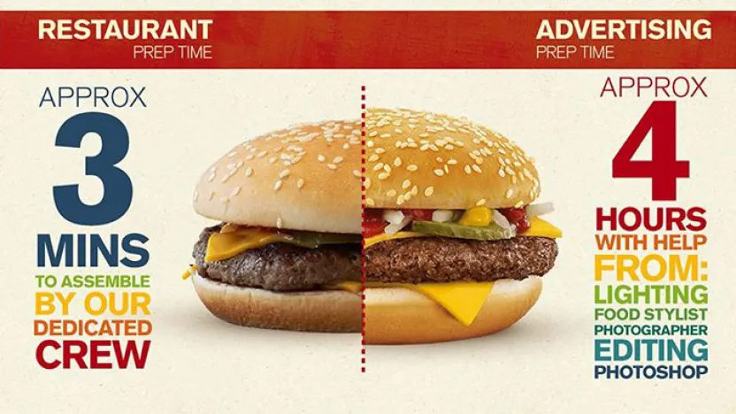
Is it WYSIWYG? Quick Symbology
Notes:
Thats a functional web GIS within minutes…but the true test is can it have meaningful symbology and labels… in that is what you see in the desktop reflected in the web interface?
Lets go from a raw dataset view to something that looks nice
Open \QField_Staging
copy paste symbology
load symbology
save symbology
load lyr file with WMS details

Slide 13
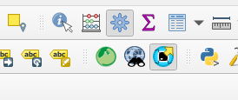
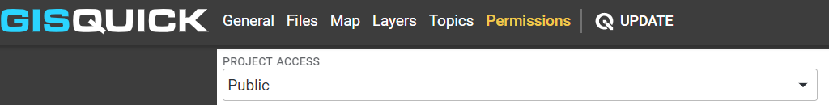
Republish to GISQuick
Notes:
Lets go from a raw dataset view to something that looks nice
Open FunGIS\QGIS\workshop\
copy paste symbology
load symbology
save symbology

Slide 14
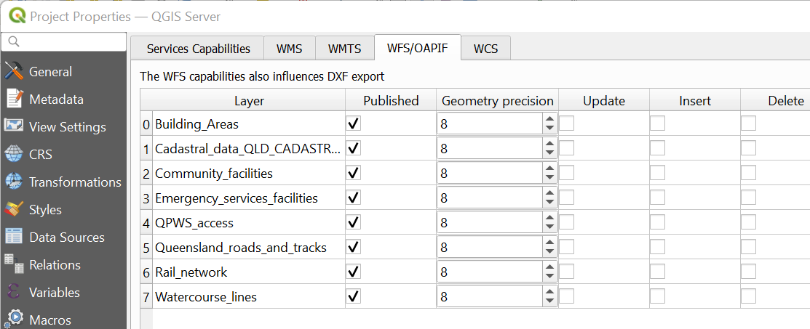
Attribute Table view re-duce, re-use, re-cycle
Notes:
To view the attribute table you must enable the WFS setting in the QGIS Desktop Project

Slide 15
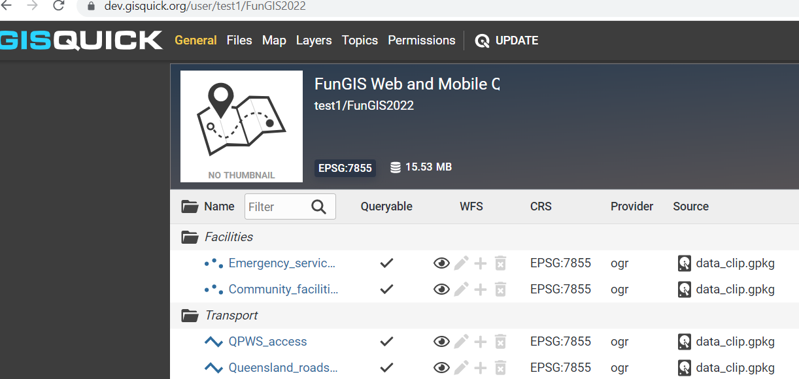
Republish to GISQuick
Notes:
See how layers where WFS has been enabled show as queryable and we could even enable editing.

Slide 16
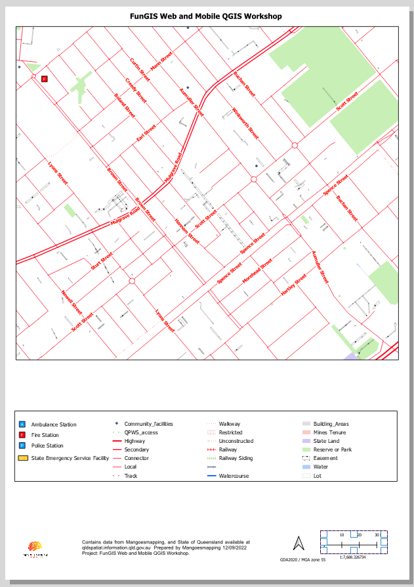
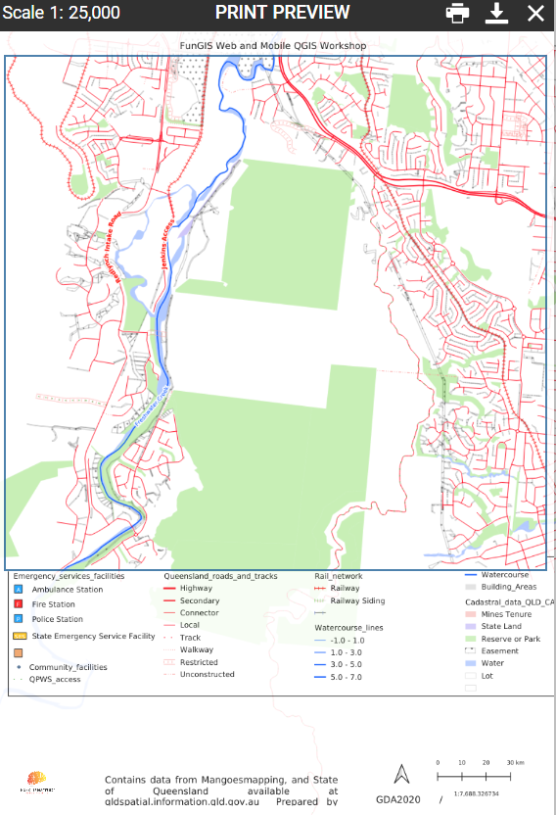
Quick Print Templates
Notes:
Let’s add a print template and see if WYSIWG between the Desktop and Web.
It’s not great.
So as we don’t see what’s expected we have to ‘break’ the template in the QGIS Desktop project so that it works better in the web view.
It’s not perfect but is acceptable especially when compared to alternative platforms.
So in summary, it’s a very quick, no code way to get a QGIS project onto the web for people to see your data without sharing PDF’s or sending people the project and data.
There are other QGIS based web servers that allow editing, redlining and more control of the print templates etc but they all include some coding and more setup. So this is by far the most functional and quickest way of going from the desktop to the web.

Slide 17
Republish to GISQuick
Notes:
You can’t configure the print templates from here, they are just upload as per the desktop project.

Slide 18
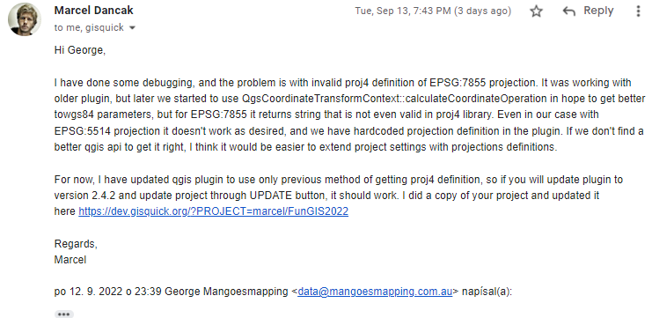
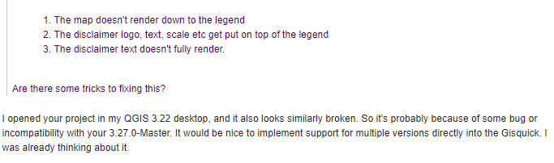
A side note - How can “Free / Open Source” software have responsive support?
Notes:
Open source teams can be very responsive if not more responsive than commercial product teams that have to go through lots of structure to make changes.

Slide 19
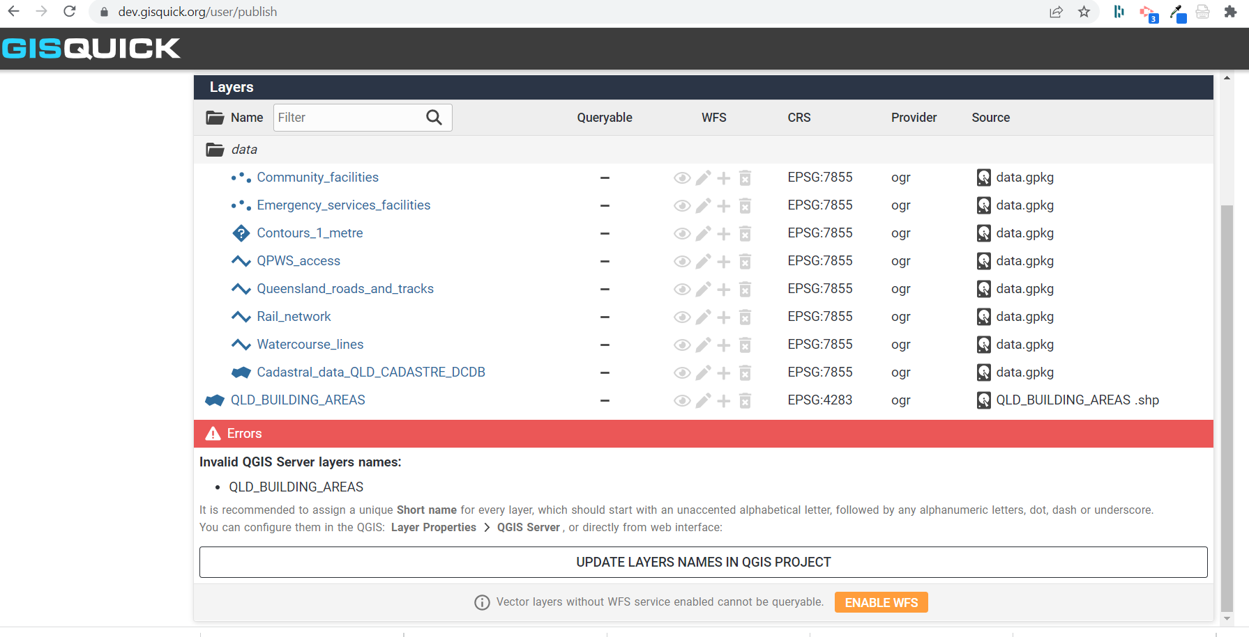
Dev System … even better!

Slide 20
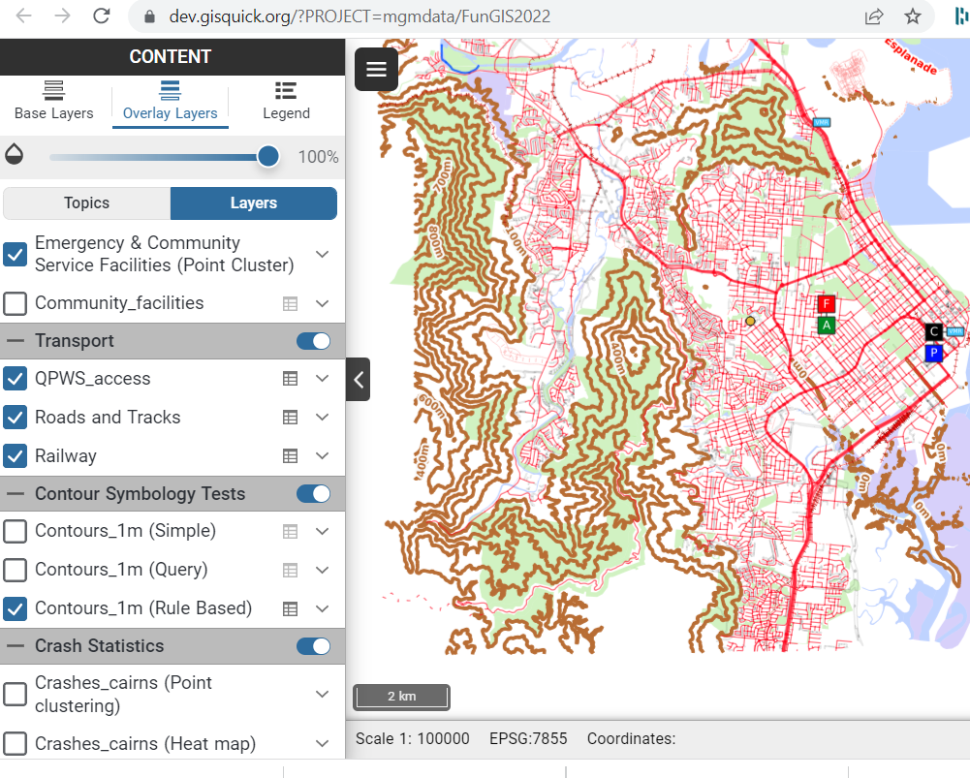
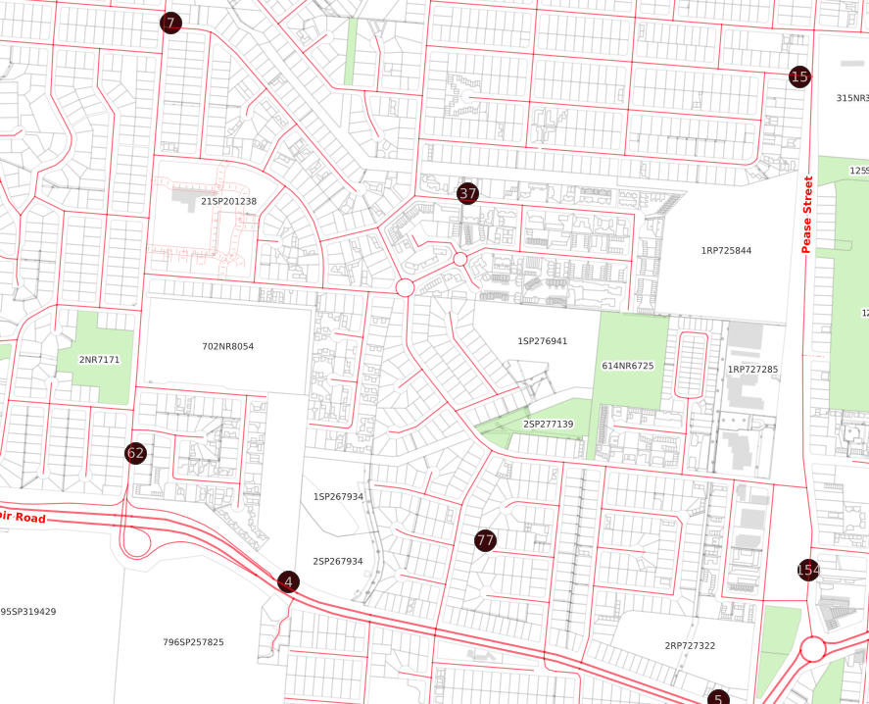
So what else is possible? Dev site
Notes:
Collage of Web interface shots. Demo using
https://dev.gisquick.org/?PROJECT=mgmdata/FunGIS2022
or
https://projects.gisquick.org/?PROJECT=georgecorea%2Fworkshop%2FWorkshop_Base

Slide 21
⭡ QField Cloud
Quickly sync projects between Desktop and Mobile environments via the cloud.
Notes:
The free system is limited by project size and usage but as with GISQuick it can be hosted on your own cloud linux system

Slide 22
QField and QField Cloud Cloud
Create an account with https://app.qfield.cloud/accounts/signup
QField Cloud has options for hosting your data. Alternatively, use your own Docker instance to host it and your data
Install the QFieldCloud plugin for QGIS
Login by clicking on the cloud icon
If you are using your server double click on the bee icon
Notes:
Max 50mb project on the test server from the company.
You can host your own if you get a linux server from AWS or similar
The screen grabs below are for their production system but the authors have given me access to a dev instance which will launch later this month so I am demoing in that.

Slide 23
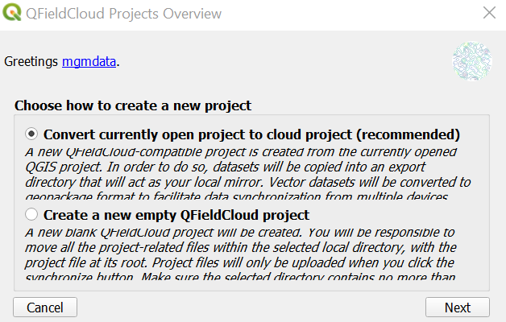
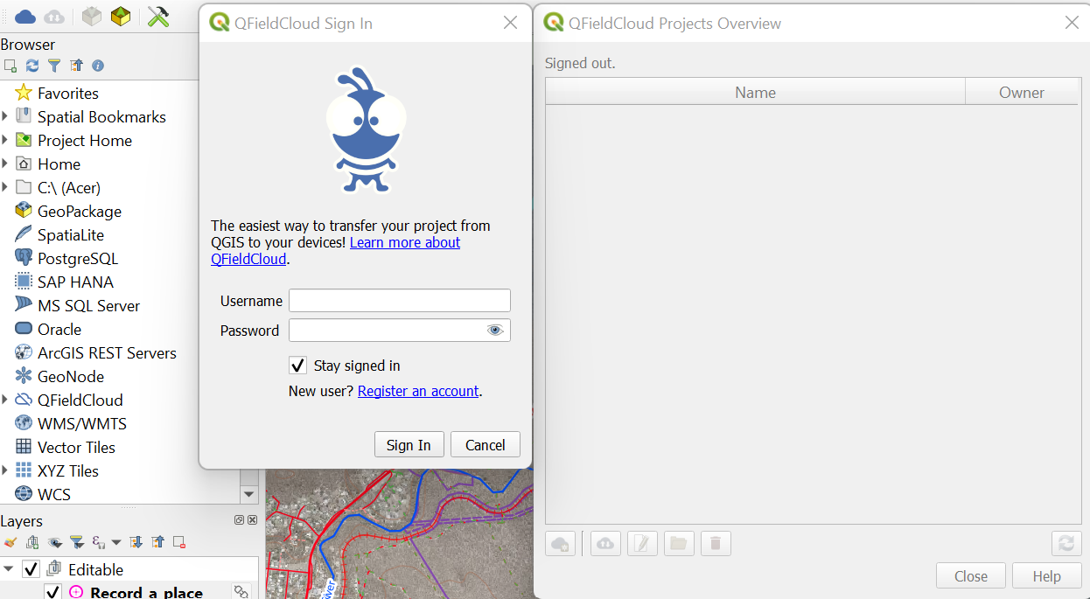
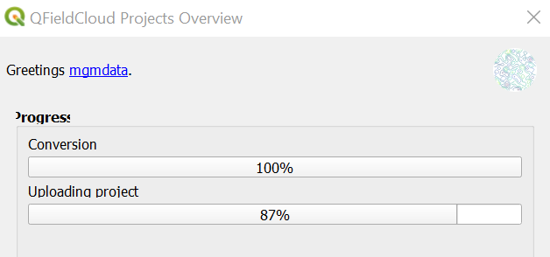
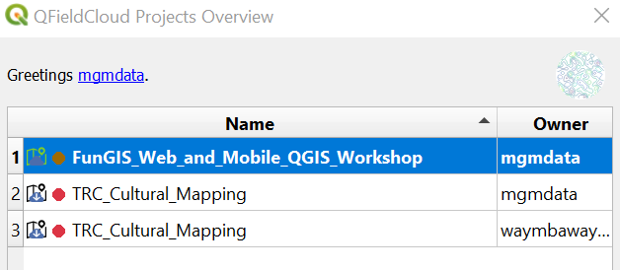
QField Cloud - QGIS Desktop Setup
IMPORTANT - it has to create its own copy of your project. This should be in a separate folder to your main project and you should never edit that. Only work in the project that you are currently in.
Notes:
Download the QFieldCloud plugin from the normal QGIS plugin store
Login to the plugin in QGIS
Double click on the bee icon to put in your custom server or register an account
Data MUST be
– in same folder as project
– ideally in one projection
– ideally in gpkg
– project title must be set
(same as in GISQuick)
IMPORTANT - it has to create its own copy of your project. This should be in a separate folder to your main project and you should only use the new one to sync from this point on. Do not use the project that you are currently in any longer.

Slide 24
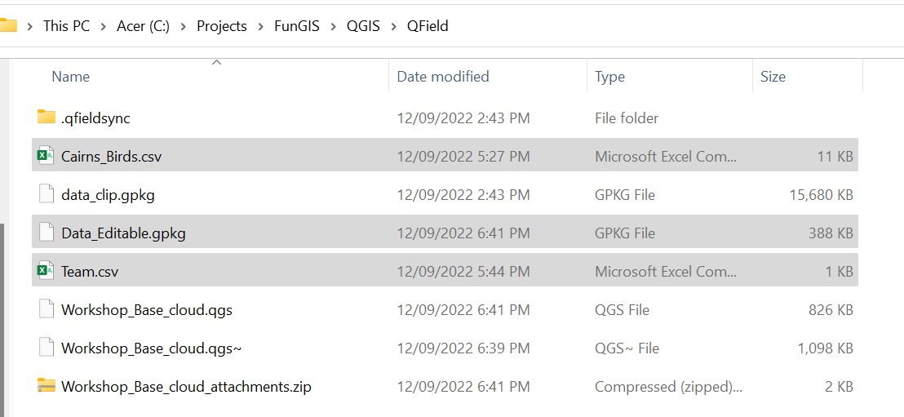
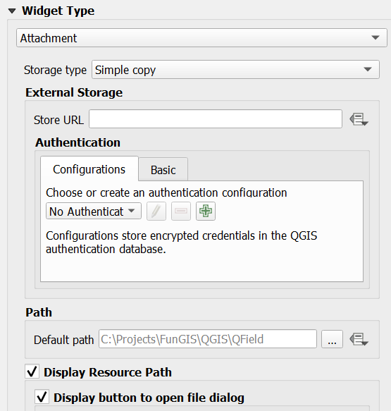
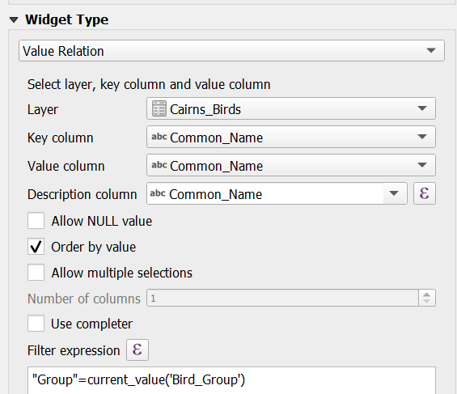
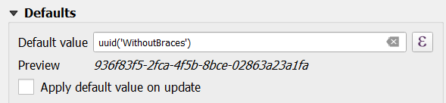
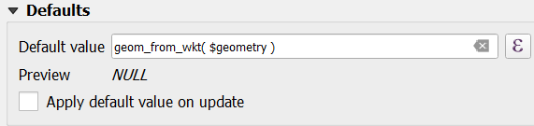
Quick Forms re-duce, re-use, re-cycle
Photos
Lists
Unique Value
Geometry
Notes:
Before we go into editing data, let’s add some forms for data collection and also control what users can enter for QC and ease of data entry.
Back in QGIS Desktop copy the data_editable.gpkg and csv files from FunGIS2022\Cheat_Files to the project folder and drag the 3 files into QGIS
Let’s discuss the powerful forms feature to simplify data entry and improve QC.
We have forms to
-generate unique column id’s
-add photos
-create cascading lists
-add dates/times and user/device information
and add geometry attributes.
They also can
-read csv data
-update the entries based on previous entries.

Slide 25
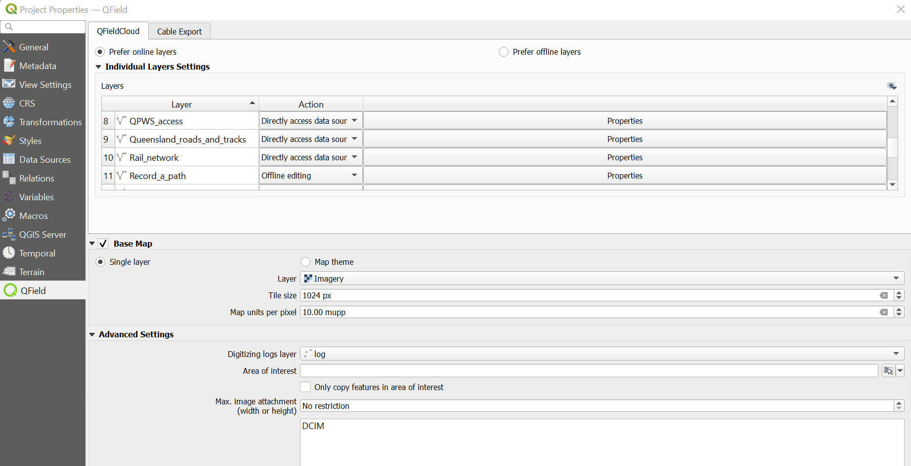
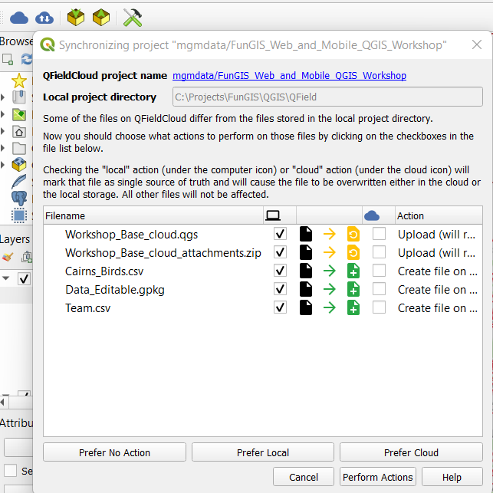
Sync with QField Cloud
Notes:
You will now see the Cloud icon with arrows active.
Check settings in the Project properties, QFieldCloud options where you can also set an area of interest and a log layer.
Additionally you can pre-download imagery for use while offline.
The AOI setting maybe useful if your data is of a large area and your team is only working in a small area so that older phones have less data to deal with.
The Action for most layers should just be copy and offline editing just for the data you want people to edit.
There’s lots of functionality hidden in here which we can’t cover in this workshop but….

Slide 26
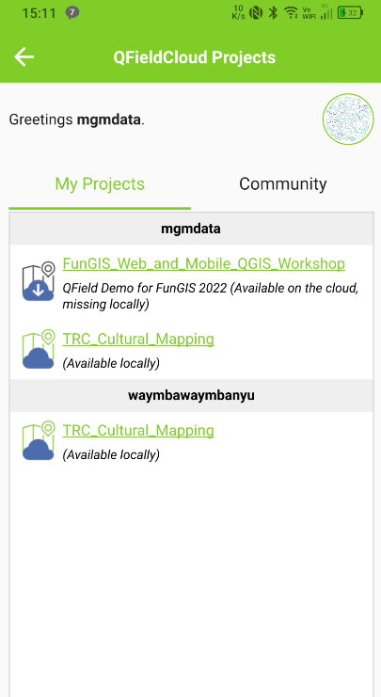
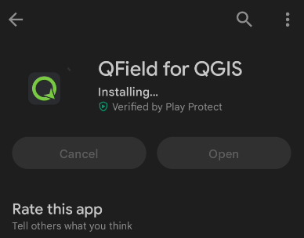
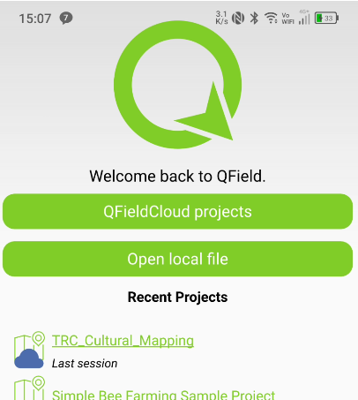
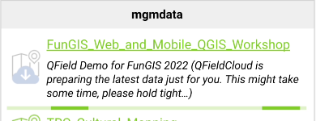

QField Dev - Mobile Setup
For Spatial Olympics 2023 the project is called - FungisSpatailOlympics2023
lt is shared by user FunGISFNQ
https://app.qfield.cloud/a/fungisfnq/FungisSpatailOlympics2023/collaborators
Notes:
For Spatial Olympics 2023 the project is called - FungisSpatailOlympics2023
lt is shared by user FunGISFNQ
https://app.qfield.cloud/a/fungisfnq/FungisSpatailOlympics2023/collaborators

Slide 27
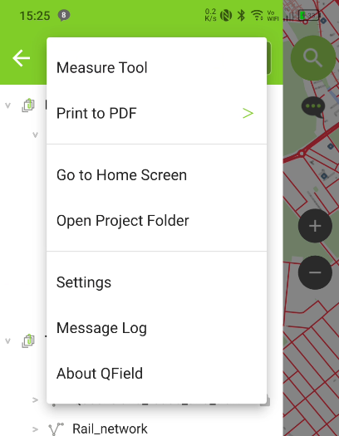
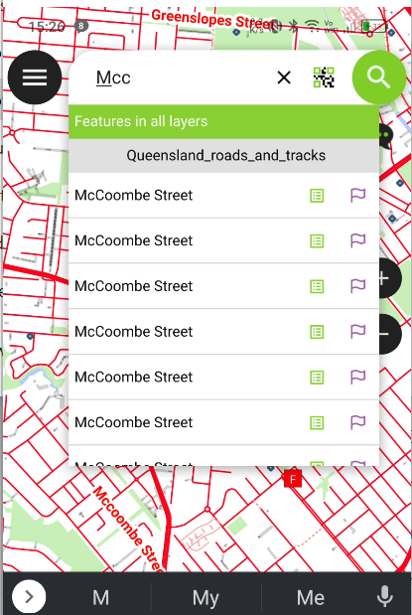
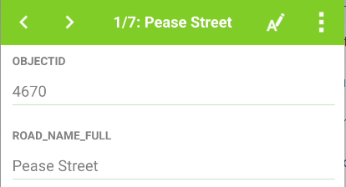
QField Cloud - Mobile App - The basics
Map View
Layer View
Search and View Attribute Table
Measure and Print
Notes:
Map View is the main screen you will see.
The 3 bars on the left allow you to access the Layers, Measure and Print functionality
The Magnifying glass on the right allow you to search and view the attribute table.
See https://docs.qfield.org/get-started/

Slide 28

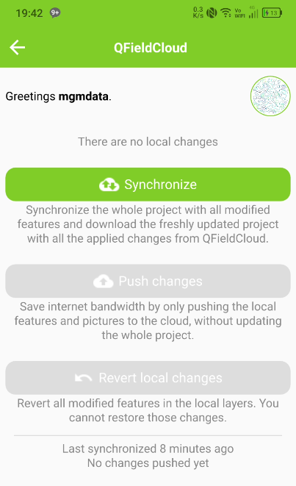
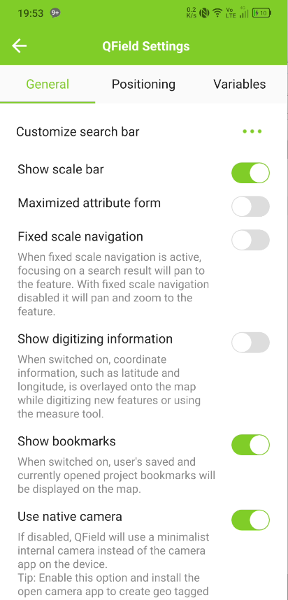
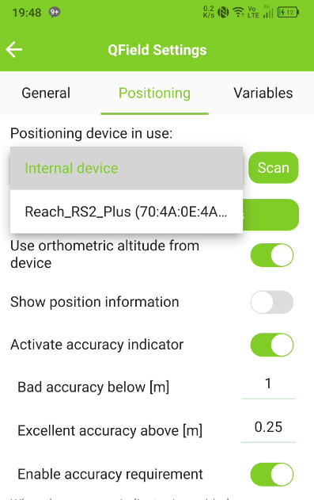
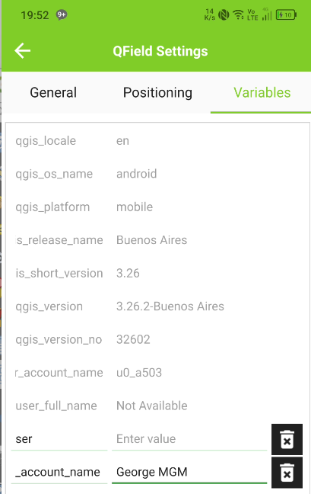
Sync field data with the cloud and back to mobile/desktop
Notes:
Click on the Blue cloud icon and then a method of synchronization. Once we make edits, the number of unsynced changes will show in the cloud icon.
Once this completes you will see the new data and any other changes in the project.
Under settings you can set it to use an external GPS, camera and variables for each user and as with everything QGIS the options are limitless.

Slide 29
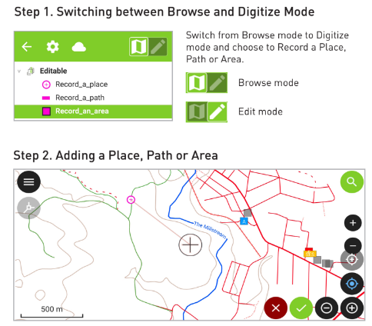
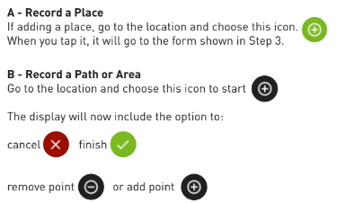
QField Mobile Editing
Notes:
The above are extracts from our training manuals

Slide 30
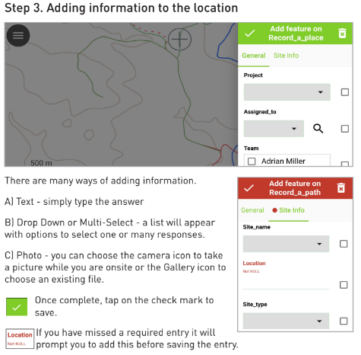


QField Mobile Editing
Notes:
You can track your location into a line dataset and also go back and edit records. If properly setup it will maintain the unique id but update the data last edited (but not date created).
Once done you will see the cloud icon shows the number of changes you made. Click on it and then choose Push Changes as per the prompts.

Slide 31





QField Desktop Sync
Notes:
Back in desktop click on the up/down arrow cloud and then it will show you what has changed and you can choose to sync.
IF there is an error - just DELETE the desktop.ini files that may get autogenerated before you run the sync.
Once complete you should see the new data. If not please close and reopen QGIS/the project.
If there aren’t any changes it will tell you.

Slide 32


QField Sync - Web Interface
Notes:
Go to https://app.qfield.cloud/a/mgmdata/FunGIS_Web_and_Mobile_QGIS_Workshop/
We won’t go into detail in this workshop but our admin training goes into how to check changes, add collaborators and maintain the online project - potentially for FREE if you have a server.
Basically we have gone from a desktop to a mobile solution for data review and editing offline without any coding. We could simply upload this to GISQuick and have a full cycle from Desktop to Mobile to Web and back again. All you need is time to learn or short cut it by doing some training.

Slide 33



Topological Editing and clear user guides
https://docs.qfield.org/
Notes:
There was a question yesterday about Topological Editing - I was thinking “hmm must post on the forums or maybe create a python script to do this check” but then I looked at the docs and...MAGIC! haven’t tried it but added this slide and learnt there’s Atlas printing in a mobile app. Even some commercial desktop GIS don’t have this.

Slide 34
Outcomes from Today’s Workshop
Learned how to manipulate GISQuick
Add data to cloud
Publish project
Assign symbology and print layout
Learned how to manipulate QField and QField Cloud
Add data to cloud
Sync with mobile devices and back to the desktop
Create forms
Notes:
Lessons Learned from Spatial Olympics
for GID use a combination of deviceid (or device user name) and the day and time to seconds

Slide 35

Notes:
Basically we have gone from a desktop to a mobile solution for data review and editing offline without any coding. We could simply upload this to GISQuick and have a full cycle from Desktop to Mobile to Web and back again. As a plug we have both user and advanced training in this tech stack.

Slide 36
Bonus Content
Notes:
For a more rich web interface that allows you to Redline and edit data there is also QGIS Web Client 2 and G3W which allows complete configuration within the cloud and access to postGIS data for a complete web based, almost Desktop like experience with UAC.

