Slide 1


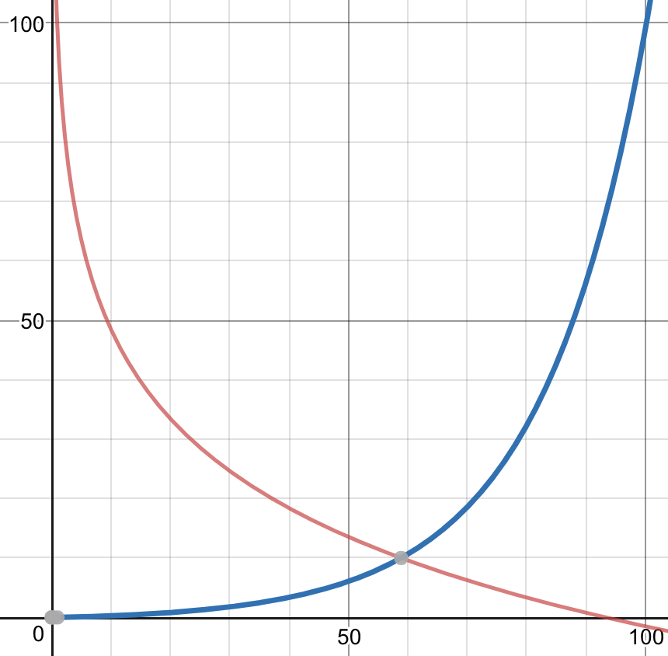
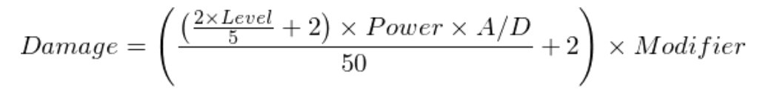
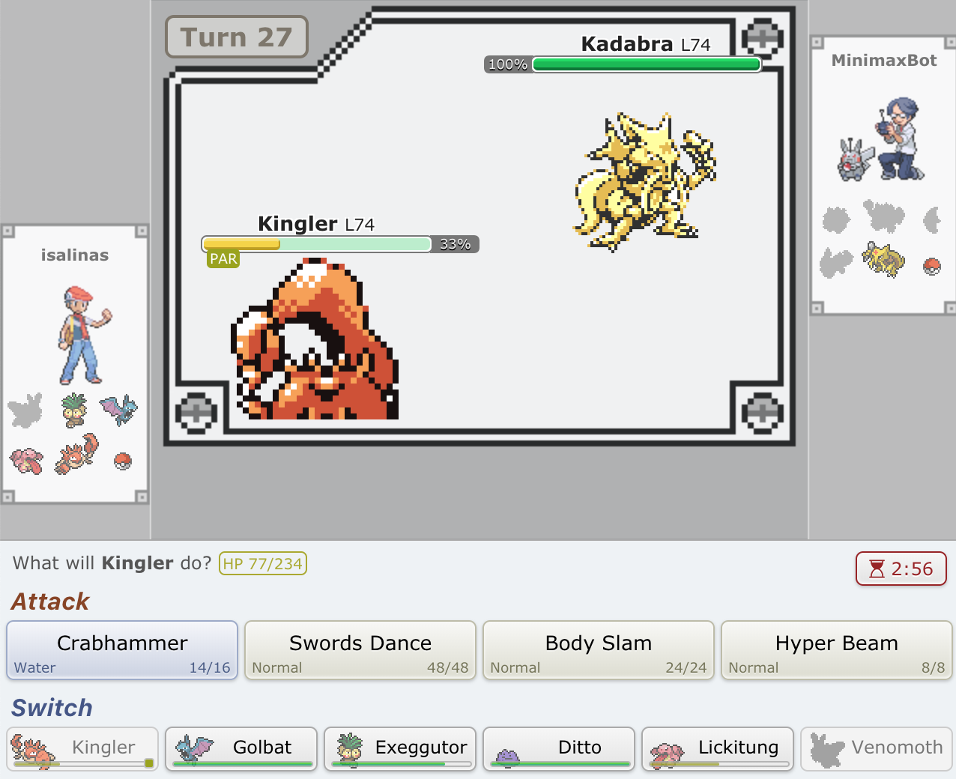
EliteFourBot: An AI player for Pokemon Showdown
Members
Oracle and Baseline
Minimax Algorithm
Nicholas Allen, Ivan Salinas, Henry Weller
PS’s server code is open source, and includes a Random AI Bot (RandomBot), which selects a random move from that Pokemon’s moveset. Pokemon switching is also random. Our baseline (BaselineBot)) used some simple heuristics we. Our Baseline Bot selects the move with the lowest pp, a move statistic representing the maximum number of times a move may be used.
When forced to switch, BaselineBot selects a Pokemon
whose type fares well against the opponent’s type.
Results:
BaselineBot beat RandomBot 56.3% of the time on average over 300 matches. Henry was able to beat RandomBot 10/10 times, and was able to beat BaselineBot 9/10 times.
Input: list of (ourMove, theirMove, score) tuples, depth At a given depth: For each of our moves: For each of their moves: Pick move that minimizes score Pick move that maximizes score
Return move
Project Goal
Build an AI bot that can play Pokemon Showdown competitively
3
4
We define competitively as the ability to defeat a proficient Pokemon Showdown player. Our member, Henry, has a favorable ELO in generation 1 Pokemon Showdown random battles, so we chose him as our oracle.
Figure 3. RandomBot
(2018, colorized)
3
5
4
5
2
6
6
3
4
3
5
8
Pokemon Showdown Rules
EliteFourBot
Pokemon Showdown (PS) is an online Pokemon battle simulator. Each player is randomly assigned six Pokemon of similar level. Each Pokemon has four moves, one or two type(s), and a list of stats (attack, defense, health or HP, special, speed). The player may also switch to another pokemon with health > 0. Though there are some moves that fall in their own category, 90% of generation 1 moves perform at least one of four actions:
1. Elevate our pokemon’s stats,
or lower the opponent’s stats
2. Affect our opponent’s status.
3. Damage the
opponent’s HP.
4. Recover HP
Every move has an accuracy and
power statistic which scale the
damage it can do (fig 1.), and
some moves have secondary
Effects; Body Slam (fig 2.) has a
basepower of 70 and a 30% chance
of causing the paralysis status
effect.
EliteFourBot uses the Minimax algorithm to determine the optimal action on a given turn. It uses a modified Minimax algorithm which allows for simultaneous moves, as per in Pokemon battles, by performing alternating minimization and maximization over all possible combinations of our actions and the opponent’s actions.
Results
EliteFourBot beat BaselineBot 73% of the time on average over five iterations of 100 rounds, with a range of 66% to 78% victory rate. Henry was able to beat EliteFourBot 7/10 times.
EliteFourBot receives the info of all of l
its Pokemon (stats, moves, types, and
status) as well as the info of the
opposing pokemon that is out,
approximating its moveset.
EliteFourBot then simulates
gameplay up to three turns in the
future using the damage calculator
Function to pick the move that
maximizes an objective function representing game score. Our scoring function evaluates our team’s info along with the info of the opposing pokemon we can see to produce a single number representing the current game state. Our scoring function is nonlinear: health recovery moves are prioritized when the Pokemon has low HP, while stat boosting moves are prioritized when our pokemon has high HP (fig 4.).
Future Directions
We limited the scope of our project to 1st generation random 1v1 battles for nostalgia and complexity management reasons. In the future, this functionality could be extended across other generations. New generations introduce weather, items, abilities, more types, 2v2 battles, and new Pokemon, increasing the state-action space that must be considered exponentially.
EliteFourBot also fails to optimize usage of certain moves. For example, incapacitating the opponent early, boosting one’s stats, and then sweeping the opponent’s team is a common strategy currently unaccounted for. There is a tradeoff between switching to a more advantageous Pokemon and losing a turn, which EliteFourBot is still unable to optimize. Our current implementation maximizes the scoring function over 3 turns,which is too short a horizon to optimize for the long term team health through the use of switch actions.
Figure 1.Damage Calculator Function
Figure 4. HP versus score function weight; Red line represents stat boosting moves, blue line represents health boosting moves.
Figure 2. PS Gen1 Random Battle Example

Slide 2
Figure 1. PS Gen1 Random Battle Example

