Slide 1
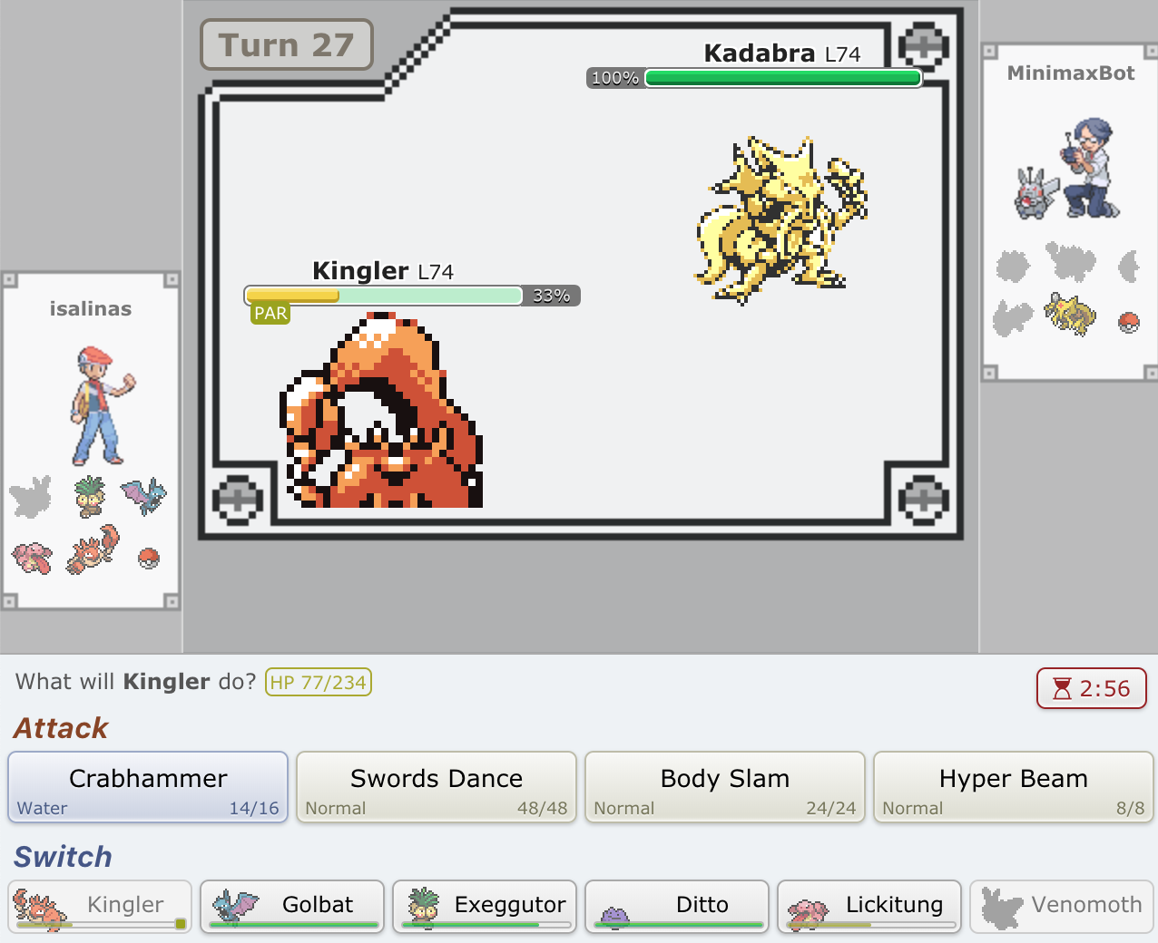
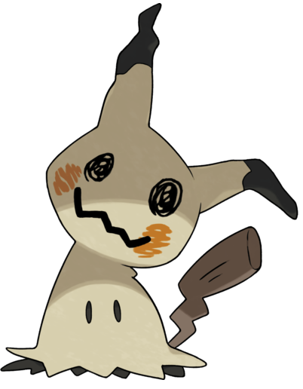
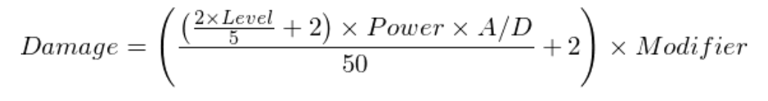
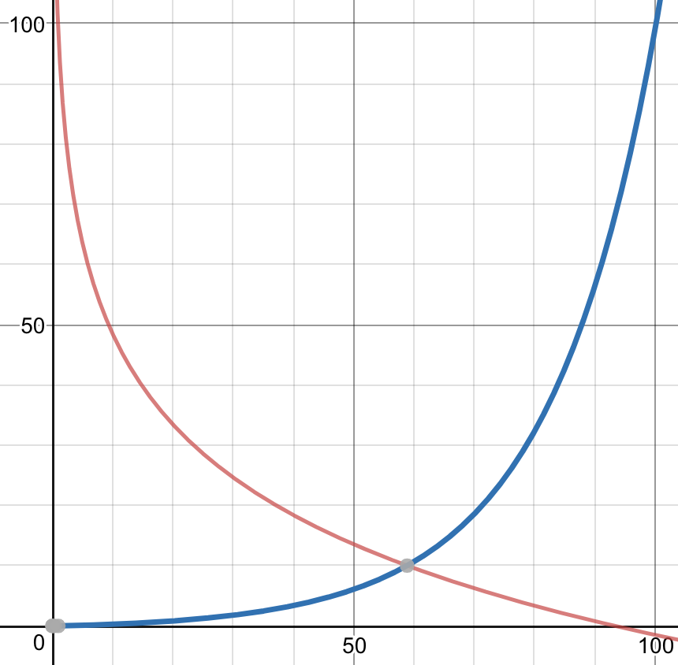
EliteFourBot: An AI player for Pokemon Showdown
Members
Pokemon Showdown Rules
Minimax Bot
Nicholas Allen
Henry Weller
Ivan Salinas
Pokemon Showdown is an online Pokemon battle simulator. The rules for this game are simple:
Each player is randomly assigned 6 Pokemon of similar level. Each Pokemon has 4 moves, type(s), and a list of stats (attack, defense, health, special attack, special defense, speed). Each move may: 1. Elevate the Pokemon’s stats, or lower the
opponent’s stats; 2. Affect the
Pokemon’s (or opponents)
status. For example, a
Pokemon may rest to increase
its health, or paralyze the
opponent; 3. Damage the
opponent’s health.
The diagram below simulates our algorithm: At a given depth: For each of our moves: For each of their moves: Get their min score Pick max of the scores we can take
Project Goal
Build an AI bot that can play Pokemon Showdown competitively
3
4
We define competitively as the ability to defeat a proficient Pokemon Showdown player. Our member, Henry, can hold his own in competitive matches against ranked players, we can use him as an upper bound. The rest of our team represents the average player.
3
5
4
5
2
6
6
3
4
3
5
8
Oracle and Baseline
Minimax Bot
Results
Pokemon Showdown’s server code is open source, and includes a Random AI Bot (RandomBot), which selects a random move from that Pokemon’s moveset. Pokemon switching is also random.
Our baseline (BaselineBot) used some simple heuristics we believed would perform better than random. When forced to switch, BaselineBot selects a Pokemon whose type fares well against the opponent’s type. Our BaselineBot also selects one of the two moves with the lowest maxpp*.
Results:
BaselineBot beat RandomBot 56.3% of the time on average over ten iterations of 100 matches, with a range of 47% to 67% victory rate.
Henry was able to beat RandomBot 10/10 times, and was able to beat BaselineBot 9/10 times.
* A move’s maxpp is the maximum number of times a Pokemon may use that particular move. In general, moves which can be used less (thus, have a lower maxpp) are the rarest and strongest move in a Pokemon’s moveset.
MinimaxBot uses the Minimax algorithm to determine the best possible move in any given turn. It uses a modified Minimax algorithm which allows for simultaneous moves, as per in Pokemon battles, by performing minimization and maximization all possible combinations of our action and the opponent’s actions.
MinimaxBot beat BaselineBot 73% of the time on average over five iterations of 100 rounds, with a range of 66% to 78% victory rate.
Henry was able to beat MinimaxBot 7/10 times.
RandomBot (2018,
(colorized)
Future Directions
We limited the scope of our project to 1st generation random 1v1 battles for nostalgia and complexity. In the future, this functionality could be extended across other generations. New generations introduce weather, items, types, 2v2 battles, and new Pokemon, increasing the complexity of MinimaxBot exponentially.
MinimaxBot also fails to optimize usage of certain moves. For example, incapacitating the opponent early, boosting one’s stats, and then sweeping the opponent’s team is a common strategy currently unaccounted for.
We also have to improve switching. There is a tradeoff between switching to a more advantageous Pokemon and losing a turn, which MinimaxBot is still unable to optimize. Our current implementation maximizes the team’s health over 4 turns, which might sacrifice the health of the team as a whole in the long run.
MinimaxBot receives all healthy Pokemon it can select from as well as their stats (health, attack, defense, etc.), those Pokemons’ moves, the types of the Pokemon, as well as the opponent Pokemon on the field and its stats, sans moves. MinimaxBot then simulates gameplay up to four turns in the future, maximizing a score function
which includes Pokemon health, status effects, and stat boosts. In particular, moves which boost health are prioritized when the Pokemon has low health, and deprioritized otherwise. The opposite holds true for stat boosting moves.
Red like represent stat boosting moves, blue represents health boosting moves. X-axis is the health percentage

