Slide 1


stream
SVC on Android, Debugged
A hardware encoder debugging story
Pratim Mallick · Android SDK @ Stream
RTC.ON 2026 · Kraków

Slide 2





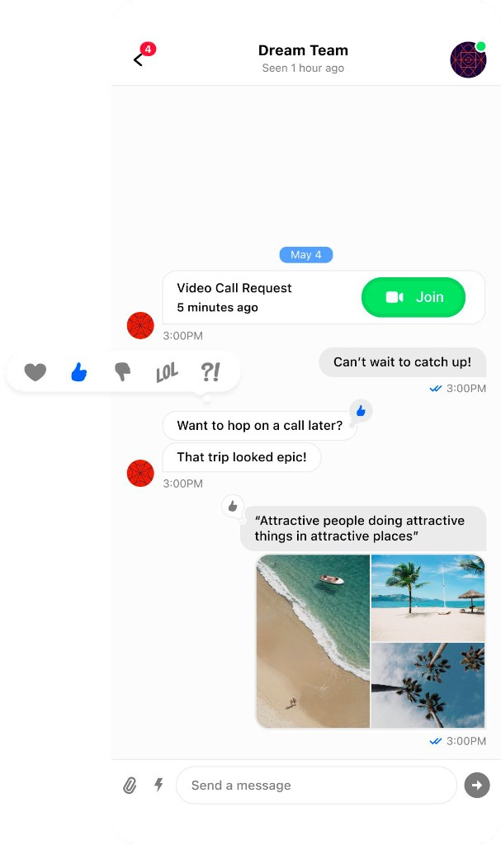
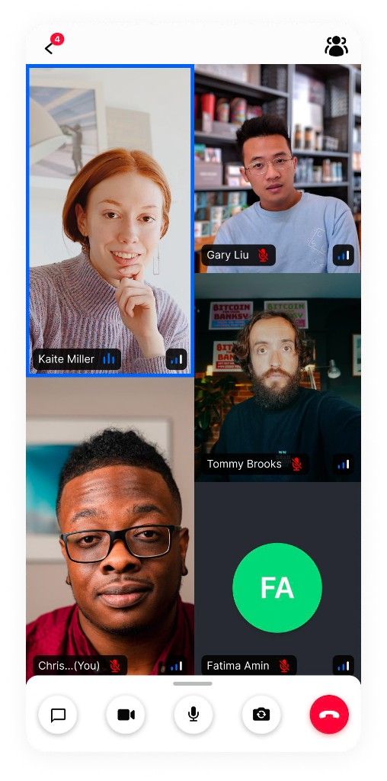

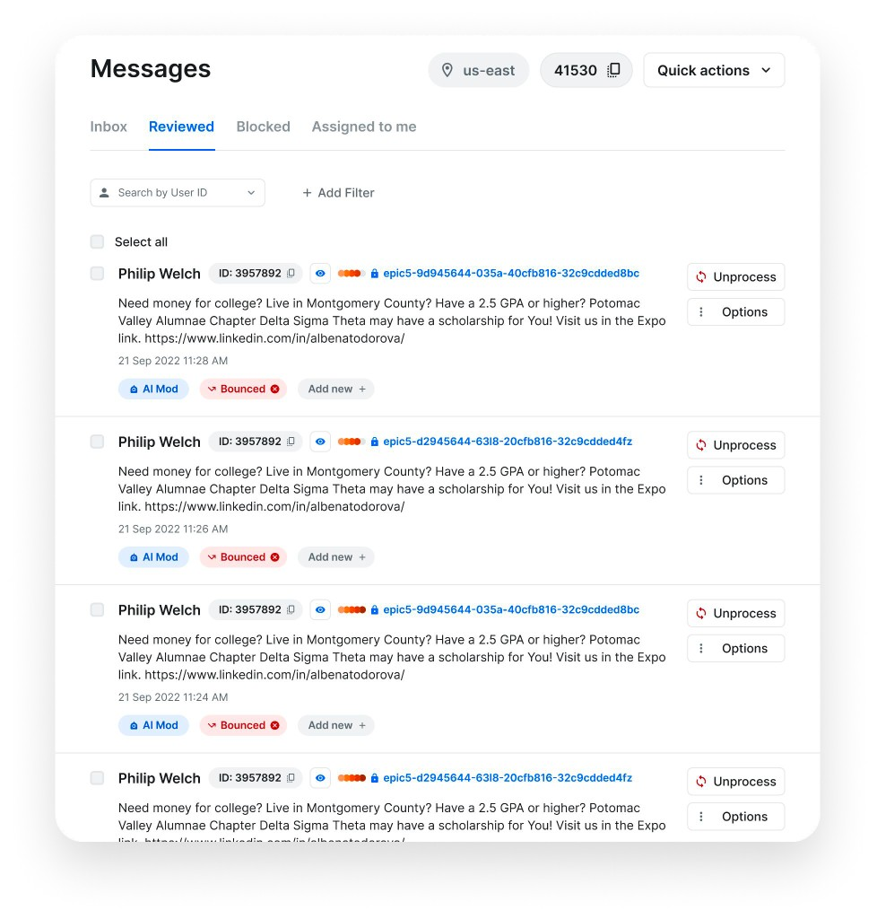
STREAM
Aug 2026
Stream Products
CHAT MESSAGING
VIDEO & AUDIO
ACTIVITY FEEDS
AUTO MODERATION

Slide 3
Aug 2026
STREAM · RTC.ON 2026
Agenda
01
VP9 SVC 101
What it is, why we need it
02
The Debugging Story
Symptom → Root cause
03
Hardware Capabilities
Can we query the system?
04
Way Forward
Practical solutions

Slide 4

Aug 2026
01
VP9 SVC 101

Slide 5
Aug 2026
VP9 SVC 101
What is Scalable Video Coding?
L3T3
720p viewer
01
02
S2 · 720p · 30 fps
Encode
once
SFU drops
layers
→
→
→
S1 · 360p · 15 fps
180p viewer
1 encoder
1 stream
No decode
No re-encode
S0 · 180p · 7.5 fps
SPATIAL
TEMPORAL
Resolution · 720p → 360p → 180p
Frame rate · 30 → 15 → 7.5 fps

Slide 6
Aug 2026
VP9 SVC 101
Why SVC? (vs Simulcast)
SVC
SIMULCAST
Phone
1 encode
720p
360p
180p
SFU
Phone
3 encodes
→
720p
SFU
→
→
→
360p
→
→
180p
1 stream · 1 encoder · SFU drops layers
3 streams · 3 encoders · more CPU
On mobile, CPU and battery win. SVC is the better fit — if the encoder can actually produce the layers.

Slide 7
Aug 2026
02
The Debugging Story

Slide 8
Aug 2026
THE DEBUGGING STORY
The Setup — Everything Works
SFU
Subscriber
(1)
Android
Publisher
(VP9 HW)
→ L1T3 →
→
1 subscriber → SFU requests L1T3 (1 spatial, 3 temporal)
Hardware VP9 encoder handles this fine
Network quality: excellent

Slide 9
Aug 2026
THE DEBUGGING STORY
3rd Participant Joins — Quality Drops
SFU
Sub 1
Android
Publisher
(VP9 HW)
→
→ L3T3_KEY →
Sub 2
→
Multiple subscribers → SFU switches to L3T3_KEY (3 spatial, 3 temporal)
SFU quality score drops immediately and never recovers

Slide 10
Aug 2026
THE DEBUGGING STORY
The Symptoms — Hardware VP9 Only
Observed only on hardware VP9. Software VP9 (libvpx) showed none of these.
01
SFU marked the stream as poor
Score fell when the 3rd participant joined — and never recovered
02
Encoder re-created in a loop
Hardware encoder destroyed and recreated ~every 200ms
03
Stats looked starved
targetBitrate reported ~71 kbps at 720×1280

Slide 11
Aug 2026
DEBUGGING
The Encoder Thrashing Loop
01
02
03
04
QUALITYSCALER
HW ENCODER
GCC / BWE
QUALITYSCALER
720p → 540p
→
STOP / START ×2
→
Bitrate drops
→
540p → 720p
QP too high
Surface → ByteBuffer
Huge frames
QP too low
← back to 720p · repeats every 5–10 seconds
Looked like the bitrate problem. We disabled QualityScaler — the loop stopped. The SFU still marked this stream as poor. So we went deeper.

Slide 12
Aug 2026
DEBUGGING
Asked for 3 Layers — Encoder Sent 1
ASKED FOR
ENCODER PRODUCED
L3T3_KEY
1 flat stream
S2 · 720p
top layer
720p only
S1 · 360p
→
mid layer
No S1 · No S0 · Nothing to split
S0 · 180p
~1.4 Mbps sent — not starved
base layer
SFU expected three layers. Hardware sent one. Stream marked poor.

Slide 13
Aug 2026
DEBUGGING
Why Those Symptoms Happened
01
SFU marked the stream as poor
SFU expected 3 spatial layers. Hardware sent 1.
02
Encoder re-created in a loop
QualityScaler flipped 720p ↔ 540p every 5–10s. Each flip recreates the HW encoder twice.
03
Stats looked starved
VP9 SVC stats bug — reports only the base layer, not the total (~1.5 Mbps).
Software VP9 never hit 01 or 02 — it produces real L3T3 layers and never tears down the encoder.

Slide 14
Aug 2026
03
Querying Hardware
Capabilities

Slide 15
Aug 2026
HARDWARE CAPABILITIES
MediaCodec SVC Support — Temporal Only
What You Can Query
What You Can't
Supported resolutions & bitrates
Profile levels
Temporal layering schemas (KEY_TEMPORAL_LAYERING)
Spatial layer support
"Does this encoder do L3T3?"
Multi-resolution SVC capability
Android 17 (API 37) adds getSupportedLayeringSchemas() — but only returns temporal schemas like webrtc.svc.l1tN. The platform confirms: hardware SVC = temporal only.

Slide 16
Aug 2026
04
Way Forward

Slide 17
Aug 2026
WAY FORWARD
Software VP9 (libvpx) — Pros & Cons
✓ Pros
✗ Cons
True L3T3 — all 3 spatial layers
No encoder re-creation issues
SFU quality stays stable
High CPU → qualityLimitationReason: cpu
Battery drains significantly faster
Frame rate may drop under load
Today's only complete fix for spatial SVC — but the CPU/battery cost is real on mobile.

Slide 18
Aug 2026
WAY FORWARD
Production Data — Android Is the Outlier
190 Android livestreams from a livestreaming customer — July 2026
Host Type | Median Quality | Poor (<70)
Android app | 89 | 41%
iOS app | 98 | 7%
Web browser | 98 | 6%
OBS / external | 99 | 0.4%
Android VP9 breakdown
HW VP9 (Samsung)
100% poor
Median quality: 30
SW VP9 (libvpx)
28% poor
CPU/battery limited
Neither VP9 path works reliably on Android. Hardware can't do SVC; software drains the device. A 720p cap doesn't help — the encoder is the bottleneck, not resolution.

Slide 19
Aug 2026
WAY FORWARD
Broadcaster Mode — Server-Side Quality Ladder
720p viewer
Android
Publisher
Stream Server
(transcodes)
→
→
→
360p viewer
1 clean HW stream
(H.264 or VP8)
Generates quality
ladder server-side
→
180p viewer
•
Phone publishes one stream on its best hardware codec — no SVC needed
•
Server generates the adaptive quality ladder viewers need
•
No CPU drain, no missing layers, no encoder re-creation
•
SDK option — opt-in for livestream / broadcast use cases

Slide 20
Aug 2026
SVC ON ANDROID, DEBUGGED
Takeaways
•
HW VP9 → temporal SVC only, spatial layers silently missing
•
SW VP9 → real SVC, but CPU/battery cost too high on mobile
•
Neither path works — 100% HW failure, 28% SW failure in prod
•
Broadcaster mode = phone sends 1 stream, server makes the ladder
•
No API to query spatial SVC — you find out from the bitstream

Slide 21
Aug 2026
Thank you
Questions?
Pratim Mallick · Stream

